Slide 1
1. Language and gender?
2. Approaches to gender study?
3. Linguistic and communicative differences between men and women?
Male-female stereotypes
Gender-exclusive differentiation
Gender-preferential differentiation
Gender differentiation in the choice of grammatical forms
?
4. Sexist language?
5. Gender – neutral language?
6. Why are there differences?

Slide 2
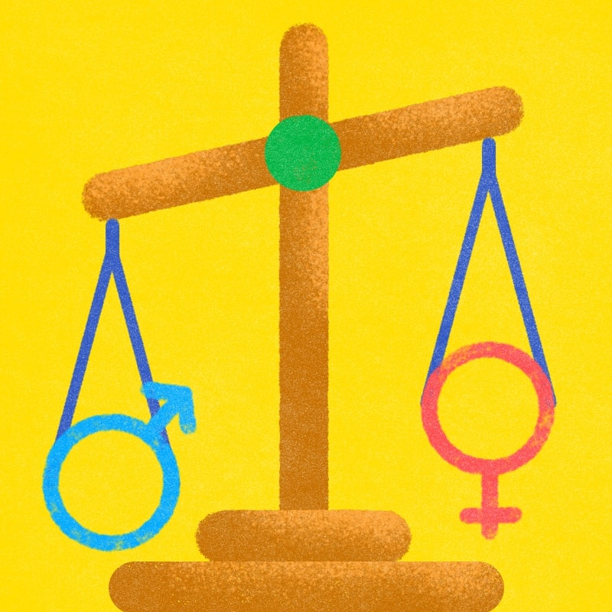
1. Language and gender
Discuss
Are there any differences between men’s language and women’s language?
Notes:
Studies show that the difference language style between each gender is half due to the difference in physiological structure, the other half is due to the influence of factors such as culture, status, society, personality and communication context.

Slide 3
expressions of hostility, profanity and expletives
Men use more swearing and
Women use more hedges and qualifiers when saying things

Slide 4
The differences and examples in Vietnamese and in English.
Firstly, the difference in language between each gender is due to the structure of the human body as well as the characteristics of phonemic physiology.
Ex: In Vietnamese, there are some phrases to describe gender’s voices like “ giọng ồm ồm như đàn ông” or “giọng the thé như đàn bà”.
Secondly, each gender is also reflected in the language to talk about each gender, to be more specific, it seems that in each language there are words that are only used for this gender but not for another one.
Ex: In Vietnamese, you have heard the phrase “bà nội trợ” but never something like “ông nội trợ”
In English, it has the word “mistress” only apply for women.
Thirdly, the difference in language between each gender manifests itself in the language used by each gender.
Ex: Woman tend to use more adjectives such as soft, sweet, good, nice and so forth while man seldom use adjectives.

Slide 5
Definition
A major topic in sociolinguistics is the relationships between language and gender. A variety of speech (or sociolect) associated with a particular gender is called a genderlect.

Slide 6
Male-female streotypes
3. Linguistic and communicative differences between men and women
Phonological, lexical, conversational, verbal and non-verbal differences in male – female communication have been noted in a variety of languges

Slide 7
Male-female streotypes are described by Graham of the university of Kentucky as follows [200]:
Table 2.19. Male-female streotypes [200]
Female | Male
Rapport | Report
Supportiveness | Dominance
Building relationship | Individuality
Ask questions | Avoid questions
Cooperate | Assert
Holistic | Focused
Seek consensus | Give order
Relate | Resolve

Slide 8
Male-female voice qualities have been generally noted as follows:
Table 2.20. Male-female voice qualities
Female | Male
Talk softly | Talk loudly
High pitch | Deep pitch
Fast rate | Slow rate
Upward inflection | Downward inflection
Strident tone | Relaxed tone

Slide 9
Graham [200] also points out gender differences in non-verbal communication:
Table 2.21. Gender differences in non-verbal communication
Body language | Male | Female
Facial expression | Less | More
Eye contact | Avoid | Prefer
Posture | More relaxed | More tense
Body proximity | Less | Closer
Touching | Sexual interest | Warm and friendship

Slide 10
Gender-exclusive differentiation
Gender-exclusive differentiation refers to differences in word forms for exclusive use by men and women; this refers to the radically different speech varieties men and women possess in particular varieties.
In some societies, a woman or a man may not normally be allowed to speak the variety of another gender. It is in this sense that varieties are gender-exclusive. A society in which this is the norm is typically one in which the roles assigned to the sexes are rigid, and in which there is little social change.

Slide 11
Gender-preferential differentiation
Gender-preferential differentiation is much more common in the languages of the world than in gender-exclusivity.

Slide 12
This phenomenon is reflected in the relative frequency with each men and women use the same lexical items or other linguistic features.
We can claim that English speakers exhibit gender-preferential differentiation Phonological differences between the speech of men and - women have been noted in a variety of languages.
In the area of morphology and vocabulary, many of the studies have focused on English.

Slide 13
- Lakoff published an influential account of women's language. She listed a set of basic assumptions about what marks out the language of women.
a-Hedge
b-Use (super )polite forms
c-Use tag questions
d-Speak in italics
e-Use empty adjectives ( georgous, marvellous)
f-Use hypercorrect grammar and pronunciation
g-Use direct quotation
h-Have a special lexicon
i-Use question intonation in declarative statements

Slide 14
j-Use “wh-” imperatives
k-Speak less frequently
l-Overuse qualifiers
m-Apologise more
n-Use modal constructions ( Would, could, might…)
o-Avoid coarse language or expletives
p-Use indirect commands and requests
q-Use more intensifiers, especially so and very.
r-Lack a sense of humour.

Slide 15
- Lakoff also claims that women use color words like mauve, beige, aquamarine, lavender, and magenta but most men do not.
- She also maintains that adjectives such as adorable, charming, divine, lovely, and sweet are also commonly used by women but only very rarely by men.
- Women are also said to have their own vocabulary for emphasizing certain effects on them, words and expressions such as so good, such fun, exquisite, lovely, divine, precious, adorable, darling, and fantastic.
- In her work, Lakoff identified a number of female linguistic features which were unified by their function of expressing lack of confidence.

Slide 16
- In Living Language, Keith and Shuttleworth record suggestions that:
WOMEN | MEN
- Talk more, talk too much | - Talk less, don't talk about emotions
- Polite more | - Swear more
- Indecisive/hesitant | - insult each other frequently, dominate conversation, speak with more authority
- support each other | - give more commands
- Cooperative more | - Competitive more
Table: Keith and Shuttleworth record suggestions in Living Language
Presenter: Thu Phương

Slide 17
- Tannen reveals a very different conversational style by men and women. Women,
Tannen says, use conversation to make connections and establish intimacy and community, what she refers to as “rapport talk”. Conversation is more cooperative than competitive, although sometimes competition is masked by apparent cooperation. Men, on the other hand, see conversation as means of establishing status and power. Information giving, or “report talk” is one way to achieve a higher status in conversation.
- Mills say that women are more polite than men.
- Lakoff identified three forms of politeness: formal, deference, and camaraderie.
Women's language is characterized by formal and deference politeness, whereas men's language is exemplified by camaraderie.

Slide 18
Verbal communication differences based on gender:
Male | Female
Avoid personal stories | Share personal stories
Attempt to dominate the conversation | Offer personal stories
Less likely to listen | Form groups
More aggressive | Listen carefully / attentively
More prone to interrupt | Allowed themselves to be interrupted more

Slide 19
An setting out a list of what she calls sociolinguistic universal tendencies, Holmes does offer some testable claims. There are five of these:
a-Women and men develop different patterns of language use.
b-Women tend to focus on the affective functions of an interaction more often than men do.
c-Women tend to use linguistic devices that stress solidarity more often than men do.
d-Women tend to interact in ways which will maintain and increase solidarity while men tend to interact in ways which will maintain and increase their power and status.
e-Women are stylistically more flexible than men.

Slide 20
According to Graham of University of Kentucky:
Men | Women
Men focus on power / rank / status | Women focus on relationships
Men talk to give information or report | Women talk to collect information or gain report
Men talk about things (business, sports, food) | Women talk about people / relationships
Men focus on facts, reason and logic | Women focus on feelings, sense and relationship
Men thrive on competing and achieving | Women are at ease with fluidity
Men know by analysis and figuring out | Women know by intuiting
tend to be focused, specific, and logic | Women are holistic and organic
Men are at ease with order, rules and structure | Women are at ease with fluidity
Men immediately want to get working on a project | Women tend to ask a lot of questions before beginning a project
Men want to think | Women want to feel

Slide 21
Gender differentiation in the choice of grammatical forms

Slide 22
Gender differentiation in the choice of grammatical forms a-differences in language use associated with the gender (or sexual orientation). b-differences in language use associated with the gender (or sexual orientation) of the referent. A gender-specific pronoun is a pronoun associated with a particular grammatical gender, such as masculine, feminine, or neuter, or with a biological gender (or sex). c-efforts to alter the language with respect to ways gender is or is not encoded. The English language makes certain distinctions of a gender-based kind. Example: https://www.youtube.com/watch?v=ljrtQtj4BOM

Slide 23
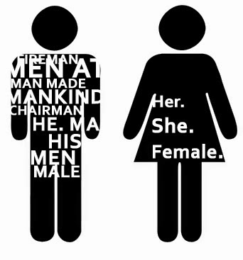
4. Sexist language

Slide 24
Definition
The term ‘sexism’ was coined in the 1960s, probably by analogy with the term racism, to describe ‘discrimination within a social system on the basis of sexual membership’ .
Sexist language can be defined as one type of discriminatory
language (use); it refers to linguistic expressions that exclude, trivialize or insult (mainly) women.
Sexism makes sense within a historically hierarchical relationship between men and women, where one is the norm, and the other marked as ‘other’ or inferior and in relation to a wide range of social practices where women (and in some cases men) are exploited, manipulated or constrained because of their sex.

Slide 25
There are three from in which it has been suggested that the English language discriminates against women:
First, the English language has developed in a male-dominated, male-centered society.
Example:
-The word MAN , man in its original sense carried the dual meaning of adult human and adult male
Man ( human beings) conquered space.
-> This is a form of female invisibility.
-There are many words, which are clearly male-orientated in that they contain the element “-man” while they can in fact apply to both sexes.
e.g. chairman, newsman, policeman, mailman, congressman.

Slide 26
Table 2.26. Male forms as the base forms
Male | Female | Male | Female
Man | Woman | Manager | Manageress
Prince | Princess | God | Goddess
Author | Authoress | Mayor | mayoress
Count | Countess | Shepherd | Shepherdess

Slide 27
Second, most obviously, perhaps, in the semantic area the English metaphors available to describe women include an extraordinarily high number of derogatory images compared to those used to describe men. Example: -Animal imagery is one example of an area where the images of women seem considerably less positive than those for men. +Animal imagery which refers to men often has at least some positive component (such as wiliness or sexual prowess) : Wolf , Birds => +Women may also be described or referred to in terms of food imagery, which is equally insulting: sugar, sweetie, honey. => used for addressing women

Slide 28
Third, newspapers [61, p.15], for example, are full of examples of wordings which are used to portray women in negative or limiting ways, i.e. wordings which:
a-depict women as sex objects and on the basis of their appearance rather than their intellect or capabilities (e.g. ‘a blonde’);
b-define women in terms of home, family, and domestic roles (e.g. ‘mother of three’), in ways that are seldom used for men;
c-trivialize women (e.g. using ‘girl’ for a much wider age range than ‘boy’ would be used; also ‘weathergirl’; judge women , ‘career woman’).

Slide 29
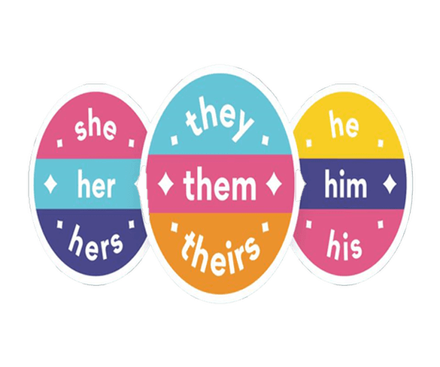
5. Gender-neutral language

Slide 30
• Gender-neutral language is language that avoids bias toward a particular sex or social gender.
• In English, this includes use of nouns that are not gender-specific to refer to roles or professions, as well as avoidance of the pronoun he (including the forms him and his) to refer to people of unknown or indeterminate gender.
The representative should come early to report on his/her group’s task accomplishments. S/he should prepare the documents.
=> For example: The words policeman and stewardess => gender-specific;
Police officer and flight attendant => gender-neutral terms

Slide 31
When the gender of the person referred to is unknown or indeterminate, a gender-specific pronoun such as he may be avoided by using a gender- neutral - pronoun – possibilities in English include he or she, s/he, or singular they.
Example: An employer must be able to rely on his secretary.
Traditionally, masculine pronouns have been used to refer to singular human nouns.
=> However, use of such masculine references is NO LONGER considered the preferred form.
Watch video:
https://youtu.be/3Q6winS806I

