Slide 1
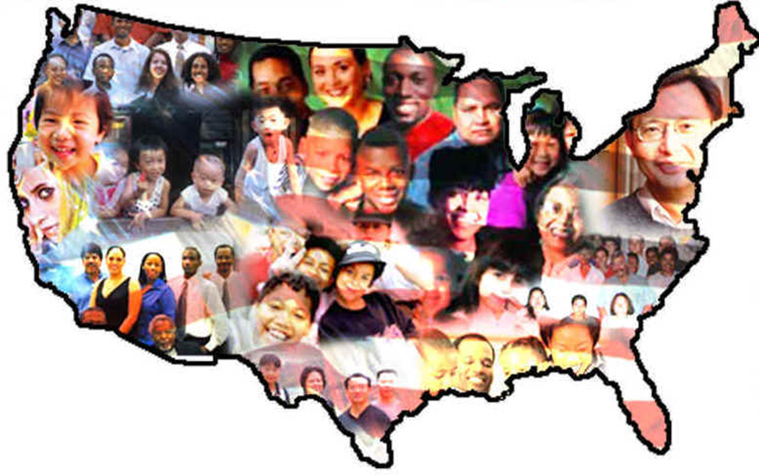
Intro to American Culture International Student Orientation 2014

Slide 2
Culture
Notes:
*Audience Participation* - Can you tell me what this is a picture of? <Iceberg> What can you tell me about icebergs? <…answer…> When I think of culture, I think of an Iceberg – much more beneath the surface than above.
Only 10% of this iceberg is visible above the water.

Slide 3
Above and Below the Surface
Food
Language
Holiday Customs
Dress
Music
Behavior
Attitudes
Priorities
Beliefs
Rules for social interaction
Assumptions
Nature of Friendships
Notes:
The 10% represents the cultural things that are clearly visible. Holiday customs, music..
But 90% is below the surface. The perceptions, attitudes, values, beliefs – that all shape the way we behave.

Slide 4
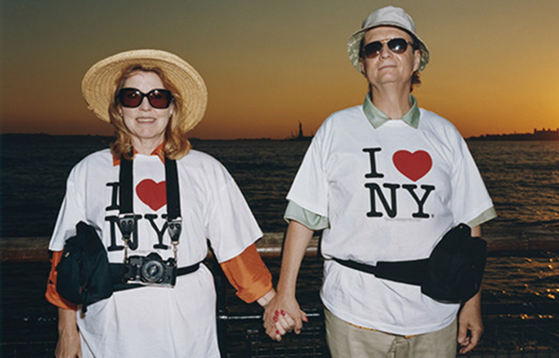
American Culture - Stereotypes
Notes:
We can’t begin to talk about American culture without talking about stereotypes. There are SO many!
What stereotypes have you heard about Americans?

Slide 5
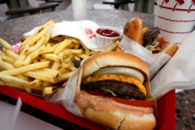
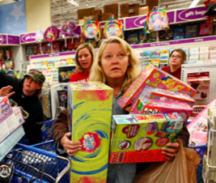
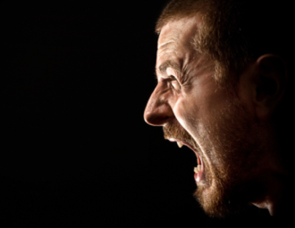
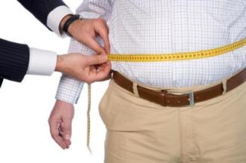
Americans...
L
O
U
D

Slide 6
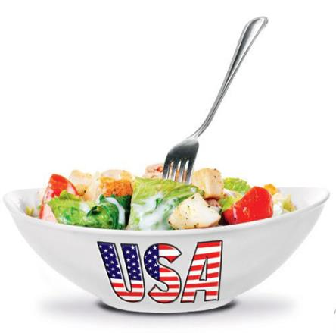
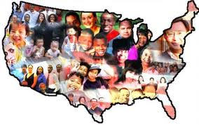
American Culture - Basics
Old: The U.S. is a “melting pot”
Today: The U.S. is a “salad bowl”
American culture allows individuals to maintain their own culture.
This makes the U.S. richer
and more diverse!
Notes:
Historically, U.S. was known as a “melting pot” – melding all different culture into one “new” American culture.
Now, its known more as a salad bowl – where each individual vegetable brings something new and different to the table, and adding them overall makes the whole salad better –

Slide 7
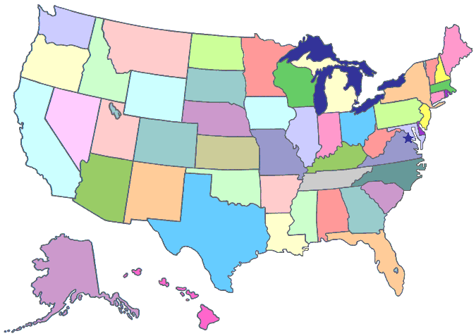
The Role of Geography
Notes:
American students attending RIT will be from all over the U.S. – which means there will be many differences: weather, dialect, living style, hospitality, traditions
It’s not easy to make generalizations about Americans. Still, there are a few characteristics you will encounter in “typical” Americans across the U.S.

Slide 8
Individuality & Control
Everyone is encouraged to have their own identity
Independence is highly valued
Being strong, self-reliant, assertive, and independent.
“Pull yourself up by your own bootstraps”
“If I work hard I can achieve anything”

Slide 9
Communication
Direct - “to the point”
Looking someone in the eye in a conversation means you are interested, respectful.
Personal space
Informality – “Hey” “What’s up?” “How are you?”

Slide 10
Time is Important!
Americans take pride in making the best use of their time.
Being late = disrespect. It’s better to arrive early!
Americans apologize if they are late.
Professors and time.
In social settings there is more flexibility. It is okay to arrive “fashionably late” to a party.

Slide 11
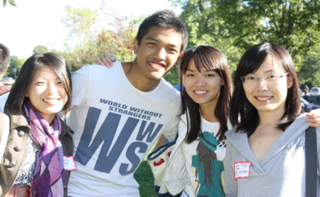
Friendships
Friendly, informal interactions
Not always lead to close, lasting friendships
Get Involved!
250 clubs on campus
Get Involved Fair
on Sat. August 23rd
Notes:
The Get Involved Fair is next Saturday and I strongly encourage you all to go to it.

Slide 12
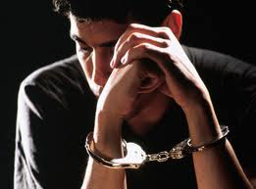
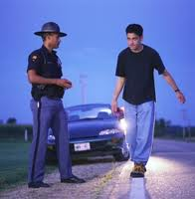
Laws / Rules
Follow all U.S. laws and university rules
You can’t say “I didn’t know”
Immigration regulations – student status
Legal drinking age is 21
If your car is stopped by police
Attorney on campus if you need legal advice.

Slide 13
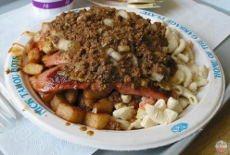
Recreational Activities
Holidays
Independence Day Thanksgiving, Halloween, Christmas, Labor Day, Memorial Day
Sports
Football, baseball, basketball, RIT hockey!
Food
Pizza, Burgers/Garbage Plates, Fried/Fast Foods, Large Portions!
Notes:
Sports – Americans love to root for their favorite teams. You will see sports team stickers on cars, people will wear “team shirts” and team colors. Football, Baseball, and Basketball are most popular.
RIT men’s and women’s hockey are Division I sports – highest level of college sports in the country.
New hockey arena.

Slide 14
RIT Culture
Notes:
**Audience Participation** “What have you learned so far about RIT Culture?” <…answer…>

Slide 15
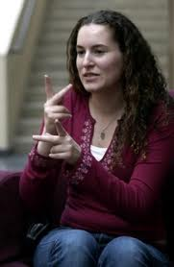
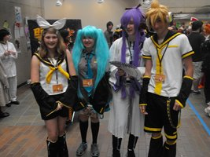
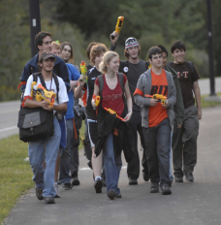
RIT Culture
Technology
Sustainability - “go green”
Deaf and Hard of Hearing Community
GLBTQA Community
ROTC
Electronic Gaming Society & Anime Club (Tora-Con)
Human vs. Zombies
Sports

Slide 16
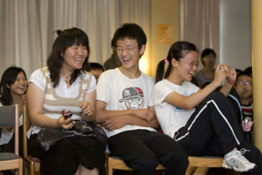
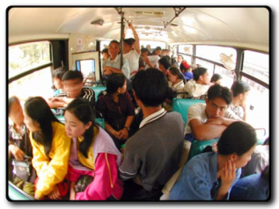
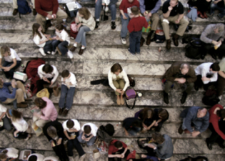
Cultural Adjustment Cycle
Honeymoon
Adjustment
Acceptance/
Integration
Culture Shock
Mental
Isolation
Notes:
Honeymoon – fascinated and excited by everything Culture Shock – Challenges rise to the surface with language, food, housing, transportation, making friends Adjustment Stage – Living with new roommates and going to school becomes easier, English language skills improve, become more self-confident, settle into your new routine Mental Isolation stage – feeling especially lonely, missing native language and culture, frustrated that people don’t seem to understand you on a deeper level, can’t always express yourself the way you want Acceptance/Integration – start to truly accept all the habits, customs, food, and characteristics of the people in your new culture (“accept”, not necessarily “like” = that’s ok!); Generally feel more comfortable in your new surroundings

Slide 17
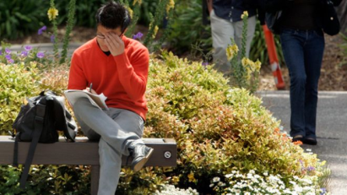
Symptoms of Culture Shock
Physical Symptoms:
Headache
Lethargy
Sleep problems
Loss of appetite
Psychological Symptoms:
Irritability
Anger over mild frustrations
Confusion
Feeling moody, isolated, insecure
Notes:
You may have one symptom, two, or all of them at some time or another.

Slide 18
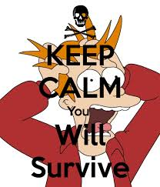
The Realities of Cultural Adjustment
It’s different for everyone
It’s an unavoidable rite of passage
It’s a known process with known symptoms
You will survive – don’t be afraid to ask for help!

Slide 19
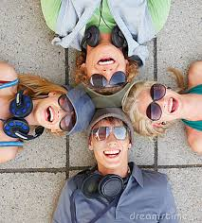
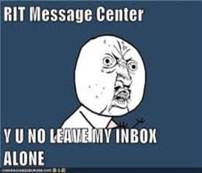
Coping Strategies
Think positively
Keep a sense of humor
Keep an open mind
Set realistic goals
Speak English as much as possible
Ask for help!

Slide 20
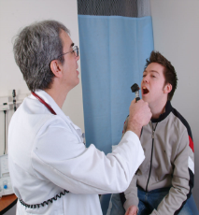
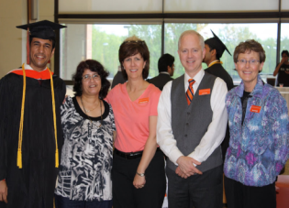
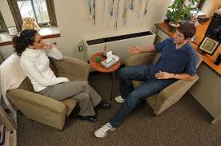
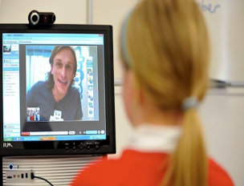
Helpful Resources
Family and friends
International Student Services
RIT Counseling Center
RIT Student Health Center

Slide 21
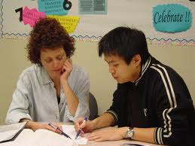
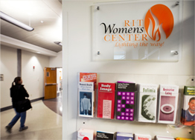
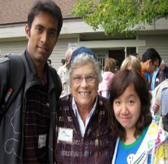
Helpful Resources
RIT Academic Support Center
RIT Center for Women and Gender
Student Organizations

Slide 22
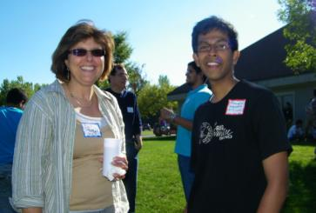
Rochester Global Connections
Volunteers from the Rochester
who are interested in meeting
and helping international students
from local colleges.
Friendship Families
Activities:
Baseball games
Food festivals
and more!
Notes:
This organization helps international students adjust to life in Rochester. They may help you shop, practice English, invite you into their home for dinner or take you to places of interest.

Slide 23
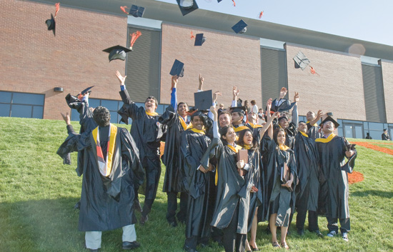
Focus on the big picture...

