Slide 1
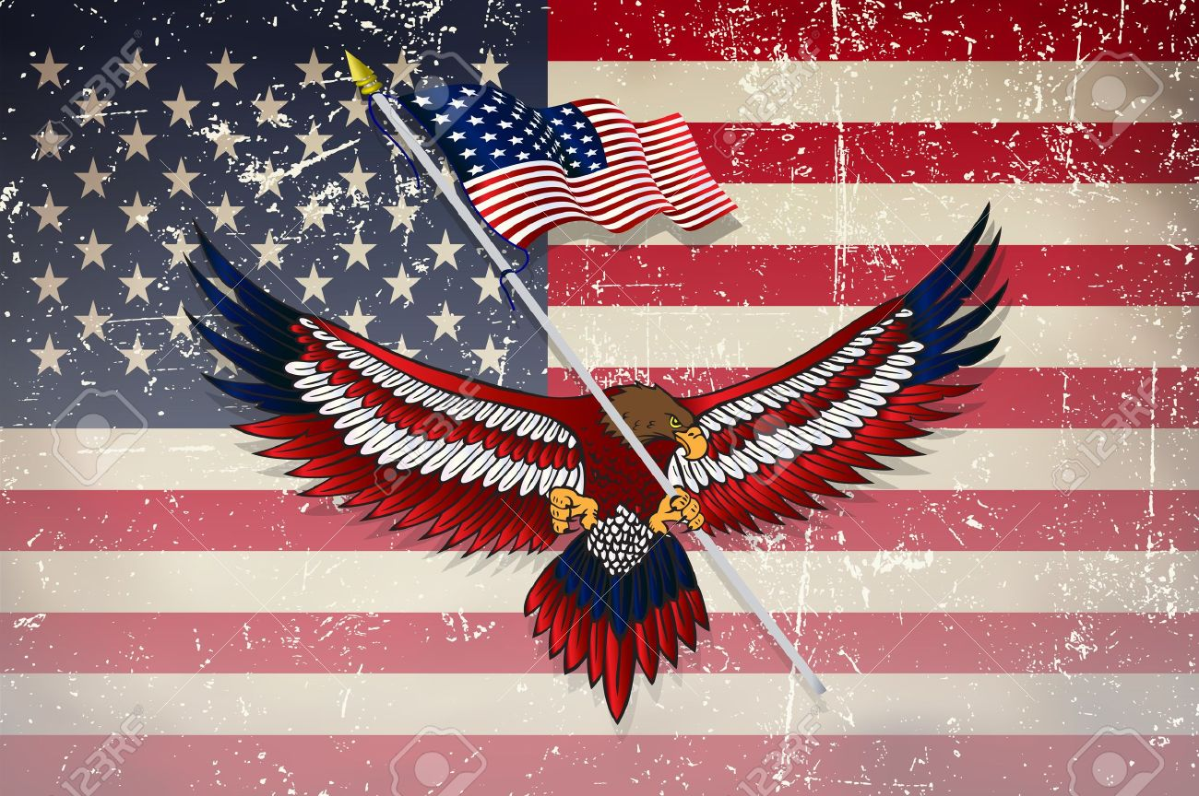
American Icons
Maryna Harmash
Group UE - 41

Slide 2
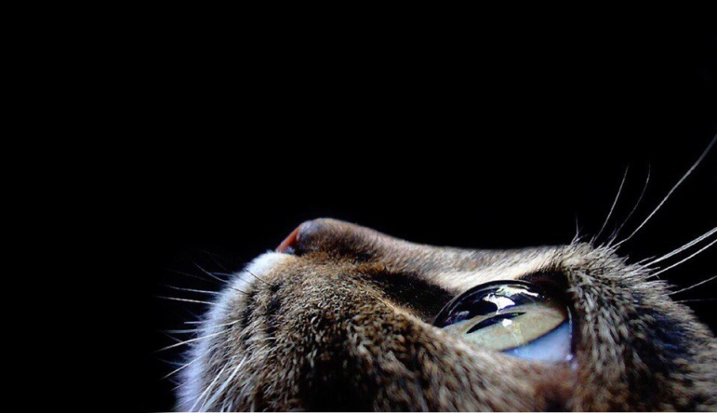
Questions
At the feet of the Statue lie broken shackles of oppression and tyranny. Is it true?
In America, everyone wears jeans as leisure wear. What does it mean?
What logos of Coca Cola company do you know?

Slide 3
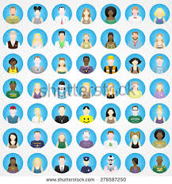
Plan
The Statue of Liberty.
Blue Jeans.
Coca Cola.

Slide 4
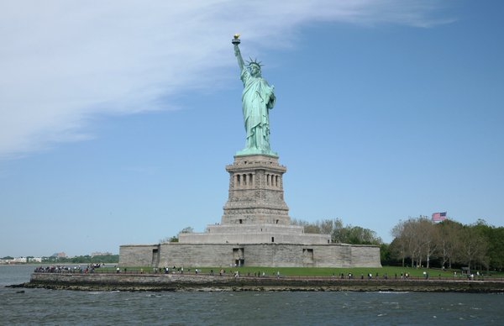
1. The Statue of Liberty

Slide 5
Characteristic of the Statue of Liberty
Total overall height from the base of the pedestal foundation to the tip of the torch is 305 feet, 6 inches.
Height of the Statue from her heel to the top of her head is 111 feet, 6 inches.
The Statue has a 35-foot waistline.
Total weight of the Statue of Liberty is 225 tons (or 450,000 pounds)

Slide 6
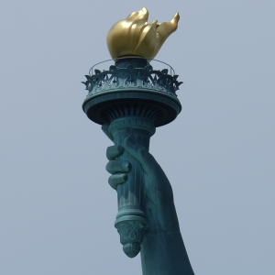
Torch
During the restoration completed in 1986, the new torch was carefully covered with thin sheets of 24k gold

Slide 7
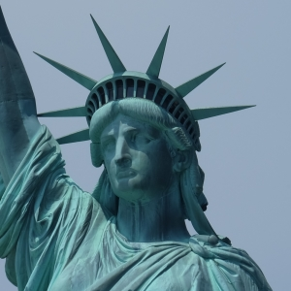
Crown and face
There are seven rays on her crown, one for each of the seven continents, each measuring up to 9 feet in length and weighing as much as 150 pounds.
The face on the Statue of Liberty measures more than 8 feet tall.

Slide 8
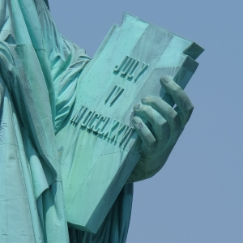
Tablet and Dates
A tablet held in her left hand measures 23' 7" tall and 13' 7" wide inscribed with the date JULY IV MDCCLXXVI (July 4, 1776).
Official dedication ceremonies held on Thursday, October 28, 1886.

Slide 9
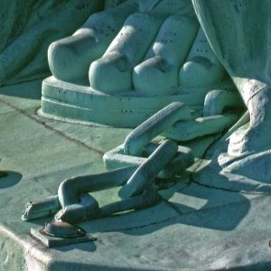
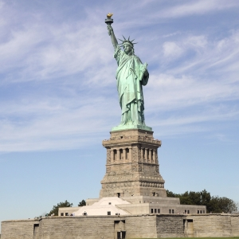
Chains
At the feet of the Statue lie broken shackles of oppression and tyranny.
Steps & Color
There are 154 steps from the pedestal to the head of the Statue of Liberty
The exterior copper covering of the
Statue of Liberty is 3/32 of an inch thick (less than the thickness of two pennies) and the light green color (called a patina)
is the result of natural weathering of the copper

Slide 10
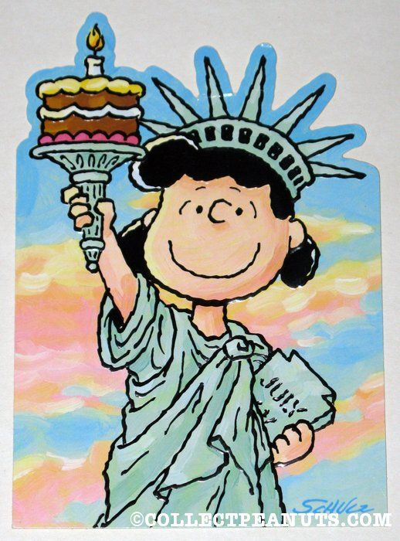
The Statue of Liberty is more than a monument. She is a beloved friend, a living symbol of freedom to millions around the world. These exhibits are a tribute to the people who created her, to those who built and paid for her, to the ideals she represents, and to the hopes she inspires.

Slide 11
2. Blue Jeans
Blue jeans are the most popular type of clothing in the world; but they are not modern! In fact, jeans have existed for over 140 years.

Slide 12
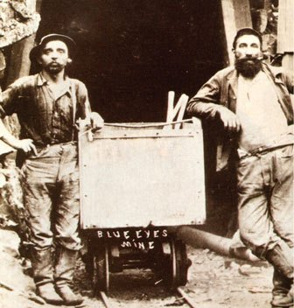
The America blue jeans history
( firstly as a workwear )

Slide 13
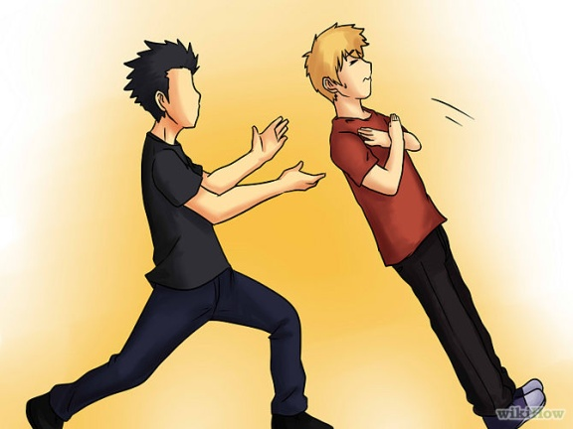
JEANS for EVERYONE ?
In America, everyone wears jeans as leisure wear. Some people wear jeans all the time, even for work. But Americans are perhaps less formal than other nations. At the "G7" summit in Denver, in 1997, American President Bill Clinton gave all his visitors jeans, for a "Western evening". Tony Blair, the British Prime Minister, put them on, but other European leaders, including Chancellor Kohl of Germany and Jacques Chirac, the President of France, refused.
Some people still think
that jeans are not respectable clothes!

Slide 14
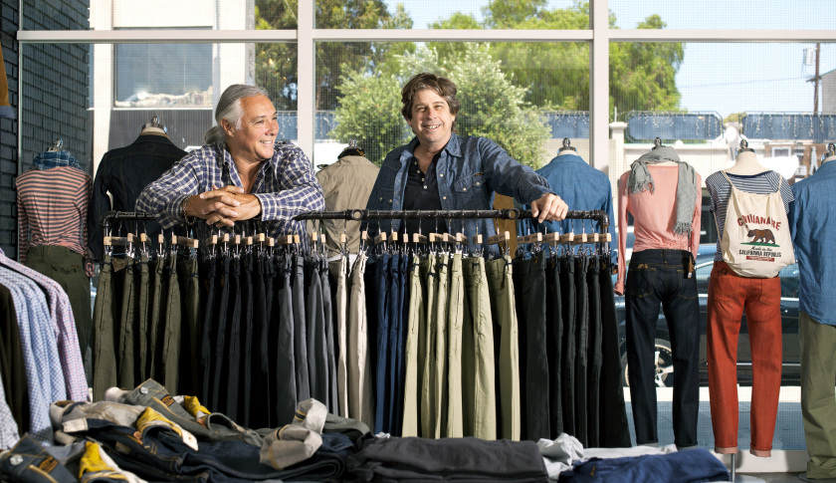
Not the young! Jeans are now the international uniform worn by young people. Why? That is a good question!

Slide 15
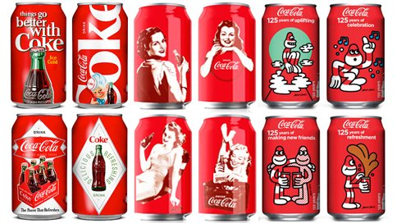
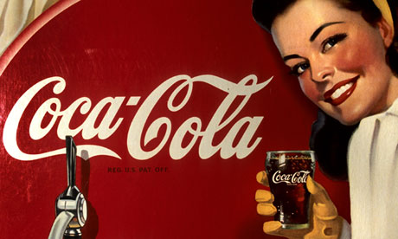
3. Coca cola

Slide 17
Success story of Coca Cola Company

Slide 18
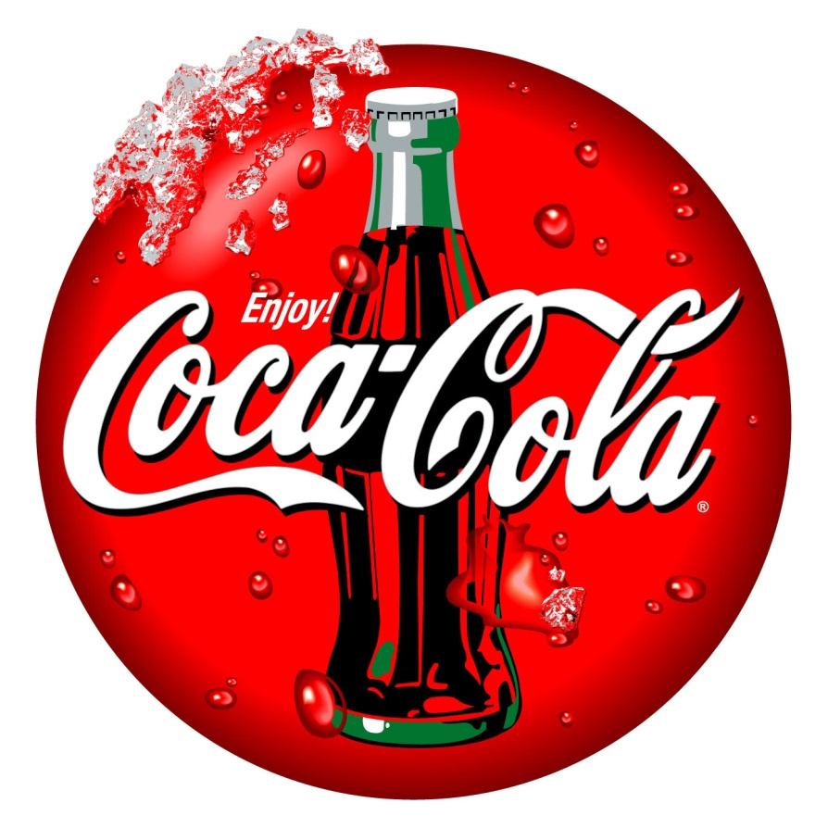
Evolution of the Coca Cola
logo

Slide 19
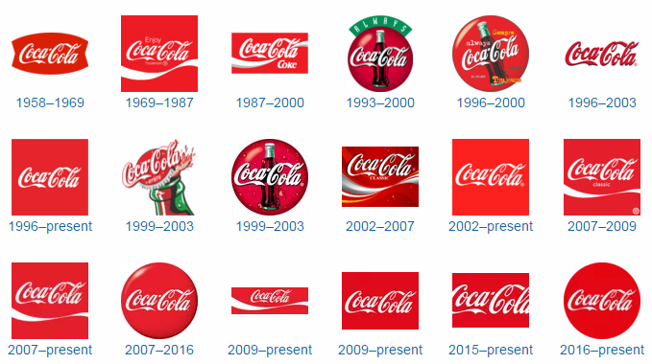

Slide 20
Sources
http://www.slideshare.net/PreetiYadav1/coca-cola-knowledge-management
http://www.zoominfo.com/c/The-Coca-Cola-Company/36143134
http://logos.wikia.com/wiki/Coca-Cola
http://www.libertyellisfoundation.org/about-the-statue-of-liberty
http://www.libertyellisfoundation.org/statue-facts
http://linguapress.com/intermediate/blue-jeans.htm

