Slide 1
WRITING PARAGRAPH STRUCTURE
NGUYEN TRAN HOAI PHUONG

Slide 2
A PARAGRAPH
TOPIC SENTENCE
SUPPORTING DETAILS
CONCLUDING SENTENCE

Slide 3
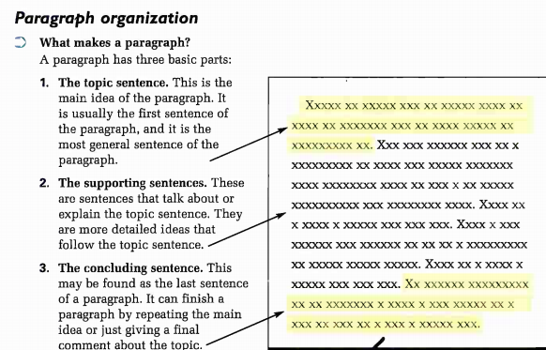
THREE PARTS OF A PARAGRAPH

Slide 4
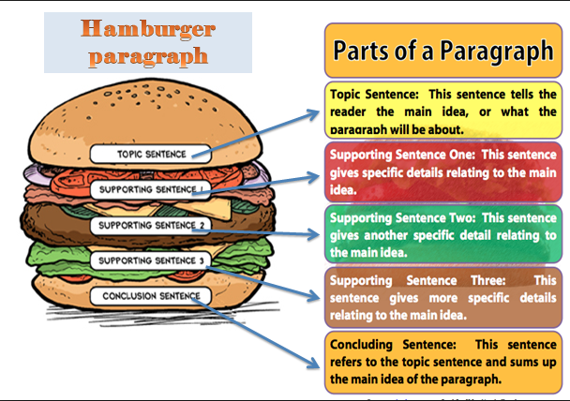
TOPIC SENTENCE
SUPPORTING DETAILS
CLOSING SENTENCE

Slide 5
THREE PARTS OF A PARAGRAPH
Exercise: Put a check (√) next to the group of sentences that makes a good paragraph. Why are the other groups of sentences not good paragraphs?
1. My best friend has many different hobbies, such as skiing, cooking, and playing the piano, and she is very good at all of these activities. For example, she has played the piano for ten years and has won in three piano competitions. She also likes to spend time traveling, and she has been to many different countries in the world. She grew up speaking Spanish and English, but now she can also speak French and Italian. I like my best friend very much.
2. One good way to learn another language is to live in a country where that language is used. When you live in another country, the language is around you all the time, so you can learn to listen to and speak it more easily.
3. Classes in literature are useful no matter what job you intend to have when you finish university. Books are about life. People who study literature learn the skill of reading carefully and understanding characters, situations, and relationships. This kind of understanding can be useful to teachers and business people alike. Literature classes also require a lot of writing, so they help students develop the skill of clear communication. Of course, a professional writer needs to have this skill, but it is an equally important skill for an engineer. Finally, reading literature helps develop an understanding of many different points of view. Reading a novel by a Russian author, for example, will help a reader learn more about Russian culture. For anyone whose job may bring them into contact with Russian colleagues, this insight can help encourage better cross-cultural understanding. Studying literature is studying life, so it is relevant to almost any job you can think of.

Slide 6
TOPIC SENTENCE
1. Definition:
The topic sentence is the most important sentence in a paragraph. It has two parts: a topic and a controlling idea.
• The topic names the subject of the paragraph.
• The controlling idea tells what the paragraph will say about the topic. It is called the controlling idea because it controls or limits the topic to a very specific points or points.
1. Many language students prefer bilingual dictionaries to monolingual dictionaries.
Explanation: The reader expects the paragraph to explain why this statement is true.
2. The best season for kids is winter.
Explanation: The reader expects the paragraph to give reasons and examples of why winters is the best season for children.

Slide 7
TOPIC SENTENCE
2. Features of a good topic sentence:
1. It controls or guides the whole paragraph.
When you read the topic sentence, you know what to expect in the paragraph.
2. A good topic sentence is not a fact that everyone accepts as true.
For example, a bad topic sentence would be, “Librabries have books”. The information in this sentence is true, but it is a a fact and is not a good choice for a topic sentence.
3. A good topic sentence is specific.
“Tea is delicious” is not a good topic sentence because the information in the sentence is too general. The reader does now know what to expect in the paragraph. If you want to write a paragraph about tea, make your topic sentence more specific, such as “Green tea has many health benefits”.

Slide 8
TOPIC SENTENCE
4. However, a good topic sentence is not too specific.
“This dictionary contains more than 42.000 words” limits the topic too much – there is nothing else for the writer to say.
5. A good topic sentence has a controlling idea.
It includes words or phrases that help guide the flow of ideas in the paragraph. The controlling ideas focuses the content of the following sentences.

Slide 9
TOPIC SENTENCE
Exercise: Circle the topic of the sentence. Underline the main idea about the topic.
1. Indonesia is very interesting country to visit.
2. Dogs make excellent pets.
3. A really good place to study is the library at my school.
4. Leaning a second language creates job opportunities.
5. Soccer is my favorite sport because it is exciting to watch.
6. One of the most valuable tools for students is the computer.
7. My sister and I have very different personalities.
8. Summer is the best time to travel in my country.
9. My hometown is a friendly place to live.
10. Although buying a house may seem appealing, renting an apartment has many advantages.

Slide 10
TOPIC SENTENCE

Slide 11
TOPIC SENTENCE
Exercise 3: For each of these paragraphs, write a good topic sentence that is connected to the information in the paragraph.
1. When Ken wanted to enter a good university, he studied hard to pass the examination. The first time he took the exam, he did not do well, and he felt very discouraged. But he knew he wanted to study at that university, so he studied more. The next year, he tried taking the exam again. The second time, he did very well, and now he is studying engineering. I believe Ken is a good role model for me, and he has taught me that never giving up is the best way to succeed.
2. Some people choose to learn how to play a musical instrument because they want to have fun. They want to play it with their friends or maybe in a band. Another reason people play an instrument is that it is their hobby. They learned how to play it a long time ago, and now it is a way to occupy their time. Other people learn to play an instrument because it is part of their culture. Certain instruments are popular in one culture, such as the guitar in Spain or the oud in the Middle East. In some cases, however, people learn how to play an instrument because they think it will make them smarter. A great deal of research suggests that studying music can improve a person's brain function and intelligence. In sum, there is not just one main reason that people play a musical instrument.

Slide 12
TOPIC SENTENCE
Exercise: Write a topic sentence for three of these topics.
a. a favorite place to relax
b. a grandparent
c. a pet I have known
d. a favorite food to eat
e. playing musical instrument

Slide 13
SUPPORTING SENTENCES
1. Definition:
Supporting sentences give information that explains and expands the topic of the paragraph. They answer questions – who? what? when? where? why? and how? – give details. Good writers think of these questions when they write supporting sentences for the topic sentence.

Slide 14
SUPPORTING SENTENCES
2. Kinds of Supporting Sentences:
Good supporting sentences have different goals. Writer vary them to:
explain: The family moved from the village to the capital for economic reasons.
describe: She lived in a lovely three-story castle surrounded by a forest.
give reasons: Lukas finally quit his job because of the stressful working conditions.
give facts: More than ten percent of the university’s student population is international.
give examples: Oranges and grapefruits grow in California.
define: Many tourists visit Bangkok, which is the capital and largest city in Thailand.

Slide 15
Exercise :
Topic sentences
TS1: Low-fat diets are an excellent wat to stay healthy and trim.
TS2: High-protein diets are favored by athletes and competitors.
Supporting sentences
a. ___2____ These foods help build muscles and increase energy. (fact)
b. ___1____ They are preferred by the general public because they help with weight reduction. (reason)
c. _______Low-fat diets are recoq by most physicians. (fact)
d. _______Many athletes eat high-protein foods, such as meat, beans, and nuts. (example)
e. _______ Low fat-food include fruits, vegetables, and pasta. (example)
f. _______ Because they are easy to find in stores, low-fat food are convenient. (reason)
g. _______ Athletes generally eat high-protein diets to give them more energy. (reason)
h. _______ Crispy steamed vegeq and grilled fish and chicken are all tasty parts of a low-fat, heart-friendly diet. (description)

Slide 16
Exercise 3: Read each topic sentence. Then fill in the blanks with additional supporting sentences. Add as many supporting sentences as you can, but you do not have to fill in all of the blanks.
1. Owning a small car has several advantages.
A small car is easier to park.
______________________________
______________________________
2. To keep your teeth healthy and your smile bright, do the following things.
Don’t eat sugary food.
b. _____________________________
c. _____________________________

Slide 17
Exercise 3: Read each topic sentence. Then fill in the blanks with additional supporting sentences. Add as many supporting sentences as you can, but you do not have to fill in all of the blanks.
3. Consider these three / four / five factors when planning a family vacation.
Consider the interest of everyone.
___________________________
_____________________________
4. A good friend has two / three / four important qualities.
He / She can keep secrets.
________________________
________________________

Slide 18
CONCLUDING SENTENCE
A concluding sentence signals the end of the paragraph and reminds the reader of the main idea. Here are three tips to help you write a good concluding sentence:
1. Begin with a conclusion signal. Most conclusion signals have commas after them; others do not.
Followed by a comma | No comma
1. All in all In summary, In brief To conclude, In conclusion To summarize, Indeed To sum up, In short, | 2. It is clear that ……….. These examples show that …….. You can see that ………..
1. To summarize, Japanese food is both beautiful to look at and delicious to eat. Indeed, many U.S. cities and regions have a special food for everyone to enjoy. 2. It is clear that fad diets don’t work and may even damage a dieter’s health.

Slide 19
CONCLUDING SENTENCE
2. Remind your reader of the main idea by one of the following methods.
Repeat the idea in the topic sentence in different words. Do not just copy the topic sentence.
Topic Sentence: Successful bidding on eBay requires patience and strategy.
Concluding Sentence: In conclusion, wait patiently and place your bid with precision timing, and you will be the winning bidder every time.
Summarize the main point or points of the paragraph.
Concluding sentence: In conclusion, follow the steps I have outlined, and you will be the winning every time.
3. NEVER end a paragraph by introducing a new idea!
x In conclusion, you can spend a lot of money on eBay.
.

Slide 20
CONCLUDING SENTENCE
Exercise 1: On the line at the end of each paragraph, write a concluding sentence. Be sure to begin with a conclusion signal.
The college cafeteria is an inexpensive place to eat. For example, you can get a cheese burger, French fries, and a soda for only $3.00. A slice of pizza is only $1.50, and a cup of coffee is only 50 ¢. There is a daily special for about $2.50. It includes entrée, rice or potatoes, and a vegetable. The salad bar is the best dear of all. You get all you can eat for $20. ____________________________________________________________________________________________________________________________________.

Slide 21
CONCLUDING SENTENCE
2.
Watching children’s program on television is a good way to learn a foreign language. First, the actors speak slowly and repeat often. Also, the vocabulary is not difficult. Finally, there is always a lot of action, so you know what is happening even if you don’t understand the words.
____________________________________________________________________________
3.
Cell phones have taken over! Any time of the day or night, you see automobile drivers chatting away at 65 miles per hour (mph) on the highway. On sidewalks, in restaurants, and even in office building elevators, cell phone users carry on the most private conversation. Many places of business now have signs asking people to turn off their cell phones, and phones are banned in hospital waiting rooms, movie theaters, and concert halls.
_____________________________________________________________________________

Slide 22
CONCLUDING SENTENCE
Exercise 2: The following sentences are a scrambled paragraph. Put the sentences in order. This is how to proceed.
Step 1: Find the topic sentence. Give it the number 1.
Step 2: Find the concluding sentence. Give it the number 9.
Step 3: Then decide which sentences are supporting points and put them in order. Look for the words First, Second, Third and Finally.
Step 4: Decide which examples support which points.
Step 5: Copy the sentences into the appropriate boxes.

Slide 23
FAST FOOD, UNHEALTHY FOOD
______ a. For example, a 6-inch Pizza Hut Personal Pan pepperoni pizza has 660 calories, and a McDonald’s Big Mac has 560 calories.
______ b. In conclusion, a quick meal at a fast-food restaurant may be delicious, and convenient, but it is definitely not a healthy way to eat.
______ c. Second, a lot of the calories from fast food are from fat.
______d. Third, fast-food items such as hamburgers and French fries contain high amounts of salt.
______ e. Fast food is extremely popular in the United States, but it is not very good for you.
______ f. First of all, most fast food is very high in calories.
______ g. A typical meal at MacDonald’s contains as much as 1.370 milligrams of sodium.
______ h. Finally, add a sugary soft drink to your fast-food meal, and you pound the last nail into the heart of any nutritionist.
______ i. For instance, a portion of Nachos Supreme from Taco Bell contains 26 grams of fat, and a Big Mac contains 30 grams.

Slide 24
CHARACTERISTICS OF A GOOD PARAGRAPH

Slide 25
1. UNITY
The paragraph should be about ONLY ONE clear topic or main idea.
All the sentences must focus on one topic, explaining or developing the main idea.
The unity helps readers to understand the paragraph better.
Notes:
If your paragraph contains a sentence or some sentences that are NOT related to the main topic (irrelevant sentences), then it does not have a unity.

Slide 26
2. COHERENCE
Coherence = ‘to stick together’
Coherence in writing = all the ideas in a paragraph have a logical flow from one sentence to the next sentence
➔ Help readers understand the writer’s thought easily
Notes:
Coherence in writingmeans that all the ideas in a paragraph flow smoothly from one sentence to the next sentence. In other words, all of the sentences in a paragraph should have clear relationship, should be connected.
To write a coherent paragraph, there’s a common way is that organizing the ideas with an odering principle.

Slide 27
3. COHESION
Cohesion = grammartical and lexical connections that tie the sentences together
Cohesion is concerned with words, phrases, sentences and how they are connected to form a meaningful text.
The writer could achieve cohesion in the paragraph through lexical cohesion or grammatical cohesion

Slide 28
TRANSITIONAL WORDS
Introducing examples: for example, for instance, such as, in other words,…
Showing addition: and, in addition, also, furthermore, moreover, apart from, besides,…
Making conclusion or summary: in short, in brief, in summary, in conclusion, to sum up,…
Showing chronological order: at the beginning, in the end, firstly, secondly, finally, lastly, next, later,
Showing reasons: due to, owing to, because, because of, since, as,…
Showing result: therefore, so, consequently, as a result, thus,…
Showing contrast: but, however, although, even though, in spite of, despite, nevertheless, …

