Slide 1
CAUSE EFFECT PARAGRAPH

Slide 2
Definition
Cause and effect relationships explain the reason things happen or how things became the way they are.
The cause is the event that caused something else to happen.
The effect is what happened as a result of the cause.

Slide 3
Types of cause-effect paragraphs

Slide 4
Cause /effect : paragraph with one single type of development
When you write cause/effect, you tell the reasons that something happened OR you tell the results of something that happened.
Example of a topic sentence beginning a paragraph of causes:
E.g.: My father became seriously ill two years ago for several reasons. → After reading this topic sentence, readers expect to learn why the writer’s father became ill.
Example of a topic sentence beginning a paragraph of effects:
E.g.: My father’s serious illness two years ago has led to many changes in our family. → After reading this sentence, readers expect to learn what changes took place in the family as a result of the father’s illness.

Slide 5
Cause /effect : paragraph with paragraph with more than a single type of development
A cause and effect paragraph discusses both the reasons that something happened and the results.
Example of a topic sentence beginning a paragraph of cause and effect:
E.g.:
My father’s serious illness two years ago, which was the result of several unhappy coincidences, has led to many changes in our family.
→ After reading this sentence, readers expect to learn why the illness happened and what happened within the family as a result of the illness

Slide 6
ELEMENTS OF THE PARAGRAPH

Slide 7
Elements of the paragraph

Slide 8
Organization of the paragraph
C/E1, C/E2, C/E3
E + C1, C2, C
C+ E1, E2, E3

Slide 9
Focused Topic Sentence
Your topic sentence should clearly indicate whether the paragraph will focus on causes or effects or on both

Slide 10
Causes, Effects, and Time
Think about the timing of causes and effects.
Causes most often precede the problem, and effects tend to occur after the problem has arisen.

Slide 11
Order
Time: If one stage leads to another, as in a discussion of the causes and effects of upper atmospheric pollution, your paper would be organized best by time.
Space: In some instances, causes and effects are best organized by their relation in space. For example, the causes of an economic recession could be discussed in terms of local factors, regional factors, national factors, and inter- national factors.
Emphasis: Some causes and effects may be more important than others. For instance, if some causes of divorce are primary (perhaps infidelity and physi- cal abuse) and others are secondary (such as annoying habits and laziness), a paper about divorce could present the secondary causes first, and then move on to primary causes to emphasize the latter as more important.

Slide 12
Transitions

Slide 13
Transitions

Slide 14
Sentence Patterns that Indicate Cause and Effect
Because of / Due to} X, there is Y.
Because of / Due to}X, Y happens.
X{affects / influences} Y.
Y{ is affected / is influenced}by X.
X{causes / produces / results in }Y.
Y{is caused / is produced by / is a result of / is due to}X.
When / If / Because}there is X, Y happens.
X is {the cause of / the reason for}Y.

Slide 15
Read the following paragraph and answer the questions.
Girls don't do as well in math and science as boys. There are several reasons for this. The first and most important reason is that they aren't encouraged to play with toys that build up interest in math and science problems and that build skills for problem solving or understanding how things work. Girls are encouraged to play with toys that foster language and human relations skills. As a result, they can grow up not knowing how an engine works or how to build a model from directions. Second, studies have shown that teachers don't expect girls to be good at math. Even female math and science teachers pay more attention to boys in class and call on boys more often. Because teachers don't expect girls to excel, they don't try very hard, and soon girls are far behind boys in these studies. Finally, girls don't have many role models to look up to. Not very many math and science teachers are women, especially in the later grades. When the media picture mathematicians and scientists, they usually picture men. As a result, girls aren't inspired to choose these fields as careers. In summary, several factors work together in the home, in schools, and in the society at large to send a subtle message to girls. Girls almost always get the message; as a result, few girls excel in math and sciences.
1. a. Look for the topic sentence and underline it.
b. What does the topic sentence make you expect?
c. What does the second sentence make you expect about the organization of the paragraph and the focus of the cause and effect paragraph?
d. Does the paragraph fulfill the expectations raised by the topic sentence and the « focusing » sentence ? 2. Which sentences introduce the causes?
3. If the paragraph has a concluding sentence, is it a restatement or insight/lesson ?____________

Slide 16
CAUSE - EFFECT PARAGRAPH
Exercise 1: Tell whether the underlined group of words is the cause or effect in the sentences.
1. The mother bird gathers dried grass to build her nest. 2. The tree fell in the middle of the road because of the high wind. 3. Sarah picked up broken glass, so she cut her finger. 4. Alexa loved to read because she had many books. 5. When the fire alarm sounded, everyone walked out of the classroom in a quiet line.
6. The yard looked nice since Kira raked the grass. 7. Bradley improved his hitting after taking batting Exercise. 8. The house was dark when electricity went out. 9. Kate cried all day because the cat ran away. 10. The weather was warm, so Jim turned on the air conditioner.

Slide 17
CAUSE - EFFECT PARAGRAPH
Exercise 2: Underline the key terms in each of the following topic sentences. Then indicate whether the paragraph will focus on causes or effects. Smoking (CAUSE) changes a person’s life (EFECT) in a number of small but important ways. Focus: effects 1. All sorts of mischief can come from leaving kids home alone after school. Focus: 2. I was forced to quit my latest job for a number of reasons. Focus: 3. People in my community have made a number of changes in their way of life as a result of drought conditions. Focus: 4. Having braces on your teeth completely alters how you relate to members of the opposite sex. Focus: 5. There are many reasons carpooling can be a good idea. Focus:

Slide 18
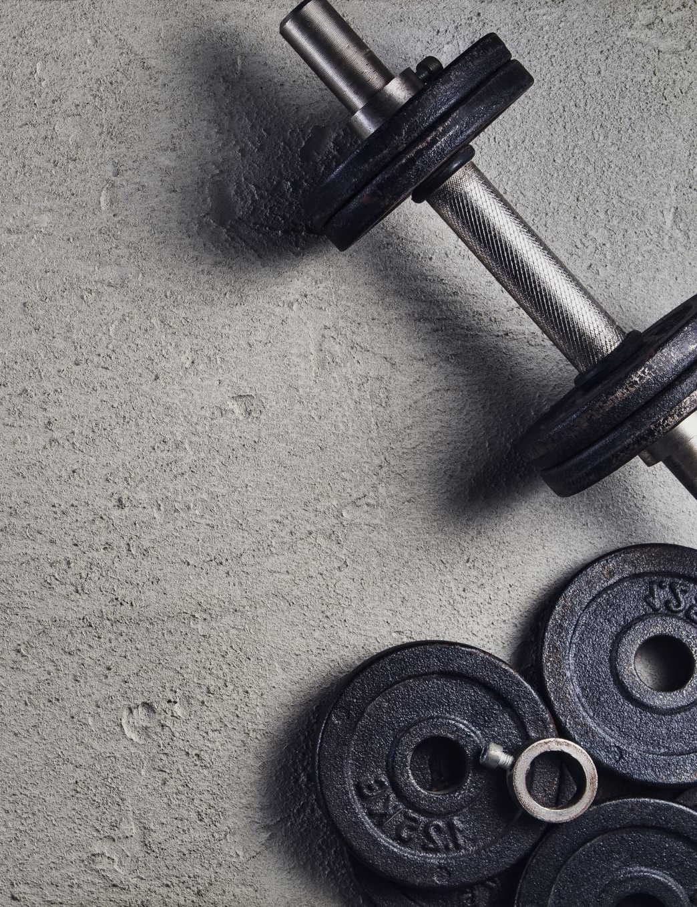
CAUSE - EFFECT PARAGRAPH
Exercise 3 : Identify the problem in each of the following situations. Then indicate what comes before and what comes after to identify cause and effect. EXAMPLE: squabbling and bickering increases / onset of puberty / strain between parents and children
onset of puberty strain between parents and children squabbling and bickering
(cause) (problem) (effect)
1. poor concentration and missed assignments / late nights out with friends / low grades
2. loss of refrigeration and spoiled food / intestinal disorder / power outage 3. disability and death / fatty diet / clogged arteries 4. increased smog and air pollution / CO2 emissions / respiratory illness
5. significant weight loss / improved self-image / exercise and self-control

Slide 19
CAUSE - EFFECT PARAGRAPH
Exercise 4 : Choose the appropriate cause/effect word or phrase to complete the sentence :
Caused by because cause of a result of due to
Leads to consequence of caused by effects of cause
1.The country road was blocked -------------the landslide.
2. John’s promotion came ---------------------he worked hard.
3. An increase in interest rates-----------------------a decrease in property sales.
4. The lanslide was-------------heavy rain.
5. It is well documented that the increase in diabetes is---------------poor dietary habits.
6. Bad economics policies were the --------------negative growth and serious shortages.
7. Being obese may----------------------serious problems.
8. Poor sleeping habits can be the --------------------stress and workload.
9. The explosion-----------------massive damage to the factory.
10. The task asked for the-----------global warming.7.3

Slide 20
Exercise 5 : Read the following paragraph and correct the inappropriate conjunctions. There are several possible reasons why my father is in excellent health, even though he is over eighty years of age. For one thing, he is in excellent condition because he has stopped smoking cigarettes. He quit smoking cigarettes because of whenever he climbed stairs he would invariably stop several times and cough loudly. His good health is also since his cutting down on the wrong kinds of foods. For example, before he would eat fatty red meat and deep-fried dishes several times a week, nowadays he seldom does. He has more energy as a result. He is also in good physical shape as a consequence his devotion to exercise. He swims three times a week at the local gym, and on sunny days he prefers to walk home rather than take the bus. So, my father is in better shape than some of his children are!

Slide 21
Read the following paragraph carefully. Answer the questions that follow.
Not eating a balanced diet
(1) Smoking has many serious effects. (2) The most obvious effect is the deterioration of a smoker's health. (3) Smoking increases the risk of lung disease, increases blood pressure, increases the risk of heart attacks, and reduces the flow of oxygen to the brain. (4) Smoking creates respiratory problems. (5) A smoker's cough expels phlegm, a thick mucus in the nose and the throat that wants to escape the body. (6) Prolonged use may lead to emphysema and the need to hook up to a machine to pump enough oxygen into the lungs. (7) Another effect of this habit is that smoking breeds halitosis; a smoker's breath always smells foul and repulsive. (8) Smoking frequently results in social isolation because fewer people smoke or want to be in the presence of second-hand smoke. (9) Friends and acquaintances often bluntly tell their smoking friends that they don't want the smell in their cars or in their homes. (10) The strong, offensive odor of smoke clings to smokers' clothing, hair, and skin. (11) The final effect of smoking is that it depletes the pocketbook. (12) Smoking is now an expensive habit, and the price of cigarettes continues to rise. (13) The effects of smoking are many, which leaves one wondering why intelligent people do not find a way to break their harmful addiction.
1. Is the topic sentence effective for a cause/effect paragraph or cause and effect paragraph? Explain your answer.
2. Which sentences introduce each of the effects of smoking? Write the sentence numbers.
3. Which effect is discussed with the greatest number of secondary details?
4. How does the writer achieve coherence in this paragraph? What order is used for the details?
5. Is the concluding sentence effective? Explain your answer

Slide 22
CAUSE AND EFFECT 4

Slide 23
1.Provide the missing sentences
Millions of people all over the world suffer from this unbearable disease which is the headache. Topic sentence: .............................................................................................................................
Cause 1: One obvious cause of headaches is undoubtedly stress.
Detail(s): ....................................................................................................................................... ......................................................................................................
Cause 2: Another important source of headaches is closely linked to people’s diet.
Detail(s): ....................................................................................................................................... ..................................................................................................
Cause 3: .........................................................................................................
Details: Allergens, such as the household chemicals including polishes, waxes, bug killers and even paint can lead to headaches.
Nearly 80% of housewives suffer from headaches and are heavily addicted to pain killers.
Concluding sentence: .............................................................................................................................

Slide 24
2. Write a full paragraph
Write a coherent and unified paragraph based on the outline above.

