Slide 1
UNIT 3:
Exploring the Red Planet

Slide 2
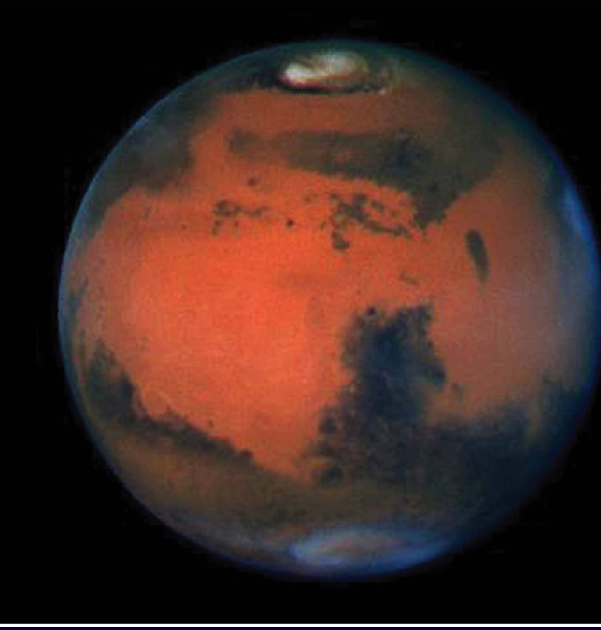
When you were a child, did you ever look up in the night sky? What questions did you ask?
Exploring space costs a lot of money. Do you think what we learn is worth the cost?
What do you know about Mars? Do you know of any plans to explore Mars?

Slide 3
a. The doors open and close ___________________.
b. The president's absence led to ____________ over his health.
c. The Earth ______ on its axis.
d. Tina's youngest son tried his hardest to fly like a superhero, but ___________ would not permit it.
e. The rocket was not _________ as planned because of the bad weather.
f. In 1957 the Soviet Union launched the first satellite to _________ the earth.
Vocabulary
1. speculation (n) : the act of guessing possible answers to a question without having enough information to be certain
2. orbit (v) : to move around a planet while in space
orbit (n): the curved path through which objects in space move around a planet or star
3. launch(v): to send a ship into the sky or into space
4. automatically : independently
5. establish (v): to create or set something in a particular way
6. NASA : National Aeronautics and Space Administration: the US government organization that is responsible for space travel and the scientific study of space
7. spin (v): to (cause to) turn around and around, especially fast.
8. gravity (n): the force that makes objects fall toward the earth, or toward some other large object such as a planet or a star

Slide 4
Timeline for a Mission to Mars
Day 342: Reaching Mars: Supply Ships – The supply ships arrive almost two weeks before the passenger ship does. After these ships are in orbit around Mars, two of the ships land on the surface. Because of their programming on Earth, the ships begin to work automatically. One of the supply ships is the artificial habitat, and it needs to be established in an appropriate area. The area needs to be large enough for the astronauts to do their research and prepare their experiments. The third ship waits in orbit for the passenger ship to arrive.
Day 365: Reaching Mars: Passenger Ship – After the passenger ship stops spinning, it enters orbit around Mars. It connects to the third supply ship. Then, the astronauts land on Mars. The passenger ship stays in orbit.
Day 357: Beginning Mission – The astronauts move into the artificial habitat, which supplies oxygen but not full gravity. They begin their exploration of Mars, which includes drilling for water, collecting rocks, and doing experiments to determine if there was ever life on Mars.
Day 417: Leaving Mars – The astronauts take off from Mars and connect to the passenger ship. They check the ship, get it ready, and begin their return to Earth.
Day 657: Landing on Earth – The astronauts get into the small ship and land on Earth in the ocean.
1.How long are astronauts isolated from other people before they leave Earth? Why are they isolated?
2.On day 116, why are the engines fired?
3. How is gravity made in space, where there is no gravity?
4. Which ship(s) arrive first at mars? Why?
5. What are some activities of the astronauts’ exploration?
NASA currently has three spaceships orbiting Mars and three rovers and one science lab on the planet, but they don’t have plan to send colonists there like Mars One does. Sending anyone – colonists for the rest of their lives or astronauts for two months – to Mars takes a lot of planning. Space researchers have suggested plans for sending people to Mars, and their plans are based on real facts. But since no one has ever gone to Mars, their plans are only speculations. For example, the people at TV’s Discovery Channel made a movie called Race to Mars, which follows a realistic timeline. The magazine Popular Science has also written about the steps needed to go to Mars. What timeline events can scientists agree on? Here is a plan that might be proposed.
Days 1-97: Launching Spaceships – parts for the three supply ships and one passenger ship are launched and begin to orbit the Earth. Spaceship builders put the ships together. After that, the three supply ships leave for Mars. The passenger ship waits in orbit until the astronauts arrive.
Days 98-112: Checking the Health of the Astronauts – The astronauts stay away from other people for two weeks before leaving Earth to avoid getting sick. Doctors make sure they are in good health.
Days 113-115: Launching the Astronauts – The Astronauts leave Earth in the fifth ship and meet the passenger ship already in orbit. The ship connects to the passenger ship. The astronauts enter passenger ship and make sure everything is in good working order.
Days 116: Leaving Earth – The engines fire to help the passenger ship leave the Earth’s gravity. When the ship is in space, it begins to spin around. The spinning creates artificial gravity.
Days 116-356: Travelling to Mars – The trip to Mars takes 240 days. The schedule for each day is similar to a typical Earth day.

Slide 5
NASA currently has three spaceships orbiting Mars and three rovers and one science lab on the planet, but they don’t have plan to send colonists there like Mars One does. Sending anyone – colonists for the rest of their lives or astronauts for two months – to Mars takes a lot of planning. Space researchers have suggested plans for sending people to Mars, and their plans are based on real facts. But since no one has ever gone to Mars, their plans are only speculations. For example, the people at TV’s Discovery Channel made a movie called Race to Mars, which follows a realistic timeline. The magazine Popular Science has also written about the steps needed to go to Mars. What timeline events can scientists agree on? Here is a plan that might be proposed.
Days 1-97: Launching Spaceships – parts for the three supply ships and one passenger ship are launched and begin to orbit the Earth. Spaceship builders put the ships together. After that, the three supply ships leave for Mars. The passenger ship waits in orbit until the astronauts arrive.
Days 98-112: Checking the Health of the Astronauts – The astronauts stay away from other people for two weeks before leaving Earth to avoid getting sick. Doctors make sure they are in good health.
Days 113-115: Launching the Astronauts – The Astronauts leave Earth in the fifth ship and meet the passenger ship already in orbit. The ship connects to the passenger ship. The astronauts enter passenger ship and make sure everything is in good working order.
Days 116: Leaving Earth – The engines fire to help the passenger ship leave the Earth’s gravity. When the ship is in space, it begins to spin around. The spinning creates artificial gravity.
Days 116-356: Travelling to Mars – The trip to Mars takes 240 days. The schedule for each day is similar to a typical Earth day.
Day 342: Reaching Mars: Supply Ships – The supply ships arrive almost two weeks before the passenger ship does. After these ships are in orbit around Mars, two of the ships land on the surface. Because of their programming on Earth, the ships begin to work automatically. One of the supply ships is the artificial habitat, and it needs to be established in an appropriate area. The area needs to be large enough for the astronauts to do their research and prepare their experiments. The third ship waits in orbit for the passenger ship to arrive.
Day 365: Reaching Mars: Passenger Ship – After the passenger ship stops spinning, it enters orbit around Mars. It connects to the third supply ship. Then, the astronauts land on Mars. The passenger ship stays in orbit.
Day 357: Beginning Mission – The astronauts move into the artificial habitat, which supplies oxygen but not full gravity. They begin their exploration of Mars, which includes drilling for water, collecting rocks, and doing experiments to determine if there was ever life on Mars.
Day 417: Leaving Mars – The astronauts take off from Mars and connect to the passenger ship. They check the ship, get it ready, and begin their return to Earth.
Day 657: Landing on Earth – The astronauts get into the small ship and land on Earth in the ocean.
Note :
Why? – Finding information quickly
What? – specific details, examples
How? – keys words: highlighted words/ names/ numbers
Your eyes work as what? - “radar”
SCANNING FOR DETAILS

Slide 6
NASA currently has three spaceships orbiting Mars and three rovers and one science lab on the planet, but they don’t have plan to send colonists there like Mars One does. Sending anyone – colonists for the rest of their lives or astronauts for two months – to Mars takes a lot of planning. Space researchers have suggested plans for sending people to Mars, and their plans are based on real facts. But since no one has ever gone to Mars, their plans are only speculations. For example, the people at TV’s Discovery Channel made a movie called Race to Mars, which follows a realistic timeline. The magazine Popular Science has also written about the steps needed to go to Mars. What timeline events can scientists agree on? Here is a plan that might be proposed.
Days 1-97: Launching Spaceships – parts for the three supply ships and one passenger ship are launched and begin to orbit the Earth. Spaceship builders put the ships together. After that, the three supply ships leave for Mars. The passenger ship waits in orbit until the astronauts arrive.
Days 98-112: Checking the Health of the Astronauts – The astronauts stay away from other people for two weeks before leaving Earth to avoid getting sick. Doctors make sure they are in good health.
Days 113-115: Launching the Astronauts – The Astronauts leave Earth in the fifth ship and meet the passenger ship already in orbit. The ship connects to the passenger ship. The astronauts enter passenger ship and make sure everything is in good working order.
Days 116: Leaving Earth – The engines fire to help the passenger ship leave the Earth’s gravity. When the ship is in space, it begins to spin around. The spinning creates artificial gravity.
Days 116-356: Travelling to Mars – The trip to Mars takes 240 days. The schedule for each day is similar to a typical Earth day.
Day 342: Reaching Mars: Supply Ships – The supply ships arrive almost two weeks before the passenger ship does. After these ships are in orbit around Mars, two of the ships land on the surface. Because of their programming on Earth, the ships begin to work automatically. One of the supply ships is the artificial habitat, and it needs to be established in an appropriate area. The area needs to be large enough for the astronauts to do their research and prepare their experiments. The third ship waits in orbit for the passenger ship to arrive.
Day 365: Reaching Mars: Passenger Ship – After the passenger ship stops spinning, it enters orbit around Mars. It connects to the third supply ship. Then, the astronauts land on Mars. The passenger ship stays in orbit.
Day 357: Beginning Mission – The astronauts move into the artificial habitat, which supplies oxygen but not full gravity. They begin their exploration of Mars, which includes drilling for water, collecting rocks, and doing experiments to determine if there was ever life on Mars.
Day 417: Leaving Mars – The astronauts take off from Mars and connect to the passenger ship. They check the ship, get it ready, and begin their return to Earth.
Day 657: Landing on Earth – The astronauts get into the small ship and land on Earth in the ocean
1.How many points are listed on this timeline?
2.Who made the movie Race to Mars?
3.What happens on Day 417?
4.How many NASA rovers are on Mars? How many ships orbit the planet?
5. What is Popular Science?
SCANNING FOR DETAILS

Slide 7
NASA currently has three spaceships orbiting Mars and three rovers and one science lab on the planet, but they don’t have plan to send colonists there like Mars One does. Sending anyone – colonists for the rest of their lives or astronauts for two months – to Mars takes a lot of planning. Space researchers have suggested plans for sending people to Mars, and their plans are based on real facts. But since no one has ever gone to Mars, their plans are only speculations. For example, the people at TV’s Discovery Channel made a movie called Race to Mars, which follows a realistic timeline. The magazine Popular Science has also written about the steps needed to go to Mars. What timeline events can scientists agree on? Here is a plan that might be proposed.
Days 1-97: Launching Spaceships – parts for the three supply ships and one passenger ship are launched and begin to orbit the Earth. Spaceship builders put the ships together. After that, the three supply ships leave for Mars. The passenger ship waits in orbit until the astronauts arrive.
Days 98-112: Checking the Health of the Astronauts – The astronauts stay away from other people for two weeks before leaving Earth to avoid getting sick. Doctors make sure they are in good health.
Days 113-115: Launching the Astronauts – The Astronauts leave Earth in the fifth ship and meet the passenger ship already in orbit. The ship connects to the passenger ship. The astronauts enter passenger ship and make sure everything is in good working order.
Days 116: Leaving Earth – The engines fire to help the passenger ship leave the Earth’s gravity. When the ship is in space, it begins to spin around. The spinning creates artificial gravity.
Days 116-356: Travelling to Mars – The trip to Mars takes 240 days. The schedule for each day is similar to a typical Earth day.
Day 342: Reaching Mars: Supply Ships – The supply ships arrive almost two weeks before the passenger ship does. After these ships are in orbit around Mars, two of the ships land on the surface. Because of their programming on Earth, the ships begin to work automatically. One of the supply ships is the artificial habitat, and it needs to be established in an appropriate area. The area needs to be large enough for the astronauts to do their research and prepare their experiments. The third ship waits in orbit for the passenger ship to arrive.
Day 365: Reaching Mars: Passenger Ship – After the passenger ship stops spinning, it enters orbit around Mars. It connects to the third supply ship. Then, the astronauts land on Mars. The passenger ship stays in orbit.
Day 357: Beginning Mission – The astronauts move into the artificial habitat, which supplies oxygen but not full gravity. They begin their exploration of Mars, which includes drilling for water, collecting rocks, and doing experiments to determine if there was ever life on Mars.
Day 417: Leaving Mars – The astronauts take off from Mars and connect to the passenger ship. They check the ship, get it ready, and begin their return to Earth.
Day 657: Landing on Earth – The astronauts get into the small ship and land on Earth in the ocean.
6.How many supply ships are necessary for a mission to Mars?
7.How long do the astronauts have to stay away from people before they leave for Mars ?
8.How many days does it take to reach Mars ?
9.How many days does it take to return to Earth?
SCANNING FOR DETAILS

Slide 8
Unit 4: LANGUAGE AND POWER

Slide 9
Vocabulary
1. unique (adj) : unusual, special in some way
→ uniqueness (n)
2. embarrass (v) : cause someone to feel nervous, worried or uncomfortable
→ embarrassed / embarrassing
3. dialect (n): a form of a language that people speak in a particular part of a country, containing some different words and grammar, etc.
4. accent (n) : the way in which people in a particular area, country, or social group pronounce words
5. slang (n): very informal language that is usually spoken rather than written, used especially by particular groups of people.
a. I can recognize your handwriting anywhere - it's _______.
b. My most ____moment was trying to introduce woman whose name I couldn't remember.
c. “Chicken" is _______ for someone who isn't very brave.
d. Nguyen Ngoc Tu writes stories in her southern _______
e. Some patients are less __________ and more willing to give information while communicating online rather than in person.
f. The disadvantage of learning online is that I cannot understand the Hue _________ of my teacher sometimes.

Slide 10
Now read the Travelling Man blog, written by a traveler who is interested in different languages and cultures
The Question of Global English Travelling Man – Jason C. – July 17
1.Hello, fellow travelers.
I’m on my way to France through the Spanish Basque country. Last night I saw a big sign at a café reading: English spoken here. It got me thinking: is English as a global language helping people around the world to communicate better? Or is it causing us to lose our uniqueness and independence? Is it fair to have one powerful language that people around the world have to learn?
2. John L: As an American, I like it. I can talk to people wherever I go and I don’t have to learn any other languages. At the same time, I sometimes feel embarrassed when I compare myself to people who know English, plus two or three other languages. I feel so stupid sometimes.
3. Miguel F: Using English as a global language makes sense to me. It’s convenient for us to have a common language. They tried Esperanto, but that didn’t spread like English. Language can’t be created and forced. It’s a natural expression of a culture. As an invented language, Esperanto doesn’t have any native culture.
4. Jason C: What’s Esperanto? Isn’t that some kind of spy language from World War II?
5. Miguel F: Earlier than that – it goes back to the 1880s. A scholar invented it to give people a common language they could all learn easily. He felt that having different languages divides people into enemy groups. He hoped that Esperanto would change things.
6. Yi-wen C:But the grammar of Esperanto is based on European languages, so it’s not that easy for non-Europeans to learn. Besides, it’s not as cool as speaking English. English is mote than a language. It’s an attitude, a lifestyle. It’s Hollywood, rock and roll.
7. Vasily Z: It’s all political. Whoever wins a war gets to control the language of the world. But I do agree that it’s easier for people to have a common language. So why not English? It’s a simple language. If it weren’t that easy, how could a billion people around the world have learned it?
8. Yuko H: I don’t think it’s easy at all. It’s taken me years to learn it.
9. Pablo B: I agree. I hate how the spelling’s so complicated, so full of exceptions.
10. Ashok P: I like that it has so many dialects. You don’t have to speak like any one nationality – you have choices.
11. Au M: For me, it was easy to learn English at school in Qatar since I went to an English-speaking school. Now my English is almost perfect. And I started young, so it’s wasn’t too hard to learn.
12. Yuko H: I wish I had perfect English. I’m not even close. There’s so much slang, and so many synonyms- it gives me a headache. And why are there so many verb tenses? Do we really need to know the past perfect? Give me Esperanto.
13. Gorla A: Try learning Basque if you want a real challenge. English is so much easier!
14. Jason C: I’m not so sure now. Thanks for sharing your ideas. I’ll post again as soon as I get to France.
1.Most Americans speak several languages. 2.Esperanto was invented as a language to help people find peace. 3.There are one billion non-native speakers of English in the world. 4.English can be difficult because of spelling, vocabulary, and grammar. 5.Everyone agrees that English is a difficult language to learn.
True or False ?

Slide 11
Reading 2: The Question of Global Language
Look at the opinion of Gorkia A. in par. 13 and the supporting example.
13. Gorla A: Try learning Basque if you want a real challenge. English is so much easier!
- Opinion : Some language are more difficult than others.
- Example: Basque
➔ The purpose of an example is to support a main idea/an opinion

Slide 12
The Question of Global English Travelling Man – Jason C. – July 17
1.Hello, fellow travelers.
I’m on my way to France through the Spanish Basque country. Last night I saw a big sign at a café reading: English spoken here. It got me thinking: is English as a global language helping people around the world to communicate better? Or is it causing us to lose our uniqueness and independence? Is it fair to have one powerful language that people around the world have to learn?
2. John L: As an American, I like it. I can talk to people wherever I go and I don’t have to learn any other languages. At the same time, I sometimes feel embarrassed when I compare myself to people who know English, plus two or three other languages. I feel so stupid sometimes.
3. Miguel F: Using English as a global language makes sense to me. It’s convenient for us to have a common language. They tried Esperanto, but that didn’t spread like English. Language can’t be created and forced. It’s a natural expression of a culture. As an invented language, Esperanto doesn’t have any native culture.
4. Jason C: What’s Esperanto? Isn’t that some kind of spy language from World War II?
5. Miguel F: Earlier than that – it goes back to the 1880s. A scholar invented it to give people a common language they could all learn easily. He felt that having different languages divides people into enemy groups. He hoped that Esperanto would change things.
6. Yi-wen C:But the grammar of Esperanto is based on European languages, so it’s not that easy for non-Europeans to learn. Besides, it’s not as cool as speaking English. English is more than a language. It’s an attitude, a lifestyle. It’s Hollywood, rock and roll.
7. Vasily Z: It’s all political. Whoever wins a war gets to control the language of the world. But I do agree that it’s easier for people to have a common language. So why not English? It’s a simple language. If it weren’t that easy, how could a billion people around the world have learned it?
Read each opinion from the text, then match the opinion with a supporting example.
Opinions:
1. As an American, I like global English.
2. The inventor of Esperanto believed in having a common language.
3. Language is political.
4. A grammar based on European languages is difficult for non-Europeans to learn.
5. A language is easy if billions of people can learn it.
Supporting Examples:
a. English
b. Speakers of English don’t have to learn other languages.
c. People who are divided by different languages often fight wars.
d. The world’s global language depends on the result of war.
e. Esperanto

Slide 13
ATTITUDE TO LANGUAGE
It is not easy to be systematic and objective about language study. Popular linguistic debate regularly deteriorates into invective and polemic. Language belongs to everyone, so most people feel they have a right to hold an opinion about it. And when opinions differ, emotions can run high. Arguments can start as easily over minor points of usage as over major policies of linguistic education.
Language, moreover, is a very public behaviour, so it is easy for different usages to be noted and criticised. No part of society or social behaviour is exempt: linguistic factors influence how we judge personality, intelligence, social status, educational standards, job aptitude, and many other areas of identity and social survival. As a result, it is easy to hurt, and to be hurt, when language use is unfeelingly attacked.
In its most general sense, prescriptivism is the view that one variety of language has an inherently higher value than others, and that this ought to be imposed on the whole of the speech community. The view is propounded especially in relation to grammar and vocabulary, and frequently with reference to pronunciation. The variety which is favoured, in this account, is usually a version of the 'standard' written language, especially as encountered in literature, or in the formal spoken language which most closely reflects this style. Adherents to this variety are said to speak or write 'correctly'; deviations from it are said to be 'incorrect!
All the main languages have been studied prescriptively, especially in the 18th century approach to the writing of grammars and dictionaries. The aims of these early grammarians were threefold: (a) they wanted to codify the principles of their languages, to show that there was a system beneath the apparent chaos of usage, (b) they wanted a means of settling disputes over usage, and (c) they wanted to point out what they felt to be common errors, in order to 'improve' the language. The authoritarian nature of the approach is best characterised by its reliance on ‘rules' of grammar. Some usages are 'prescribed,' to be learnt and followed accurately; others are 'proscribed,' to be avoided. In this early period, there were no half-measures: usage was either right or wrong, and it was the task of the grammarian not simply to record alternatives, but to pronounce judgement upon them.
These attitudes are still with us, and they motivate a widespread concern that linguistic standards should be maintained. Nevertheless, there is an alternative point of view that is concerned less with standards than with the facts of linguistic usage. This approach is summarised in the statement that it is the task of the grammarian to describe, not prescribe to record the facts of linguistic diversity, and not to attempt the impossible tasks of evaluating language variation or halting language change. In the second half of the 18th century, we already find advocates of this view, such as Joseph Priestiey, whose Rudiments of English Grammar (1761) insists that 'the custom of speaking is the original and only just standard of any language! Linguistic issues, it is argued, cannot be solved by logic and legislation. And this view has become the tenet of the modern linguistic approach to grammatical analysis.
In our own time, the opposition between 'descriptivists' and 'prescriptivists' has often become extreme, with both sides painting unreal pictures of the other. Descriptive grammarians have been presented as people who do not care about standards, because of the way they see all forms of usage as equally valid. Prescriptive grammarians have been presented as blind adherents to a historical tradition. The opposition has even been presented in quasi-political terms - of radical liberalism vs elitist conservatism.

