Slide 1
NGUYỄN TRẦN HOÀI PHƯƠNG
nguyentranhoaiphuong@hoeit.edu.vn

Slide 2
AGENDA
Session 1:
Unit 1 – Sports and Obsession + Unit 2 - The Consequences of Fraud
Session 2:
Unit 3 – Exploring the Red Planet + Unit 4 – Language and Power
Session 3:
Unit 5 – Careers of the Future + Unit 6 – What is Ecotourism?
Session 4:
Unit 7 – Finding a Spouse + Unit 8 – Is Our climate Changing?

Slide 3
Session 1
Unit 1: Sports and Obsession
Unit 2: The Consequences of Fraud

Slide 4
Unit 1: SPORTS AND OBESSION
﻿1. Can you name the sport this person is doing? How do you think he feels about his sport?
2. What kind of person participates in this type of sport?
3. How are extreme sports different from non-extreme sports?

Slide 5
Vocabulary Review
accomplished (adj) : skilled / able to do or finish something successfully
anorexia nervosa (n): a serious mental illness in which a person does not eat, or eats too little, often resulting in dangerous weight loss
enormous (adj) : extremely large / great
to name a few (idiom) : for example
sophomore: a student in grade 10 or in the second year of a program of study in a college /university (freshman, sophomore, junior, senior
work out (v): to exercise in order to improve the strength or appearance of your body
a. Reports of _____________ and other eating disorders are on the increase .
b. He was ___________________ in all the arts.
c. Hugh _________ in the gym two or three times a week.
d. “Which grade are you?” “I’m a ________.”
“Which year are you in college?” “I’m a _________.”
e. She was a devoted teacher and spent a(n) ________ amount of time and effort preparing laboratory classes and lectures.
f. We have a huge range of tea: ginger, lemon grass, brown rice, __________.

Slide 6
Reading 2: High School Star Hospitalized for Eating Disorder
7. Since joining the Vista High gymnastics team as a sophomore two years ago, Ashley has broken all school records and led the team to three regional championships.
8. Coach Coyle says, “As soon as I met Ashley, I could tell right away that she was obsessed with the sport. And that’s not the kind of athlete that you have to push. My goal with Ashley was to try and help her have more of a balanced life. I talked to her about how she was doing in her classes, what she might want to study in college. I also told her and all the members on the team to take at least one or two days a week just to let their bodies rest. I know it’s a very difficult situation, but all I can say is I’m sorry Ashley got sick.”
9. Coyle’s concern for Jones’s health is shared by her teammates and friends. Some of them recall how the tiny gymnastics star worked out at the health club in addition to hours of regular practice with the team. They describe how the walls of her bedroom are covered with photos of Olympic winners – Mo Huilan and Gabby Douglas to name a few.
10. Jones, who currently weighs only 72 pounds (32.6 kgs), is expected to remain in the hospital for at least a few month.
Choose the best answers:
1. Ashley’s coach hopes that she will eave the hospital and _____.
a. focus on her health b. join the Olympic team
2. Anorexia nervosa is an obsession with _____.
a. exercise b. weight
3. One reason for becoming anorexic is that it gives you a feeling of _____.
a. more control b. mental focus
1. Vista High School gymnast Ashley Jones was hospitalized Tuesday for complications related to anorexia nervosa. Her coach, Dianne Coyle, says that she will not be returning to the gymnastics team this season.
2. “It’s really a loss – not only to the team but also to Ashley personally,” says Coyle. “She had hopes of qualifying for the Olympics, but her health comes first, of course. Once she is better, I’m sure she can get back into the sport and go for the gold.”
3. Dr. Paula Kim, director of the Eating Disorders Clinic at Santa Anita Hospital, explains that it is not unusual for athletes, especially gymnasts, to become obsessed with their weight. One reason for this is that in gymnastics, the lighter the body, the more skillfully it can perform. She explains that an obsession with weight can lead to extreme dieting, which affects not only the body but also the mind.
4. “For the anorexic, the mental focus becomes very small: food and weight. In a way, it’s easy to see how this helps the anorexic manage the fear of living in the big, uncontrollable world out there. You may not be able to control how other people feel about you, but you can control what you put in your mouth. You can also control how many hours you spend at the gym. Soon you get hooked on controlling your weight.”
5. High school counselor Lisa Rodriguez has expressed concern that Jones’ s illness is related to pressure.
6. “There’s an enormous amount of pressure that goes along with training for the Olympics,” she says. “I know that she comes from a very accomplished family – I think that’s why she felt she had to achieve so much in sports. Also, when you talk about the Olympics, you’re talking about being the best of the best. I think that added to Ashley’s feeling of pressure.”

Slide 7
Reading 2: High School Star Hospitalized for Eating Disorder
7. Since joining the Vista High gymnastics team as a sophomore two years ago, Ashley has broken all school records and led the team to three regional championships.
8. Coach Coyle says, “As soon as I met Ashley, I could tell right away that she was obsessed with the sport. And that’s not the kind of athlete that you have to push. My goal with Ashley was to try and help her have more of a balanced life. I talked to her about how she was doing in her classes, what she might want to study in college. I also told her and all the members on the team to take at least one or two days a week just to let their bodies rest. I know it’s a very difficult situation, but all I can say is I’m sorry Ashley got sick.”
9. Coyle’s concern for Jones’s health is shared by her teammates and friends. Some of them recall how the tiny gymnastics star worked out at the health club in addition to hours of regular practice with the team. They describe how the walls of her bedroom are covered with photos of Olympic winners – Mo Huilan and Gabby Douglas to name a few.
10. Jones, who currently weighs only 72 pounds (32.6 kgs), is expected to remain in the hospital for at least a few month.
4. Some of the pressure in Ashley’s life was because she wanted to be the best gymnast in ______.
a. her country b. the world
5. Before she went to the hospital, her coach had been pushing her to focus on gymnastics _____.
a. less b. more
1. Vista High School gymnast Ashley Jones was hospitalized Tuesday for complications related to anorexia nervosa. Her coach, Dianne Coyle, says that she will not be returning to the gymnastics team this season.
2. “It’s really a loss – not only to the team but also to Ashley personally,” says Coyle. “She had hopes of qualifying for the Olympics, but her health comes first, of course. Once she is better, I’m sure she can get back into the sport and go for the gold.”
3. Dr. Paula Kim, director of the Eating Disorders Clinic at Santa Anita Hospital, explains that it is not unusual for athletes, especially gymnasts, to become obsessed with their weight. One reason for this is that in gymnastics, the lighter the body, the more skillfully it can perform. She explains that an obsession with weight can lead to extreme dieting, which affects not only the body but also the mind.
4. “For the anorexic, the mental focus becomes very small: food and weight. In a way, it’s easy to see how this helps the anorexic manage the fear of living in the big, uncontrollable world out there. You may not be able to control how other people feel about you, but you can control what you put in your mouth. You can also control how many hours you spend at the gym. Soon you get hooked on controlling your weight.”
5. High school counselor Lisa Rodriguez has expressed concern that Jones’ s illness is related to pressure.
6. “There’s an enormous amount of pressure that goes along with training for the Olympics,” she says. “I know that she comes from a very accomplished family – I think that’s why she felt she had to achieve so much in sports. Also, when you talk about the Olympics, you’re talking about being the best of the best. I think that added to Ashley’s feeling of pressure.”

Slide 8
Reading 2: “High School Star Hospitalized for Eating Disorder”
Who is speaking in par. 3 ?
3. Dr. Paula Kim, director of the Eating Disorders Clinic at Santa Anita Hospital, explains that it is not unusual for athletes, especially gymnasts, to become obsessed with their weight. One reason for this is that in gymnastics, the lighter the body, the more skillfully it can perform. She explains that an obsession with weight can lead to extreme dieting, which affects not only the body but also the mind.
1. Vista High School gymnast Ashley Jones was hospitalized Tuesday for complications related to anorexia nervosa. Her coach, Dianne Coyle, says that she will not be returning to the gymnastics team this season.
2. “It’s really a loss – not only to the team but also to Ashley personally,” says Coyle. “She had hopes of qualifying for the Olympics, but her health comes first, of course. Once she is better, I’m sure she can get back into the sport and go for the gold.”
?? Who is speaking? How do we know?
Is this a quotation or reported speech?
5. High school counselor Lisa Rodriguez has expressed concern that Jones’ s illness is related to pressure.
QUOTATIONS & REPORTED SPEECH
- Where ? - in news articles
- What? - Quotation : quotation marks – exact words
- Reported Speech: an explanation – different words
- How? - focusing on names / pronouns
- Why? - keeping track of what people in the article have done /said
Who is speaking in par. 6 ?
6. “There’s an enormous amount of pressure that goes along with training for the Olympics,” she says. “I know that she comes from a very accomplished family – I think that’s why she felt she had to achieve so much in sports. Also, when you talk about the Olympics, you’re talking about being the best of the best. I think that added to Ashley’s feeling of pressure.”

Slide 9
Who is being referred to by the highlighted pronouns in par. 9?
9. Coyle’s concern for Jones’s health is shared by her teammates and friends. Some of them recall how the tiny gymnastics star worked out at the health club in addition to hours of regular practice with the team. They describe how the walls of her bedroom are covered with photos of Olympic winners – Mo Huilan and Gabby Douglas to name a few.
Reading 2: “High School Star Hospitalized for Eating Disorder”
Is this quotation or reported speech?
Who is being referred to by the pronoun her and their in par.8 ?
8. Coach Coyle says, “As soon as I met Ashley, I could tell right away that she was obsessed with the sport. And that’s not the kind of athlete that you have to push. My goal with Ashley was to try and help her have more of a balanced life. I talked to her about how she was doing in her classes, what she might want to study in college. I also told her and all the members on the team to take at least one or two days a week just to let their bodies rest. I know it’s a very difficult situation, but all I can say is I’m sorry Ashley got sick.”

Slide 10
James: I’ve been really into surfing for more than fifteen years. I started learning in England, then I began going on surfing holidays abroad with my mates – we went to Bali in Indonesia, and also South Africa. After that I started wanting bigger challenges, so five years ago I decided to try the really big waves in Hawaii. Of course they can be dangerous and you have to concentrate one hundred percent, but it’s worth it for the thrill you get when you’re riding them. It’s a magical feeling, like flying above the ocean, and for those few seconds you totally forget everything else in your life.
Susan: Part of me had always wanted to try skydiving, but I was really scared the first time. The worst bit was just before I jumped out of the plane – I wanted to be back on the ground, not 4,000 metres up in the air. Of course, as a beginner you don’t do it on your own – you’re attached to the instructor who opens the parachute for you. Falling through the air at 180 kilometres per hour is a massive adrenaline rush. That first time was five years ago, and since then I’ve done more than twenty solo jumps.
Mike: Mountains offer a challenge I find impossible to ignore. I started climbing about twenty years ago, and I’ve now climbed three of the highest five peaks in Europe. Of course it can be dangerous, and I’ve had some scary moments, but the sense of achievement when you reach the top is amazing. When you’re pulling yourself up that wall of rock it feels like you’re in a battle against nature – it’s not a feeling you can get from anything in everyday life.
Teresa: I became hooked on snowboarding the very first time I tried it. I soon realized I had a natural talent for it, and it wasn’t long before I was winning competitions and getting a bit of prize money. My dream is to be able to make my living just from boarding, so I now take three months off work every winter and concentrate on improving my technique. I’d recommend boarding to anyone. The exhilaration of going down the mountain, plus the beauty of the scenery – it’s just fantastic.

Slide 12
Unit 2: The Consequences of Fraud

Slide 13
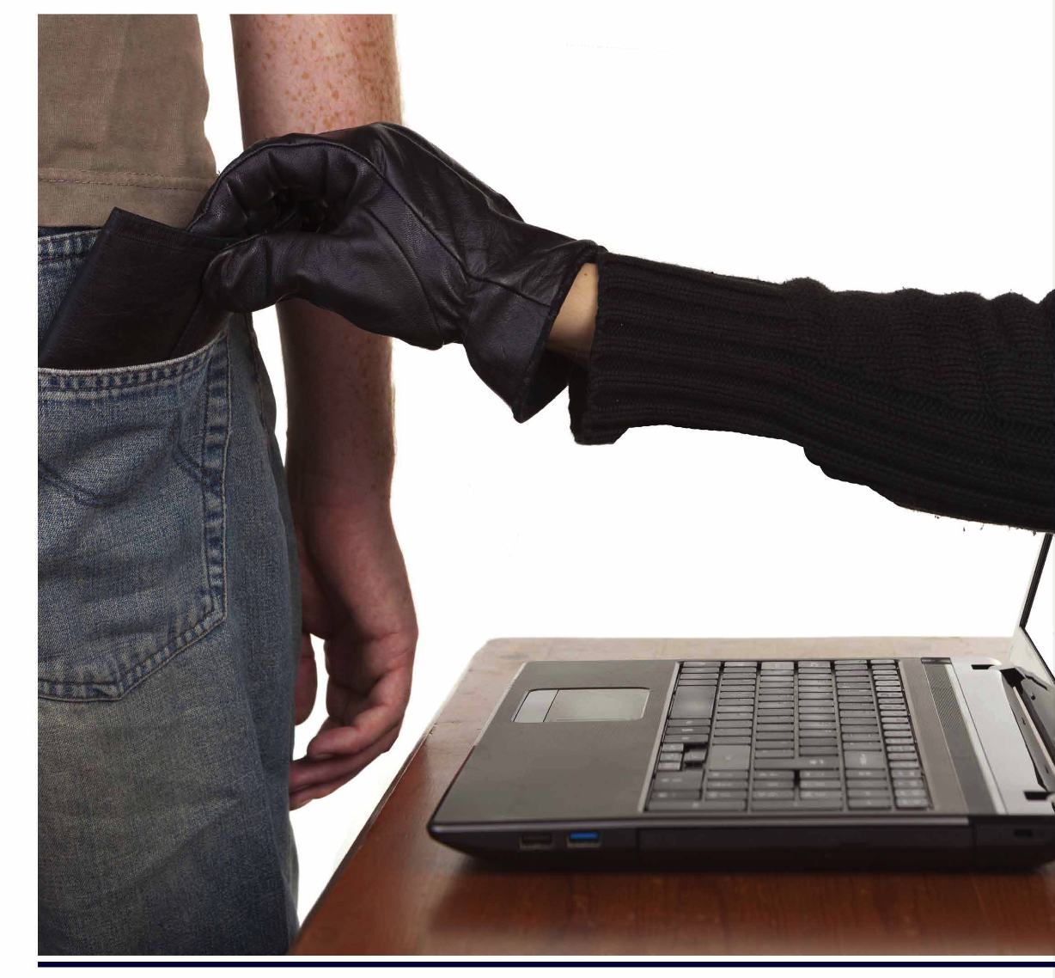
1. There are many types of fraud, for example, medical fraud, Internet fraud, and identity theft. What type of fraud does the photo illustrate?
2. What are some other kinds of fraud?
3. Is fraud more or less common today than in the past? Why or why not?

Slide 14
Read the story. Use the words from the list to fill in the blanks. Not all of the words will be used.
conman fishy motive weary
duplicate impersonating suspicious
I had a scary phone conversation with a (1) ____________ last week. The man was (2)_____________________ a government agent. He asked me for my name, address, passport number, and social security number. I knew something was (3) _____________________, so I didn’t tell him anything. I hung up and called the police instead. They said I was right to be (4) ____________________.

Slide 15
Reading 2: “The Michelle Brown Story: Identity Theft”
Now read the story of Michelle Brown, a real woman who experienced identity theft.
The story appears in The Art of the Steal by Frank Abagnale.

Slide 16
1. It began on a winter day with a seemingly ordinary message on an answering machine. It was from someone at the bank. Something about her new Dodge Ram pickup and the payment part due on the loan …
2. Michelle Brown was a single woman in her late twenties. She lived in Southern California and worked as a credit analyst. She was cheerful, and people found her fun to be around. Friends were always telling her how she was too nice. She worked hard and was tidy with her finances. She owned 15 credit cards but had never been late on a single payment. Ever since she was 17, she had perfect credit. She liked everything in her life to be perfect.
3. She returned the call. She told the bank officer that there had to be a mistake; she hadn’t bought a truck. The officer quickly agreed that he must have the wrong Michelle Brown. The phone numbers on the credit application weren’t working… To prove beyond a doubt that it was another Michelle Brown he was searching for, she told him her Social Security number. She was stunned – it was the same one that was on the application.
4. Alarmed, she called up the credit reporting agencies and told them that something fishy was going on. They put a fraud alert on her credit and promised to send out a report on her recent purchases. She checked with the Division of Motor Vehicles and learned something astonishing: a duplicate driver’s license had recently been issued to a Michelle Brown. Someone else was using her name, her address, her Social Security number, and her driver’s license. It was as if someone was slowly erasing her identity…
5. When her credit report arrived, there were delinquent bills on it for thousands of dollars, including a sizable phone bill and even a bill for liposuction treatments. What was this? What became afraid to open her own mailbox, for fear of what new debt would be awaiting her. In time, she would learn that there was an arrest warrant for Michelle Brown in Texas. The charge was conspiracy to sell marijuana. She had never broken a law, any law. How could she be wanted by the police?
6. She began to worry that the other Michelle Brown would break into her apartment in search of her passport or checks, or who knew what else. Whenever she got home after dark she carried a flashlight and searched through the rooms, including every closet. She was weary and angry. When she went to bed at night, she was scared. It she heard the slightest noise, her first thought was that the woman calling herself Michelle Brown was out there in the dark, right beneath her window. Who was this person who was stealing her identity? Why of all the people in the world, did she pick her? And what did she want?
COMPREHENSION: True or False? Rewrite the false statements.
1.Michelle Brown was careless with her finances. ______
2. One form of identification was stolen from her. ______
3. The person who stole her identity made a variety of purchases. _____
4. She began selling drugs as a way of paying the bills. _____
5. Identity theft affected her emotionally as well as financially. _____

Slide 17
2. Michelle Brown was a single woman in her late twenties. She lived in Southern California and worked as a credit analyst. She was cheerful, and people found her fun to be around. Friends were always telling her how she was too nice. She worked hard and was tidy with her finances. She owned 15 credit cards but had never been late on a single payment. Ever since she was 17, she had perfect credit. She liked everything in her life to be perfect.
How do we know Michelle was tidy with her finances?
Which sentences, phrases, and words that give information about that?
What examples are given to explain Michelle’s identity theft?
4. Alarmed, she called up the credit reporting agencies and told them that something fishy was going on. They put a fraud alert on her credit and promised to send out a report on her recent purchases. She checked with the Division of Motor Vehicles and learned something astonishing: a duplicate driver’s license had recently been issued to a Michelle Brown. Someone else was using her name, her address, her Social Security number, and her driver’s license. It was as if someone was slowly erasing her identity…
→ driver’s license , name, address, SSN
What examples of delinquent bills are mentioned?
5. When her credit report arrived, there were delinquent bills on it for thousands of dollars, including a sizable phone bill and even a bill for liposuction treatments. What was this? What became afraid to open her own mailbox, for fear of what new debt would be awaiting her. In time, she would learn that there was an arrest warrant for Michelle Brown in Texas. The charge was conspiracy to sell marijuana. She had never broken a law, any law. How could she be wanted by the police?
→ Phone bill, liposuction treatment bill
DETAILED EXAMPLES
+ What ? – information about time / place / people and events
+ Functions? – support and explain main ideas
+ Why must be identified? – help readers to understand main ideas of a text
+ Signal words : for example, for instance, such as, including , in addition, in fact
Example: Main idea & 3 detailed examples
Michelle Brown liked her life to be perfect. For example, she worked hard and
was tidy with her finances. In addition, she had never been late on a single
payment. In fact, ever since she was 17, she had perfect credit.

Slide 18
Scamming the Scammers
Tiffany Wilson is a scambaiter; that is, she spends time communicating with scammers in order to catch them out. Here she tells her story.
‘I first got into scambaiting when my grandmother got tempted into adopting a puppy. She’d seen some pictures of cute puppies on social media, along with a text saying that they were going to get killed unless someone adopted them. Fortunately, I warned her before it was too late. Scammers attract people with bargain prices, so she didn’t lose much. It isn’t until later, when people have fallen in love with their puppy, that the scammers start demanding huge amounts of money. We tried to get the money back from the bank, but that wasn’t possible.
‘I was already familiar with the puppy scam then. We’d learnt about scamming during internet safety classes at school, though I heard about the puppy scam elsewhere. It was mentioned in an online video about the different ways scammers get money out of people. I think my generation knows much more about scamming than older people. It’s occasionally mentioned in the kinds of news articles my grandma reads, but people my age who see loads of scambaiting videos have a much better idea of how common scamming is and the tactics that are used.
‘Scambaiting involves engaging scammers in conversation. When they ask you to do something, you act a little stupid by asking lots of questions or making mistakes. It’s frustrating for them, but they stay on the line patiently because they think they will get money out of you. I don’t think you can be a scambaiter unless you are pretty sociable, as you have to talk to people for a long time. Most scambaiters put videos of their calls online, and the popular ones are very funny.
1. Tiffany’s grandmother...
a. paid a small amount of money to scammers.
b. didn’t pay any money to scammers.
c. lost a lot of money to scammers.
d. paid a lot of money to scammers but was later refunded.
2. How did Tiffany find out about the puppy scam?
a. From an internet safety class at school.
b. From a video that was made by a scambaiter.
c. From an online source.
d. From a news article her grandmother read.
3. According to Tiffany, all scambaiters need to be...
a. good actors
b. patient
c. not good at technology
d. sociable

Slide 19
‘I scambait first and foremost because I want to help people recognise scams, and although most viewers of my videos are young, I’m sure the content they learn passes on to other family members. It’d be nice if I actually helped to get a scammer arrested, but there are just too many scammers for police to deal with. But as long as I am wasting a scammer’s time, that person can’t be scamming someone else. I also get a bit of income from the adverts that go out on my videos.
‘Some scambaiters go too far, though, when creating entertainment by punishing the scammers. I saw one video in which the scambaiter convinced a scammer that he had a well-paid job for him in Lagos. The guy used all his money to travel to the capital of Nigeria, and when he got there, there was nothing for him. For the scambaiter and the viewers, that was all a big joke. For that poor guy in Africa who was trying to earn a living by any means, it was a real situation and it could have been dangerous.
I’m aware that scambaiting doesn’t promote good international relationships. The most popular of my videos are the ones that make the scammers look foolish, and I’m forever deleting racist comments. I know that a lot of scammers are really poor. They believe that all Westerners are rich and that scamming them does little harm. I’ve tried to convince scammers to get a more responsible job, but I haven’t had any luck yet, as they have few employment opportunities. But I hope the conversations I have with them go some way in helping people understand the lives of people in poor countries and the things they have to do for cash.’
4. Which one is NOT a reason why Tiffany scambaits?
a. To educate people.
b. To help police catch scammers.
c. To waste scammers’ time.
d. To earn money.
5. What behaviour by a scambaiter did Tiffany find particularly shocking?
a. A scambaiter stole money that the scammer had earned from scamming.
b. A scambaiter discovered a scammer’s address and travelled there to film him.
c. A scambaiter tricked the scammer into spending his money to get a fake job.
d. A scambaiter got the scammer a job in order to trick him.
6. What is Tiffany currently trying to do on her videos?
a. Make scammers appear foolish.
b. To change scammers’ perceptions of Westerners.
c. Help scammers find other jobs.
d. Educate viewers about the lives of scammers.

