Slide 1
some control
most control
no control

Slide 2
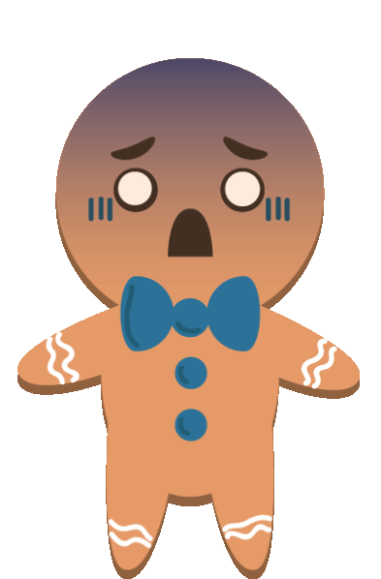
Humankind’s 8 most common fears

Slide 3
fear of public speaking (Glossophobia)

Slide 4
fear of heights (Acrophobia)

Slide 5
fear of snakes (Ophidiophobia)

Slide 6
fear of closed/confined/small spaces

Slide 7
fear of the dark (Lygophobia/Nyctophobia)

Slide 8
fear of getting a disease (Nosophobia)

Slide 9
fear of violent weather (Astraphobia)

Slide 10
fear of death (Thanatophobia)

Slide 11
G1 fear of public speaking
Causes
Symtoms:
Treatments
G2 fear of heights
G3 fear of snakes
G4 fear of closed/confined/small spaces
G5 fear of the dark
G6 fear of getting a disease
G7 fear of violent weather
G8 fear of death

Slide 13
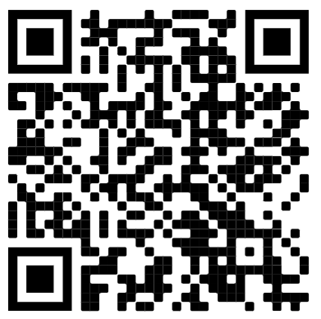
How Bad Is Your Fear Of Public Speaking?

Slide 14
Watch a video

Slide 15
Can people overcome the fear of public speaking?

