Slide 1
?!
A test of endurance
Which kinds of sports entail endurance?
UNIT 1

Slide 2
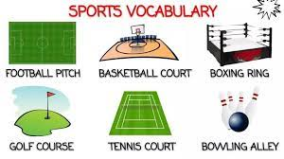
i
j
d
e
a
b
c
f
h

Slide 3
?!
Before you listen
In this podcast, Jay Batchen talks about his experience as an ultramarathon runner.
fame
money
Jay’s motives for running

Slide 4
While listening
Main idea

Slide 5
filmed
met
six
food and extra clothing
in tents
life/special/great

Slide 9
d
b
e
c
a

Slide 11
Thank you

