Slide 1
REVISION
LISTENING 3
FINAL TEST

Slide 2
LISTENING 3 TEST FORMAT
3 conversations
2 monologues
Topic: weather, direction, daily life, information exchange, time/location of events/ transports.
Part 1
Part 2
Part 3
5 multiple choice questions (A,B, or C)
2.5- B2.2
2 short presentations
Topic: languages, tourism, sports, careers, space, climate change
8 multiple choice questions (A,B, or C)
4.0- B2.2
1 long conversation
Topic: shopping, fashion, hobbies, careers, study
7 true/false questions
3.5- B2.2

Slide 3
PART 1

Slide 4

Q1
You hear a man talking about his work. Why did he change his job?
A He wanted to do outdoor work.
B He had health problems.
C He needed more money.

Slide 5
Q2
You hear a man telling someone about getting lost. How did he feel about getting lost?
A scared
B excited
C annoyed

Slide 6
Q3
You hear two people talking at a zoo. How does the woman feel?
A worried
B sad
C bored

Slide 7
Q4
You hear a woman talking about a sport. Why might she give it up?
A It takes up too much time.
B It is too expensive.
C The weather is getting too bad.

Slide 8
Q5
You hear a voicemail message. Who is the woman?
A a mother
B a colleague
C a friend

Slide 9
PART 2

Slide 10
You will hear part of a radio interview with a man called Thomas Barker, who is an ex-criminal.
1 What does Thomas say about his home life when he was a child?
A His family had a lot of money.
B His parents were good role models.
C His brothers got into trouble with the police.
2 Thomas says that he started stealing things because
A he liked the element of danger.
B he wanted to be part of the group.
C he enjoyed getting things for free.
3 What was different about the crimes he was involved in later?
A the degree of planning
B the worry about getting caught
C the number of crimes he committed
4 What was Thomas' attitude to his crimes at that time?
A He did not take his crimes seriously.
B He disliked the level of violence involved.
C He envied the more serious criminals.

Slide 11
PART 3

Slide 12
Listen and decide whether each statement is true or false.
2
1 Make sure you get on coach 3 at the beginning and end of the trip.
2 Go to the ticket office if you get separated from the guide.
3 The Freedom Key card entitles you to a discount on food and drink in the palace.
4 No need to get permission from the locals before taking their photos.
5 Local people will accept 20% less than the price they have asked for souvenirs.
6 The statue of King Hupugarta is inside the main gate.
7 Avoid touching the statue of King Hupugarta.
F
main gate
F
T
F
30
F
T
T

Slide 13
Thank you

Slide 14
CONTENTS OF THIS TEMPLATE
You can delete this slide when you’re done editing the presentation
Fonts | To view this template correctly in PowerPoint, download and install the fonts we used
Used and alternative resources | An assortment of graphic resources that are suitable for use in this presentation
Thanks slide | You must keep it so that proper credits for our design are given
Colors | All the colors used in this presentation
Icons and infographic resources | These can be used in the template, and their size and color can be edited
Editable presentation theme | You can edit the master slides easily. For more info, click here
For more info:
SLIDESGO | SLIDESGO SCHOOL | FAQS
You can visit our sister projects:
FREEPIK | FLATICON | STORYSET | WEPIK | VIDEVO

Slide 15
TABLE OF CONTENTS
01
02
03
04
05
06
Introduction
Carbon
Causes
You can describe the topic of the section here
You can describe the topic of the section here
You can describe the topic of the section here
Variations
Mechanisms
Conclusions
You can describe the topic of the section here
You can describe the topic of the section here
You can describe the topic of the section here

Slide 16
WHOA!
This can be the part of the presentation where you introduce yourself, write your email

Slide 17
01
INTRODUCTION
You can enter a subtitle here if you need it

Slide 18
CLIMATE RESEARCH
Mercury is the closest planet to the Sun and the smallest one in the entire Solar System. This planet's name has nothing to do with the liquid metal, since Mercury was named after the Roman messenger god. Despite being closer to the Sun than Venus, its temperatures aren't as terribly hot as that planet's. Its surface is quite similar to that of Earth's Moon, which means there are a lot of craters and plains
Mercury takes a little more than 58 days to complete its rotation, so try to imagine how long days must be there! Since the temperatures are so extreme, albeit not as extreme as in Venus, and the solar radiation is so high, Mercury has been deemed to be non-habitable for humans. We've already mentioned that Mercury is the smallest planet in the Solar System, but conversely, its core has the same size as Earth's
SAVE

Slide 19
INTRODUCTION LIST
Do you know what helps you make your point clear?
Lists like this one:
They’re simple
You can organize your ideas clearly
You’ll never forget to buy milk!
And the most important thing: the audience won’t miss the point of your presentation

Slide 20
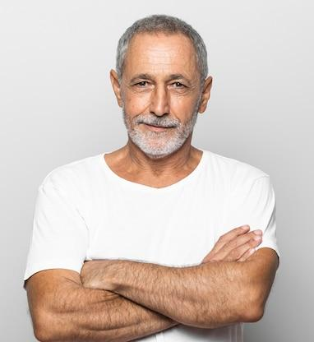
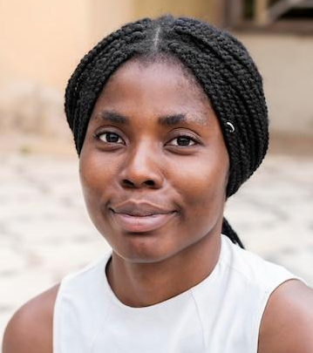
OUR TEAM
Timmy Jimmy
Jenna Doe
You can speak a bit about this person here
You can speak a bit about this person here

Slide 21
IMPORTANT FACTORS
Mercury
Venus
Mars
It’s the closest planet to the Sun and the smallest one in the Solar System
Venus has a beautiful name and is the second planet from the Sun
Despite being red, Mars is actually a cold place. It’s full of iron oxide dust

Slide 22
ABOUT GLOBAL WARMING
Venus
Jupiter
Venus is the second planet from the Sun
It’s the biggest planet in the Solar System
Mars
Saturn
Mars is actually a very cold place
Saturn is a gas giant and has several rings

Slide 23
GENERATION OF GASES
01
04
02
05
03
06
Mars
Moon
Mars is very cold
It's the Earth’s satellite
Venus
Saturn
Venus is very hot
Saturn is a gas giant
Jupiter
Earth
Is the biggest planet
Earth harbors life

Slide 24
AWESOME
WORDS
S S

Slide 25
—SOMEONE FAMOUS
“This is a quote, words full of wisdom that someone important said and can make the reader get inspired.”

Slide 26
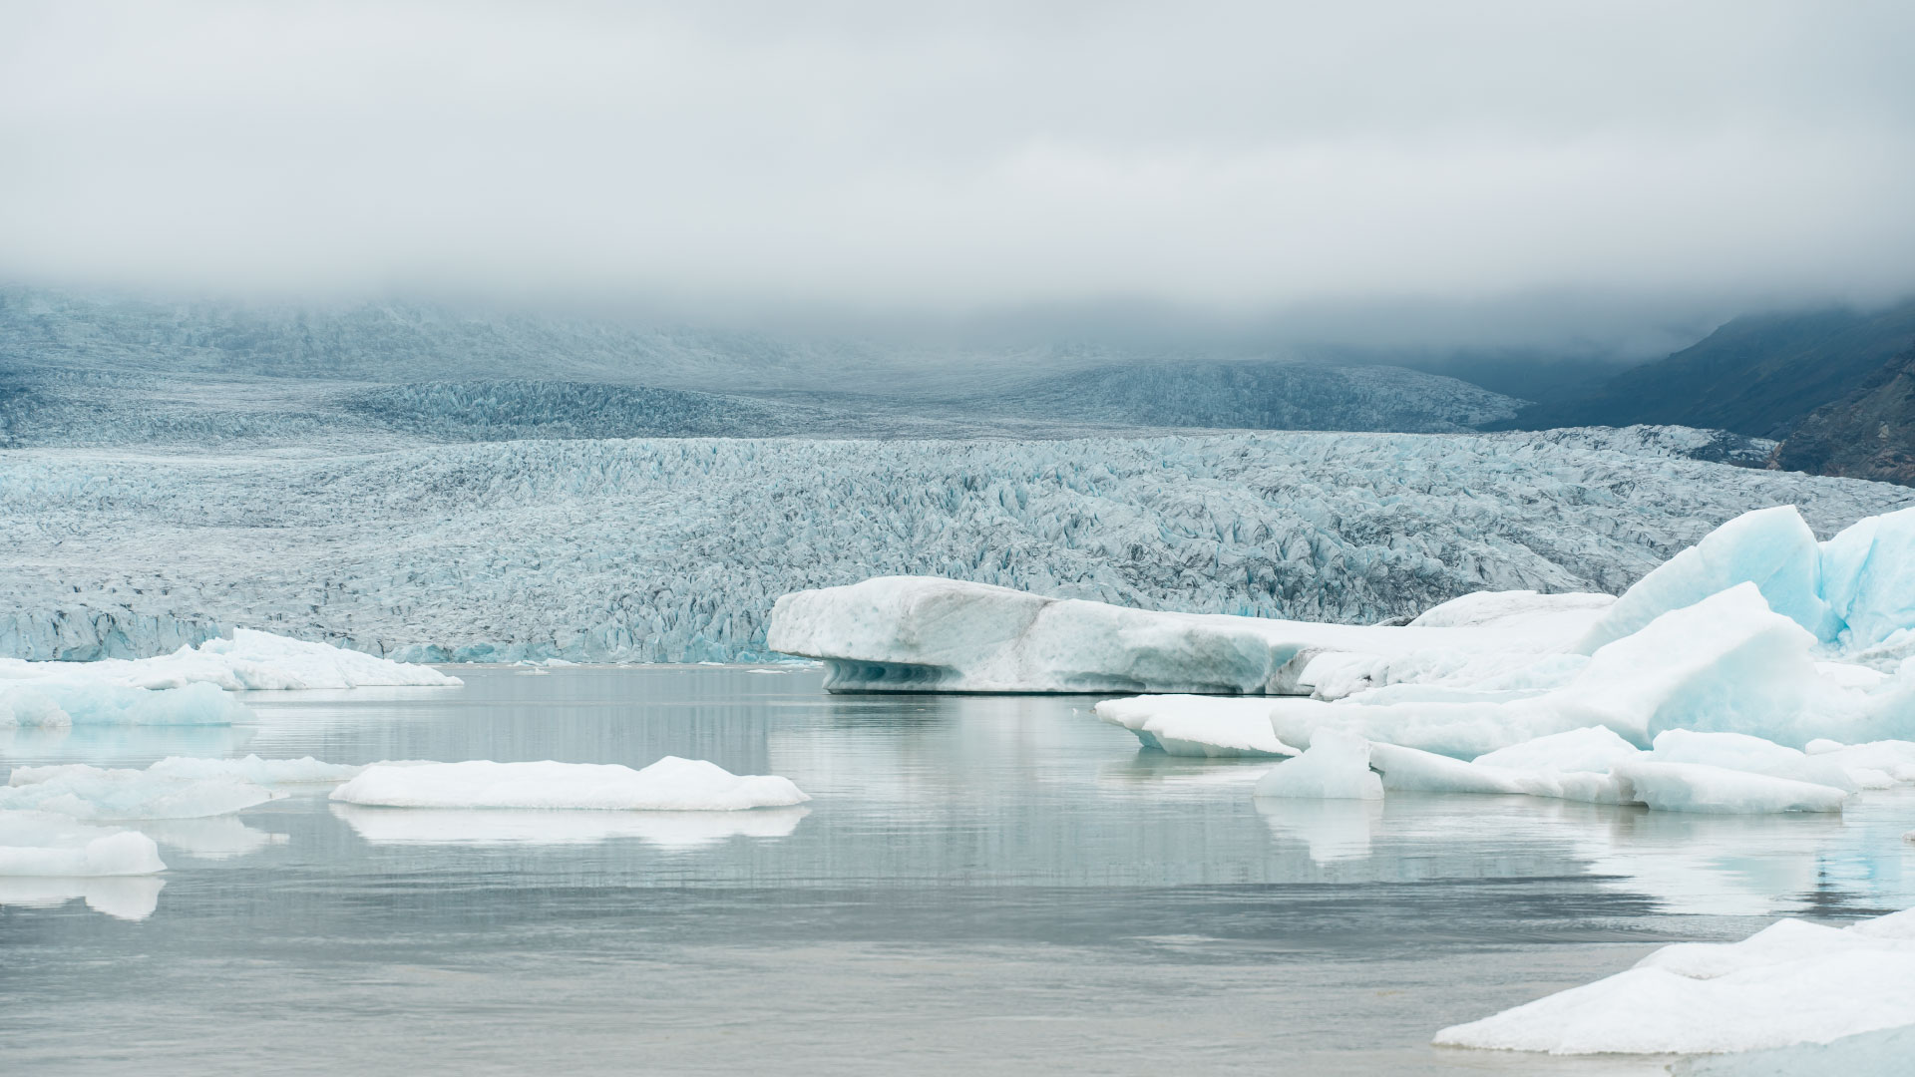
A PICTURE IS WORTH A THOUSAND WORDS

Slide 27
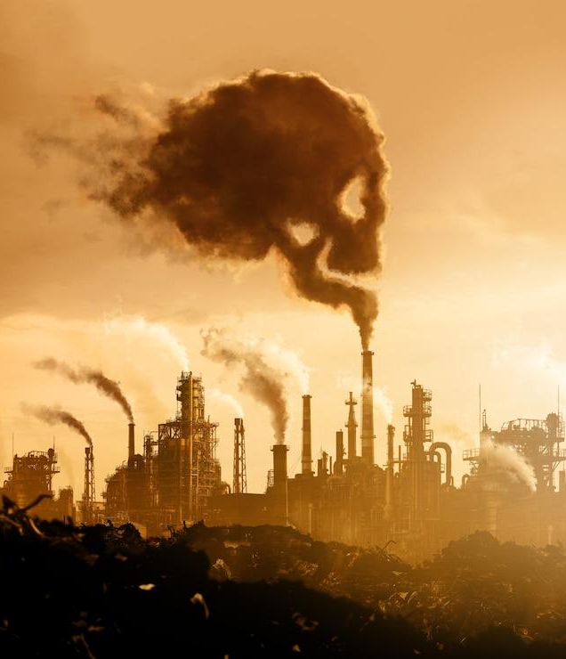
CONSEQUENCES OF CLIMATE CHANGE
Images reveal large amounts of data, so remember: use an image instead of a long text. Your audience will appreciate it

Slide 28
150,000
OUR HOUSE IS ON FIRE
Big numbers catch your audience’s attention

Slide 29
9h 55m 23s
333,000
386,000 km
The Sun’s mass compared to Earth’s
Jupiter's rotation period
Distance between Earth and the Moon

Slide 30
02
CARBON
You can enter a subtitle here if you need it

Slide 31
FUTURE OF GLOBAL WARMING
25%
75%
50%
25%
Venus has a beautiful name and is the second planet from the Sun
Mercury is the closest planet to the Sun and the smallest of them all
Despite being red, Mars is actually a cold place. It’s full of iron oxide dust

Slide 32
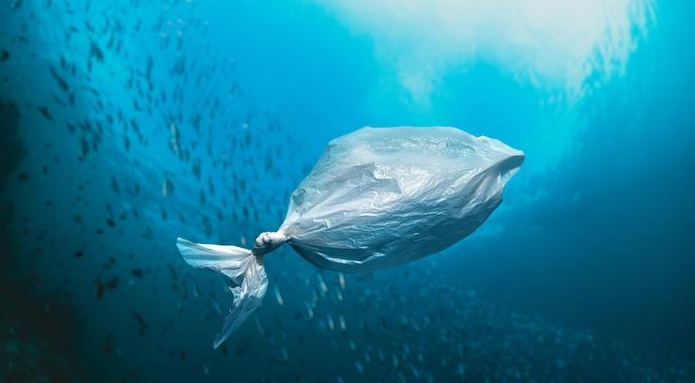
COMPUTER MOCKUP
You can replace the image on the screen with your own work. Just right-click on it and select “Replace image”

Slide 33
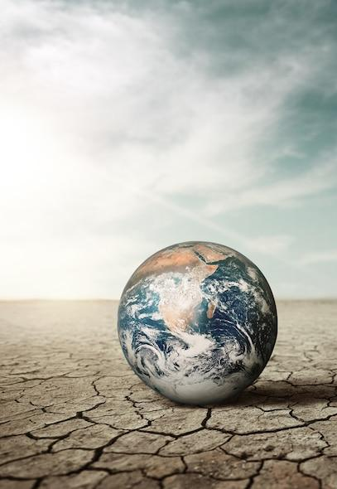
TABLET MOCKUP
You can replace the image on the screen with your own work. Just right-click on it and select “Replace image”

Slide 34
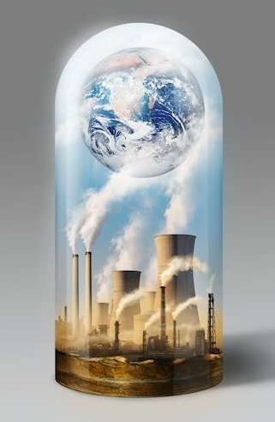
SMARTPHONE
You can replace the image on the screen with your own work. Just right-click on it and select “Replace image”

Slide 35
HUMAN ACTIVITY
G
M
H
C
A
Gases
Methane
Jupiter is the biggest planet of them all
Venus is the second planet from the Sun
Carbon
Aerosols
Mercury is the smallest planet
Jupiter is the biggest planet of them all

Slide 36
POTENTIAL EFFECTS
A
Venus is the second planet from the Sun
Mars
B
C
Saturn is a gas giant and has several rings
Jupiter is the biggest planet of them all

Slide 37
GLOBAL WARMING
Venus
Venus is the second planet from the Sun
Saturn
It’s composed of hydrogen and helium
Neptune
It’s the farthest planet from the Sun

Slide 38
OBJECTIVES TO MINIMIZE
Mars
Venus
Despite being red, Mars is actually cold
Venus has extremely high temperatures
Earth
Jupiter
Mercury
Earth is the planet where we all live
It’s the biggest planet of them all
It’s the smallest planet of them all

Slide 39
SOIL DEGRADATION
Saturn
Venus
Saturn is a gas giant with rings
Venus is a very hot planet
Jupiter
Mars
Jupiter is the biggest planet
Mars is actually a very cold place

Slide 40
GLOBAL WARMING
OBSERVATIONS
Mars
Despite being red, Mars is a cold place
Venus
Saturn
Jupiter
Venus is the second planet from the Sun
Saturn is a gas giant and has several rings
Jupiter is the biggest planet of them all

Slide 41
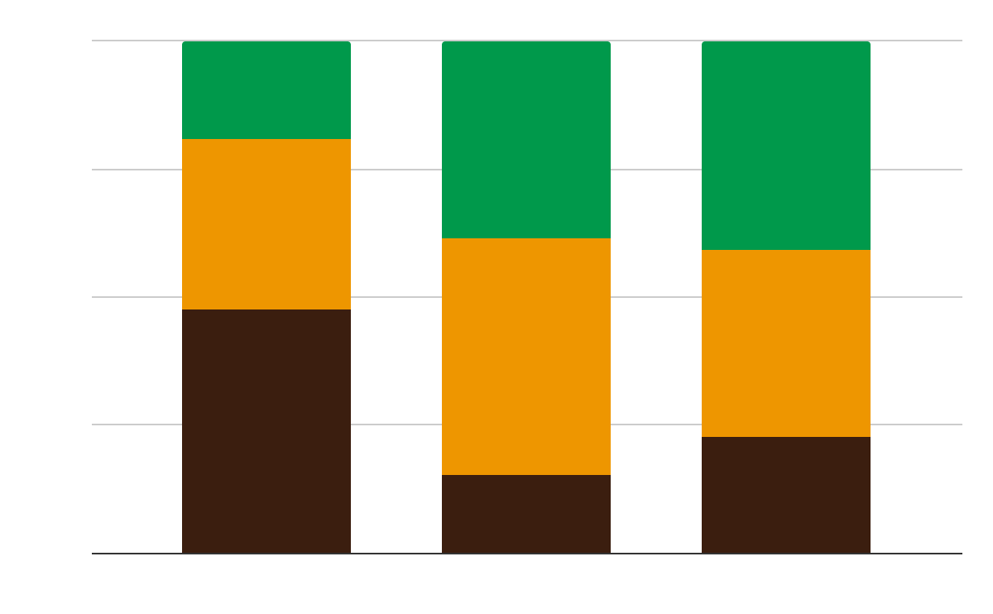
GLOBAL WARMING GRAPH
Ozone
Earth is the planet where we all live
Carbon
Mercury is the smallest planet
Methane
Saturn is a gas giant with rings
Follow the link in the graph to modify its data and then paste the new one here. For more info, click here

Slide 42
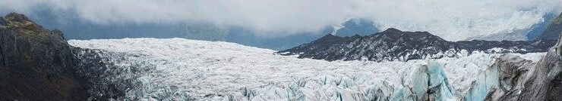
EARTH'S CLIMATE SYSTEM
Mercury takes a little more than 58 days to complete its rotation, so try to imagine how long days must be there! Since the temperatures are so extreme, albeit not as extreme as in Venus, and the solar radiation is so high, Mercury has been deemed to be non-habitable for humans

Slide 43
SIMULATIONS OF FUTURE
A
B
Earth
Venus
Earth is the third planet from the Sun and the only one with life:
Mars
Venus
Mercury
The Moon
Neptune
Earth
Jupiter
Venus has a beautiful name and is the second planet from the Sun:
Earth
Mas
Neptune
Jupiter
Mercury
Mars
The Moon

Slide 44
ACTIONS IN THE WORLD
Earth
Mars
Mercury
You can describe the topic of the section here
You can describe the topic of the section here
You can describe the topic of the section here

Slide 45
HOW CAN WE HELP?
A | Mercury is the closest planet to the Sun and the smallest one in the Solar System. This planet's name has nothing to do with the liquid metal
B | Venus has a beautiful name and is the second planet from the Sun. It’s terribly hot, even hotter than Mercury
C | Earth is the third planet from the Sun and the only one that harbors life in the Solar System. This is where we all live on
D | Despite being red, Mars is actually a cold place. It's full of iron oxide dust, which gives the planet its reddish cast
E | Jupiter is a gas giant and the biggest planet in the Solar System. It's the fourth-brightest object in the night sky

Slide 46
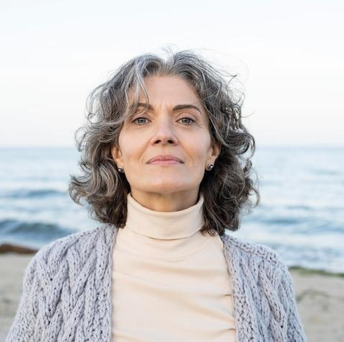
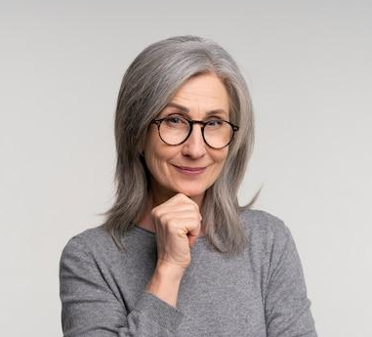
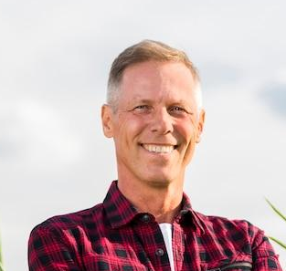
OUR ENVIRONMENTALISTS
—Laura Patterson
“Neptune is the farthest planet from the Sun and the fourth-largest in our Solar System!”
—Monique Nelson
“Mercury is the closest planet to the Sun and also the smallest one in our Solar System”
—John James
“Despite being red, Mars is a cold place. It’s full of iron oxide dust, what gives it its reddish color"

Slide 47
THANKS!
Do you have any questions?
youremail@freepik.com
+91 620 421 838
yourcompany.com
Please keep this slide for attribution

Slide 48
ICON PACK

Slide 49
ALTERNATIVE RESOURCES
Here’s an assortment of alternative resources whose style fits the one of this template:
Hand drawn world environment day background I

Slide 50
RESOURCES
Did you like the resources on this template? Get them for free at our other websites:
PHOTOS
Cloudy nature landscape by lake
Climate change with industrial pollution
Cloudy nature landscape by lake
Front view man posing for camera
Climate change with industrial pollution
Medium shot senior man with crossed arms
Close up beautiful african woman portrait
Portrait of beautiful older woman at the beach
Close up portrait of senior woman

Slide 51
RESOURCES
Did you like the resources on this template? Get them for free at our other websites:
PHOTOS
Climate change with dry soil
Climate change concept collage
ICONS
Climate Chan Climate Change | Filled
VECTORS
Hand drawn climate change instagram stories template
Hand drawn climate change instagram post collection

Slide 52
Instructions for use
If you have a free account, in order to use this template, you must credit Slidesgo by keeping the Thanks slide. Please refer to the next slide to read the instructions for premium users.
As a Free user, you are allowed to:
- Modify this template.
- Use it for both personal and commercial projects.
You are not allowed to:
- Sublicense, sell or rent any of Slidesgo Content (or a modified version of Slidesgo Content).
- Distribute Slidesgo Content unless it has been expressly authorized by Slidesgo.
- Include Slidesgo Content in an online or offline database or file.
- Offer Slidesgo templates (or modified versions of Slidesgo templates) for download.
- Acquire the copyright of Slidesgo Content.
For more information about editing slides, please read our FAQs or visit Slidesgo School:
https://slidesgo.com/faqs and https://slidesgo.com/slidesgo-school

Slide 53
Instructions for use (premium users)
As a Premium user, you can use this template without attributing Slidesgo or keeping the "Thanks" slide.
You are allowed to:
Modify this template.
Use it for both personal and commercial purposes.
Hide or delete the “Thanks” slide and the mention to Slidesgo in the credits.
Share this template in an editable format with people who are not part of your team.
You are not allowed to:
Sublicense, sell or rent this Slidesgo Template (or a modified version of this Slidesgo Template).
Distribute this Slidesgo Template (or a modified version of this Slidesgo Template) or include it in a database or in any other product or service that offers downloadable images, icons or presentations that may be subject to distribution or resale.
Use any of the elements that are part of this Slidesgo Template in an isolated and separated way from this Template.
Register any of the elements that are part of this template as a trademark or logo, or register it as a work in an intellectual property registry or similar.
For more information about editing slides, please read our FAQs or visit Slidesgo School:
https://slidesgo.com/faqs and https://slidesgo.com/slidesgo-school

Slide 54
Fonts & colors used
This presentation has been made using the following fonts:
Chelsea Market
https://fonts.google.com/specimen/Chelsea+Market
Gothic A1
https://fonts.google.com/specimen/Gothic+A1
#f4f0f0
#367f8c
#006a79
#ffffff
#d16f1a
#19a3a0
#00994b
#3b1e0f
#ee9600
#beb8ac

Slide 55

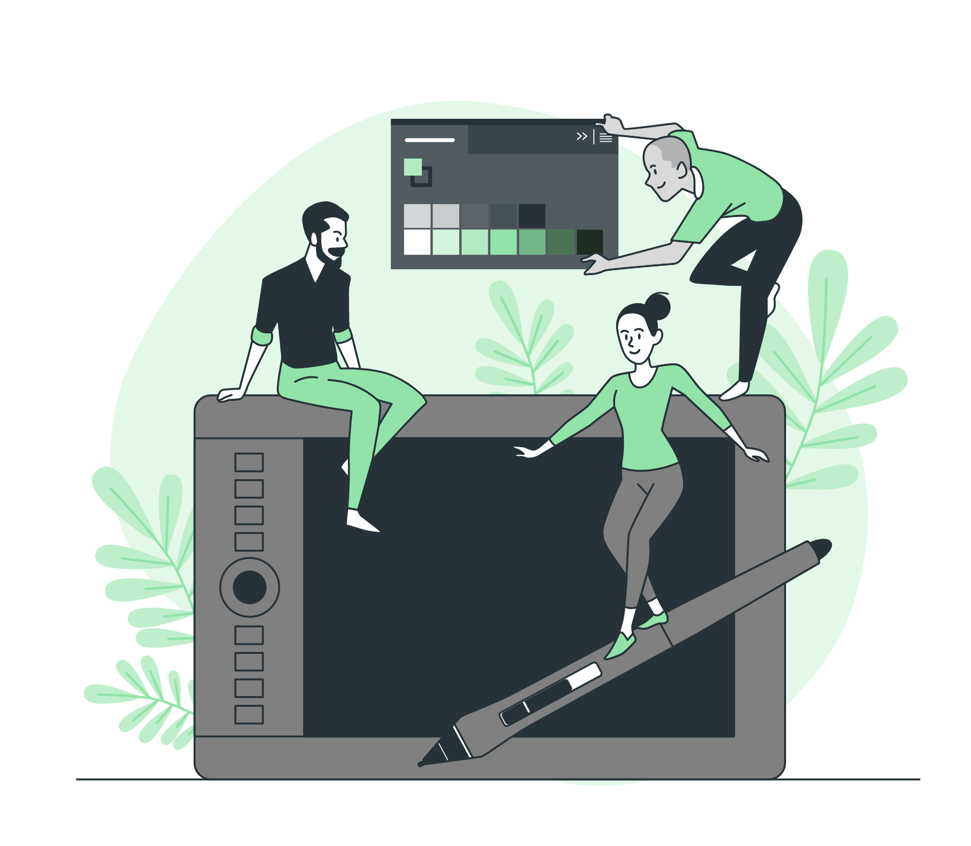



Storyset
Create your Story with our illustrated concepts. Choose the style you like the most, edit its colors, pick the background and layers you want to show and bring them to life with the animator panel! It will boost your presentation. Check out how it works.
Pana
Amico
Bro
Rafiki
Cuate

Slide 56
Use our editable graphic resources...
You can easily resize these resources without losing quality. To change the color, just ungroup the resource and click on the object you want to change. Then, click on the paint bucket and select the color you want. Group the resource again when you’re done. You can also look for more infographics on Slidesgo.

Slide 59
JANUARY
FEBRUARY
MARCH
APRIL
MAY
JUNE
PHASE 1
Task 1
Task 2
PHASE 2
Task 1
Task 2
JANUARY
FEBRUARY
MARCH
APRIL
PHASE 1
Task 1
Task 2

Slide 62
