Slide 1
HELLO
WELCOME TO
MY CLASS
SPEAKING 3

Slide 3
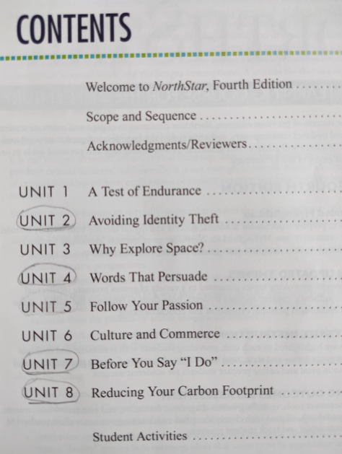

Slide 4
TOPIC: AVOIDING IDENTITY THEFT

Slide 5
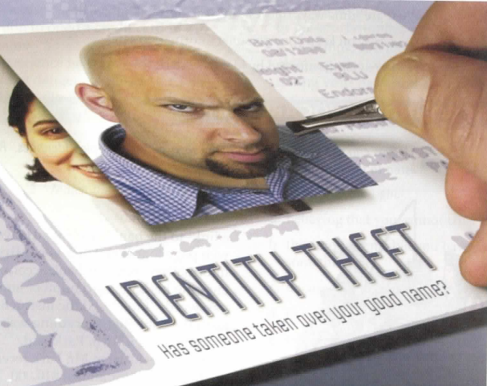
What is happening to the woman's picture? Why?
2. What does “identity theft” mean?

Slide 6
SHARE INFORMATION
Identity theft is a type of fraud.
The thieves steal personal information-such as a person's name, address, driver's license, or passport number-and use it to open bank or credit card accounts in the name of the victim, the person harmed.
Victims often find out about the theft when they start getting bills for things they didn't buy.

Slide 7
1. What are some ways thieves can steal someone’s personal information?

Slide 8
1. What are some ways thieves can steal personal information?
Criminals pretend to work for real companies.
They send e-mail messages to thousands of people.
They trick people into going to a fraudulent website (which looks like a real site) and giving out their personal information.
Then the thieves use the information to commit identity theft.

Slide 9
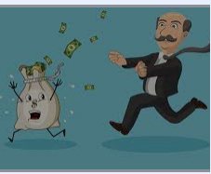
How are victims affected by identity theft?

Slide 10
3. What should you do if you are a victim of identity theft?
2. How can you keep your personal information safely?

Slide 11
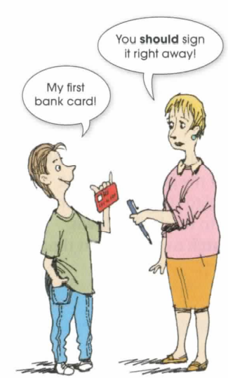
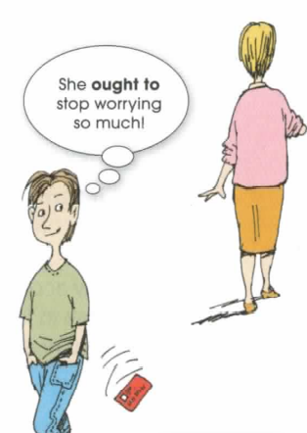
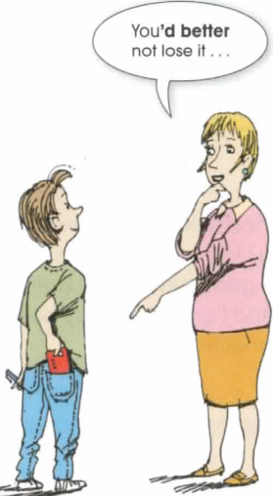

Slide 13
* Can you share a story of stealing information that you / your best friend/ your family member have / has ever experienced?

Slide 14
ROLE PLAY
In this activity, you will create and perform a 3-5-minute role play about identity theft.
A role play is a short performance. The actors take on roles, or become characters, and act out a situation.
Often the situations are similar to experiences that people might have in real life.
Try to use the vocabulary, grammar, pronunciation, and language for keeping a conversation going that you learned in the unit.

Slide 15
Work in a group of three. Follow the steps.
Step 1: Choose a situation for the role play. Choose from the following ideas:
filing a police report
getting a call from a department store about a bill
calling a credit card company about a theft
giving advice to a friend about identity theft
(your own idea)

Slide 16
Decide on the place, characters, and story. Choose from the following ideas: Place:
at a police station
in a department store
on the phone
Characters (think about age, personality, and feelings about the situation):
identity theft victim
police officer
store employee
identity thief
(your own idea)

Slide 17
Story: Background : What happened before the role play starts? Plot: What happens during the role play?
Step 2: Create the role play. Act like your character and speak naturally. Practice the role play several times.
Step 3: Perform your role play for the class.

Slide 18
RESEARCH
Step 1: Find out more about identity theft. Choose one topic from the box or think of your own.
child identity theft
dumpster diving
shoulder surfing
criminal identity theft
mortgage fraud skimming
data theft
phishing

Slide 19
Step 3: Share your information with the class
Step 2: Research the topic on the Internet or in the library. Use the questions to guide your research
1. What is ____?
2. Is it a common way to commit identity theft?
3. What can people do to protect themselves against?

Slide 20
HOMEWORK: Make a video (3-4 minus) to present your opinion about one of the followings
Tell a story about identity theft. It can be from your own experience, or something you heard or read about. Who were the victims? How did the thief steal their identity? What happened after the theft?
2. More and more criminals are stealing personal information from computers or over the Internet. How can people protect themselves from this kind of crime?

Slide 21
TOPIC: WORDS THAT PERSUADE

Slide 22
1. Where / When do you often hear or see persuasive words?
2. What words are often used to persuade somebody?

Slide 23
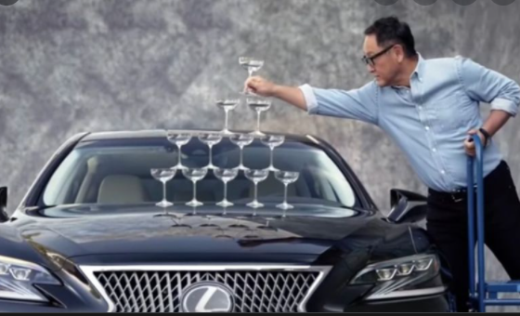
1. Look at the photo. What do you think the salesman will say to persuade a customer to buy a car?

Slide 24
SHARE INFORMATION
https://www.youtube.com/watch?v=M6a0Nn8Xjvc
Does the ad have…?
a funny situation/ context
a good song / good words/persuasive words
nice-looking people
a famous person
(Other)

Slide 25
EXPRESSION OPINIONS
1. When is it OK to use euphemisms or deceptive language in a corporate context? When is it not OK?
2. What about euphemisms or deceptive language in personal relationship?

Slide 26
Work in groups of 4. Each person in the group speaks from a different point of view:
A corporate leader
An employee
A real estate agent
A home buyer
Take turns completing each statements and giving and an example.
I think that euphemisms (hurt people/ make people feel better). For example,…
B. I think that euphemisms (are necessary /are used too much) in business. For example,…

Slide 27
Look at the pictures of the products. Create a short advertisement for each product with an expressive adjective, a superlative, and an intensifier./
Test drive the incredible X-14. It’s the most reliable sporty car on the road.

Slide 28
She…
Your baby…
These shoes…

Slide 29
Try …
Nobody likes …

Slide 30
HOMEWORK:
Think or create a (new) product.
2. Make an advertisement for that product using persuasive words
3. Make a video (3-4 mins) to perform your advertisement

Slide 31
SOME SUGGESTIONS
1. Choose the product and target audience for your ad.
2. Decide on the appeal you will use and how you will get the consumers' attention.
3. Discus other techniques / PERSUASSIVE WORDS you can use in the ad (music, catchy slogan, sound effects, funny voice).

Slide 32
TOPIC: BEFORE YOU SAY “I DO”

Slide 33
Discuss the questions with the class.
1. What's happening in the picture?
2. Look at the title of the unit. What happens before you say "I do"? What do you think this unit will be about?

Slide 34
Read the following statements about marriage. Do you agree or disagree with them?
1. In most marriages, only one person can get what he / she wants?
2. To have a happy marriage, the couple must be good friends?
3. You should choose your spouse carefully before marriage, but after marriage you should accept his / her mistakes.

Slide 35
Work in groups.
Discuss the following topic: "Is it better to be married or single?

Slide 36
Choose a topic for your presentation. You may choose one of the following topics or think of your own topic.
1. living together before marriage
2. the rights of unmarried couples
3. using dating services to find a spouse (Internet sites, personal ads, speed dating)
4. arranged marriages vs. love marriages
5. mixed marriages (religion, age, language, culture, race)
6. types of families (blended, single parent)
7. living situations in marriage (long-distance marriages , living with relatives )
8. Divorce
9. Gay marriage

Slide 37
TOPIC: REDUCING YOUR CARBON FOOTPRINT

Slide 38
SHARE INFORMATION
Your personal carbon footprint is the amount of carbon dioxide (Co₂) that you put into the air when you drive a car, fly in an airplane, or use electricity made by burning coal or gas.

Slide 39
Look at the picture.
1. Look at the photo. Is this something happening now, in the near future, or in the distant future?

Slide 40
2. Over the past 100 years, temperatures and weather patterns around the world have changed. There are more storms, floods, and extreme temperatures.
What extreme weather have you heard about or experienced?

Slide 41
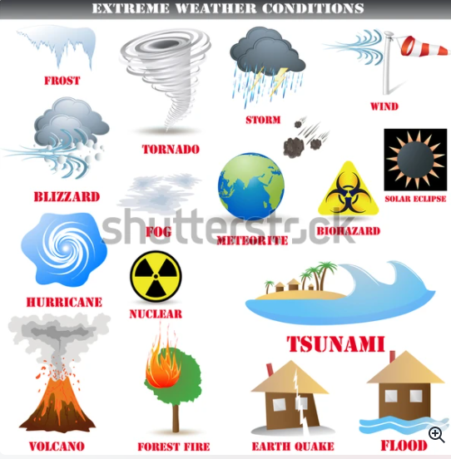

Slide 42
Scientist believe that climate change is caused by global warming. Global warming is an increase in temperatures all over the world
What do you think might be some of the causes of global warming?

Slide 43
WORK IN GROUPS
GROUP A
What can individuals do to reduce carbon dioxide emissions?
GROUP B
What can government and industry do to reduce carbon dioxide emissions?

Slide 44
EXPRESS OPINIONS
Agree / Disagreeing Language
I agree / disagree with the statement because…
I think / don’t think … because….
I think this is / isn’t a good idea because…
have to/ must/ don’t have to/ must not / can/ can’t / should

Slide 45
Build more public transportation
Stop using electricity
Ignore the problem of global warming
Buy / install solar panels
Stop immediately using gasoline-powered cars
Reduce factory emissions
Drive big cars
Ride bicycles
Walk

Slide 46
DISCUSSION
1. New technology will solve the problem of climate.
2. Industries should pay extra for energy that they consume and the emissions that they release.
3. More countries should generate their energy from nuclear power.
4. All countries should limit the number of cars on the road and increase public transportation.
5. Even if individuals work collectively to reduce their personal carbon footprint, their efforts are still just a drop in the bucket.

Slide 47
HOMEWORK (FINAL TEST)
The earth is getting warmer and warmer. What should we do to reduce the amount of carbon dioxide?
Make a video about 3-5 minutes presenting your opinions.

