Slide 1
TOPIC: ADVERTISING ON THE AIR

Slide 2
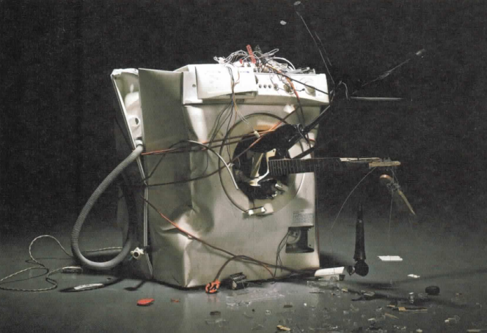
1. Look at the picture. What product do you think this company is advertising?
2. Do you think this is a good ad? Would you buy the product? Why / why not?
3. Look at the title of the unit? What kind of advertising do you think this unit will be about? (Advertising on the Air)

Slide 3
SHARE INFORMATION
https://www.youtube.com/watch?v=M6a0Nn8Xjvc
Does the ad have…?
a funny situation
a good song
nice-looking people
a famous person
(Other)

Slide 4
What is an ad?
Advertising is a way companies get consumers to buy their products.
Where can you see an ad?
TV
Magazines
Newspaper
Streets
Walls …

Slide 5
To get our attention, an ad can be added techniques
For example:
Sound effects (a crying baby, breaking glass..)
“product placement”
Good immages
Famous / hot person

Slide 6
life standard
ages
culture
factors
genders
social class
places
needs
jobs

Slide 7
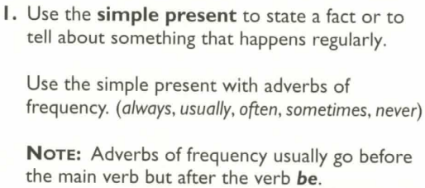
Tenses in ads

Slide 8
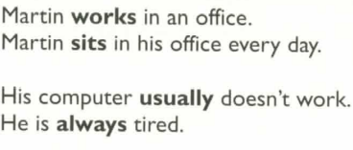
Tenses in ads
2. Use the present progressive to tell about something that is happening right now.
- Mart in is sitting on the beach.
- He isn't reading e-mail.

Slide 9
Tenses in ads
3. Use the simple present wit h non-action verbs. Non-action verbs describe states or situatio ns, not actions .
They can:
a . show emotions ( hate, lik e, love, want, wish )
show mental states ( know , believe, remember,
forget)
show possess io n ( have, own, belong)
desc ri be senses ( hear,see)
- Mart i n wants a new job. - - Martin loves Sunny Resorts.
He remembers the office as a bad dream.
He has all the time he need s.
- He sees nothing but blue skies.

Slide 10
Tenses in ads
N OTE: Some verbs that describe senses have an action and a non-action meaning. ( smell, taste, fee/, look, think )
Action: Martin is looking at an ad for Sunny Resorts.
(is looking = is reading)
Non-action: Mart i n looks tired.
(looks = seems I appears)

Slide 11
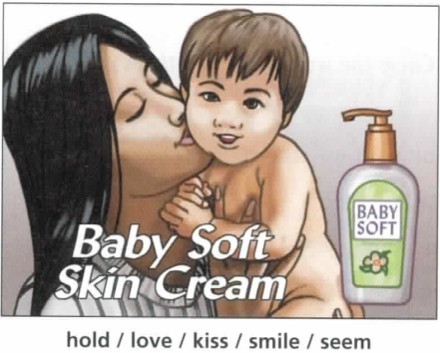
Work with a partner. Take turns describing what is happening in each ad. Use the simple present and present progressive and the verbs provided.
Example
STUDENT A: The mother is holding the baby.
STUDENT B: She loves the baby.

Slide 12
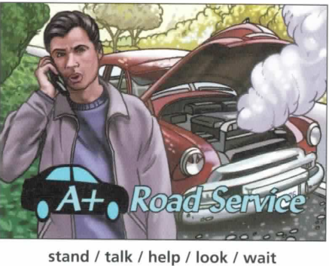

Slide 13
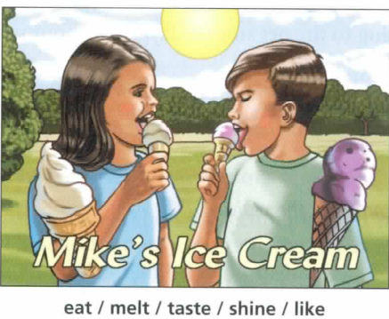

Slide 14
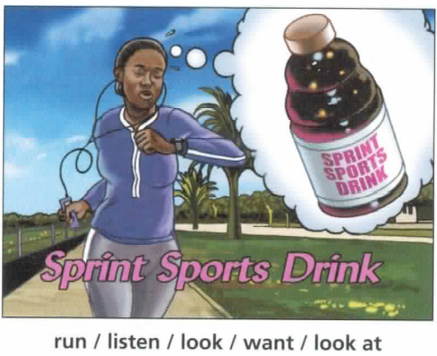

Slide 15
Discuss one of the topics
There are many unusual places to advertise aside from TV, radio, and magazines. For example, one company covered the wall of a train station in Tokyo with pictures of its product. People could peel the pictures off the wall and take them home.
Make a list of unusual methods of advertising that you have seen. Which is the most unusual? Why are advertisers doing this?

Slide 16
Discuss one of the topics
2. Children are a big target audience for advertisers. Companies hope that if they start selling product to children at an early age, children will continue to buy the products when they are adult. Some people are against advertising to children. They say that children should not be targets because they are too easily affected by advertising.
What is your opinion? Should advertisers be allowed to advertise to children? Why or why not?

Slide 17
RESEARCH
Step 1: Find three magazine ads that grab your attention and bring them to class.
Step 2: Work in small groups. Show your ad to the group and discuss the questions.
Who is the target audience?
What techniques does the advertiser use to sell the product?
Do you think this ad is effective? Why or why not?

Slide 18
HOMEWORK Work in a group of four or five. Follow the steps.
Step 1: Plan the ad.
Choose the product and target audience for your ad.
Decide on the appeal you will use and how you will get the consumers' attention.
Discus other techniques you can use in the ad (music, catchy slogan, sound effects, funny voice).

Slide 19
Step 2: Write a script and practice the ad. Make sure that each group member has a speaking part and a copy of the script.
Step 3: Make a video. Give a brief introduction about the product and target audience. Then perform the ad.

Slide 20
TOPIC: IDENTITY THEFT

Slide 21
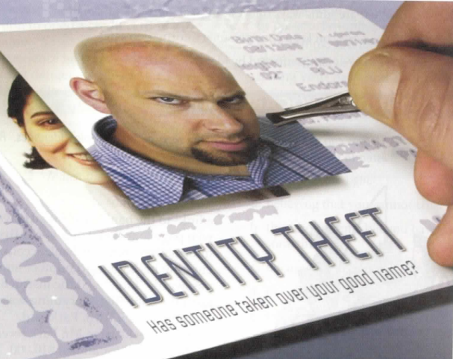
What is happening to the woman's picture? Why?
2. What does “identity theft” mean?

Slide 22
SHARE INFORMATION
Identity theft is a type of fraud.
The thieves steal personal information-such as a person's name, address, driver's license, or passport number-and use it to open bank or credit card accounts in the name of the victim, the person harmed.
Victims often find out about the theft when they start getting bills for things they didn't buy.

Slide 23
1. What are some ways thieves can steal personal information?
Criminals pretend to work for real companies.
They send e-mail messages to thousands of people.
They trick people into going to a fraudulent website (which looks like a real site) and giving out their personal information.
Then the thieves use the information to commit identity theft.

Slide 24
2. How can you keep your personal information safe?
Be careful about e-mail messages and websites that ask for personal information. Don't give out information that a thief could use as proof of identification, such as a driver's license or passport number.
If you think you have been a victim of phishing, deal with it right away by· calling your bank and the police. Don't wait until you start getting bills.

Slide 25
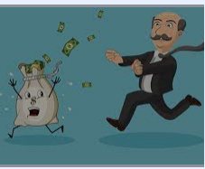
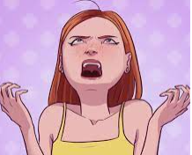
How are victims affected by identity theft?

Slide 26
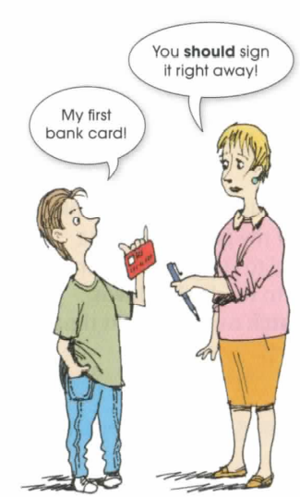
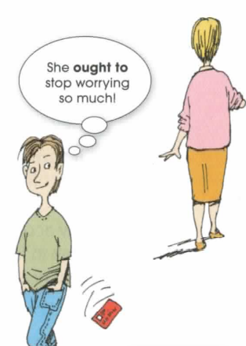
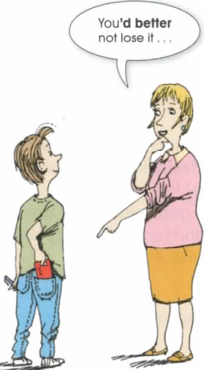

Slide 28
ROLE PLAY
In this activity, you will create and perform a 3-5-minute role play about identity theft.
A role play is a short performance. The actors take on roles, or become characters, and act out a situation.
Often the situations are similar to experiences that people might have in real life.
Try to use the vocabulary, grammar, pronunciation, and language for keeping a conversation going that you learned in the unit.

Slide 29
Work in a group of three. Follow the steps.
Step 1: Choose a situation for the role play. Choose from the following ideas:
filing a police report
getting a call from a department store about a bill
calling a credit card company about a theft
giving advice to a friend about identity theft
(your own idea)

Slide 30
Decide on the place, characters, and story. Choose from the following ideas: Place:
at a police station
in a department store
on the phone
Characters (think about age, personality, and feelings about the situation):
identity theft victim
police officer
store employee
identity thief
(your own idea)

Slide 31
Story: Background : What happened before the role play starts? Plot: What happens during the role play?
Step 2: Create the role play. Act like your character and speak naturally. Practice the role play several times.
Step 3: Perform your role play for the class.

Slide 32
Discuss one of the topics. Use the vocabulary and grammar from the unit
Tell a story about identity theft. It can be from your own experience, or something you heard or read about. Who were the victims? How did the thieve steal their identity? What happened after the theft?
2. More and more criminals are stealing personal information from computers or over the Internet. How can people protect themselves from this kind of crime?

Slide 33
RESEARCH
Step 1: Find out more about identity theft. Choose one topic from the box or think of your own.
child identity theft
dumpster diving
shoulder surfing
criminal identity theft
mortgage fraud skimming
data theft
phishing

Slide 34
Step 3: Share your information with the class
Step 2: Research the topic on the Internet or in the library. Use the questions to guide your research
1. What is ____?
2. Is it a common way to commit identity theft?
3. What can people do to protect themselves against?

Slide 35
TOPIC: THE ART OF STORYTELLING

Slide 36
PREDICT
1. What's happening in the photo?
2. Read the title of the unit. Why is storytelling an art? How is it similar to the art of painting or dancing?

Slide 37
SHARE INFORMATION
1. Did anyone tell you stories when you were a child? Who told the stories? What kind of stories did you hear?
2. What do you like about different kind of storytelling? Which types do you like best? Why?
listening to someone tell a story
reading a book
seeing a movie
watching a play

Slide 38
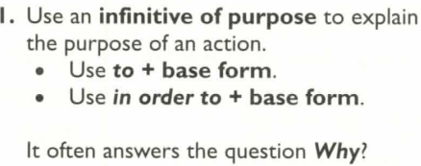
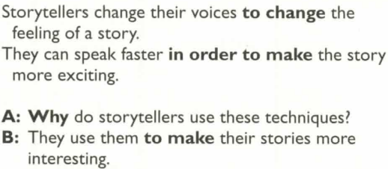
Grammar: Infinitives of Purpose

Slide 39
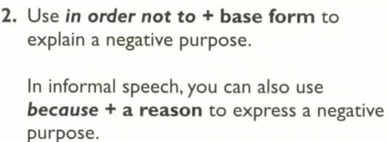
Grammar: Infinitives of Purpose

Slide 40
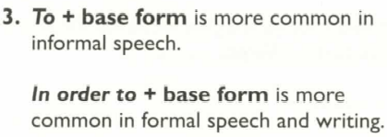
Grammar: Infinitives of Purpose

Slide 44
Discuss one of the topics. Use the vocabulary and grammar from the unit.
1. Today, most stories are told through book and movies rather than through oral storytelling. What will people lo e if the tradition of oral storytelling end? What are the advantages and disadvantages of modern storytelling through book and movies?
2. There are some stories that are very similar from one culture to another. For example, almost every country in the world has a version of "Cinderella”, a story about a poor girl who marries a prince. What do you think is the reason for this?

Slide 45
HOMEWORK
Make a video
You will prepare a story and tell it. The story could be from your culture or one that you make up yourself.
Try to use the vocabulary, grammar, pronunciation, and transitions you learned in the unit.

Slide 46
TOPIC: BEFORE YOU SAY “I DO”

Slide 47
Discuss the questions with the class.
1. What's happening in the picture?
2. Look at the title of the unit. What happens before you say "I do"? What do you think this unit will be about?

Slide 48
Work in a small group.
Discuss the following topic: "Is it better to be married or single?

Slide 49
Choose a topic for your presentation. You may choose one of the following topics or think of your own topic.
living together before marriage
the rights of unmarried couples
using dating services to find a spouse (Internet sites, personal ads, speed dating)
arranged marriages vs. love marriages
mixed marriages (religion, age, language, culture, race)
types of families (blended, single parent)
living situations in marriage (long-distance marriages , living with relatives )
divorce
Other:

Slide 50
TOPIC: TO SPANK OR NOT TO SPANK

Slide 51
Look at the picture.
1. What did the child do?
2. Why do you think the parent is spanking the child?
3. Do you think corporal punishment is a good punishment in this case?

Slide 52
SHARE INFORMATION
How did your parents punish you when you were a child? How did you feel about the punishment then? How do you feel about it now?
As a child, how did you learn right from wrong?

Slide 53
EXPRESS OPINIONS
What are some effective ways to discipline a child?
Why are they effective?

Slide 54
DEBATE
1. Teenagers should be punished as adults.
2. Teachers should be able to use spanking to discipline their students.
3. Governments should use corporal punishment to punish criminals.
4. Parents should be punished when their children do something wrong.

