Slide 1
HELLO
WELCOME TO
MY CLASS
LISTENING 1

Slide 3
1 | A World of Friends
2 | Making Unusual Art
3 | Special Possessions
4 | Creativity in Business
5 | Understanding Fears and Phobias
6 | Risks and Challenges
7 | Only Child – Lonely Child?
8 | Soccer: The Beautiful Game

Slide 4
TOPIC: A WORLD OF FRIENDS

Slide 5
1. Are you an extrovert or an introvert person? Why do you think so?

Slide 6
2. Is it important to have a best friend? Why or why not?

Slide 7
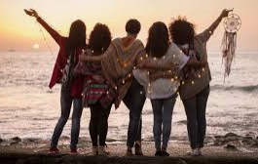
LISTEN TO THE RADIO COMMERCIAL FOR THE FRIENDSHIP FORCE
“A World of Friends Is a World of Peace”

Slide 8
Circle the correct answer to complete the sentence
The Friendship Force says, “When you have
friends in foreign countries, _____”
a. you held to bring peace to the world
b. you can be in the Friendship Force
a. you held to bring peace to the world

Slide 9
VOCABULARY 1

Slide 10
Nina and Rick are talking about the Friendship Force. Listen to the beginning of the conversation. Then answer the questions.

Slide 11
1. What are you listening to? Choose the answer.
A. a telephone call
A. a telephone call B. a radio talk show
2. What will Nina and Rick talk about?
A. host families B. shopping C. traveling
D. hotels E. music F. groups
G. students H. children I. languages
A. host families B. shopping C. traveling
D. hotels E. music F. groups
G. students H. children I. languages

Slide 12
Read the sentences. Write T (true) or F (false).
T
___1. Friendship Force visitors can be young or old.
__ 2. Some Friendship Force visitors stay in hotels.
__ 3. Nina wants to stay with a host family in Thailand.
__ 4. All host families speak English.
__ 5. Nina and Rick think it's good to have international friends.
F
T
F
T

Slide 13
Listen again. Circle the correct answer to complete each sentence.
1. Friendship Force groups have __ people.
a. 13 to 50 b. 15 to 30
1. Friendship Force groups have __ people.
a. 13 to 50 b. 15 to 30
2. Friendship Force groups meet for the first time __ .
a. before they travel b. in the foreign country
3. Nina thinks, "When you live with a host family, you learn __ :'
a. their language b. about their country
4. Nina __ Thai (the language of Thailand).
a. speaks a little b. doesn't speak
5. Friendship Force visitors stay with their host family for one or two __ . a. weeks b. months
6. After they stay with their host family, many Friendship Force visitors travel __ . a. to a different country b. in the same country
2. Friendship Force groups meet for the first time __ .
a. before they travel b. in the foreign country
3. Nina thinks, "When you live with a host family, you learn __ :'
a. their language b. about their country
4. Nina __ Thai (the language of Thailand).
a. speaks a little b. doesn't speak
5. Friendship Force visitors stay with their host family for one or two __ . a. weeks b. months
6. After they stay with their host family, many Friendship Force visitors travel __ . a. to a different country b. in the same country

Slide 14
MAKING INFERENCES BASED ON REACTIONS
Listen to the example. What is Nina's reaction?
Example
NINA: Well, first, can college students be in the Friendship Force?
RICK: Sure. We have people of all ages-teenagers, college
students, even grandparents!
NINA: Oh, that's great.

Slide 15
1. Nina has a (positive / negative) reaction.
1. Nina has a (positive / negative) reaction.
2. She ____________
is probably a college student
probably knows some college students
2. She ____________
is probably a college student
probably knows some college students

Slide 16
Excerpt One
1. Nina has a (positive / negative) reaction.
2. Nina is not worried about living with a host family, so she is probably a __ person.
a. shy b. friendly
1. Nina has a (positive / negative) reaction.
b. friendly

Slide 17
Excerpt Two
1. Nina has a (positive / negative) reaction.
2. Nina is worried because she doesn't speak Thai. She is really asking Rick, "Will I ______?”
have problems with my host family
learn the language
1. Nina has a (positive / negative) reaction.
have problems with my host family

Slide 18
Excerpt Three
1. Nina has a (positive / negative) reaction.
2. Nina likes the idea of "people, not places:' She thinks you can learn more about a
foreign country when you _____ .
meet the people
visit the important places
1. Nina has a (positive / negative) reaction.
meet the people

Slide 19
EXPRESS OPINIONS 1. Do you think it's good to stay with a host family? Why or why not? 2. Do you need to speak the same language well to make friends with someone? Why or why not? 3. What are the best ways to learn about another country?

Slide 20
LISTEN TWO: THE BEST SUMMER OF MY LIFE!
COMPREHENSION
Annie Quinn is an American high school student. Last summer, she traveled to Costa Rica with a group called The Experiment in International Living (EIL).

Slide 21
Listen to the interview with Annie. Circle the correct information to complete each sentence.
1. The students in Annie's group came from different (states / countries).
2. Some of the students (spoke different languages / had different religions).
3. The students in Annie's group stayed in Costa Rica for (a month / two weeks).
4. Annie loved the students in her group and (Ana / her host family).
5. Annie's host family (was very friendly / had a daughter).
6. Annie learned Spanish in her Spanish class and from her (host family / Spanish friends).
7. Annie learned that speaking the same language is not always (a good idea / necessary).
8. Experiment groups usually stay in a foreign country for (two / three to five) weeks.
states .
had different religions).
a month
4. Annie loved the students in her group and (Ana / her host family).
was very friendly .
host family
7. Annie learned that speaking the same language is not always (a good idea / necessary).
8. Experiment groups usually stay in a foreign country for (two / three to five) weeks.

Slide 22
LISTENING SKILL
PREDICTING INFORMATION AFTER AND AND BUT
Listen to the examples.
Examples
Annie: " . . . we all came from different states, and we had different religions and cultures:’
(a difference) (a difference)
B: Annie: “At first, I didn't speak much Spanish, but I learned a lot of Spanish from them and in my Spanish class, too.”
(negative information) (positive information)

Slide 23
Listen to the excerpts from Annie's interview. You will hear the first sentence and the word and or but. Try to predict what kind of information the second part of the sentence will have. Circle the sentence ending that makes sense. Then listen to the complete sentence to check your answer.
Excerpt One
a. I loved my host family.
b. I had some problems with my host family.

Slide 24
Excerpt Two
a. We all came from the same states.
b. We all came from different states.
Excerpt Three
a. At first, I spoke Spanish well.
b. At first, I didn't speak much Spanish.

Slide 25
TOPIC: UNDERSTANDING FEARS AND PHOBIAS

Slide 26
I. PRE-LISTENING
1. Are you scared of anything? What is it?
2. Why are some people scared of certain things?
3. Does having a fear of something change a person’s life? How?

Slide 27
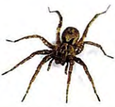
II. LISTENING ONE: PSYCHED: A RADIO SHOW
1. A phobia is a very strong fear. Read and listen to the blog about arachnophobia, the fear of spiders.

Slide 28
1. a serious issue a. you didn't make a problem happen
2. be angry with b. I'm joking; I'm not serious.
3. confused c. in a situation that may hurt or kill you
4. fear d. move back and forth quickly
5. hurt e. feel mad or upset because something is not OK
6. in danger f. up to now
7. not your fault g. make a person feel pain
8. just kidding h. not understanding
9. shake i. feeling of being in danger
10. still j. a big problem

Slide 29
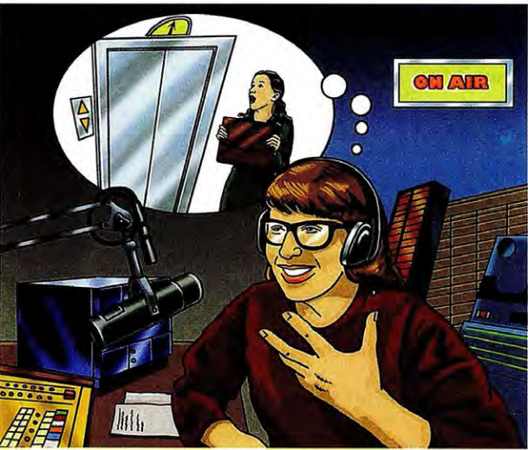
III. PREVIEW
You are listening to Psyched, a call-in radio show. The host of the show is Doctor Jones. She is a psychologist, someone who helps people understand their feelings.

Slide 30
According to Doctor Jones, what is a phobia?
a. a shaking body b. a real danger c. a strong fear
According to Doctor Jones, what is a phobia?
a. a shaking body b. a real danger c. a strong fear
2. What happens to people with phobias?
They feel like they are in danger.
They are in danger. c. They feel very strong.
They feel like they are in danger.
__ afraid
__ happy
__ money
__serious
__ afraid
__ happy
__scared
__ problem
__ money
__serious
__scared
__ problem
3. What words will you probably hear in this radio show?

Slide 31
Choose the best answer to each question.
What does Doctor Jones say about phobias?
a. A phobia can't hurt you. b. A phobia changes your life.
What does Doctor Jones say about phobias?
a. A phobia can't hurt you. b. A phobia changes your life.
2. What happened to Anna because of her phobia?
a. She was excited in Paris. b. She was scared in Paris.
2. What happened to Anna because of her phobia?
a. She was excited in Paris. b. She was scared in Paris.
3. What is Anna's advice about phobias?
Don't be angry with yourself.
Don't take a job for a million dollars.
3. What is Anna's advice about phobias?
Don't be angry with yourself.
Don't take a job for a million dollars.
4. Why is Anna's life better today?
She can ride elevators.
b. She reads many books.
4. Why is Anna's life better today?
She can ride elevators.
b. She reads many books.

Slide 32
Listen again. Write T (true) or F (False).
1. Arachnophobia is the fear of spiders.
2. People with phobias sometimes shake.
3. A phobia is being afraid of danger.
4. Claustrophobia is the fear of small spaces.
5. Anna cared about the kids in the Eiffel Tower.
6. Anna was scared of elevators and cars.
7. Writing helps Anna feel less afraid.
8. Anna's life is easy today.
9. Having a phobia is your fault.
10. Many people have phobias.
T
T
F
T
F
T
F
F
F
T

Slide 33
MAKE INFERENCES
UNDERSTANDING THE MEANING OF EXAGGERATIONS
Listen to the example. Answer the question.
Example
The speaker says she "was going to die:' What does this mean? Look at the following choices:
a. She could die inside the Eiffel Tower.
b. She felt very afraid inside the Eiffel Tower.
b. She felt very afraid inside the Eiffel Tower.

Slide 34
Listen to the excerpts. Think about the exaggeration. What do you think the speaker is really trying to say?
Excerpt One
Why does the speaker use the word forever?
__ a. She spent a long time climbing stairs.
__ b. She wasted time because of her phobia.
a. She spent a long time climbing stairs.

Slide 35
Excerpt Two
Why does the speaker use the phrase "twenty books a week"?
__ a. She reads many books.
__ b. She is a very good reader.
a. She reads many books.
Excerpt Three
Why does the speaker use the phrase "a million dollars"?
__ a. People with elevator phobias can lose important chances.
_ _ b. It costs a lot of money to have an elevator phobia.
Excerpt Three
Why does the speaker use the phrase "a million dollars"?
__ a. People with elevator phobias can lose important chances.
_ _ b. It costs a lot of money to have an elevator phobia.

Slide 36
EXPRESS OPINIONS
Discuss the questions with a partner.
What do you think about the Eiffel Tower story? Do you sometimes get scared in high buildings?
2. Do you have a phobia? Do you know someone with a phobia? Explain.
3. Do you think books and doctors can help people with phobias? What other things can help? Explain.

Slide 37
LISTENING TWO: CROSSING A BRIDGE
COMPREHENSION
Listen to the conversation between Alien and the psychologist. Then circle the correct answer to complete each sentence.

Slide 38
Alien is afraid __
a. a truck will hit him
b. of driving a truck
a. a truck will hit him
2. The psychologist tells him to think of other things __ .
that he is afraid of
that he does well
3. The psychologist tells him
to __ .
a. look straight ahead
b. look at the trucks
a. look straight ahead
that he does well
4. In the end, Alien feels __ .
a. very happy that he crossed the bridge
b. unhappy because he didn't cross the bridge alone
a. very happy that he crossed the bridge

Slide 39
VOCABULARY
Read the conversation and notice the phrases in bold.
YOUNG MAN: I can't ride this bike! I'm going to fall!
FRIEND: Calm down. You can do it.
YOUNG MAN: I don't know how. What's wrong with me?
FRIEND: Come on, you can do it. You need to believe in yourself.
YOUNG MAN: How can I do that? I'm going to fall!
FRIEND: Just keep going. Don't give up.

Slide 40
Match the phrases on the left to the definitions on the right. Write the letter of the correct definition on the line.
believe in yourself a. why do I have this problem?
2. calm down b. don't stop doing something
3. come on c. stop feeling scared
4. keep going d. have a good opinion of yourself
5. what's wrong with me? e. stop trying
6. give up f. something we say to help others feel stronger

Slide 41
LISTENING SKILL
NOTICING CONTRADICTIONS
When speakers disagree with each other, they sometimes contradict the other speaker. To contradict, you say the opposite of what the other person says.
Listen to the example.
Example
Who is disagreeing with whom? How do we know?

Slide 42
Listen to two excerpts from "Crossing a Bridge." Pay attention to contradictions
Who is disagreeing with whom? What are the two speakers disagreeing about? Which words do they put stress on?
Excerpt One
Who is disagreeing with whom? How do we know?
a. Alien disagrees with the psychologist.
b. The psychologist disagrees with Alien.
How do we know? He stresses the word ------- -
a. Alien disagrees with the psychologist.

Slide 43
Excerpt Two
Who is disagreeing with whom?
a. Alien disagrees with the psychologist.
b. The psychologist disagrees with Alien.
How do we know?
He stresses the word _ ______ _
b. The psychologist disagrees with Alien.

Slide 44
PRONUNCIATION: PAST TENSE: -ED ENDINGS
The -ed ending is sometimes pronounced as a new syllable and sometimes as a new sound.
Listen to Alien's explanation of an accident.
Example
ALLEN: The driver in front of me stopped quickly. I don't know why he needed to stop. I tried to stop, too, but it was too late. When I stopped, the driver behind me crashed into my car!
Look at the underlined verbs. Is the -ed ending a new syllable or a new sound?

Slide 45
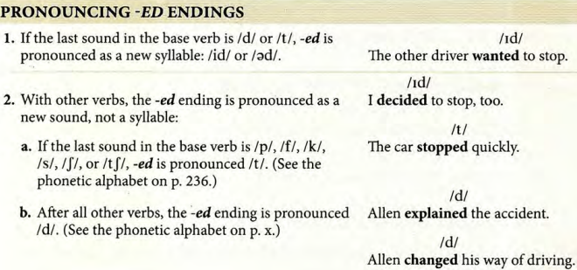

Slide 46
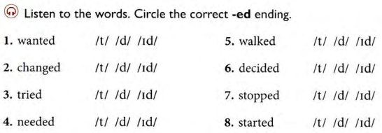

Slide 47
Listen to the sentences about Dr. Jones, the psychologist in Listening One. Then repeat each sentence and look at the underlined verbs. Is -ed pronounced /t/ /d/ or /id/? Write your answers above the verbs.

Slide 48
1. She wanted to help others with their problems.
2. She studied at New York University.
3. After she graduated, she became a psychologist.
4. She worked at a hospital for three years.
5. She talked to many people about their problems.
6. Then she decided to start a radio show.
7. She helped many people with fears and phobias.
8. She also earned a lot of money for her work.
9. After many years of working, she stopped.
10. She decided to enjoy life at the beach.

Slide 49
SPEAKING SKILL
USING IMPERATIVES
Listen to the examples from Listening One and Listening Two. Underline the imperative in each one. Then listen again and repeat the imperative verb.
Examples
Believe me, a phobia is a very serious issue.
Don't be angry with yourself.
Think of all the other things you do well.
Don't look at the trucks. Just look at the road.

Slide 50
TOPIC: RISKS AND CHALLENGES

Slide 51
PRE-LISTENING
1. Have you ever done something very difficult or dangerous?
2. Why do some people want to take a risk?

Slide 52
LISTENING ONE: THE AMAZING SWIMMER, DIANA NYAD.
1. Do you know Diana Nyad? If not, read and listen to the radio documentary about her.

Slide 53
Two sports reporters are talking about Diana Nyad
on the radio. Listen to the beginning of their news report.
Check the things they are going to talk about next
____Diana's world records ____sharks
____the weather ____singing songs
____Diana's childhood ____Diana's age
____ jellyfish ____ life in Cuba

Slide 54
Listen to the news report again. Choose the best word or phrase to complete
each sentence.
1. Diana is having a difficult time because of the (jellyfish bites / sharks).
2. Diana feels sick, but she doesn't want to (go back to Cuba / give up).
3. Long distance swimming is difficult because the swimmer (is alone in the water /
doesn't have a team of helpers).
4. To swim long distances, Diana trains her body and her (mind / breathing).
5. Diana uses a kind of meditation1 to help her to (enjoy swimming more / continue
swimming for a very long time).
6. Diana doesn't give up easily because she enjoys (setting a record / having a challenge).
7. Diana is very (determined / afraid) to reach her goal.
8. Diana is a great example for many people who want to (set a new goal in their life /
become amazing swimmers).
1. Diana is having a difficult time because of the (jellyfish bites / sharks).
2. Diana feels sick, but she doesn't want to (go back to Cuba / give up).
3. Long distance swimming is difficult because the swimmer (is alone in the water /
4. To swim long distances, Diana trains her body and her (mind / breathing).
/ continue
swimming for a very long time).
6. Diana doesn't give up easily because she enjoys (setting a record / having a challenge).
determined
set a new goal in their life

Slide 55
Listen again. Write T (true) or F (false). Correct the false information.
__ 1. Diana is swimming from Cuba to Florida for the fourth time.
__ 2. Diana started swimming 31 hours ago.
___3. Diana's wetsuit covers her mouth.
_ _ 4. Diana is having trouble breathing.
__ 5. Diana thinks that long-distance swimming is a lonely sport.
__ 6. Diana clears her mind by counting and singing.
_ _ 7. Diana can count to 1,000 in four languages.
__ 8. Diana thinks long-distance swimming is easier for young people.

Slide 56
MAKE INFERENCES
UNDERSTANDING RHETORICAL QUESTIONS
Listen to Examples 1 and 2 and answer the questions.
Example 1
What does Jim's question mean?
a. How is Diana able to swim in these terrible conditions?
b. It's amazing that Diana can continue swimming even in these terrible conditions!
b. It's amazing that Diana can continue swimming even in these terrible conditions!

Slide 57
Example 2
What does Jim's question mean?
a. How does Diana clear her mind?
b. I can't believe that Diana knows how to completely clear her mind!
The correct answer is: a. How does Diana clear her mind?

Slide 58
Listen to the excerpts from the news report. Choose the best answer.
Excerpt One
What does Sue's question mean?
a. Do you really believe that Diana counts to 1,000 in four languages and sings
songs 1,000 times?
b. It's very difficult to count to 1,000 in four languages and sing songs 1,000 times!!
It's unbelievable that Diana can do this!
b. It's very difficult to count to 1,000 in four languages and sing songs 1,000 times!!
It's unbelievable that Diana can do this!

Slide 59
Excerpt Two
What does Sue's question mean?
a. No one swims in the ocean without a shark cage because it's too dangerous!
b. Do any other swimmers swim in the ocean without a shark cage?
a. No one swims in the ocean without a shark cage because it's too dangerous!

Slide 60
Excerpt Three
What does Jim's question mean?
a. How many people are as determined to reach their goal as Diana Nyad is?
b. Diana Nyad is an extremely determined person! There aren't many people like
her!
b. Diana Nyad is an extremely determined person! There aren't many people like
her!

Slide 61
LISTENING TWO: AN OUTWARD BOUND EXPERIENCE
COMPREHENSION
Listen to the interview with Jeremy. Complete each sentence. Two answers are correct. After you finish, take turns reading the two correct sentences aloud with a partner.

Slide 62
1. Jeremy joined Outward Bound _ ______ _
a. to meet new people
b. to experience new things
c. to prove that he's not a "baby"
2. Jeremy wants to prove to ________ that he can do hard things.
a. himself
b. his family
c. his group leaders
3. Jeremy thinks Outward Bound is great because _______ _
a. he's doing a lot of hard things
b. the kids help each other and have fun
c. he walks in the mountains every day

Slide 63
4. Before he went rock climbing, Jeremy _______ _
a. was afraid to do it
b. was sure that he could do it
c. thought it was impossible to do it
5. After he went rock climbing, Jeremy _ ______ _
a. felt that it was really dangerous
b. felt excited that he did it
c. felt more confident
6. Jeremy discovered that _______ _
a. he is a strong person
b. it's exciting to take risks
c. it's dangerous to take risks
4. Before he went rock climbing, Jeremy _______ _
a. was afraid to do it
b. was sure that he could do it
c. thought it was impossible to do it
5. After he went rock climbing, Jeremy _ ______ _
a. felt that it was really dangerous
b. felt excited that he did it
c. felt more confident
6. Jeremy discovered that _______ _
a. he is a strong person
b. it's exciting to take risks
c. it's dangerous to take risks

Slide 64
LISTENING SKILL
LISTENING FOR SURPRISING OR UNEXPECTED RESULTS
The conjunction but can signal a contrast between a cause and a result.
Living in the mountains is difficult, but Jeremy isn't having any problems. [cause] [result]
However, when we want to make it clear that the result is surprising or unexpected, we often use even though before the cause.
Even though living in the mountains is very difficult, Jeremy is having a great time. [cause] [unexpected result]
OR Jeremy is having a great time even though living in the mountains is very difficult.
[unexpected result] [cause]

Slide 65
Listen to the example.
Example
Which information is the surprising result?
a. you can do a lot of things
b. you're afraid
The correct answer is: a. you can do a lot of things.
The correct answer is: a. you can do a lot of things.

Slide 66
Listen to the excerpts from the interview. Choose the answer that tells the surprising or unexpected result.
Excerpt One
Which information is the surprising result?
a. I'm fourteen
b. everyone thinks I'm the "baby"
b. everyone thinks I'm the "baby"

Slide 67
Excerpt Two
Which information is the surprising result?
a. it's hard
b. we're really having a good time
Excerpt Three
Which information is the surprising result?
a. we're doing difficult things
b. it's really not dangerous
b. we're really having a good time
b. it's really not dangerous

Slide 68
TOPIC: ONLY CHILD – LONELY CHILD

Slide 69
I. PRE-LISTENING
1. Are you an only child? Or do you have an only child?
2. In your country, how many children do most families have?
3. Do you want to be an only child? Why or why not?

Slide 70
LISTENING ONE: CHANGING FAMILIES
1. Lisa and Jules Conner are the parents of an only child. They started a new blog for one-child families. Work with a partner. Read the conversation that they posted on their blog. Choose the correct word for each blank. Then listen to check your answers.
A Conversation with the Bloggers:
Lisa and Jules Corner

Slide 71
Listen to the beginning of Changing Families, a TV talk show. Then answer the questions. The host, Maria Sanchez, is going to talk to two families.
1. Maria is probably going to ask the parents, "Why did you decide to __ ?"
a. have children b. have only one child
b. have only one child
2. What are Maria and the families going to talk about?
____siblings ____teachers
____culture ____grandparents
____decisions ____travel
____money ____friends
____age ____feelings
____siblings ____teachers
____culture ____grandparents
____decisions ____travel
____money ____friends
____age ____feelings

Slide 72
Listen to the interview again. Complete the sentences with the words and phrases from the box. You will not use all of the words and phrases.
a good life a happy child a lot of money busy
difficult easy lonely siblings
1. Today, many people don't believe that only children are ______
2. For Marion and Mark, raising a young child is ______
3. Marion and Mark think Tonia is _____
4. Tom and Jenna can afford to give one child _____
5. Jay is usually _____ with his friends, sports, and music.
lonely
difficult
a happy child
a good life
busy

Slide 73
Listen again. Write T (true) or F (false). Correct the false information.
1. There are more only children in big cities.
2. Marion had a baby when she was 36.
3. Marion and Mark can't take care of Tonia.
4. Tonia spends time with her parents and friends.
5. Tonia is a very popular child.
6. Maria read that only children are more interesting than children with
siblings.
7. In 2050, there are going to be 90 million people in the world.
8. Jenna and Tom made a difficult decision.
9. School, music, and traveling are important to Jenna and Tom.
10. Sometimes Jay is lonely.
T
F
F
T
T
F
F
T
T
F

Slide 74
MAKE INFERENCES
MAKING INFERENCES BASED ON WORD CHOICES
An inference is a guess about something that is not directly stated. To make an inference, use information that you understand from what you hear.
We can usually understand what people mean or how they feel even if they don't explain everything directly. Their word choices often help us to infer their meaning or feeling.

Slide 75
Listen to the example.
Example
1. What can we infer/understand about Mark?
a. After Tonia was born, he and Marion thought about having another child.
b. After Tonia was born, he and Marion never thought about having another child.
2. Which word(s) helped you to understand this? ______
The correct answers are:
1. a.
2. decided

Slide 76
Listen to the excerpts from the TV talk show. Circle the correct answer to complete each sentence.
Excerpt One
1. What can we infer about Marion and Mark?
a. They feel too old to raise a second child.
b. They want to raise another young child.
2. Which word(s) helped you to understand this? ____ _ _ _
a. They feel too old to raise a second child.
thirty-eight

Slide 77
Excerpt Two
1. What does Maria want people to understand?
a. There is new information about only children that many people don't know.
b. People already know everything about only children.
2. Which word(s) helped you to understand this? ______
Excerpt Three
1. What does Jenna want to explain?
a. Money is more important to them now than in the past.
b. Their son needs a lot of expensive things.
2. Which word(s) helped you to understand this? ______ _
a. There is new information about only children that many people don't know.
interesting
a. Money is more important to them now than in the past.
It’s different.

Slide 78
EXPRESS OPINIONS
Read the statements. Do you Agree or Disagree?
It's better for children to have young parents.
2. Only children are more popular than children with siblings.
3. People need to think about the population problem in the world when they decide
how many children to have.

Slide 79
LISTENING TWO:
HOW DO ONLY KIDS FEEL
COMPREHENSION
Now listen to Tonia and Jay, two only children. They are speaking to Maria Sanchez. Circle the best answer to complete each sentence.

Slide 80
1. Tonia __ being an only child.
a. likes b. loves c. doesn't like
2. Most of Tonia's friends have ___
a. siblings b. sisters c. older parents
c. doesn't like
a. siblings
3. Tonia's mother ______her decision to Tonia.
a. didn't explain b. explained
c. isn't going to explain
4. How does Tonia feel about her parents' decision? She __ .
a. understands it and agrees with it
b. understands it but isn't happy about it
c. doesn't understand it
b. explained
b. understands it but isn't happy about it

Slide 81
5. Jay and Tonia have __ feelings about being only children.
a. unusual b. the same c. different
6. When Jay spends time with his parents, he feels __ .
a. different b. special c. uncomfortable
7. Jay and his parents enjoy __ .
a. traveling Jay b. living in Asia
c. staying home
8. Many of Jay's friends don't like to __ .
a. do things alone b. spend time with their parents
c. cry like a baby

Slide 82
LISTENING SKILL
hates it. She wants to have a sister

Slide 83
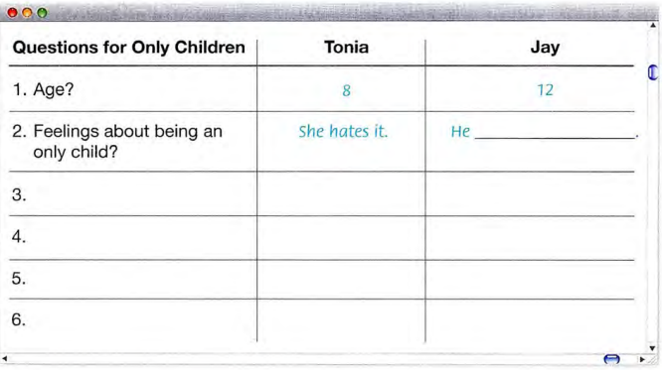
likes his family
talk to parents?
Talk to mom
How do you feel?
sad
Can you understand?
Yes, but still sad.
feel lonely?
No, never.

