Slide 1
HELLO
WELCOME TO
MY CLASS
SPEAKING 2

Slide 3
1 | OFFBEAT JOBS
2 | WHERE DOES THE TIME GO?
3 | A PENNY SAVED IS A PENNY EARNED
4 | WHAT HAPPENED TO ETIQUETTE?
5 | THE FAT TAX
6 | EVERYDAY HEROS
7 | GAMING YOUR WAY TO BETTER HEALTH
8 | ENDANGERED LANGUAGES

Slide 4
TOPIC: OFFBEAT JOBS

Slide 5
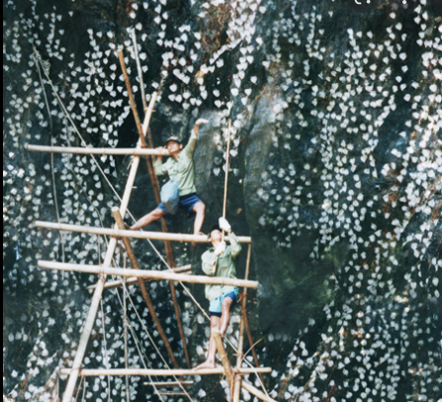
OFFBEAT JOBS
1. Look at the photo. What are the people doing? What is the men’s job?

Slide 6
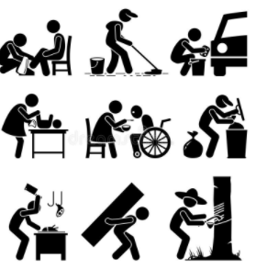
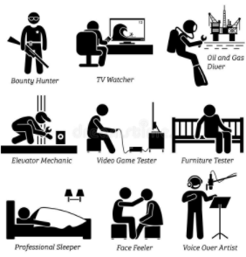
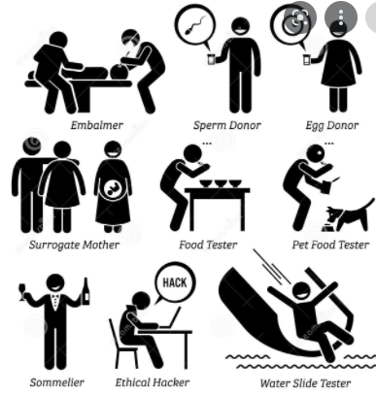
2. Can you think of
other offbeat jobs?

Slide 7
3. What is most important to you when choosing a job? Can you explain?
Salary - Colleagues
Hours - others…
Interest
Safety
Workplace
Education
Promotion
Travelling …

Slide 8
Picking salangane’s nest?
1. Can you describe the job?
2. What are the pros and cons of the job?

Slide 9
VOCABULARY
Work with a partner. Read the sentences below. Circle the best definition for each boldfaced word or phrase.
I work 60 hours a week, and I always think about my work. I am a workaholic.
a. works a lot and finds it difficult not to work
b. knows a lot people

Slide 10
VOCABULARY
2. I want a career where I can work with money. I am very good with numbers.
likes to count and do math
doesn’t like doing math
3. I want to be a professional shopper because I don’t want to have a boss. If I don’t want to have a boss, I want to _____.
a. work for myself b. work in a big company

Slide 11
VOCABULARY
4. Some people like office job. Not me. I enjoy a job that lets me make things. I am good with my hands.
likes to do office work all day.
is good at fixing or buildings things
5. I’m good at finding solutions to difficult situations. My friends often ask me to help them. They say I am a good problem solver.
a. good at finding the best way to do something
b. need a lot of help doing things

Slide 12
VOCABULARY
6. I really enjoy working in a store because I like talking to and helping people. I have good people skills.
can relate well with other people
is usually very shy
7. I am good at telling people what I think, and I can explain things well. I am very clear when I speak. I have good communication skills.
is difficult to understand
is very easy to understand

Slide 13
VOCABULARY
8. I always come to work on time and do my work well. Sometimes I stay longer at work to finish my job. My boss says I’m hardworking.
works a lot and is not lazy
doesn’t do a good job
9. My favorite job was working in a restaurant. There were many people working there, and we worked well together. We were all team players.
a. works alone and doesn’t help others
b. works in a group and helps others

Slide 14
VOCABULARY
10. I worked in a store last year. The boss let me count the money at the end of the day and take it to the bank. My boss didn’t worry because I am trustworthy.
a. honest b. not honest
11. I really enjoy working as a dog walker. I don’t have to sit indoors at a desk. I can work outdoors in the fresh air and sunshine.
a. not a desk job b. inside a building

Slide 15
TALK ABOUT YOURSELF
Tell me about yourself. What do you do now? What kind of person are you? Give an example.
What type of job do you want? -I’d like ….
What skills do you have? Give an example of when you used that skill.
4. What are your strengths and weaknesses? Give examples

Slide 16
HOMEWORK: Make a video about 3-4 minutes to describe an offbeat you know. Your presentation should include:
What the job is called
Place to work
What skills
Pros and cons
You like this job or not. Why or why not?

Slide 17
TOPIC: WHERE DOES THE TIME GO?

Slide 18
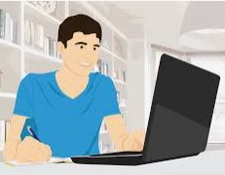
1. Look at the photo. Which of these activities do you think the student is doing?
Doing school work, listening to music, texting ; chatting online; surfing the Web; watching videos; playing video games

Slide 19
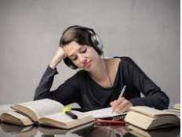
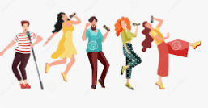
Do you ever do some activities at the same time? Which ones?

Slide 20
VOCABULARY
1. Anita wants to graduate from college. She is hardworking, so I’m sure she will achieve her goal.
a. To want to do something
b. To get something by working hard
2. When you are in class, it’s important to focus on what the teacher is saying. You should pay attention so you can remember the important points.
a. To direct your attention or effort
b. To remember what someone told you

Slide 21
VOCABULARY
3. This history class is very challenging, but I have positive attitude, and I think that I can do well if I work hard.
a. A hardworking person
b. A hopeful way of thinking
4. At my school, there is a lot of pressure to get good grades. Some parents and teachers even expect you to get straight A’s.
a. Getting good grades in school
b. Feeling of stress because people expect you to do something

Slide 22
VOCABULARY
5. My roommate wastes a lot of time talking on the phone when she should be doing her homework. Then she never has enough time to finish.
a. To use something in a way that is not useful or effective
b. To do something quickly

Slide 23
SOLVE PROBLEMS
Situation 1: You are roommates in college.
Student A: You have a big test tomorrow and want to study. You’re nervous.
Student B: You want to have a party, but your roommate disagrees. You’re upset with your roommate.

Slide 24
SOLVE PROBLEMS
Situation 2: You are a student and counselor.
Student A: You need some help managing your time and learning better study habits. You ask counselor for some help.
Student B: Give student A pieces of advice

Slide 25
SOLVE PROBLEMS
Situation 3: You are a student and a parent talking about school. Student A, you are not doing very well in school. Your parent wants you to explain why.
Situation 4: You are a student and a professor discussing an assignment that is due. Student A, you ask your professor for more time to finish the assignment. Your professor wants you to turn it in on time.

Slide 26
HOMEWORK
Make a video (3-4 minutes) showing your opinion:
Do you think it’s better for students to live at home with their families, or away from home? (advantages and disadvantages)
Do you prefer a large school or a small school? Why?
What do you think is the most important factor in student success?
Who do you ask for advice when you face
challenges?

Slide 27
TOPIC: WHAT HAPPENED TO ETIQUETTE?

Slide 28
1. Look at the photo? What is happening?
2. In your opinion, is this polite or not? Why do you think so?

Slide 29
Etiquette means the rules we follow to behave (act) politely.
What are some other actions that you think are polite?
What are some that are rude (not polite)?
Why do you think they are rude? Discuss your opinion with the class.

Slide 30
EXPRESS OPINIONS
Discuss the questions with the class
In your opinion, are people less polite these days than in the past? Give examples to explain your opinion.
2. Where did you learn manner: At home? At school? At a religious institution?
3. New York City scored as the number one city for good manners. Are you surprised? Why or why not?

Slide 31
PRACTICE
Example:
A: Would you like something to drink?
B: No, thanks. I’m good.
Offer your classmates:
- something to drink
- some chocolate
- help on their homework
- a ride home from school

Slide 32
PRACTICE
Example:
A: Would you like something to drink?
B: No, thanks. I’m good.
Offer your classmates:
- something to drink
- some chocolate
- help on their homework
- a ride home from school

Slide 33
PRACTICE
Invite your classmates to:
- go to a concert tonight
- come to your house for dinner on Saturday
- play soccer after class
- go mountain climbing this summer

Slide 34
Discuss the situations. What could you say?
Situation 1:
You are in a restaurant having dinner with a friend.
A person is sitting alone at a table near you, talking loudly on a cell phone.
You can’t hear your friend or enjoy your meal.

Slide 35
Discuss the situations. What could you say?
Situation 2:
You are at a party with your friend.
Another person comes over and enters the conversation and makes small mistakes with you. Your friend gets bored and starts texting.

Slide 36
Discuss the situations. What could you say?
Situation 3:
You go to your friend’s house for dinner. Your friend is from another culture. When you enter, you forget to take off your shoes. Then, during dinner, your friend’s mother offers you different kinds of food that you never tried before. There is one kind of food that you don’t like, but your friend’s mother keeps offering it to you.

Slide 37
Discuss the situations. What could you say?
Situation 4:
You bought expensive tickets to see a concert. You invite your friend to go with you. Your friend turns you down, but you don’t believe the reason.

Slide 38
Do you agree or disagree with the quote. Explain.
“Treat everyone with politeness, even those who are rude to you – not because they are nice, but because you are” – Author Unknown
2. “Consideration for others is the basis of a good life, a good society.” – Confucius
3. “Visitors should behave in such a way that the host and hostess feel at home.” – J.S.Farynski

Slide 39
Have you ever experienced a situation that is normal in your country but unusual in another country?
Example:
It is popular in Vietnam if you use your chopsticks to pick food for the guests. However, it is unpopular in a Western country.

Slide 40
HOMEWORK
Have you ever made a mistake or embarrassed with a situation because of the different cultures.
Make a video (3-4 minutes) telling a story about it and how you solved the problem.

Slide 41
TOPIC: THE FAT TAX

Slide 42
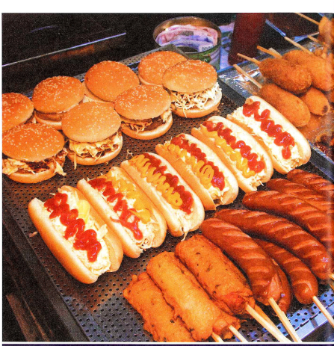
Look at the photo
of the fast food. Do you
think this food is healthy or
unhealthy? Why?
What are some other kinds of fast food that you know?

Slide 43
2. Our eating habits mean the foods and ways we usually eat. What are some unhealthy eating habits? What are some problems caused by unhealthy eating habits?
3. Look at the title of the unit? What do you think it means?

Slide 44
Describe the usual eating habits of people in your country, for example:
How many meals do most people eat a day, and at what times? Which meals is the most important meal of the day?
What kinds of food do people usually eat? Home-cooked? Take out? Fast food?
Where do people usually eat their meals? At home? In restaurants?
Who do people usually eat with? With family members or friends? Alone?

Slide 45
Describe the usual eating habits of people in your country:
5. Do you enjoy eating foods from different countries? Which country’s food (other than your own) do you like best? Why do you like it?
6. Do you think fast food can be healthy? Why or why not? Give an example of a fast food and explain why you think it is healthy or unhealthy.
7. What’s your favorite food? Why do you like it? Is it healthy or unhealthy?

Slide 46
VOCABULARY
A: Do you like Thai food?
B: Absolutely! It’s my favorite kind of food. a. Maybe
b. Yes, very much.
2. Please don’t cry! There’s nothing to be concerned about.
worried about
interested in

Slide 47
VOCABULARY
3. I am in favor of classes of healthy eating in all schools. It is important that all children grow up with healthy eating habits.
like the idea of
am worried about
4. The food you eat can affect your health. That’s why you should eat food that’s good for you.
make a change in something
make someone healthier

Slide 48
VOCABULARY
5. You need to take steps to improve your eating habits. Here is a list of things you can do.
a. do something specific
b. spend a lot of time

Slide 49
EXPRESS OPINIONS
Answer the questions. Give reasons for your opinions.
1. Do you think a fat tax is a good idea. Why or why not?
2. If someone food costs more because there is a fat tax, will you still buy it? Why or why not?
3. Do you think a fat tax is the best way to deal with the public health problem of obesity? Why or why not?
4. What other ideas do you have for dealing with obesity?

Slide 50
CREATE
STUDENT A: You are a counselor who works with people who are trying to develop healthier eating habits. Ask Student B some questions to find out about his / her eating habits. Then give some advice.
STUDENT B: You are tired a lot of the time. You are visiting a counselor because you want advice on how to improve your eating habits so that you will have more energy and feel better. Answer Student A’s questions.

Slide 51
SUGESTED QUESTIONS
How many meals do you usually eat a day?
What do you eat for breakfast? Lunch? Dinner?
Do you eat a lot of snacks during the day? What kind of snacks do you eat?
What is your biggest meal of the day?
Where do you eat? At home? At restaurant? At your desk? In the car?
Do you eat a lot of fast food?
Who do you eat with? Family? Friends? Alone

Slide 52
ROLE PLAY
Your friend eats fast food all of the time and gets sick a lot. He / she isn’t overweight, but you are concerned about that his / her eating habits are not healthy. Talk about some things he / she might do.
Your city has a big problem with obesity. Talk about some steps the government might to deal with the problem.

Slide 53
ROLE PLAY
3. You are a parent, and you want your children to grow up with healthy eating habits. Talk about what you might do.
4. You are a school principal and many of the children in your school have unhealthy eating habits and eat a lot of junk food. Talk about the steps that you might take to discourage unhealthy eating habits in the school.

Slide 54
HOMEWORK
Make a video (3-4 minutes) showing your opinions about fast food. What are its advantages and disadvantages?
OR
2. Make a video (3-4 minutes) describing a famous dish and how to make this dish. Have you ever tried it? Do you like it?

