Slide 1
HELLO
WELCOME TO
MY CLASS
SPEAKING 1

Slide 3
1 | A World of Friends
2 | Making Unusual Art
3 | Special Possessions
4 | Creativity in Business
5 | Understanding Fears and Phobias
6 | Risks and Challenges
7 | Only Child – Lonely Child?
8 | Soccer: The Beautiful Game

Slide 4
TOPIC: A WORLD OF FRIENDS

Slide 5
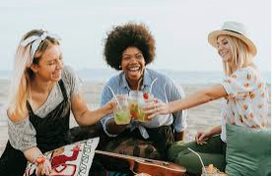
A WORLD
OF FRIENDS
1. Read the title of the unit. What does it mean?

Slide 6
A WORLD
OF FRIENDS
2. Look at the photo. Are the people friends or
family? Where are they?

Slide 7
A WORLD
OF FRIENDS
3. Do you have friends from other countries?
How did you meet them?

Slide 8
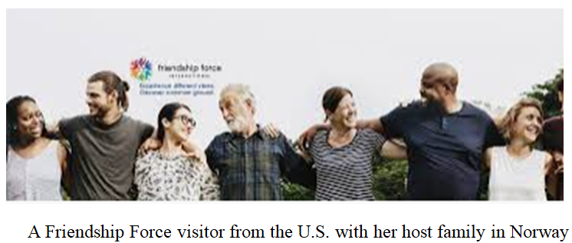
Is there a Friendship Force club in your country?

Slide 9
EXPRESS OPINIONS
Do you think it’s good to stay with a host family? Why or why not?
Do you need to speak the same language well to make friends with someone? Why or why not?
What are the best ways to learn about another country?

Slide 10
The adjectives describe people’s personalities
Q: What’s he like? / What’s she like?
(This means: “What kind of personality does he / she have?”)
Or: “How can you describe him / her?”
A: He’s / She’s (adjective)

Slide 11
The adjectives describe people’s personalities
friendly | talkative | serious | quiet
funny | calm | boring | nervous
Interesting | nice | lazy | mean
hardworking | shy | warm | kind

Slide 12
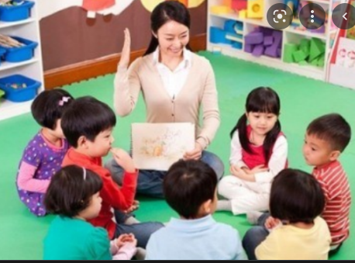
The adjectives describe people’s personalities
Mila

Slide 13
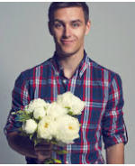
Can you describe him?

Slide 14
1. Complete the first column with information about yourself.
2. Interview two classmates. Ask them the same questions. Write their answers in the chart.
YOU | CLASSMATE A: ______ | CLASSMATE B: ______
I am: __________________ I like to travel / spend time at home. I am interested in _____ I have problems ______ | ________________ is: ______________ likes to travel / spend time at home. ______ is interested in ______. _______ has problems _______ | __________________ to travel / spend time at _________. ______ interested in ________ __________ has problems ____________

Slide 15
Work in groups of 4-5 students: Make a presentation about an organization
Questions to Guide Your Research
1. What is the name of the organization?
2. Who can belong to the organization?
3. What does the organization do?
4. Where did the organization begin? When?
5. Would you like to work for this organization? Why or why not?

Slide 16
HOMEWORK: Make a video about 3-4 minutes to present about you and your best friend. Your presentation should include:
Your name, class, DOB, hobbies…
Your best friend’s information
Your relationship / friendship
Your story of friendship
….

Slide 17
TOPIC: UNDERSTANDING FEARS AND PHOBIAS

Slide 18
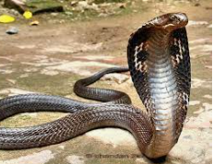
1. Look at the photo. Why are some people scared of snakes?
2. Why are some people scared of certain things?
3. Does having a fear of something change a person’s life? How?

Slide 19
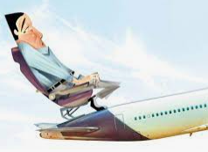
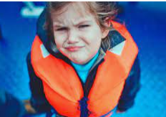
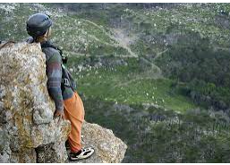
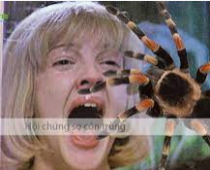
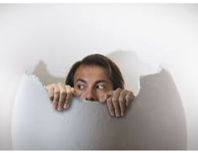
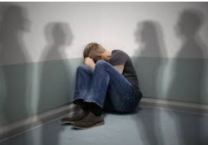
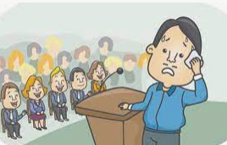
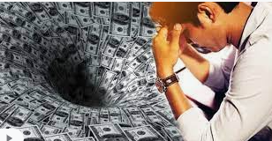
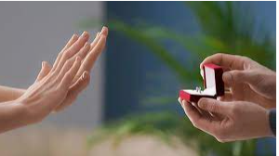
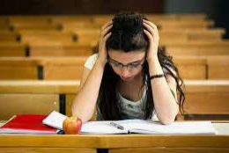
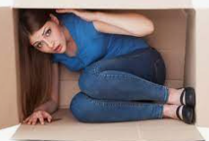
Do you have a phobia?
Do you know someone with a phobia? Explain.

Slide 20
2. Types of phobias?

Slide 21
2. Types of phobias?
Achluophobia (fear of the dark) Botanophobia (fear of plants) Chrometophobia (fear of money) | Gamophobia (fear of marriage) Ombrophobia (fear of rain) Papyrophobia (fear of paper) | Scolionophobia (fear of school)

Slide 22
Give some pieces of advice
Example:
Young man: I can’t ride this bike. I’m going to fall!
Friend: Calm down. You can do it.
Young man: I don’t know how. What’s wrong with me?
Friend: Come on, you can do it. You need to believe in yourself.
Young man: How can I do that? I’m going to fall!
Friend: Just keep going. Don’t give up.

Slide 23
Give some pieces of advice
______ ______ ______ ______ | 1. If a problem is common… 2. When you deal with a problem… 3. Confident people… 4. If you have power… | a. you find a way to solve it. b. believe they can do things. c. you can change a situation d. many people have it.

Slide 24
CREATE
Look at the list of fears. Discuss the questions with a partner.
Elevators insects public speaking
Dogs darkness driving
1. What kind of issues do people with these fears have?
2. What’s the best way to deal with these fears?
3. Which one of these fears do you think is
common? Why?

Slide 25
Interview Questions
What kind of fear did you (or someone else) have?
How old were you (or someone else)?
Why did you (or someone else) have this fear?
How did you (or the other person) feel? Were you angry or confused?
How did this fear change your life?

Slide 26
Example
My partner is Justin. When Justin was 10 years old, he was very afraid of dogs. He had a reason for this fear. One time, a big dog hurt his older brother. After this, he started shaking when he saw dogs. His heart beat faster, and he cried. He stayed home often. Sometimes, when friends invited him to their houses, didn’t go. He didn’t want to see their dogs.

Slide 27
* PRONUNCIATION
PRONOUNCING –ED ENDINGS
need – needed
wait – waited
visit - visited

Slide 28
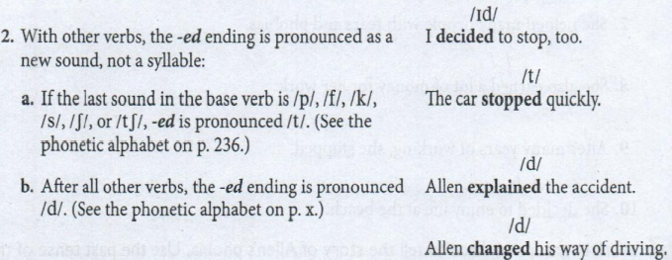
* PRONUNCIATION
PRONOUNCING –ED ENDINGS
watch – watched
book – booked
wash - washed

Slide 29
* PRONUNCIATION
PRONOUNCING –ED ENDINGS
Work in groups of three to tell the story of Allen’s phobia. Use the past tense of the verb in parentheses to make a complete sentence. One person in the group will start the story and the other members of the group will continue the story. Be careful to pronounce the past tense ending correctly.
Example
When he was a young man, he …
(start) to be afraid of many things.
The correct response is: When he was a young man, he started to be afraid of many things.

Slide 30
* PRONUNCIATION
PRONOUNCING –ED ENDINGS
1. When he was a young man, he …
A. (stop) driving his car.
B. (walk) to work every day.
C. (decide) to see a psychologist.
2. While working with the psychologist, he …
A. (learn) a new way of thinking about himself.
B. (change) his old ideas about driving.
C. (try) to cross the bridge in his car.

Slide 31
* PRONUNCIATION
PRONOUNCING –ED ENDINGS
3. After working with the psychologist, he …
(want) to try new things.
B. (study) planes and flying.
C. (start) flying a small plane.

Slide 32
SPEAKING SKILL
USE IMPERATIVES
Speakers often use imperatives to give advice. An imperative is the command form of a verb. It is always in present tense. Don’t is used in the negative form. The subject is “you” since the speaker is giving a command to other people. However, the word you is not included in the imperative.
1. A: I’m scared of taking my driving test.
B: Don’t ________. You can do it.

Slide 33
2. A: I don’t like elevators.
B: _________ instead!
3. A: I get scared when I travel alone.
B: ______. Then you won’t be alone!
4. A: I want a pet, but I’m afraid of dogs.
B: ________. They don’t bike.
5. A: I don’t want to fly to San Francisco from New York.
B: ________. You’ll see more.
6. A: I hate that clown movie!
B: Don’t ________. Play a game instead.

Slide 34
HOMEWORK
Make a video (3-4 minutes) telling a story of your phobia or someone’s.
How do you / does this person deal with your / his or her issues? What can we learn from this person?

Slide 35
TOPIC: RISKS AND CHALLENGES

Slide 36
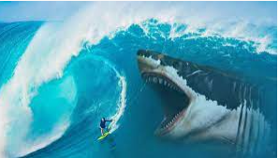
1. What’s happening in this photo? Is it dangerous? What is the swimmer wearing?
2. Have you ever done something very difficult?
3. Have you ever done something that you were afraid to do?

Slide 37
CREATE
Work in small groups. Ask and answer the questions.
1. Did you ever take a risk? What kind of risk was it? (Risks are not always physical. They can be mental, financial, cultural, or involve relationships with other people). Were you successful? How did you feel?

Slide 38
2. Did you ever do anything dangerous? What was it? Were you careful? How did you feel?
3. Did you ever feel very determined to do something? What was it? Were you successful? How did you feel?
4. Did you ever discover something about yourself? What was it? How did you discover it?

Slide 39
SPEAKING SKILL
EXPRESS UNEXPECTED RESULTS WITH EVEN THOUGH
To show that a result is unusual or not expected, we often use the words even though before the cause.
Even though things are not going very well, Diana is still swimming.
[cause] [result]
Or
Diana is still swimming even though things are not going very well.
[result] [cause]

Slide 40
Combine the two sentences using even though.
Read the sentences aloud.
1. Diana is an amazing swimmer. She is 64 years old.
2. Diana tried four times and was not successful. She wanted to try again.
3. Diana swam for more than 50 hours. It was very difficult.
4. There were dangerous sharks in the ocean. Diana swam without a shark cage.
5. The jellyfish bit Diana. She wore a special wetsuit.
6. The swim from Cuba was ling and difficult. Diana was so happy that she did it.

Slide 41
Complete each sentence with a cause or an unexpected result that makes sense.
1. Even though I’m afraid of high places, I ________
2. I want to join Outward Bound even though _______
3. Some people enjoy taking risks even though _______
4. I decided to ______ even though ________
5. Even though ____________, I’m very determined to do it.
6. Some people are afraid to fly in airplanes even though ________

Slide 42
FINAL SPEAKING TASK
You are going to role-play an interview between a TV news reporter and a risk-taker.
Step 1: Together with the class, think of at least six interesting questions to ask the risk-taker. Write them down.
Step 2: Work with a partner. Student A, you are a TV news reporter. You are interviewing a risk-taker while he / she is doing something very challenging or dangerous. Use the questions that you wrote down in Step 1 and any others you want to ask.

Slide 43
FINAL SPEAKING TASK
You are going to role-play an interview between a TV news reporter and a risk-taker.
Student B, you are a risk-taker. You can be an athlete, an entertainer, or any other person who is doing something very challenging or dangerous. You can also be yourself if you can tell about a time that you took a risk. (Remember that a risk or challenge is not always physical). Answer the questions that the TV news reporter asks you.
Step 3: When you are finished, change roles. Student A, choose a different risk-taker to role-play. Student B. you are the TV news reporter.

Slide 44
HOMEWORK
Make a video (3-4 minutes) telling a story of your risk or challenges that you’ve tried / done.
Your story should include:
What was your risk / challenge?
When did you do it ?
What was the result?
How did you feel?
…

Slide 45
TOPIC: ONLY CHILD – LONELY CHILD

Slide 46
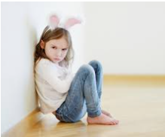
1. Read the title of the unit. What is an only child? What does the title mean?
2. In your country, how many children do most families have?
3. How many students in the class are only children? How many students have one brother or sister? Two? Three or more?

Slide 47
EXPRESS OIPINIONS
Read the statements. Mark each one A (Agree) or D (Disagree). Then discuss your opinions with the class.
_____ 1. It’s better for children to have young parents.
_____ 2. Only children are more popular than children with siblings.
_____ 3. People need to think about the population problem in the world when they decide how many children to have.

Slide 48
* Match the vocabulary in bold with the correct definitions below.
selfish
independent
self-confident
spoiled
(don’t) get along well with
have many close friends
1. They have a lot of very good friends.
2. They can do many things without help.
3. They think only about themselves.
4. They believe they are good people, with good abilities
5. They have problems with other children
6. They are never satisfied. They always want more and more things

Slide 49
* What are the advantages of having only one child? What are the advantages of being an only child?
ADVANTAGES | ADVANTAGES

Slide 50
AGREEING – DISAGREEING - EXPLAIN
1. Most only children (feel / don't feel) very different from their friends.
2. Only children (are / are not) more popular than children with siblings.
3. Only children (are / are not) more mature than children with siblings.
4. Many only children (are / are not) spoiled.
5. It's (good / not good) to be the youngest child in a family.

Slide 51
AGREEING – DISAGREEING - EXPLAIN
6. It's (good / not good) to be the oldest child in a family.
7. (All /Not all) children need siblings.
8. Many only children (have trouble / don't have trouble) making friends.
9. It's (fine / not responsible) to have more than one child.
10. Children (need / don't need) to learn how to enjoy being alone.

Slide 52
HOMEWORK
Do you want to be the only child? Why or why not? What are the advantages and disadvantages of being an only child?
Make a video (3-4 minutes) showing your opinions.

