Slide 1
FUNCTIONAL GRAMMAR– Chapter FIVE CONCEPTUALISING PATTERNS OF EXPERIENCE
Instructor: Nguyen Minh Thien, PhD.

Slide 2
CHAPTER Five OUTLINE
Conceptualising experiences expressed as situation types
Material processes of doing and happening
Causative processes
Processes of transfer
Conceptualising what we think, perceive and feel
Relational processes of being and becoming
Processes of saying, behaving and existing

Slide 3
CONCEPTUALISING EXPERIENCES EXPRESSED AS SITUATION TYPES
Processes, participants, and circumstances
The process: the central part of the situation, realised by a verb
Participants: symbolically represent the persons, things, and abstract entities involved in the process
Attributes: elements which characterise, identify, or locate the participants
Circumstances: those of time, place, manner, condition, etc. attendant on the situation

Slide 4
CONCEPTUALISING EXPERIENCES EXPRESSED AS SITUATION TYPES
Three main types of processes:
Material processes are processes of ‘doing’
Mental processes, or processes of ‘experiencing’ or ‘sensing’
Relational processes, or processes of ‘being or ‘becoming’
Inherent participants and actualised participants
E.g. Do you drive? (a car); Have you eaten yet? (lunch, dinner)

Slide 5
MATERIAL PROCESSES OF DOING AND HAPPENING
Agent and Affected in voluntary processes of “doing”
E.g.: The Prime Minister (Agent) resigned (Process). (What did X do?)
Ted (Agent) hit (Process) Bill (Affected).
Bill (Affected Subject) was hit (Process) by Ted (Agent)
Force
E.g.: The earthquake (Force) destroyed (Process) most of the city (Affected)
Affected subject of involuntary processes of “happening”
E.g.: Jordan (Affected subject) slipped (Involuntary Process) on the ice (Circumstance)

Slide 6
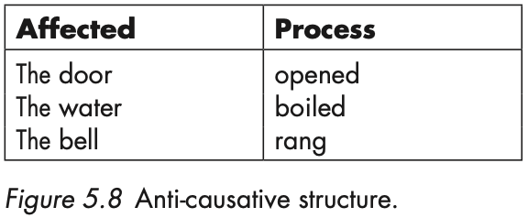
CAUSATIVE PROCESSES
Causative material processes and ergative pairs
When the Affected object of a causative clause (e.g. the door, the water, the bell) is the same as the
Affected subject of an intransitive clause, we have an ergative alternation or ergative pairs, as in
I rang the bell (transitive) and The bell rang (intransitive).

Slide 7
PSEUDO-INTRANSITIVES
Pseudo-intransitives:
Express a general property of the entity to undergo the process in question
Tends to occur in the present tense
A cause is implied but an Agent can’t be added in a by-clause
There is no corresponding transitive construction, either active or passive, that exactly expresses
the same meaning as these intransitives (e.g. Colloquial language is translated badly)

Slide 8
PROCESSES OF TRANSFER
PROCESSES THAT ENCODE TRANSFER: GIVE, LEND, CHARGE, PAY, OFFER OWE
Examples:
Ed gave the cat a bit of tuna.
Bill’s father has lent us his car.
Have you paid the taxi-driver the right amount?
Recipient vs Beneficiary
Examples:
I wrote a letter to him vs. I wrote a letter for him.

Slide 9
CONCEPTUALISING WHAT WE THINK, PERCEIVE, AND FEEL
MENTAL PROCESSES: COGNITION (know, understand), PERCEPTION (see, notice, hear, feel), AFFECTIVITY
(like, love, admire, miss), and DESIDERATION (hope, want, desire)

Slide 10
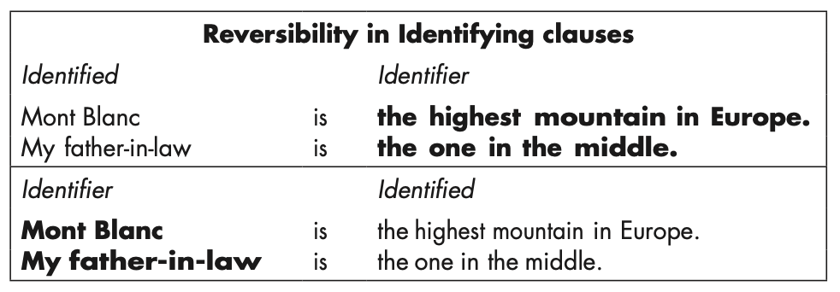
RELATIONAL PROCESSES OF BEING AND BECOMING
The attributive pattern
The identifying pattern

Slide 11
PROCESSES OF SAYING, BEHAVING, AND EXISTING
Verbal processes:
Silvia (Sayer) had to say (Verbal process) her name twice (Said)
Jill (Sayer) told (Verbal process) him (Recipient) what she knew (Said)
Behavioural processes:
He yawned rudely.
Existential processes:
There is a good film on at the Scala.

