Slide 1
FUNCTIONAL GRAMMAR– Chapter four: INTERACTION BETWEEN SPEAKER AND HEARER
Instrutor: Nguyen Minh Thien, PhD.

Slide 2
CHAPTER FOUR OUTLINE
Speech acts and clause types
The declarative and interrogative clause types
The exclamative and imperative clause types
Indirect speech acts, clause types, and discourse functions
Questions, clause types and discourse functions
Directives

Slide 3
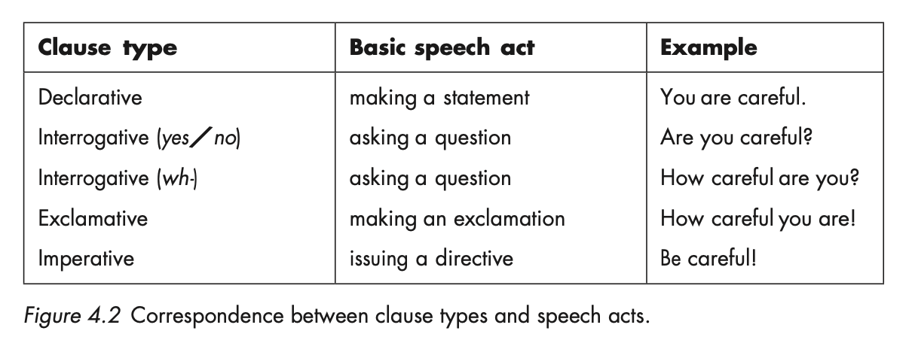
SPEECH ACTS AND CLAUSE TYPES
Speech acts are the acts we perform through words. Certain general types of speech acts
are basic to everyday interaction: statements, questions, exclamations, and directives.

Slide 4
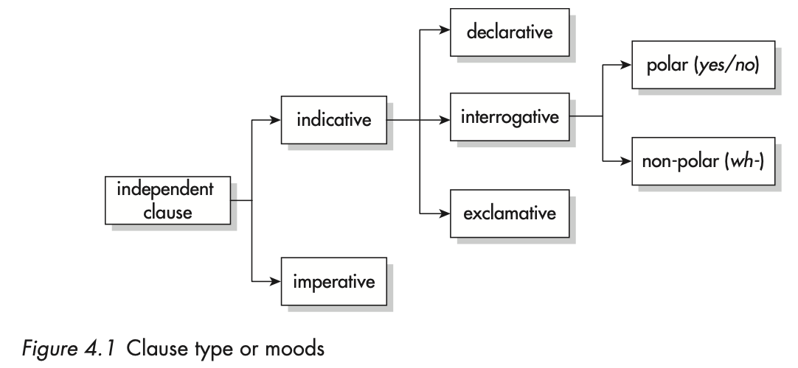
SPEECH ACTS AND CLAUSE TYPES
Each of the basic speech acts is associated in grammar with a type of clause; the declarative is typically used to encode a statement, the interrogative a question, etc. These are the direct correspondences between form and function that we refer to as direct speech acts.

Slide 5
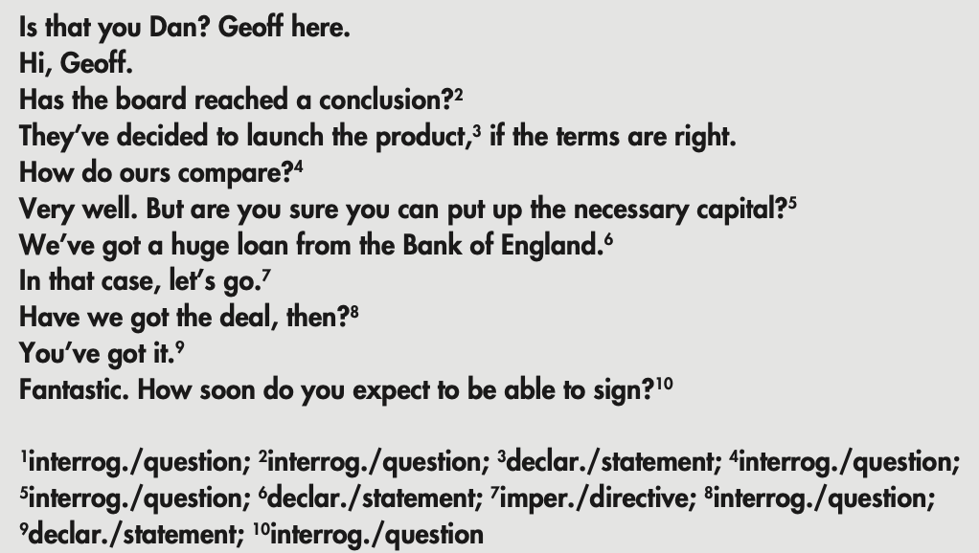
DIRECT SPEECH ACTS AND INDIRECT SPEECH ACTS
When a clause type is used to carry out the speech act typically associated with it, it is considered to be a direct speech act. Thus in a direct speech act, the declarative is said to have the illocutionary force of a statement, an interrogative has the force of a question, an imperative has the force of a directive, and an exclamative as the force of an exclamation.
The force is the speaker’s intended meaning at that particular point in the discourse.

Slide 6
DIRECT SPEECH ACTS AND INDIRECT SPEECH ACTS (CONT’D)
In interpersonal interaction, however, the relationship is frequently more complex – and more flexible. Every clause type can carry out different speech acts. When a clause type has any other but its typical force, we consider it an indirect speech act.
Example:
A: The door-bell’s ringing.
B: I’m in the bath.
A: Okay. I’ll go.

Slide 7
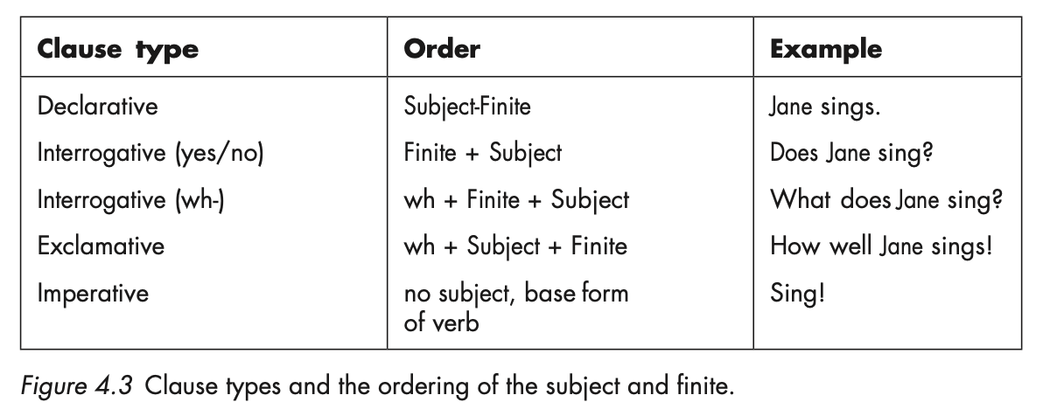
THE DECLARATIVE AND INTERROGATIVE CLAUSE TYPES
SUBJECT-FINITE VARIATION

Slide 8
THE DECLARATIVE AND INTERROGATIVE CLAUSE TYPES
THE DECLARATIVE CLAUSE TYPE:

Slide 9
THE DECLARATIVE AND INTERROGATIVE CLAUSE TYPES
THE INTERROGATIVE CLAUSE TYPE:

Slide 10
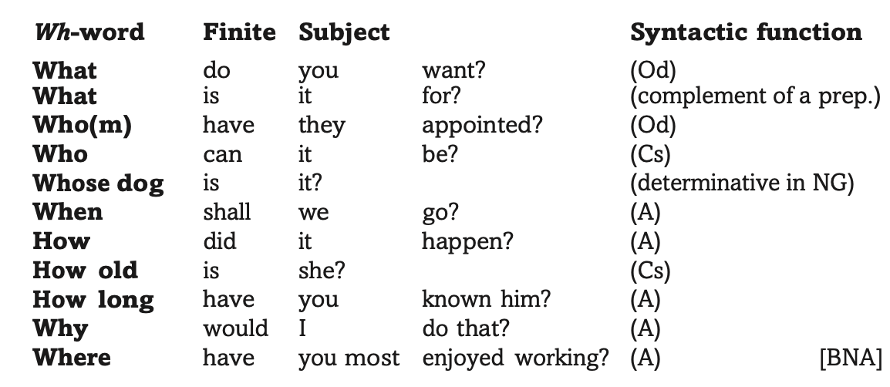
THE DECLARATIVE AND INTERROGATIVE CLAUSE TYPES
THE WH-INTERROGATIVE CLAUSE TYPE:

Slide 11
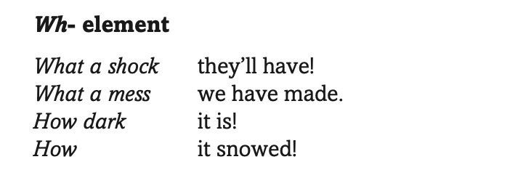
THE EXCLAMATIVE AND IMPERATIVE CLAUSE TYPES
The exclamative
The imperative

Slide 12
INDIRECT SPEECH ACTS, CLAUSE TYPES AND DISCOURSE FUNCTIONS
Performatives
Explicit performatives
I promise I’ll be careful.
We advise you to book early to avoid disappointment.
Less explicit performatives with modalisation
I can offer you beer, whisky, gin, cola…
Let me thank you once more for your collaboration.
I am afraid I have to request you to move to another seat.
Negative declaratives
I don’t need any more calendars, thank you.
I don’t promise you that I’ll convince him.
Smoking is not allowed here.

Slide 13
QUESTIONS, CLAUSE TYPES AND DISCOURSE FUNCTIONS
Rhetorical questions:
Do you expect me to wait here all day?
What could I say?
Questions as preliminaries:
Are you going to the hospital this morning?
No.
Well if you do it’ll give us a chance to find out whether he’s coming home.
SOME, ANY, and NEGATIVES forms in biased questions:
Do you know anyone in Westminster? Vs Do you know someone in Westminster?
Is there no butter? (There should be some butter, but it seems there isn’t.)
Isn’t there some butter somewhere? (It seems there isn’t, but I expect there is.)
Would you like some more coffee?
Do you want something, a soft drink before you go?

Slide 14
DIRECTIVES

Slide 15
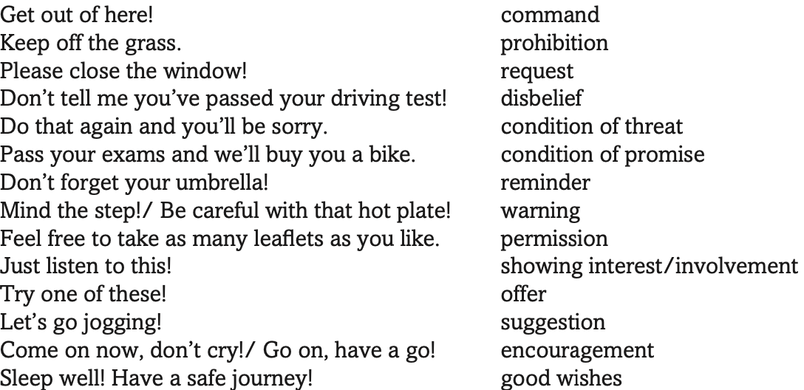
DIRECTIVES

Slide 16
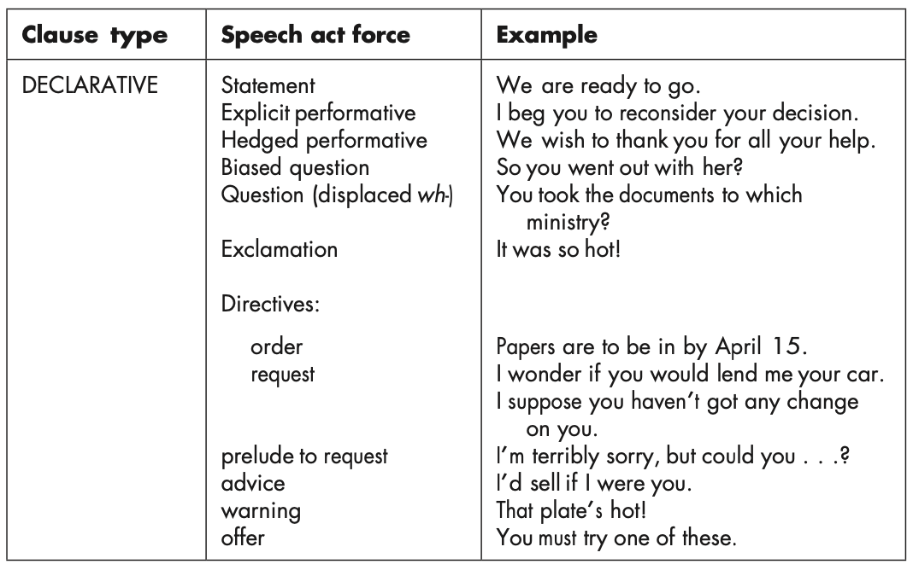
CLAUSE TYPES AND SPEECH ACTS: SUMMARY

Slide 17
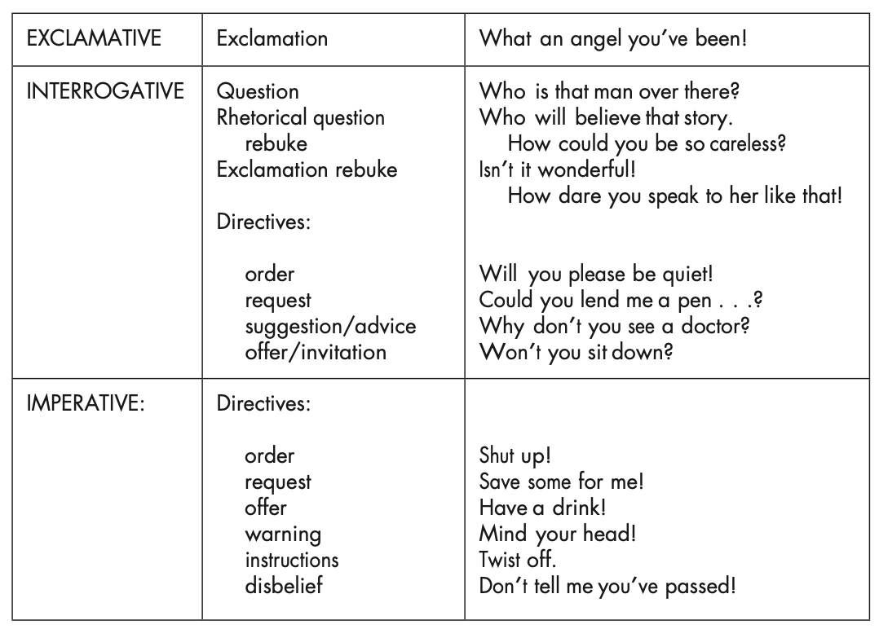
CLAUSE TYPES AND SPEECH ACTS: SUMMARY

