Slide 1
Section 4
Ambiguous structures

Slide 2
Structurally ambiguous noun phrase.
A noun phrase is considered as STRUCTURALLY AMBIGUOUS when its structure permits more than one interpretation.
Example:
Some Japanese print collectors
1a. some Japanese collectors of prints
1b. some collectors of Japanese prints
2. More exciting ideas
2a. more ideas that are exciting
2b. ideas that are more exciting

Slide 3
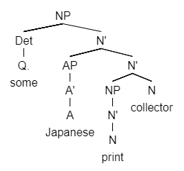
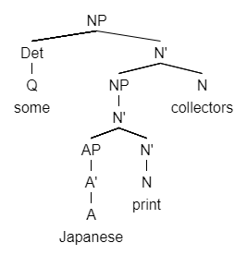
1a. some Japanese collectors of prints
1b. some collectors of Japanese prints
collectors
collectors

Slide 4
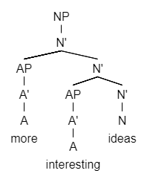
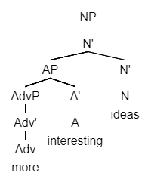
2a. more ideas that are exciting
2b. ideas that are more exciting

Slide 5
Structurally ambiguous verb phrase.
1. [He] watched the hunters with the binoculars.
This verb phrase is structurally ambiguous because:
1a. He watched the hunters with binoculars.
→ SVOA
1b. He watched the hunters with binoculars.
→ SVO

Slide 6
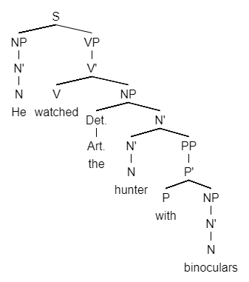
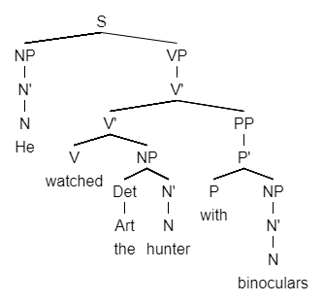
1a. He watched the hunters with binoculars.
→ SVOA
1b. He watched the hunters with binoculars.
→ SVO

Slide 7
Structurally ambiguous verb phrase.
2. [They] are moving sidewalks.
This verb phrase is structurally ambiguous because:
2a. They are moving sidewalks.
→ SVO
2b. They are moving sidewalks.
→ SVC

Slide 8
Structurally ambiguous verb phrase.
3. [The witch] turned on the stove.
This verb phrase is structurally ambiguous because:
3a. The witch turned on the stove.
→ SVO
3b. The witch turned on the stove.
→ SVA

Slide 9
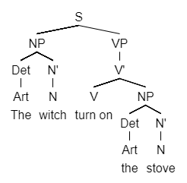
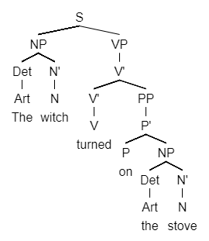
3a. The witch turned on the stove.
→ SVO
3b. The witch turned on the stove.
→ SVA

Slide 10
Exercise
An old car enthusiast
More boring subjects
John saw the performers with the binoculars.
She decided on the train.

Slide 11
Homework
A foreign stamp collector
An American car importer
More interesting places
Harry watched the dog with one eye.

