Slide 1
Section 3
Sentence patterns & sentence structure trees

Slide 2
I saw the white house.
I saw the house white.
I painted the house white.
1. → I saw it.
3. → I painted it white.
*

Slide 3
The order of words is dependent on the phrase structure.
The grammaticality of a sentence depends not on the sequence of words but how the words are combined into phrases.

Slide 4
The types of verb
To be & linking verbs:
smell taste look feel seem become appear grow
Action verbs as the main verbs in the sentence, the action verb may be either transitive (take a direct object) or intransitive (not take a direct object).

Slide 5
Terms used to identify various parts of each sentence pattern include the following:
S = subject
V = verb
A = adjunct (modifier)
O = object
dO =direct object
iO = indirect object
P = preposition
C = complement

Slide 6
Pattern 1 – SV
The action verb takes no direct object.
Even if the action verb is followed by a prepositional phrase, the verb is still intransitive as long as it does not take a direct object.
My cousin will arrive.
My cousin will arrive with my uncle.

Slide 7
Pattern 2 – SVA
An adjunct is a phrase which is not necessary to the structure of the clause, but which adds some extra meaning to it.
It started to rain suddenly.

Slide 8
Pattern 3 – SVC
The verb of being is followed by an adverb indicating where or when or a prepositional phrase.
Subject is renamed or described after a verb of being or a linking verb.
The verb of being is followed by an adjective/a noun/ a prepositional phrase that functions as the subjective complement
My friends are here/at the museum.
There is a fly in the soup.
Joe is a student.
The cake looks good.
Her voice was quite lovely.
Mr. James has been a teacher for 40 years.
Jenny looks like her mother.
Subjective Complement (SC) - a noun, pronoun, or adjective that renames or describes (equals) the subject after a verb of being or a linking verb.

Slide 9
Pattern 4 – SVO
The action verb is followed by a direct object.
John ate some apples.
My mother baked a delicious cake.
Direct Object (DO) - a noun or pronoun answering "whom" or "what" after an action verb. A direct object "receives" or is the "object" of the action.

Slide 10
Pattern 5 – SVOA
The action verb is followed by a direct object and an adverbial adjunct.
She realized her mistake quickly.
I met him at the park.

Slide 11
Pattern 6 – SVOC
The action verb is followed by a direct object. The direct object is followed by an adjective functioning as an objective complement.
Objective Complement (OC) - a noun, pronoun, or adjective that renames or describes (equals) the direct object.
Subjective Complement (SC) - a noun, pronoun, or adjective that renames or describes (equals) the subject after a verb of being or a linking verb.
They consider James a CEO.
We find the meatballs delicious.

Slide 12
Pattern 7 – SV_{i}O_{d}O
The action verb is followed by an indirect object and then a direct object.
Direct Object (DO) - a noun or pronoun answering "whom" or "what" after an action verb. A direct object "receives" or is the "object" of the action.
Indirect Object (IO) - a noun or pronoun answering "to whom/what" or "for whom/what" after an action verb.
An indirect object
always precedes a direct object
never has the word “to” or “for” stated
She gave her daughter a new dress.
I bought him a drink.

Slide 13
Pattern 8 – SV_{d}OP_{i}O
The action verb is followed by a direct object and a prepositional phrase follows the direct object.
The PPs that correspond in this way with indirect objects are always introduced by to or for (which is also called “a prepositional object”):
I will buy some toys for you.
They gave a prize to Steve.
Susan works two jobs for her family.
I turn off the TV for him.

Slide 14
Recipient & Beneficiary
The Prepositional Object (prepO, for short) contains to when the participant is Recipient and for when it is Beneficiary and this difference is determined by the verb.
Verbs which take Recipient Indirect Objects and alternative to prepOs are typically verbs of transferring goods, services or information from one person to another. They include:
give grant hand leave offer owe pass promise read send show teach throw write
Example:
We are offering our clients a unique opportunity. (… to our clients)
He owes several people money. (…to several people)
I handed Jennifer the pile of letters. (…to Jennifer)

Slide 15
Recipient & Beneficiary
Verbs which take Beneficiary Indirect Objects, with alternative for constructions, are verbs which carry out an action on someone’s behalf. They include:
book bring build buy cash cut fetch find get keep leave make pour reserve save spare write
Example:
Book me a seat on the night train. (… for me)
Would you cash me these traveler checks? (…for me)
She cut the boy some slices of ham. (…for the boy)

Slide 16
Sentence patterns
SV
SVA
SVC
SVO
SVOA
SVOC
SV_{I}O_{D}O
SV_{d}OP_{i}O

Slide 17
Exercise
Mary worked carefully.
My son looks very handsome in his new suit.
My older sister lost her purse in the bus.
The children are swimming.
My girlfriend has just dyed her hair blonde.
My father was moving the car.
John and his brother seemed too hungry.
Peter booked a double room for himself.
She showed us many beautiful pictures.
They laughed uncontrollably.

Slide 18
Exercise
Mary worked carefully. - SVA
My son looks very handsome in his new suit. - SVC
My older sister lost her purse in the bus. - SVOA
The children are swimming. – SV
My girlfriend has just dyed her hair blonde. - SVOC
My father was moving the car. - SVO
John and his brother seemed too hungry. - SVC
Peter booked a double room for himself. - SVdOPiO
She showed us many beautiful pictures. - SViOdO
They laughed uncontrollably. - SVA

Slide 19
Section 3 (Cont.)
SENTENCES
& SENTENCE STRUCTURE TREE

Slide 20
Types of clauses
Finite clauses vs. non-finite clauses
The distinction between finite and non-finite clauses depends on the form of the verb chosen: “If the speaker wishes to express tense, person or number, a ‘finite’ form of the verb is chosen, such as eats, locked, went and the clause is then called a finite clause.” [Downing and Locke, 1992: 11]
Example:
She BROKE the dish.
He HAS GONE.
It IS unnecessary.

Slide 21
Types of clauses
If the verb form does not express this type of information about the verbal ‘process’, the verbs and the clauses are classed as ‘nonfinite’.
Example:
For Sandra TO DELAY her graduation is unnecessary. (to-infinitive)
I let him DO it by himself. (bare infinitive)
Anna CHATTING with the construction workers.(active present participle)
He left me STUNNED. (passive past participle)
The light HAVING GONE out, we lighted candles. (active perfect participle)
Briefly, “a non-finite clause is a clause with a non-finite (tense-less) verb group. MAIN clauses are always finite. So non-finite clauses can only be SUBORDINATE.

Slide 22
Types of clauses
Embedded clauses
“If embedded clauses are omitted from a sentence containing them, the sentence is usually ungrammatical. This is because embedded clauses are arguments of a higher predicate, very often the subjects or objects of their container clauses. Any finite sentence that loses its subject or object argument becomes ungrammatical. So the embedded clauses are indispensable for grammaticality.” [Jacobs, 1995: 68]
Example:
The police REPORTED that Sharon’s car had broken down.
Tom THOUGHT that Karen believed the story.

Slide 23
Sentence types
Declarative sentences
Interrogative sentences
Imperative sentences
Exclamative sentences

Slide 24
Sentence types
Declarative sentences
My aunt likes books.
You haven’t closed the door.
Interrogative sentences
Can you see this?
Do you agree?
What did you eat?
How long have you learnt English?

Slide 25
Sentence types
Imperative sentences
Go home.
Shut up.
Don’t touch this switch.
Exclamative sentences
What a load of nonsense he talks!
How fast he runs!
What a beautiful house!

Slide 27
Realization of the Subject
We can identify the Subject of a sentence by asking ‘Who or what carried out the action denoted by the verb?’ and ‘Who or what is this sentence about?’
NPs functioning as Subject
A rat bit my toe.
This shoe hurts me.
However, Subjects can also be realized by other phrase types.
PPs functioning as Subject
Under the stairs was a safe area to be during the war.
Outside the fridge is not a good place to keep milk.
AP functioning as Subject
Restless is what I would call him.
AdvP functioning as Subject
Cautiously is how I would suggest you do it.

Slide 28
Realization of the Subject
Finite clauses functioning as Subject
That he will go to New York soon is obvious.
Because he is generous doesn’t mean that he is rich.
What the terrorists said puzzled the police.
Why she consented remains a mystery.

Slide 29
Realization of the Subject
Nonfinite clauses functioning as Subject
To-infinitive clauses functioning as Subject
with a Subject of their own:
For Judith to buy that house would spell disaster.
For us to understand the issues requires a major mental effort.
For Janet to go to College would be a good idea.
without a Subject of their own:
To be a good teacher is more difficult than people think.
To see her is to love her.
without a Subject of their own, introduced by Wh-word:
What to read during the holidays is the question all students are asking.
Who to ask for permission seems quite clear.
Where to sleep in this town will not be an easy problem to solve.

Slide 30
Realization of the Subject
Bare infinitive clauses functioning as Subject
Party the night away is a nice thing to do.
-ing participle clauses functioning as Subject
with a Subject of their own:
Pete breaking the rules is unacceptable.
George buying all those books will cost his father a fortune.
without a Subject of their own:
Going on holiday always creates tensions.
Running a business is hard work.
Swimming in this lake will make you ill.

Slide 31
Realization of the Predicate and Predicator
The Predicate in a sentence consists of everything but the Subject. Inside the Predicate we distinguish the Predicator, the Direct Object and an Adjunct.
Example: Eric lost his keys yesterday.
Predicates are Verb Phrases and Predicators are always main verbs.
Direct Objects are usually constituents which refer to an entity that can be said to undergo the action denoted by the verb. A simple way of determining what is the Direct Object in a particular sentence is to ask ‘Who or what is affected by the action denoted by the verb?’

Slide 32
Realization of the Predicate and Predicator
The function of Indirect Object was as the Goal/Receiver or Beneficiary of the activity denoted by the verb. Indirect Objects are very restricted in their realization. More often than not they are Noun Phrases. Occasionally they are Wh-clauses.
Adjuncts are constituents that tell you more about the how, when, where or why of the activity or situation expressed by the sentences they occur in. There are no fewer than six ways. Adjuncts can be Adverb Phrases, Prepositional Phrases, Noun Phrases, finite clauses, nonfinite clauses and Small Clauses.

Slide 33
Realization of the Predicate and Predicator

Slide 35
I-node
What sort of mechanism could we make use of for these purposes?
In line with recent work in linguistics we will assume that sentences contain a node labelled ‘I’ (short for ‘inflection’), which is immediately dominated by S.
This node is responsible for two things.
making sure that verbs acquire tense,
taking care of the agreement that obtains between Subjects and verbs
(e.g. the -s ending on bakes in he bakes a cake).

Slide 37
Det

Slide 38
My brother will not bake a cake.
(A sentence with an auxiliary verb and a negative word)
Det
Det
N
poss
not

Slide 39
Tim thoght that Kate believed the story.
(A sentence with an embeded clause)

Slide 40
Tim thoght that Kate believed the story.
(A sentence with an embeded clause)
CP
C

Slide 41
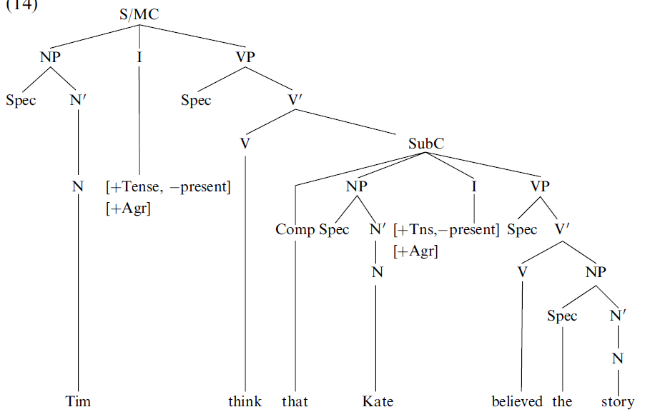
Tim thoght that Kate believed the story.
(A sentence with an embeded clause)
CP
CP
C
C
Det
N
N
Art
thought

Slide 42
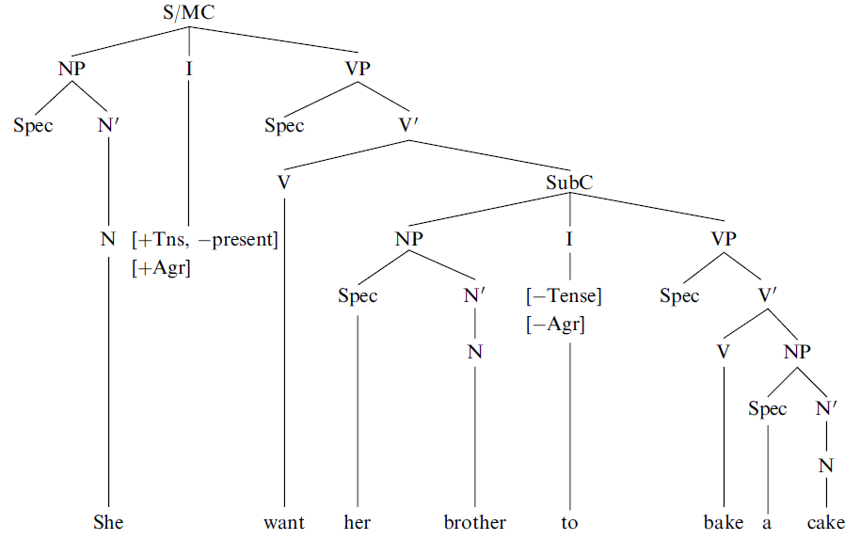
She wanted her brother to bake a cake.
(A sentence with a non-finite clause)
CP
CP
CP
Det
C
C
Det
N/Pro
poss
art
wanted

