Slide 1
English syntax
SECTION 2 – VERB PHRASES

Slide 2
English verbs
Two tenses (thì): present and past
Four aspects (thể): simple, progressive, perfect, perfect-progressive
Three moods (thức): indicative, subjunctive, imperative
Two voices (thái): active and passive

Slide 3
Indicative mood
The indicative mood (thức chỉ định) is a verb form that makes a statement or asks a question. For example:
Jack sings every Friday. → It's a statement.
Is Jack the lead vocalist? → It's a question.
Compare the examples above with this:
Sing us a song, Jack.
This verb is not in the indicative mood.
It is in the imperative mood.
It's an order. It's not a statement or a question.

Slide 4
Subjunctive mood
The subjunctive mood (thức giả định) is the verb form used to explore a hypothetical situation. Examples:
- If it were me, I'd go. (As this explores a hypothetical situation, was becomes were.)
- I wish it were real. (As this expresses a wish, was becomes were.)
- It is imperative that the game begin at once. (As this expresses a demand, begins becomes begin.)
- I propose he work full time. (As this expresses a suggestion, works becomes work.)

Slide 5
Imperative mood
The imperative mood (thức cầu khiến) is a verb form that gives a command. For example:
Run!
Get out!
Empty the bin, John.
Compare the examples above with this:
John empties the bin.
This verb is not in the imperative mood. It is in the indicative mood.
Commands can include orders, requests, advice, instructions, and warnings.

Slide 6
Verb phrase
A VERB PHRASE must contain is the VERB GROUP, in the verb group contains one lexical verb and may have up to four auxiliary verbs, besides the negative word not:
EX: He may not have been being interrogated.
In other words, the verb phrase in English consists of a verb group and all the words and word groups which belong with the verb group and cluster around it. The verb group itself is called the head, and the other words and word groups are the modifiers and/or the complements of the head.

Slide 7
Verb phrase
The modifier is the generic term for all the adverbial adjuncts that optionally provide further information about the action, the process, the event, etc. talked about in the clause in which they occur.
The relation between the verb group and the adverbial adjunct is one of modification: there is a one-way dependency between the verb group (as head) and the adverbial adjunct (as modifier). Thus, the use of the verb group without any adverbial adjunct is grammatically acceptable.

Slide 8
Verb phrase
The complement is the generic term for all the completers of the verb, which are usually known as the direct object, the indirect object, the subjective complement, the objective complement.
The relation between the verb group and the NP is one of complementation: there is a two-way dependency between the verb group (as head) and the NP (as complement).

Slide 9
Complements of verb phrase
Intransitive verbs
(Mono)transitive verbs
Prepositional verbs
Ditransitive verbs
Verbs with NP – PP complements

Slide 11
The structure of verb phrase
An intransitive verb
(John) sleeps.
VP
V’
V
sleeps

Slide 12
The structure of verb phrase
A (mono)transitive verb
(John) bakes a cake.
VP
V’
V
bakes
NP
a cake

Slide 13
The structure of verb phrase
A (mono)transitive verb
(John) bakes a cake.
VP
V’
V
NP
Det
N’
Art
a
N
cake
bakes

Slide 14
The structure of verb phrase
A prepositional verb (V + adverbial)
(John) goes to school.
VP
V’
V
goes
PP
to school

Slide 15
The structure of verb phrase
A ditransitive verb
(John) gave his mother some flowers.
VP
V’
V
NP
NP
gave
his mother
some flowers

Slide 16
The structure of verb phrase
A ditransitive verb
(John) gave his mother some flowers.
VP
V’
V
NP
NP
Det
N’
Det
N’
Q some
Poss
his
N
mother
N
flowers
gave

Slide 17
The structure of verb phrase
Verb with NP-PP complement (V + O + Adverbial)
(John) put the book on the table.
VP
V’
V
NP
PP
put
the book
on the table

Slide 18
The structure of verb phrase
Verb with NP-PP complement (V + O + Adverbial)
(John) put the book on the table.
VP
V’
V
NP
PP
Det
N’
Art
the
N
book
put
on the table

Slide 19
Modifiers in verb phrase
Post-verbal modifiers:
Ex: John works quietly in his room in the morning.
►Order of post-verbal adverbs:
MANNER → PLACE → TIME
Pre-verbal modifiers
Ex: John always visits his grandma at weekend.

Slide 20
The structure of verb phrase
Post-verbal modifier
(John) does the homework in his room.
VP
V’
V’
PP
V
NP
Det
N’
Art
the
N
homework
do
in his room

Slide 21
The structure of verb phrase
Post-verbal modifiers
VP
(John) does the homework in his room in the morning.
V’
V’
PP
V’
PP
V
NP
Det
N’
Art
the
N
homework
do
in his room
in the morning

Slide 22
The structure of verb phrase
Pre-verbal modifier
(John) always visits his grandma.
VP
V’
AdvP
V’
V
NP
Det
N’
Poss
his
N
grandma
always
visits

Slide 23
The structure of verb phrase
An important note on NP as adverbs
(John) does his homework every day.
VP
V’
V’
NP
V
NP
Det
N’
Poss
his
N
homework
do
every day

Slide 24
The structure of verb phrase
An important note on NP as adverbs
(John) does his homework every day.
VP
V’
V’
NP
V
NP
Det
N’
Det
N’
Poss
his
N
homework
Dist.
every
N
day
do

Slide 25
Phrasal verb & Prepositional verb
(We) talk about Syntax.
(We) look up a word.
VP
VP
V’
V’
V
PP
V
NP
talk
about Syntax
Det
N’
(We) talk about Syntax.
(We) look up a word.
it
Art
a
N
word
look up
*(We) look up it.
(We) look IT up.

Slide 26
Exercise 1 - Draw the tree diagram of the following phrases
wash your face
study a new lesson
eat breakfast every day
put sugar in my coffee
always worry about her weight
go to the cinema at the weekend
sing loudly in their garden last night
gave my girlfriend a new dress

Slide 27
Exercise 2 - Draw the tree diagram of the following phrases
cook dinner every day
withdraw money from the bank
always complain about the work
go to the park in the morning
walk quietly in my garden in the evening
sent my little daughter a new toy

Slide 28
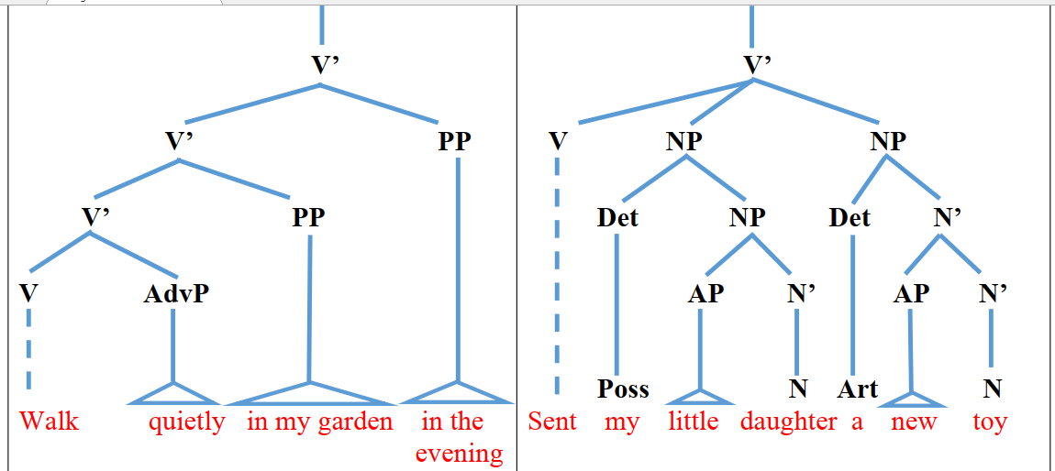
N’
V’
V

