Slide 1
Phonetics & Phonology
Instructor: Nguyen Minh Thien, PhD.

Slide 2
Class regulations
You are expected to attend all classes.
Attendance will be checked regularly.
Being 10 minutes late accounts for one period absence.
You are permitted no more than 2 class sections during the term.
You are expected to participate actively in class activities & complete all your homework.
Cell phones will be turned off or switched to vibrate mode during class time.

Slide 3
Testing & Assessment
Items | Ratio | Note
Participation | 5 % | 8/10 class sections
Regular tests | 15% | Exercise & Assignment
Mid- term test | 20% | Written test
Final test | 60% | Written test
Total | 100 %

Slide 4
Textbooks
Required textbooks:
[1] Lê, T.H. & Trần T.P.T. (2020). Phonetics and Phonology. Dong Nai Technology University
[2] Trần, T.P.T. & Lê, T.H. (2020). Phonetics and Phonology. Dong Nai Technology University
Recommended textbooks:
Peter Roach, 2000. English Phonetics and Phonology . Cambridge University Press.
Fromkin, V., Rodman, R. and Hyams, N., 2011. An Introduction to Language. Wadsworth Cengage Learning

Slide 5
Contents of the course
Part 1: Phonetics
Articulators above the larynx
Vowels
- Vowel description
Consonants
Consonants description
+ Voicing
+ Places of articulation
+ Manner of articulation

Slide 6
Contents of the course
Part 2: Phonology
Segmental phonology
+ Phonemes
+ Allophones
+ Phonological rules
Supra-segmental phonology
+ Syllables
+ Stress
+ weak forms
+ Aspects of connected speech
+ Intonation

Slide 7
Phonetics vs. Phonology
Phonetics is concerned with the physical aspects of speech sounds.
Phonology is concerned with the functional properties (natures) of speech sounds.

Slide 8
Accent vs. Dialects
Languages have different accents: they are pronounced differently by people from different geographical places, from different social classes, of different ages and different educational backgrounds. Difference of accent are pronunciation difference only.
The word dialect refers to a variety of a language which is different from others not just in pronunciation but also in such matters as vocabulary, grammar and word order.

Slide 9
RP vs. GA
RP (or BE – British English) stands for "Received Pronunciation", the traditional name for the standard British English accent.
GA (or AE – American English) stands for "General American" as the accent spoken by "the majority of Americans”.

Slide 10
The phonetic alphabet - IPA
http://ipa.typeit.org/full/

Slide 11
Part 1 – PHONETICS

Slide 12
Articulators above the larynx

Slide 13
PRINCIPAL ORGANS OF ARTICULATION
Articulators above the Larynx

Slide 14
PRINCIPAL ORGANS OF ARTICULATION
The major parts of the oral cavity

Slide 15
PRINCIPAL ORGANS OF ARTICULATION
The vocal tract

Slide 16
The vocal tract
Most speech sounds are produced by pushing lung air through the vocal cords/larynx up the throat, and into the mouth or nose, and finally out of the body.
The opening between the vocal cords is the glottis and is located in the voice box or larynx. The tubular part of the throat above the larynx is the pharynx. What sensible people call “the mouth,” linguists call the oral cavity to distinguish it from the nasal cavity, which is the nose and the plumbing that connects it to the throat, plus your sinuses. Finally there are the tongue and the lips, both of which are capable of rapid movement and shape changing. All of these together comprise the vocal tract. (Fromkin, 2011)
Changes in the shape of the vocal tract cause differences in speech sounds.

Slide 17
Vowels & Consonants
In speaking of the alphabet, we may call “a” a vowel and “c” a consonant, but that means only that we use the letter “a” to represent vowel sounds and the letter “c” to represent consonant sounds.
In phonetics, the terms consonant and vowel refer to types of sounds, not to the letters that represent them.

Slide 18
Vowels & Consonants
Vowels = vowel sounds are produced with little restriction of the airflow from the lungs out the mouth and/or the nose.
Consonants are produced with some restriction or closure in the vocal tract that impedes the flow of air from the lungs.

Slide 19
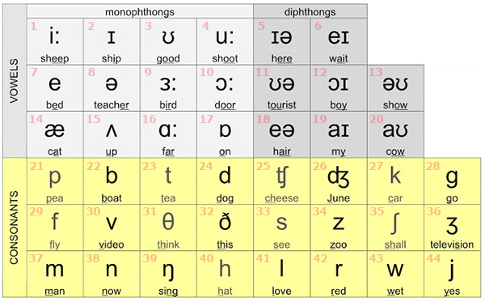
Vowels & Consonants
20 vowel sounds
24 consonant sounds

Slide 20
Vowels
A vowel is a sound formed where air coming from the lungs is not blocked by the mouth or throat.
In other words, a vowel is a sound created by the relatively free passage of breath through the larynx and oral cavity, usually forming the most prominent and central sound of a syllabus.

Slide 21
English vowels
Pure vowels
+ Short vowels
+ Long vowels
Diphthongs
Triphthongs

Slide 22
English pure vowel sounds

Slide 23
Vowel classification
The quality of a vowel depends on the shape of the vocal tract as the air passes through:
Different parts of the tongue may be high or low in the mouth.
The tongue may be forward or backward in the mouth.
The lips may be spread or pursed.
The articulators may be tense or lax.
The classification of vowels is based on 4 major aspects:
Tongue height: close, open, mid (beat – bit – but)
Tongue shape: front, back, central (beat – boot – bat)
Lip rounding: round, spread, neutral (boot – beat – birth)
Tenseness/laxness: tense, lax (beat – bit)

Slide 24
Pure vowels
Short vowels: /ɪ/, /ʊ/, /e/, /ʌ/, /ɒ/, /æ/, /ə/
Long vowels: /iː/, /uː/, /ɑː/, /ɜː/, /ɔː/

Slide 25
English short vowels

Slide 26
English short vowels
ə

Slide 27
English long vowels

Slide 28
English vowel chart

Slide 29
Example
/ɪ/: - short,
- close,
- front,
- spread,
- lax vowel.
/ɜː/: - long,
- half-open (bit lower than mid),
- central,
- neutral,
- tense vowel

Slide 30
Diphthongs
Diphthongs are sounds articulated with a glide from one vowel to another.
8 diphthongs:
Centring diphthongs gliding towards the /ə/ vowel (schwa): /ɪə/, /eə/, /ʊə/
Closing (high) diphthongs gliding towards the /ɪ/ and /ʊ/ vowels: /eɪ/, /aɪ/, /ɔɪ/, /əʊ/, /aʊ/
The first part of all the diphthong is much longer and stronger than the second part.

Slide 31
Diphthongs
DIPHTHONGS
CENTRING
CLOSING
Ending in ə
Ending with ɪ
Ending with ʊ
ɪə
eə
ʊə
eɪ
aɪ
ɔɪ
əʊ
aʊ

Slide 32
Diphthongs

Slide 33
Example

Slide 34
Triphthongs
A triphthong is a glide from one vowel to another then to a third, all produced rapidly without interruption.
Triphthongs can be considered as being composed of five closing diphthongs with /ə/ vowel added on the end.
eɪ + ə = eɪə
aɪ + ə = aɪə
ɔɪ + ə = ɔɪə
əʊ + ə = əʊə
aʊ + ə = aʊə

Slide 35
Example

Slide 36
Consonants
A consonant is a sound formed by stopping the air flowing through the mouth.
There are 24 consonants.
Consonants are classified according to 3 things:
Voicing
Place of articulation
Manner of articulation

Slide 37
Voicing
Consonants can differ from each other in terms of voicing. Consonants may be grouped in pairs, both members of a voiceless/voiced (fortis/lenis) pair.
Voiceless: [p], [t], [k], [f], [θ], [s], [ʃ], [tʃ]
Voiced: [b], [d], [g], [v], [ð], [z], [ʒ], [dʒ], [l], [m], [n], [ŋ], [w], [r], [j]

Slide 38
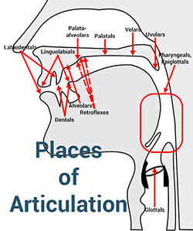
Place of articulation
Where the articulation happens
Movement of the tongue and lips creates the constriction, reshaping the oral cavity in various ways to produce the various sounds.

Slide 39
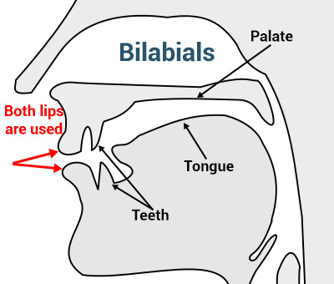
Places of articulation
Bilabials are consonant sounds produced by using both lips together.
Examples: [b], [p], [m], [w]

Slide 40
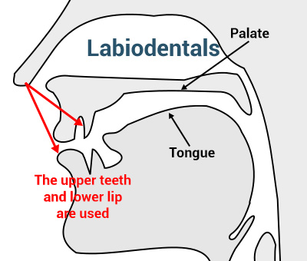
Places of articulation
Labiodentals are articulated by using both the lower lip and the upper front teeth.
Examples: [f], [v]

Slide 41
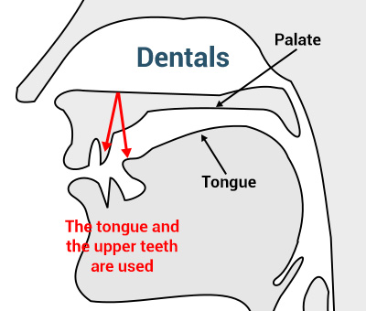
Places of articulation
Dental (Interdental) consonant sounds made by the articulation of the tongue between the teeth.
Examples: [θ], [ð]

Slide 42
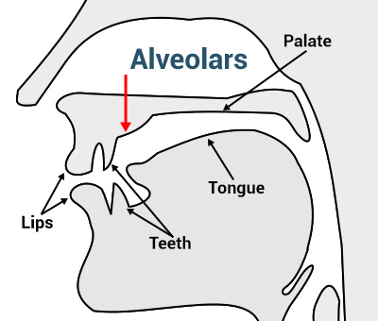
Places of articulation
Alveolar consonant sounds made by the articulation of the tip of the tongue towards the alveolar ridge, which is the area lying between the upper front teeth and the palate.
Examples: [t], [d], [s], [z], [n], [l]

Slide 43
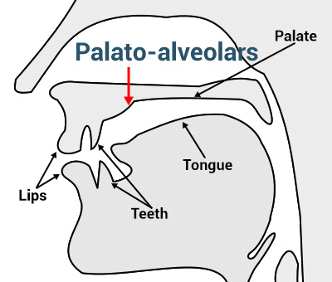
Places of articulation
Post-alveolar/Palatal-alveolar sounds made by the articulation of the front of tongue towards the area between the alveolar ridge and hard palate.
Examples: [ʃ], [ʒ], [tʃ], [dʒ], [r]

Slide 44
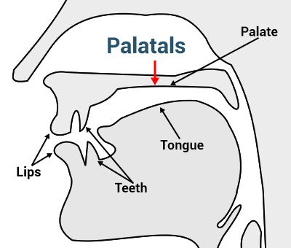
Places of articulation
Palatal sounds made by the articulation of the body tongue towards the hard palate.
Example: [j]

Slide 45
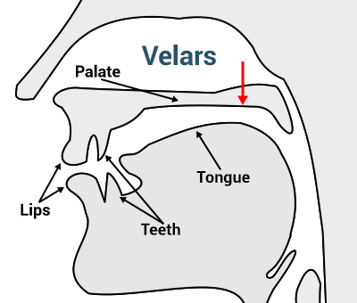
Places of articulation
Velar sounds made by the articulation of the body of the tongue towards the velum.
Examples: [k], [g], [ŋ]

Slide 46
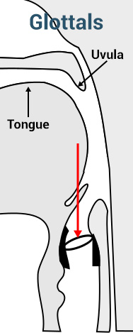
Places of articulation
Glottal sounds are those sounds made at the glottis.
Examples: [h], [ʔ]

Slide 47
Manner of articulation
How the articulation happens/How the airflow is controlled.
The way the airstream is affected as it flows from the lungs up and out of the mouth and nose.

Slide 48
Manner of articulation
Stops/plosives are consonant sounds:
The airstream is completely blocked in the oral cavity,
Then the air is allowed to “explode” out of the mouth.
Examples: [b], [p], [d], [t], [k], [g]

Slide 49
Manner of articulation
Fricatives are sounds:
The airstream is partially blocked in the oral cavity
Some of the air is allowed to come through out a very narrow opening.
Examples: [f], [v], [θ], [ð], [s], [z], [ʃ], [ʒ], [h]

Slide 50
Manner of articulation
Affricates are sounds that combine the manners of articulation for the plosive and the fricative.
Examples: [tʃ], [dʒ]

Slide 51
Manner of articulation
A lateral is a sound formed by allowing the air to escape around the sides of the tongue.
Examples: [l]

Slide 52
Manner of articulation
A nasal is a sound formed by the obstruction of the vocal tract and the lowering of the velum.
Examples: [m], [n], [ŋ]

Slide 53
Manner of articulation
An approximant is formed by the constriction of the vocal tract but with no obstruction in the vocal tract.
Examples: [w], [r], [j]

Slide 54
Note: transcribe vowels phonemically
When a vowel is followed by a voiced consonant ([b], [d], [g], [v], [ð], [z], [ʒ], [dʒ], [l], [m], [n], [ŋ], [w], [r], [j]), it is shorter than when it stands at the end of a syllable.
Example: [ɪ] in bid is shorter than [ɪ] in happy.
When a vowel stands before a voiceless consonant([p], [t], [k], [f], [θ], [s], [ʃ], [tʃ]), it is shortened by that consonant.
Example: [iː] in beat [bǐːt] is shorter than [iː] in bead [biːd]

Slide 55
Note: transcribe vowels phonemically
When a vowel occurs in an unstressed syllable, it is shorter than it is in a stressed syllable.
Example: [ɔː] in record (n) /’rekɔːd/ is shorter than [ɔː] in record (v) /rɪ’kɔːd/.
When a vowel stands before a nasal consonant ([m], [n], [ŋ]), it is nasalized by that consonant.
Example: [ɔː] in born [bɔ̃ː n] is nasalized by the nasal sound [n] after it.

Slide 56
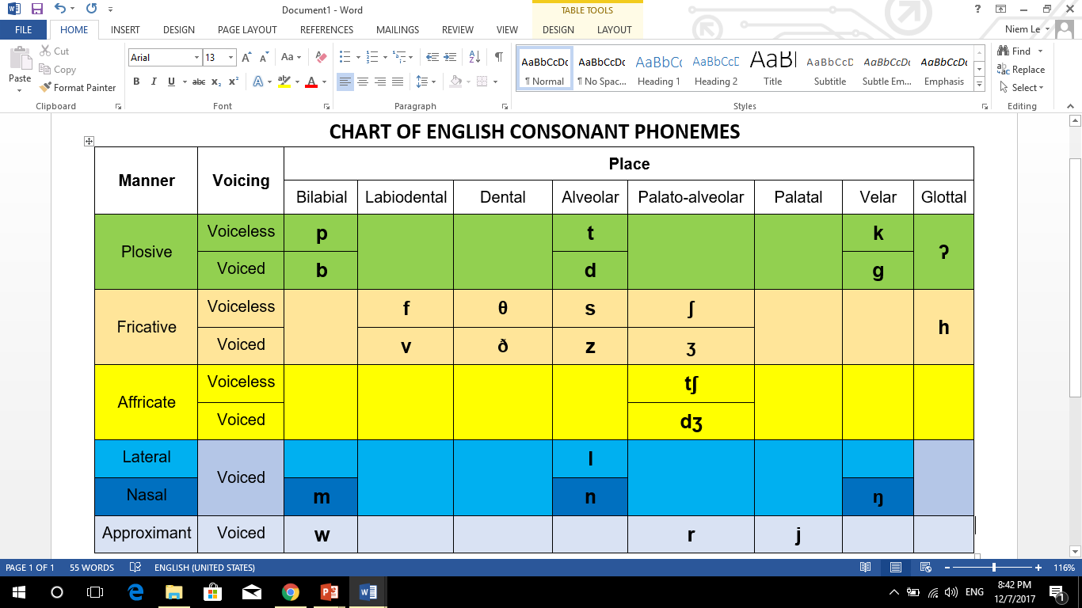

Slide 57
