Slide 1
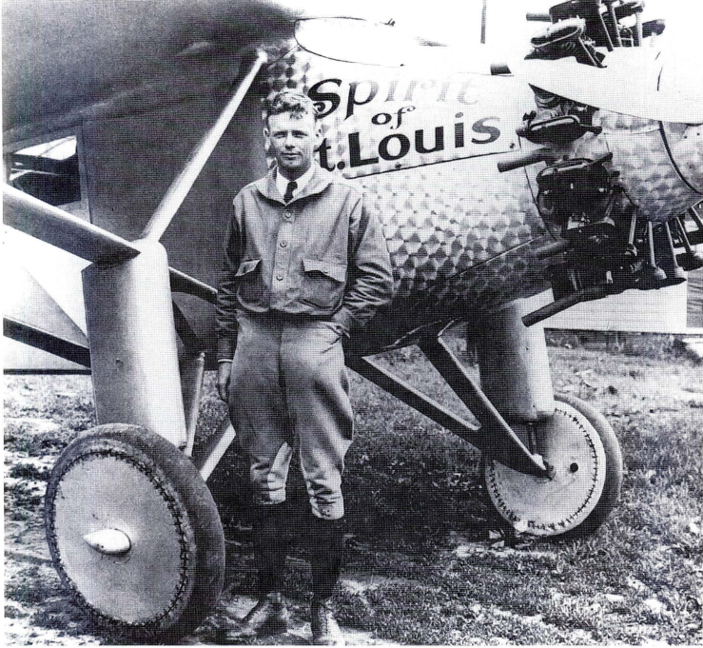

Slide 3
https://yourhomework.net/vocabulary/lesson/000000140003

Slide 4
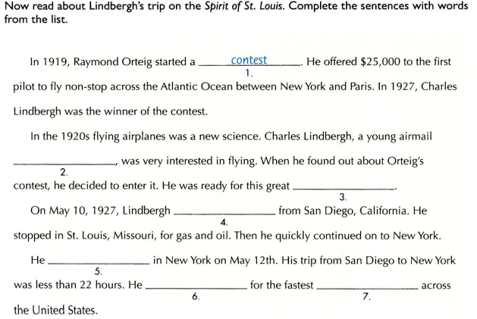
pilot
adventure
took off
landed
set a record
flight
hero
media
unforgettable

Slide 5
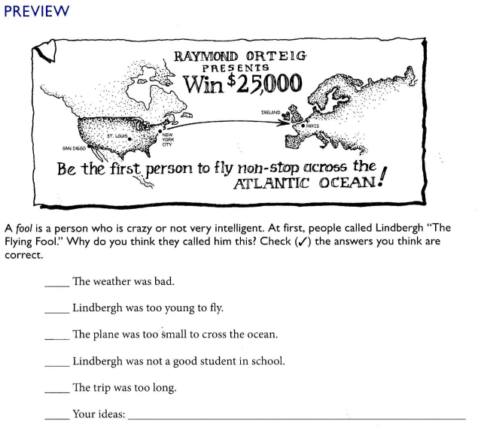
✓
✓
✓
✓

Slide 6
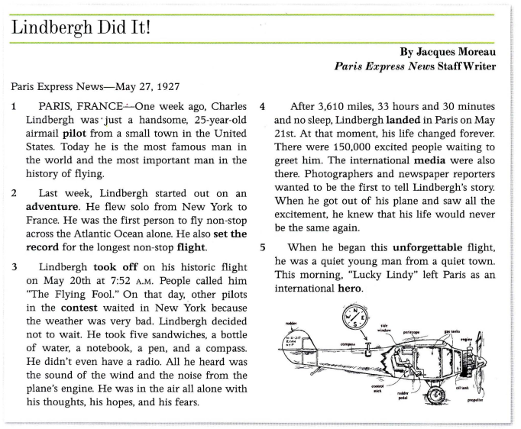

Slide 7
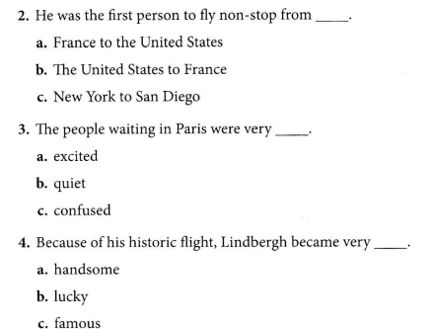

Slide 8
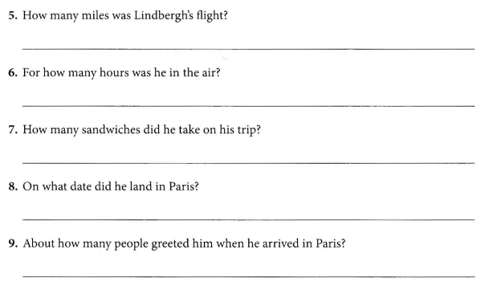
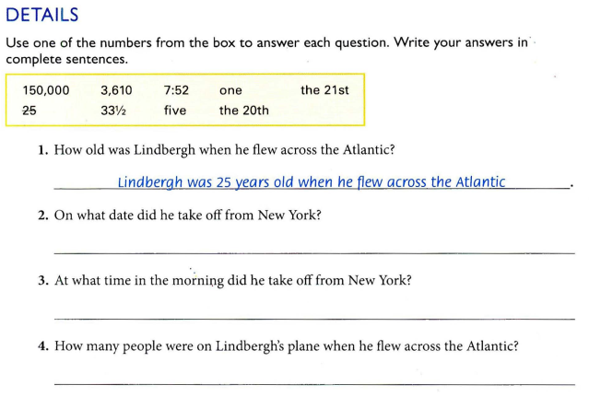
Lindbergh’s flight was 3,610 miles
He was in the air for 33 ½ hours
He took 5 sandwiches on his trips
He took off from New York on the 20th
He took off from New York at 7.52 in the morning
He landed in Paris on the 21st
There was one
150,000 people greeted him when he arrived in Paris

Slide 9
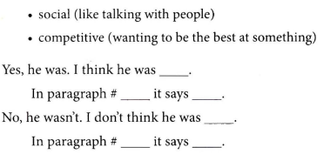

Slide 10
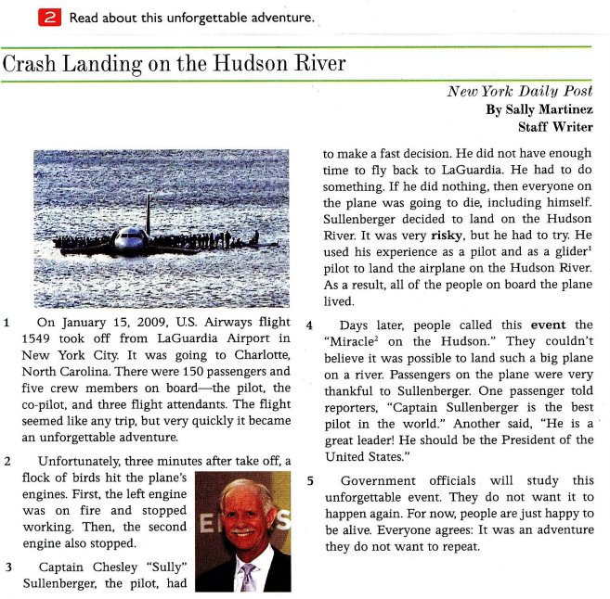

Slide 11
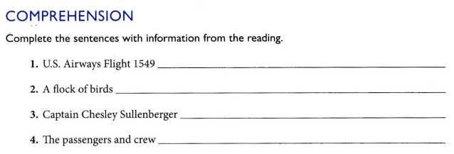
took off from LaGuadia Airport in New York City
hit the plane’s engines
decided to land on the Hudson River
lived

Slide 12
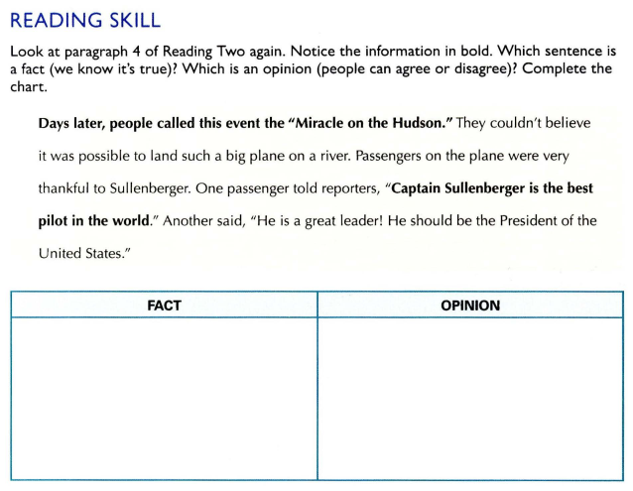
Miracle on the Hudson
Captain Sullenberger is the best pilot in the world

Slide 13
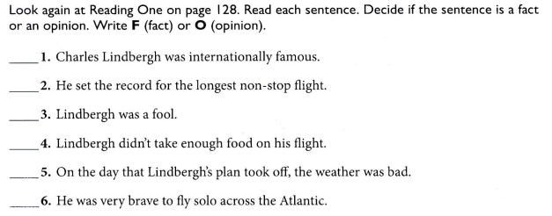
F
F
O
O
F
O

Slide 14
flew solo from New York to France
His flight including 150 passengers and 5 crew members was hit by a flock of birds
He set the record for the longest non-stop flight
He decided to land on the Hudson River. All lived

Slide 15
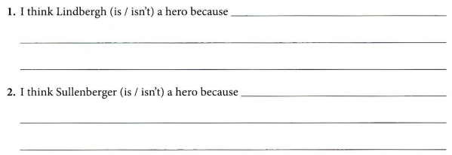
he is just the best pilot
he made quick and right decision to land on the Hudson River and save 150 passengers and 5 crews

