Slide 1
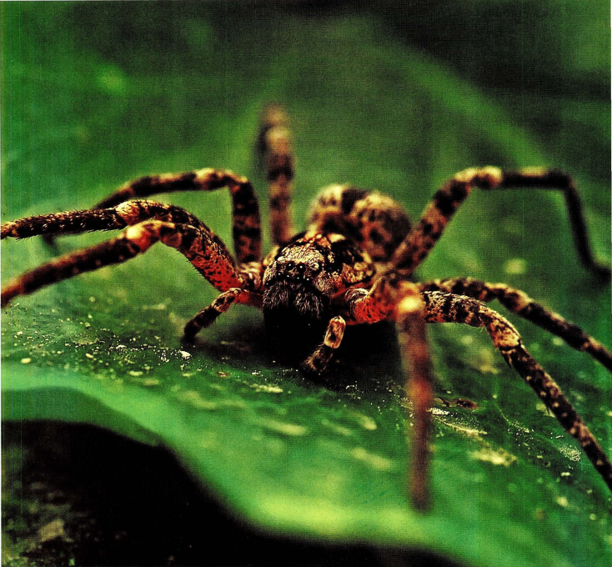

Slide 3
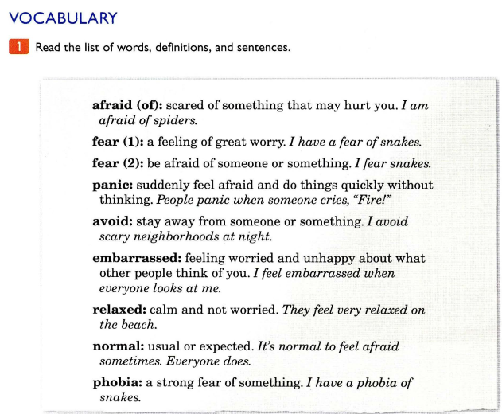
https://yourhomework.net/vocabulary/lesson/000000360001

Slide 4
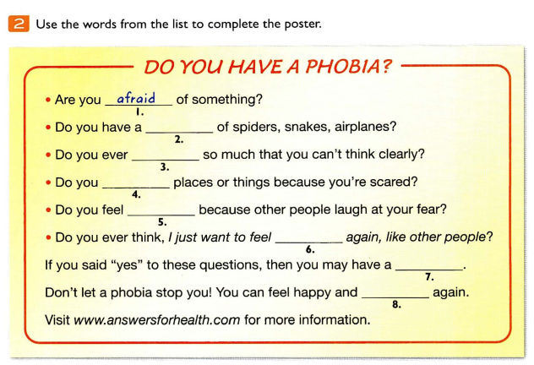
phobia
panic
avoid
embarassed
normal
fear
relaxed

Slide 5
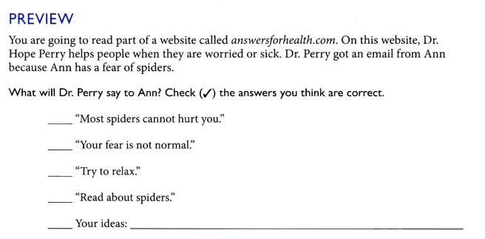
✓
✓
✓

Slide 6
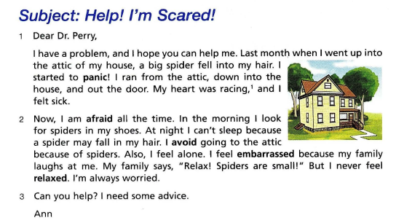
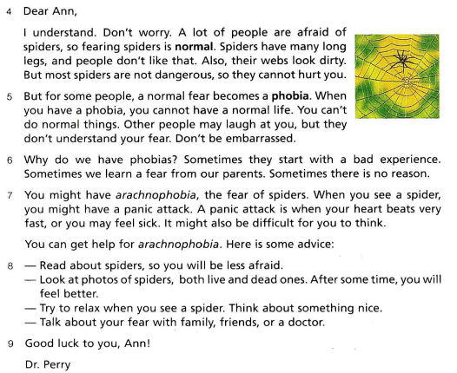

Slide 8
sleep
phobia
bad
Ann
sick
talk

Slide 10
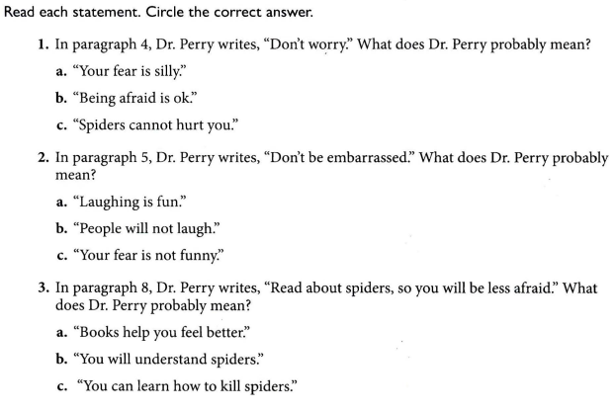

Slide 12
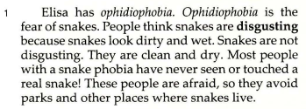
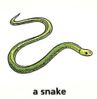
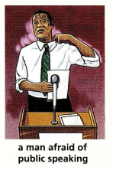
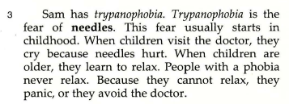

Slide 13
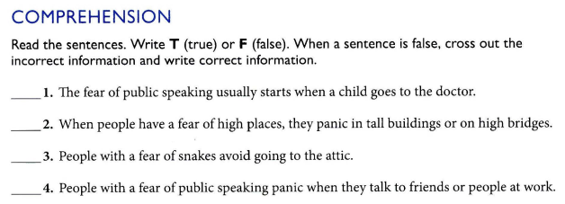
a lot of people are watching and listening
F
T
parks and other places where snakes live
F
T

Slide 14
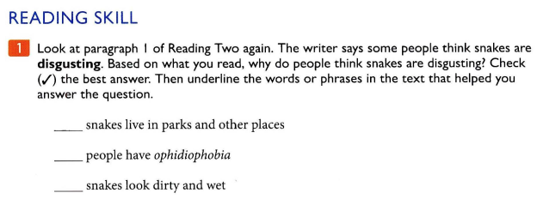
✓

Slide 16
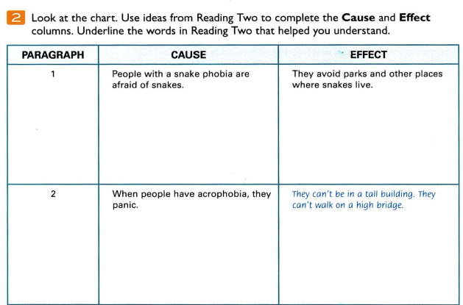
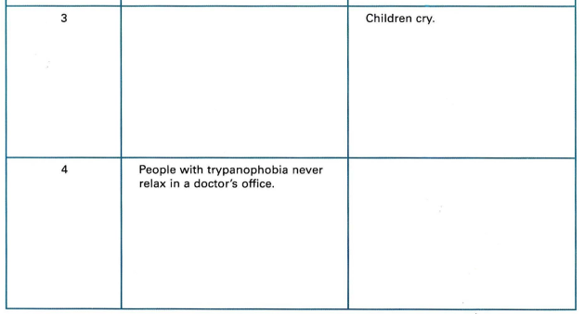
When children have trypanophobia
They panic or they avoid the doctor

Slide 17
ophidiophobia
trypanophobia
glossophobia
arachnophobia
acrophobia
spiders
needled
public speaking
snakes
high places
Panic, avoid the doctor
have wet hands, sweat a lot
panic attack
avoid parks and other places where snakes live
Can’t be in a tall building/ can’t walk on a high bridge

Slide 18
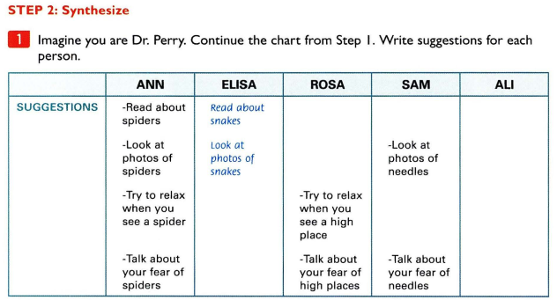

Slide 19
