Slide 2
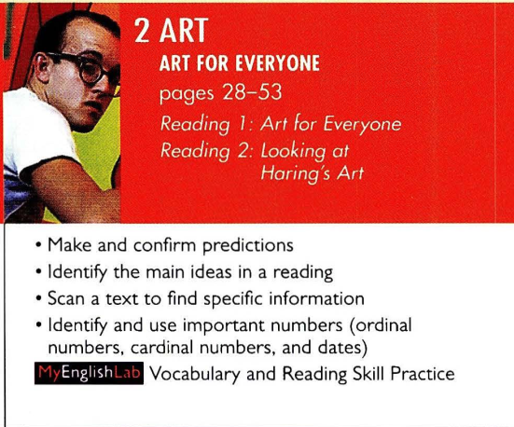

Slide 3
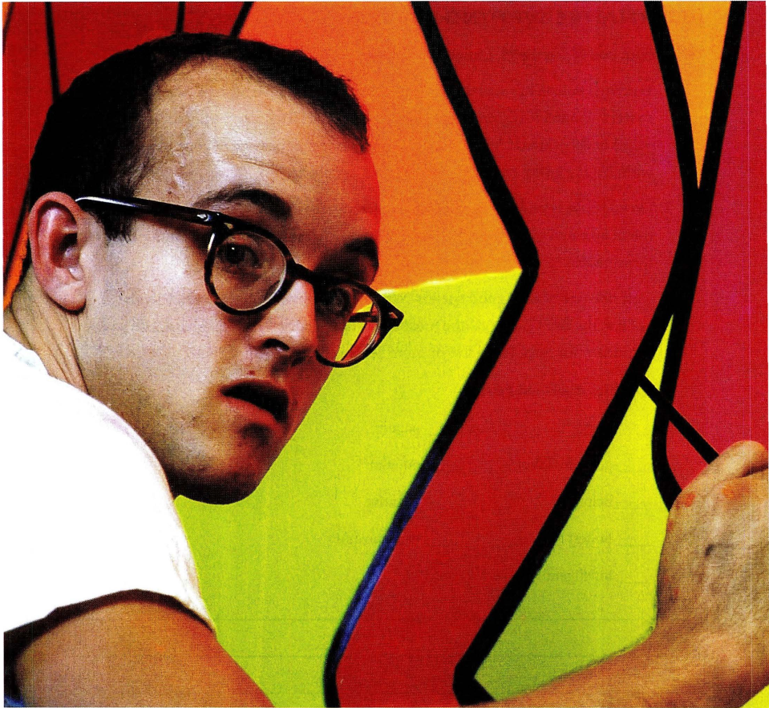
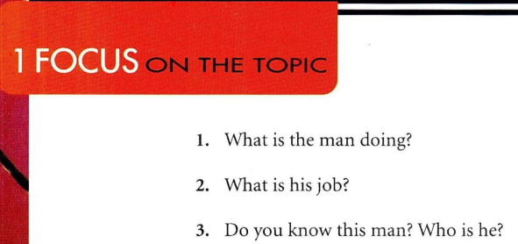
https://yourhomework.net/vocabulary/lesson/000000279002

Slide 4
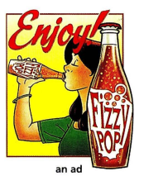
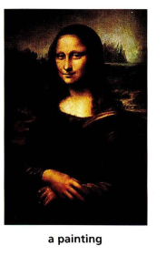
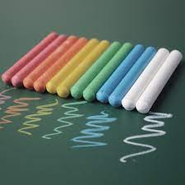
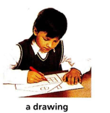
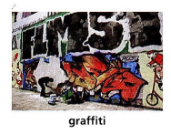
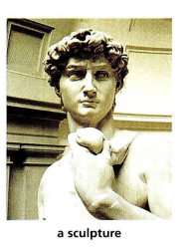

Slide 5
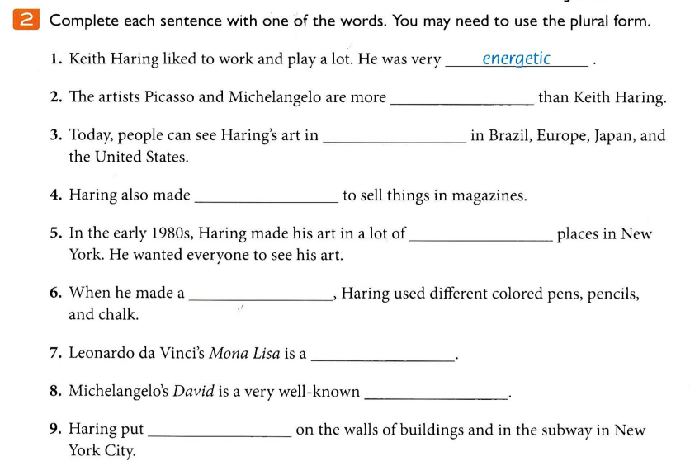
famous
museum
ad
public
drawing
painting
sculpture
graffiti

Slide 6
Cardinal and ordinal numbers

Slide 7
CARDINAL NUMBERS
One
two
Three
Four
Five
Six
Seven
Eight
Nine
Ten
Eleven
Twelve
Thirteen
Fourteen
Fifteen
Sixteen
Seventeen
Eighteen
Nineteen
Twenty
Twenty-one
Twenty-two
30 Thirty
40 Forty
50 Fifty
60 Sixty
70 Seventy
80 Eighty
90 Ninety
100 One hundred

Slide 8
CARDINAL NUMBERS
Write the following cardinal numbers
24
56
100
33
98
65

Slide 9
CARDINAL NUMBERS
Answers
24 Twenty-four
56 Fifty-six
100 One hundred
33 Thirty-three
98 Ninety-eight
65 Sixty-five

Slide 10
ORDINAL NUMBERS
Ordinal numbers are used to indicate position in relation to other numbers
The snail won the race. He was the first one to eat a lettuce!!!

Slide 11
ORDINAL NUMBERS
First – 1st
Eleventh – 11th
Twenty- first – 21st
Second – 2nd
Twelfth – 12th
Twenty-second – 22nd
Third – 3rd
Thirteenth – 13th
Twenty-third – 23rd
Fourth – 4th
Fourteenth – 14th
Twenty-fourth – 24th
Fifth – 5th
Fifteenth – 15th
Thirtieth – 30th
Sixth – 6th
Sixteenth – 16th
Thirty-first – 31st
Seventh – 7th
Seventeenth – 17th
Eighth – 8th
Eighteenth – 18th
Nineteenth – 19th
Ninth – 9th
Tenth – 10th
Twentieth – 20th

Slide 12
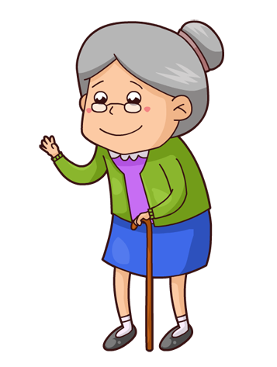
My grandmother
is 84 years old.

Slide 13
Chelsea introduces five new players.

Slide 14
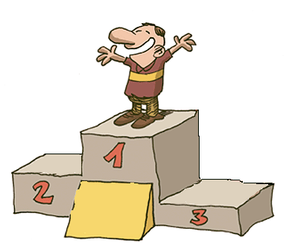
He is in the first position in the local race.

Slide 15
Valentine’s day is on February fourteenth.

Slide 16
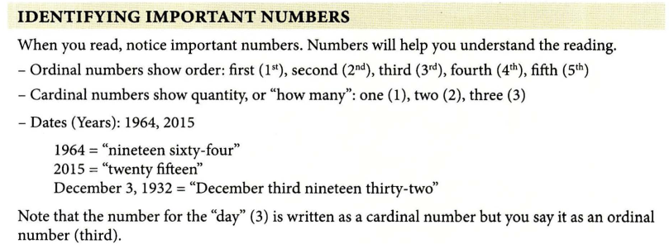

Slide 17
How do you express…
Dates
12/04/53 Twelve four fifty three
Practice:
5/27/79
12/15/12
3/09/88

Slide 19
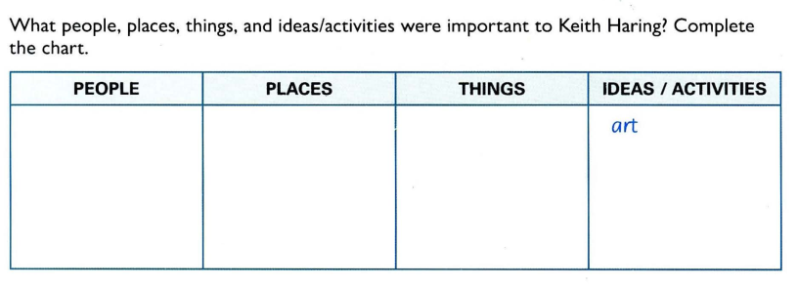
Pennsylvania
The pop show
NYC police
Children and people with AIDS
New York City
The art show
School of Visual Arts
graffiti
Tony Shafrazi Gallery in NYC
picture
Asia
Tokyo

Slide 20
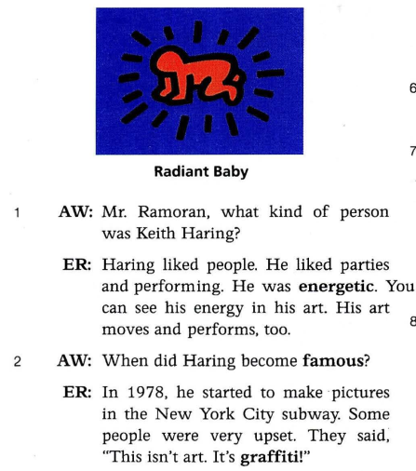
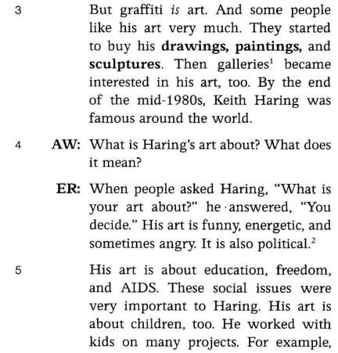

Slide 21
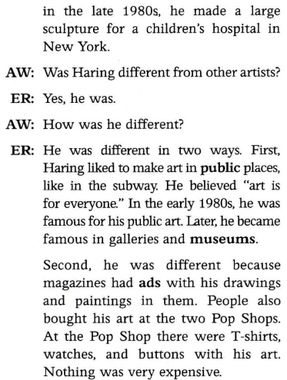
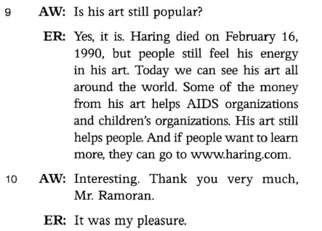
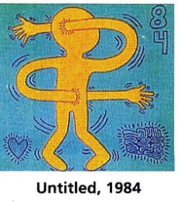

Slide 22
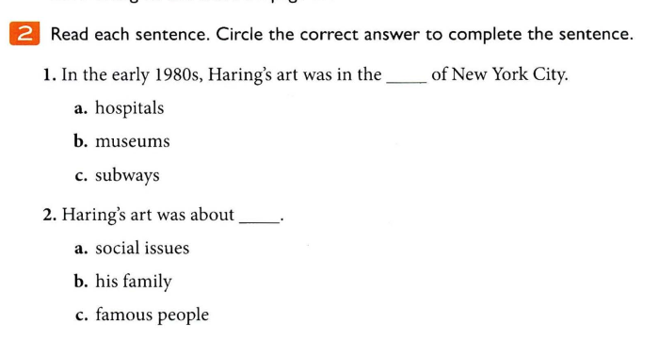

Slide 23
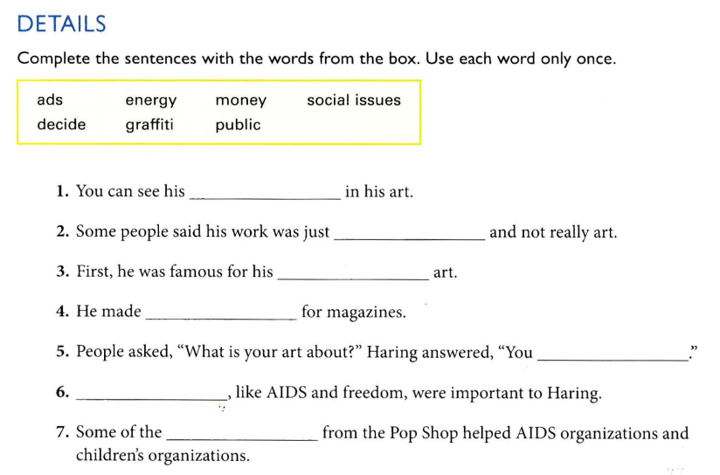
energy
graffiti
public
ads
decide
Social issues
money

Slide 24
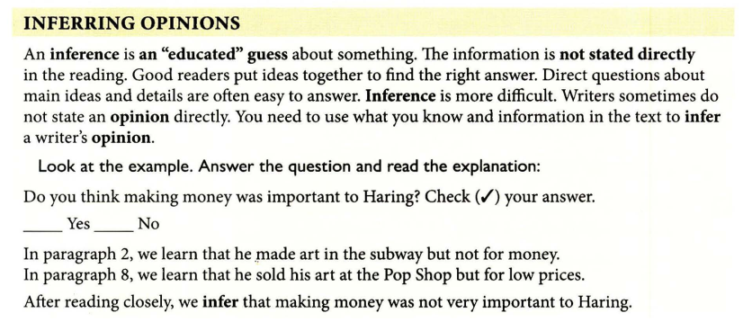

Slide 25
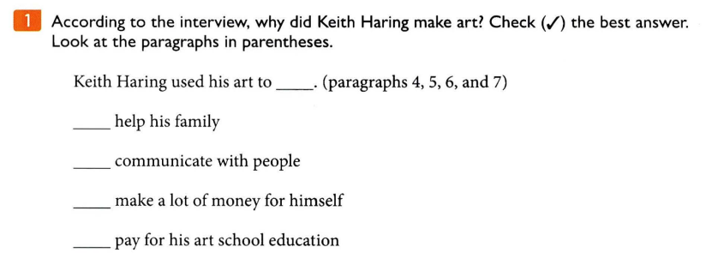
✓

Slide 26
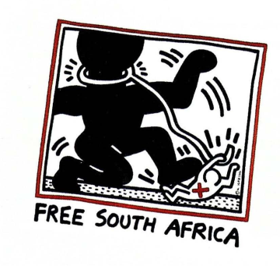

Slide 27
Some
snake
posters

Slide 28
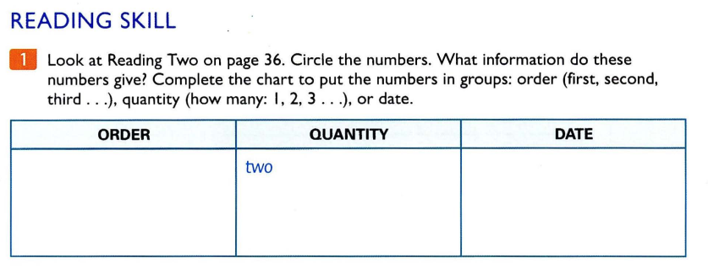
first
1985
second
20,000
1989

Slide 29
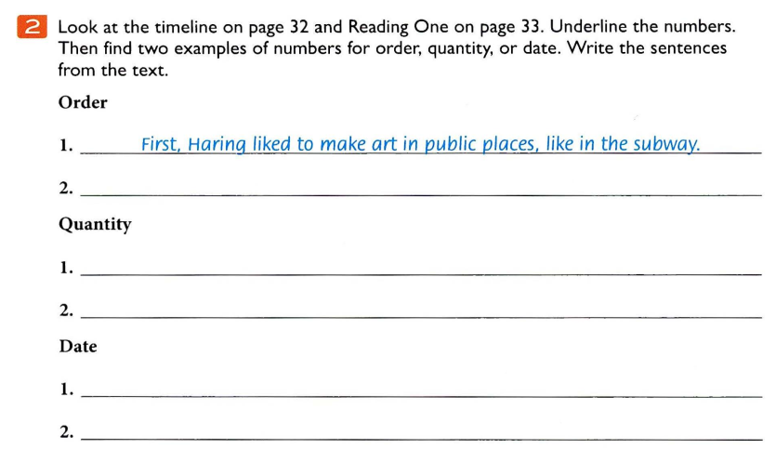

Slide 30
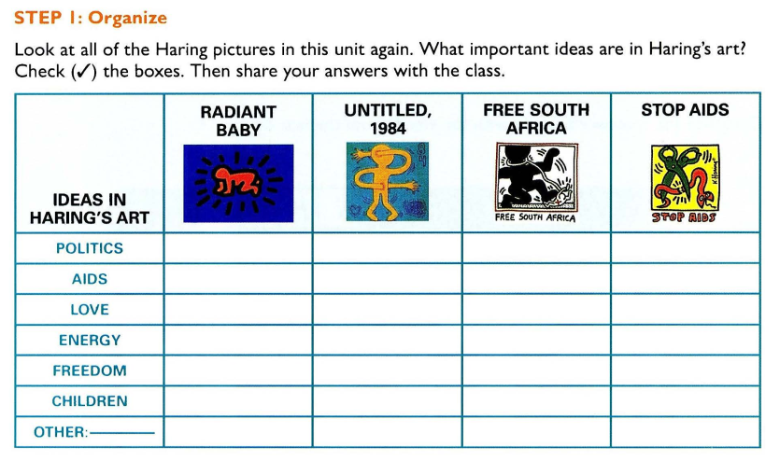
✓
✓
✓
✓
✓
✓
✓
✓

Slide 31
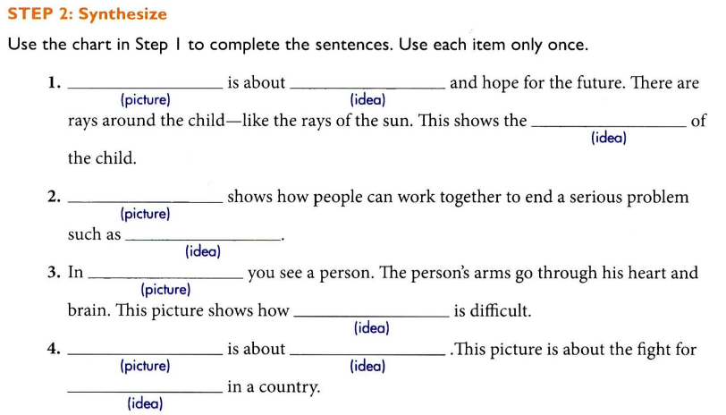
Radiant baby
love
energy
United 1984
wars
Free south Africa
freedom
Stop AIDS
social problem
aids

