Slide 1
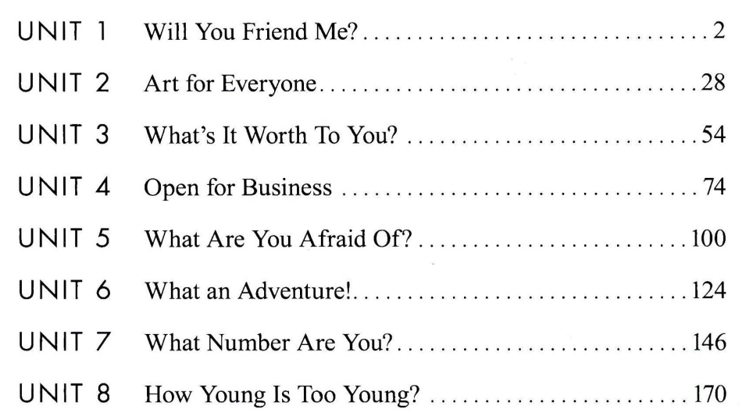

Slide 2
https://yourhomework.net/vocabulary/lesson/000000464002

Slide 3
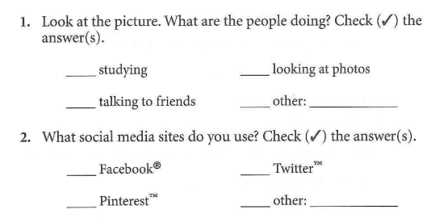
✓
✓

Slide 4
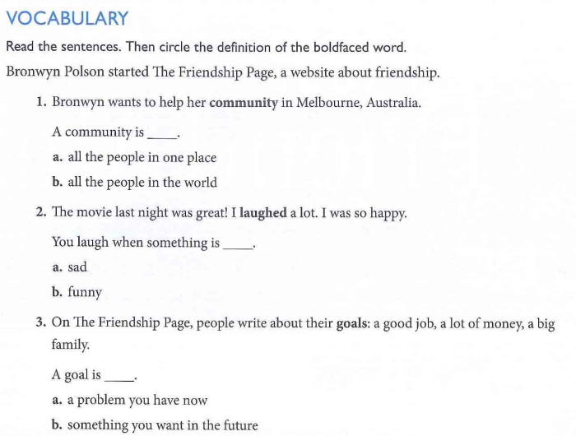

Slide 5
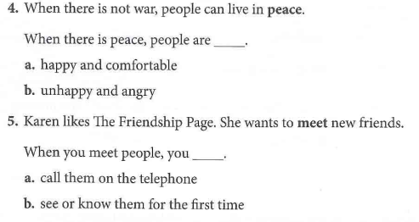

Slide 6
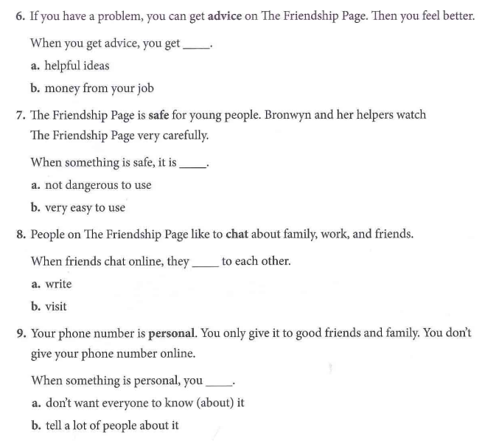

Slide 8
✓
✓
✓
✓
✓

Slide 9
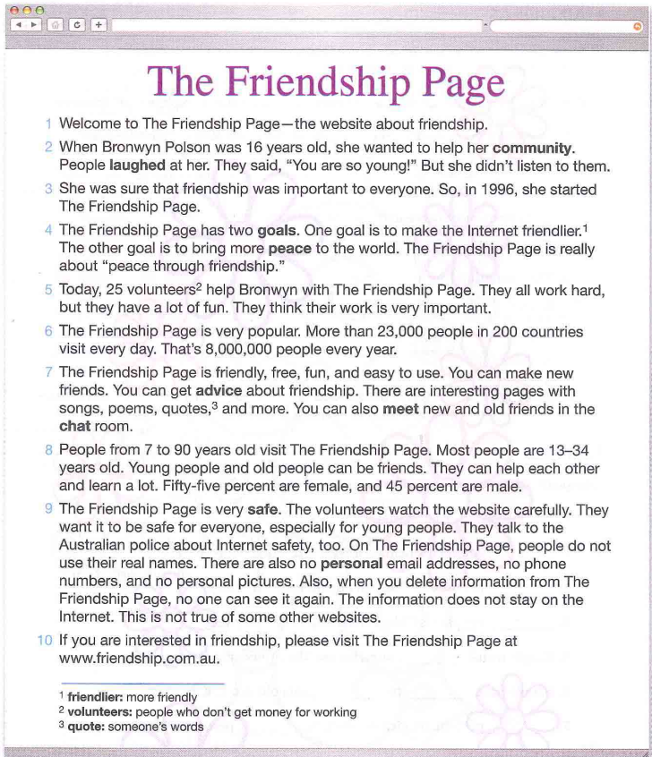

Slide 11
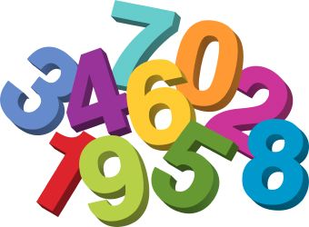
Expressing Numbers in English

Slide 12
How do you express…
Large numbers:
000,000,000,000
billion million thousand hundred
300 billion
Remember:
NOT billions, thousands, or hundreds!!

Slide 13
How do you express…
Hundreds
225 Two hundred twenty five
Practice:
333 894 237 662

Slide 14
How do you express…
Thousands
831,259 Eight hundred thirty one thousand, two hundred fifty nine
Practice:
2,333 14,894 38,237

Slide 15
How do you express…
Millions
298,356,000
Two hundred ninety eight million, three hundred fifty six thousand
Practice:
10,476,329 823,564,004

Slide 16
How do you express…
Decimals
4.56 Four point five six
(. = point)
Practice:
98.6 104.68 3.99

Slide 17
How do you express…
Percentages
39% Thirty nine percent
(% = percent)
Practice:
75% 24% 99%

Slide 18
How do you express…
Fractions
Read the top number as a cardinal number,
followed by the
ordinal number + ‘s’ (if plural)
4/5 Four fifths
(cardinal number/ordinal number + s)

Slide 19
How do you express…
Fractions
2/3 two thirds
1/2 one half (an exception)
3/2 three halves
Practice:
1/4 1/3 7/8 4/2

Slide 20
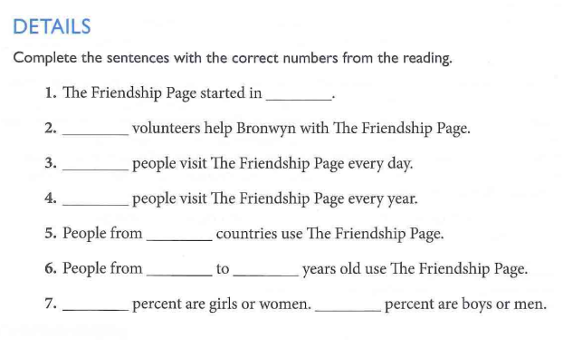
1996
25
23,000
8,000, 000
200
7
90
55
45

Slide 21
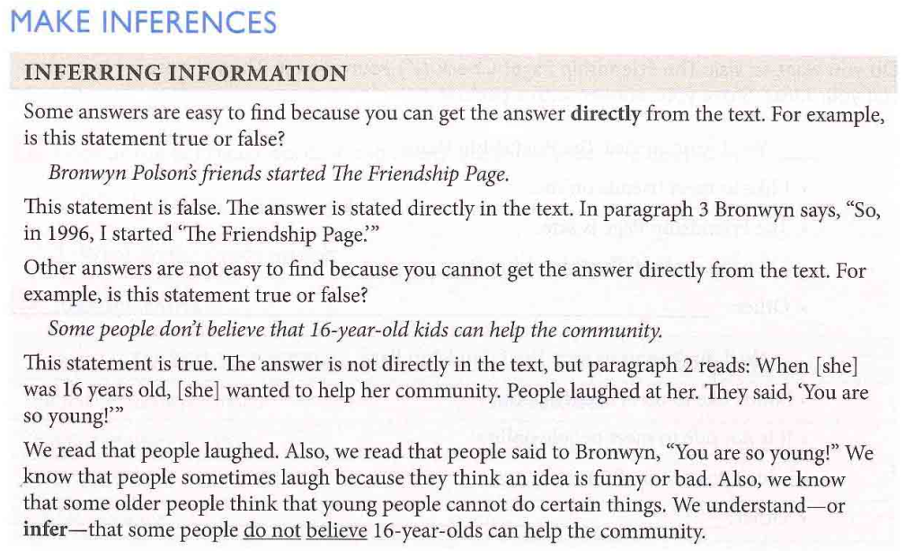

Slide 22
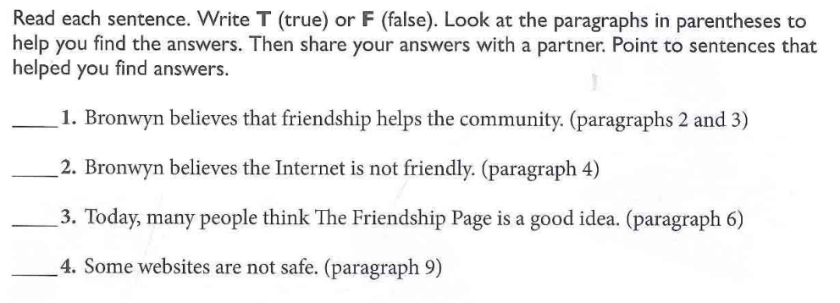

Slide 23
T
F
T
T

Slide 25
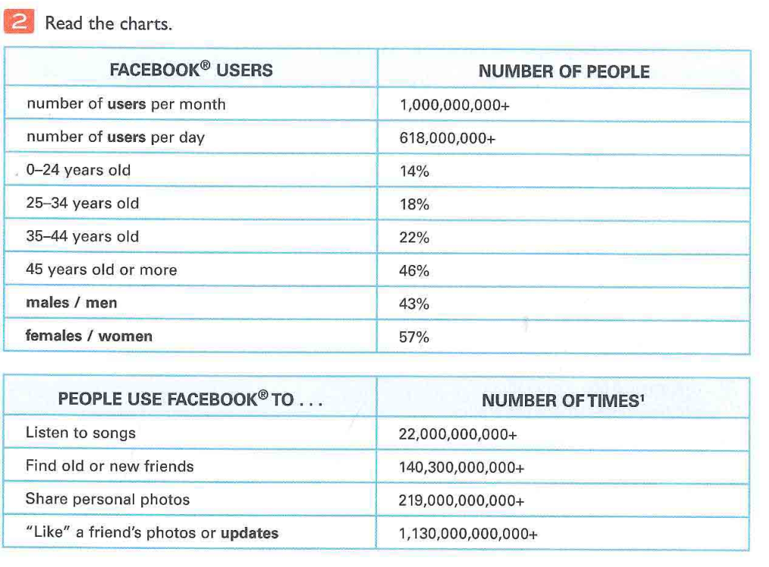

Slide 26
F
T
F
F
T

Slide 27
✓

Slide 28
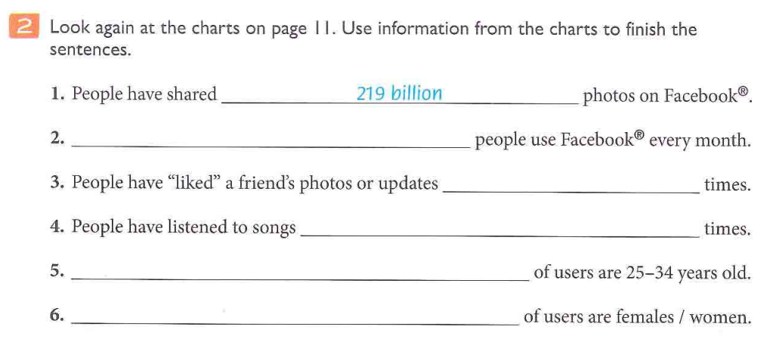
1,000, 000, 000
1,130, 000, 000, 000
22, 000, 000, 000
18%
57%

Slide 29














