Slide 1
Unit 9: The Frontier Heritage
https://www.youtube.com/watch?v=r7qovpFAGrQ&ab_channel=LilNasXVEVO

Slide 2
Lecturer: Ms Trịnh Vũ Thanh Tuyền Email: tuyentrinh1803@gmail.com Phone: 0942323117

Slide 3
Get started
What is “frontier”?
What American movies about the Old West have you seen?
What are the characteristics of American movies heroes?
Why do so many Americans own guns?
Frontier (n)
Heritage (n)

Slide 4
Frontier (n) UK/ˈfrʌn.tɪər/ /frʌnˈtɪər/ US /frʌnˈtɪr/
a border between two countries
the western US where settlers began to move to live in the 19th century

Slide 5
Heritage /ˈher.ɪ.tɪdʒ/
features belonging to the culture of a particular society, such as traditions, languages, or buildings, that were created in the past and still have historical importance

Slide 6
Hello!
I am Jayden Smith
I am here because I love to give presentations.
You can find me at @username

Slide 7
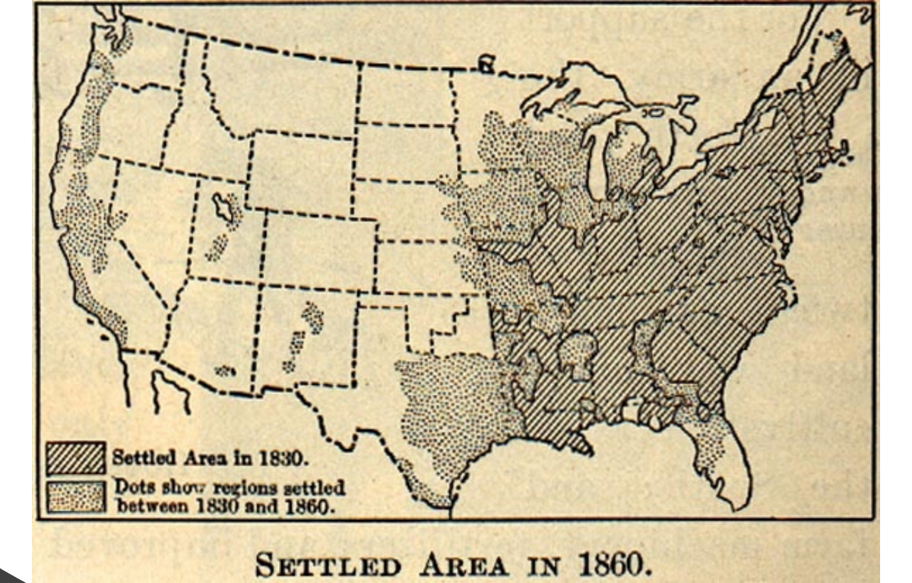
1.
Transition headline
Let’s start with the first set of slides

Slide 8
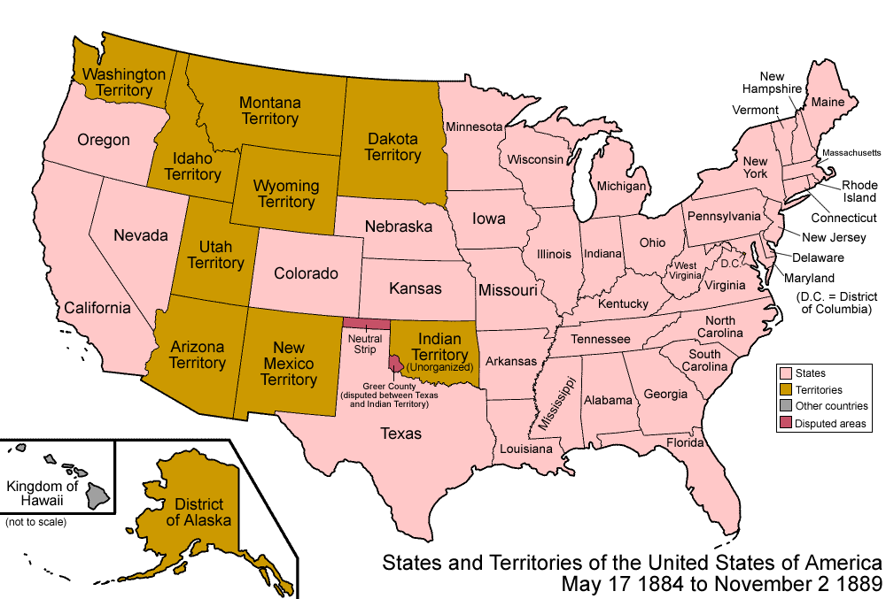

Slide 9
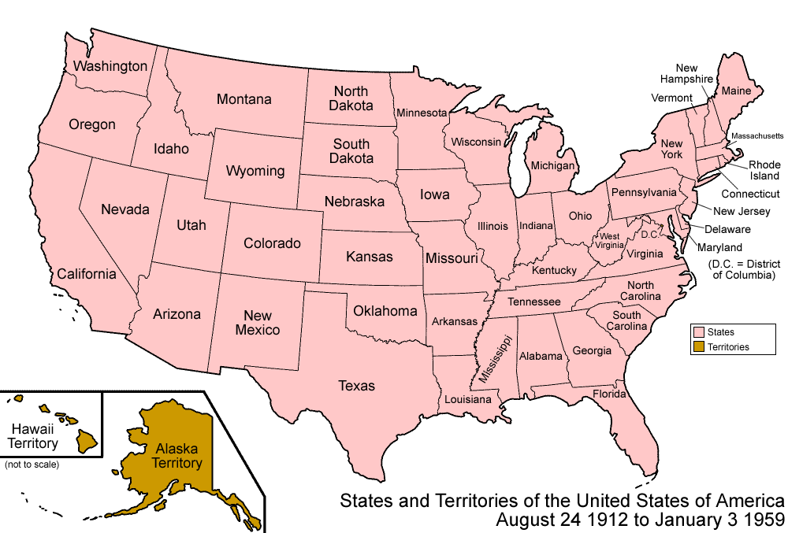

Slide 10
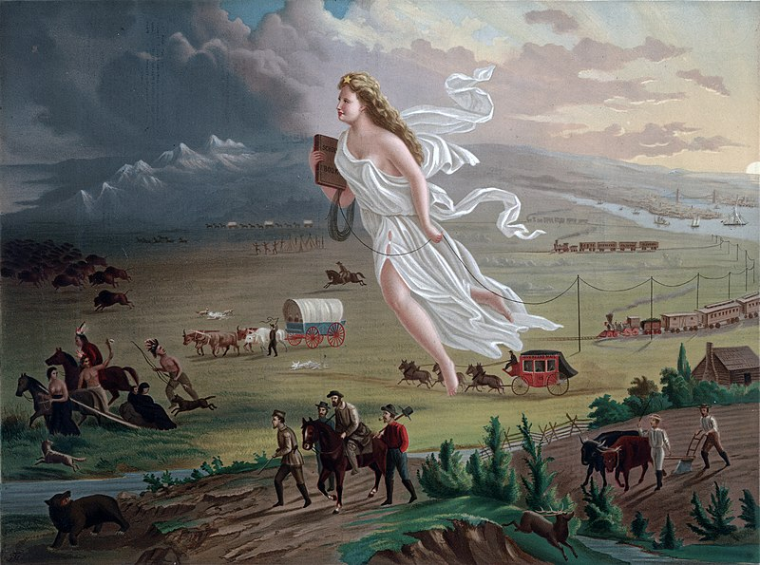
Manifest Destiny
a phrase coined in 1845, is the idea that the United States is destined—by God, to expand its dominion and spread democracy and capitalism across the entire North American continent.

Slide 11
“Quotations are commonly printed as a means of inspiration and to invoke philosophical thoughts from the reader”

Slide 12
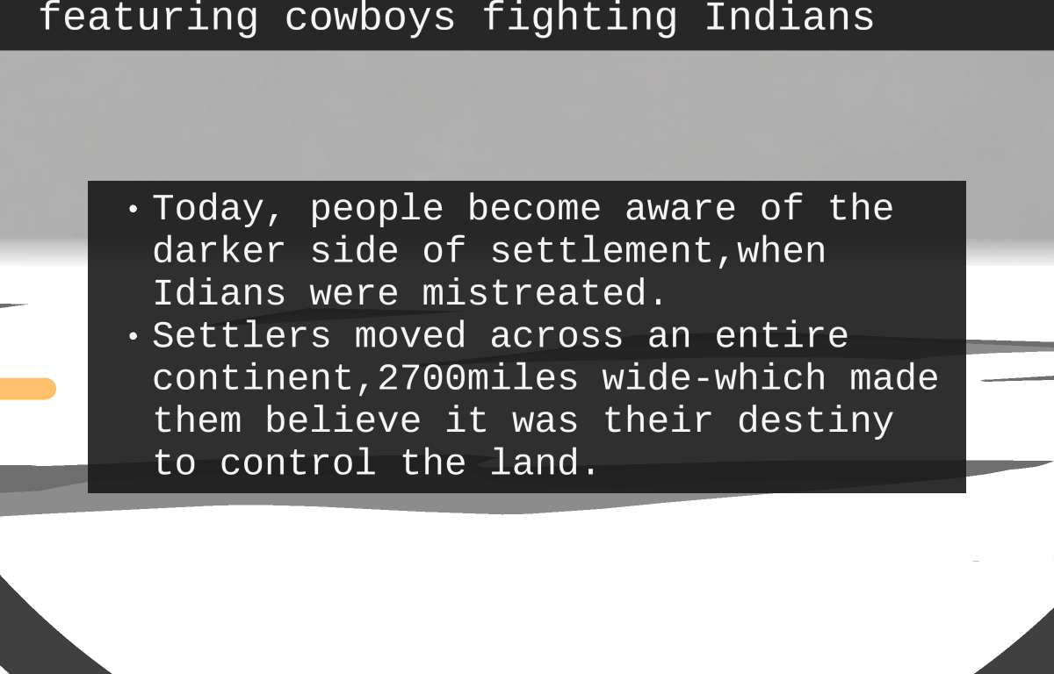
This is a slide title
Here you have a list of items
And some text
But remember not to overload your slides with content
Your audience will listen to you or read the content, but won’t do both.

Slide 13
Inventiveness and Can-Do Spirit
Equality of Opportunity
Self-Reliance and Rugged Individualist
The frontier heritage

Slide 14
Big concept
Bring the attention of your audience over a key concept using icons or illustrations

Slide 15
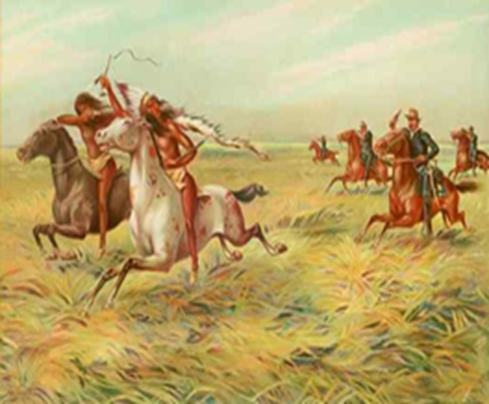
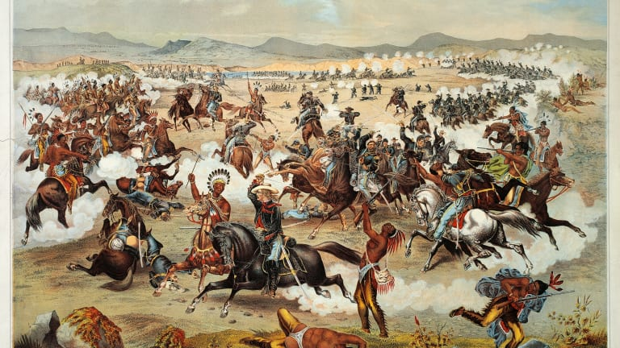
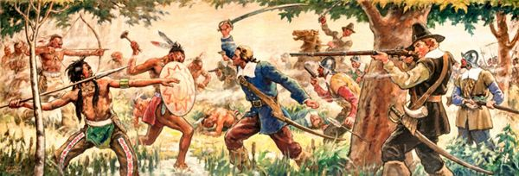
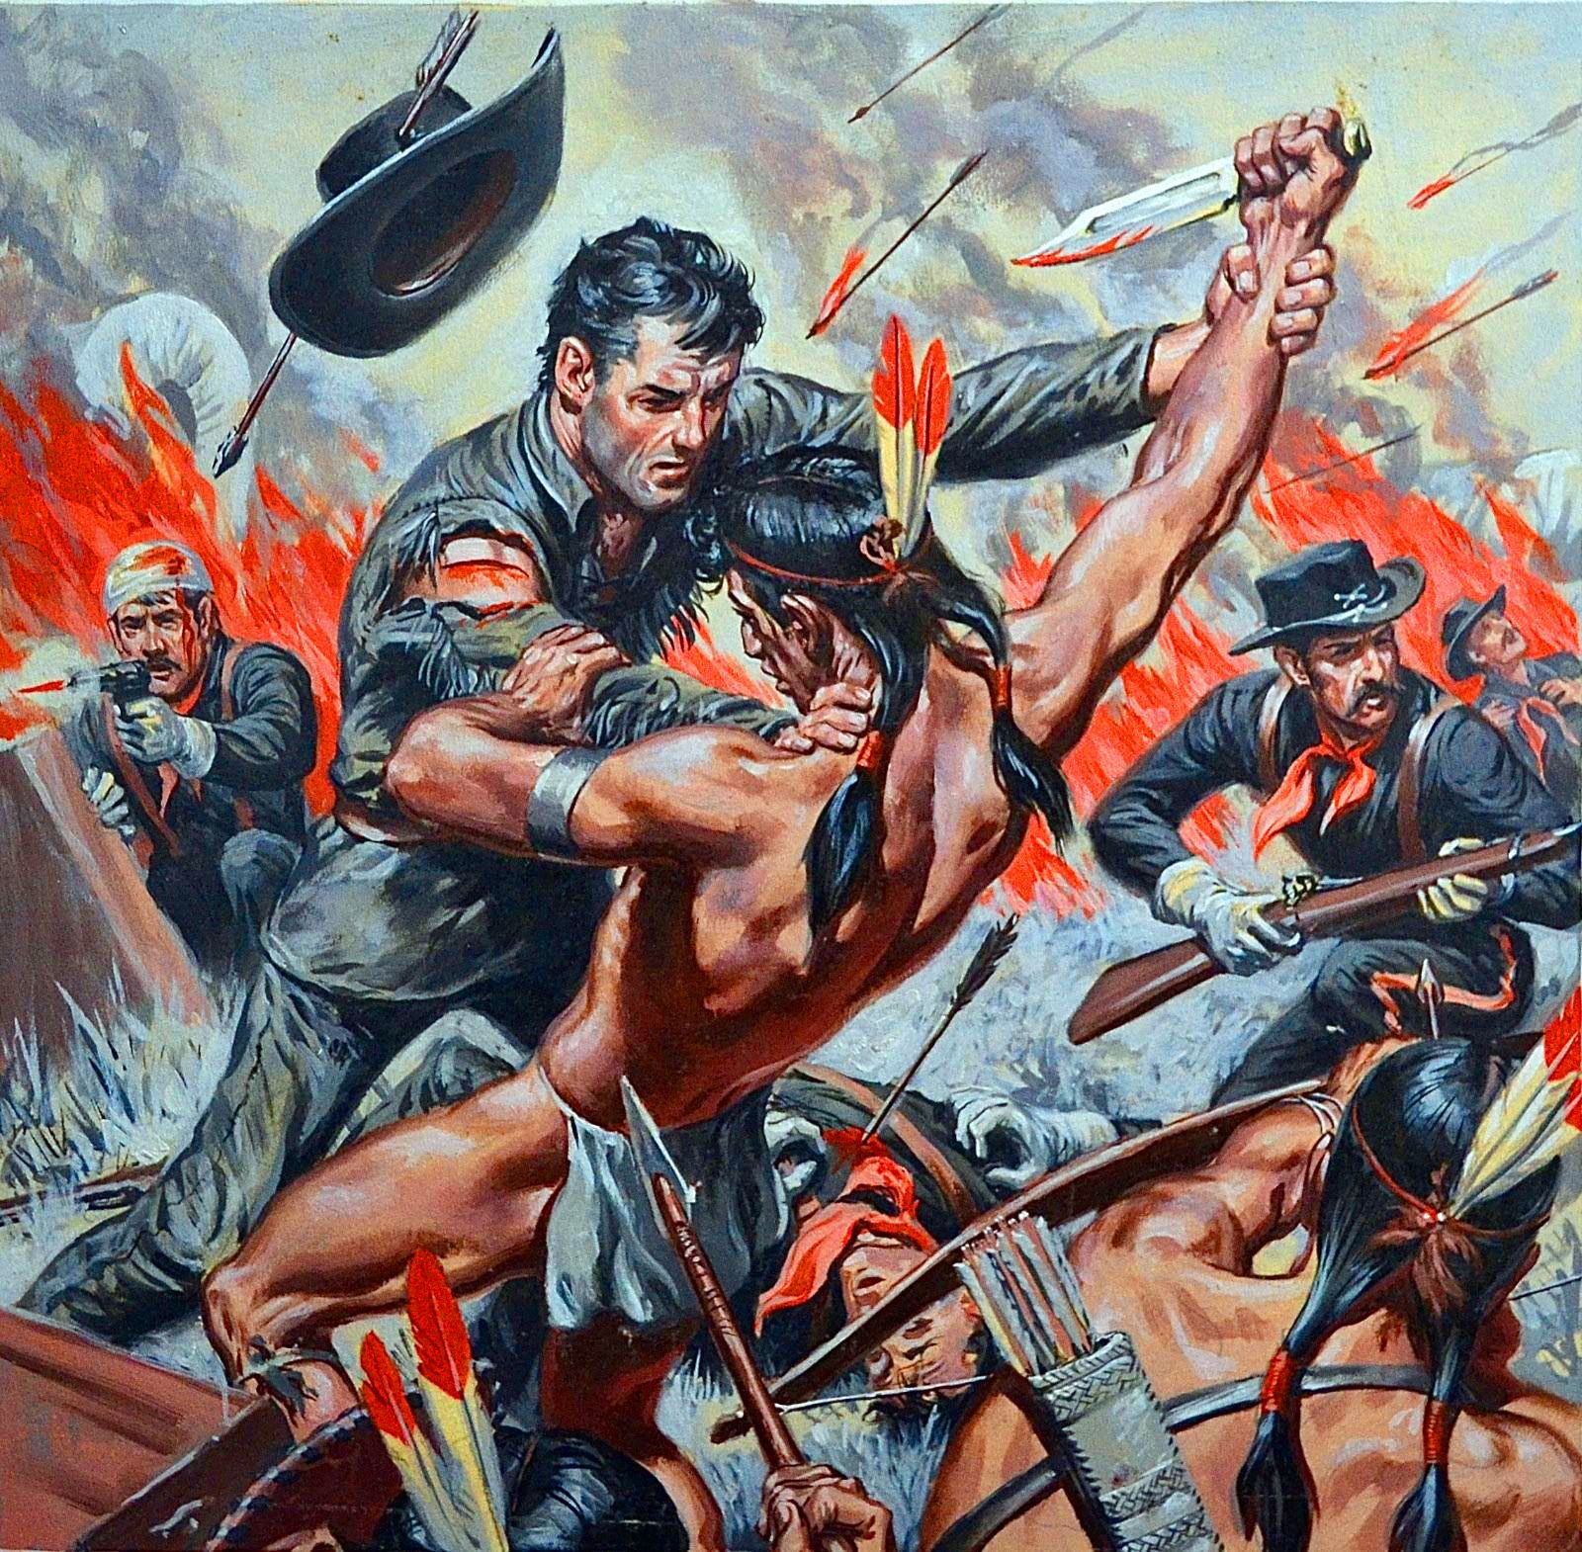

Slide 16
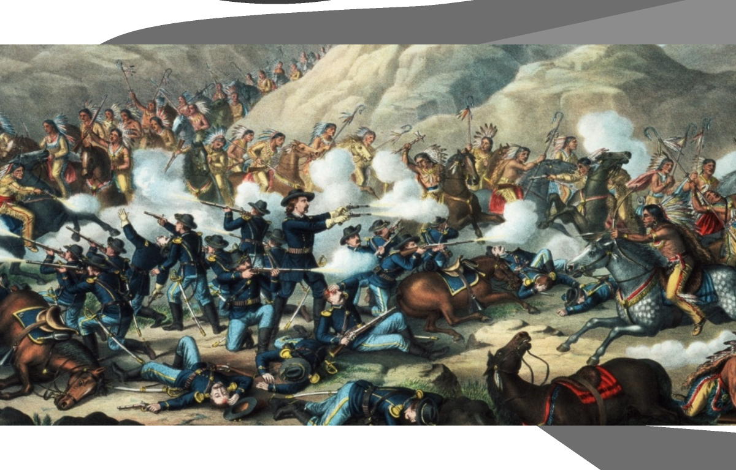
You can also split your content
White
Is the color of milk and fresh snow, the color produced by the combination of all the colors of the visible spectrum.
Black
Is the color of coal, ebony, and of outer space. It is the darkest color, the result of the absence of or complete absorption of light.

Slide 17
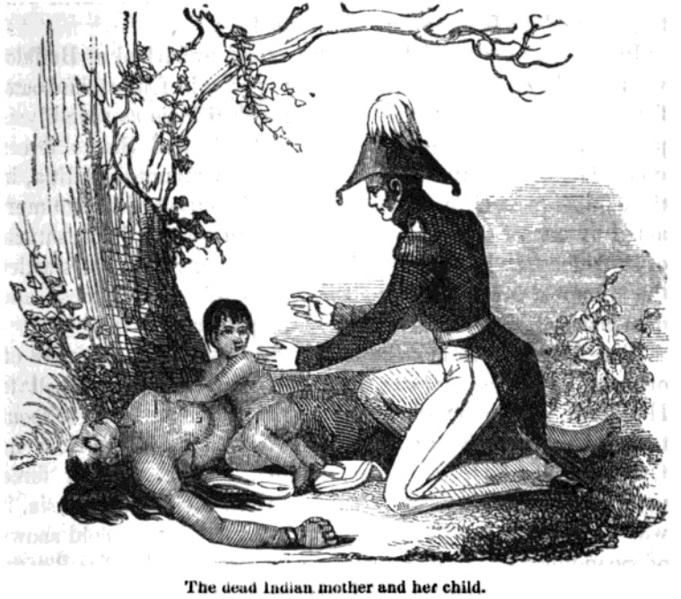

Slide 18
https://www.youtube.com/watch?v=Xpm37jn-Rv4&ab_channel=PaulOGradyForTheLoveOfDogs

Slide 19
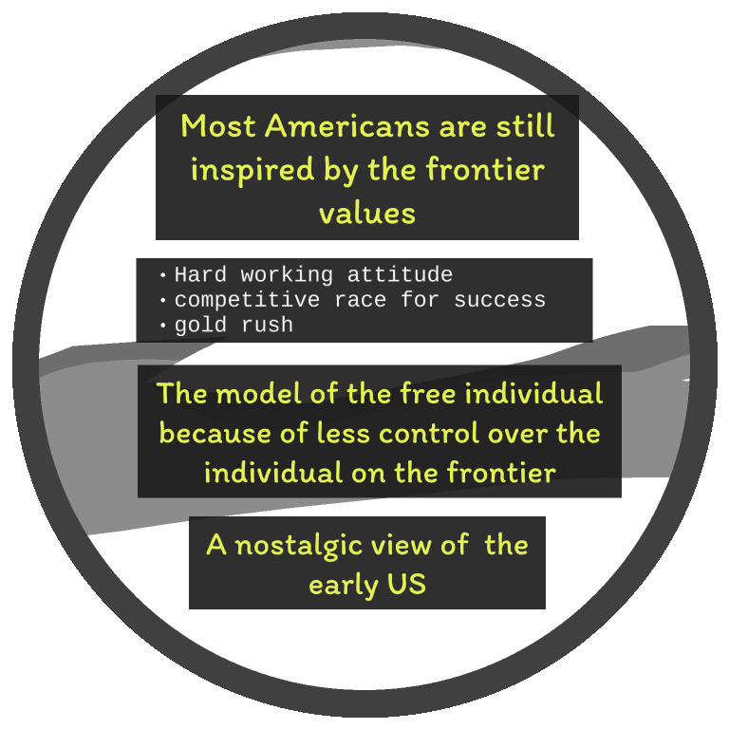

Slide 20
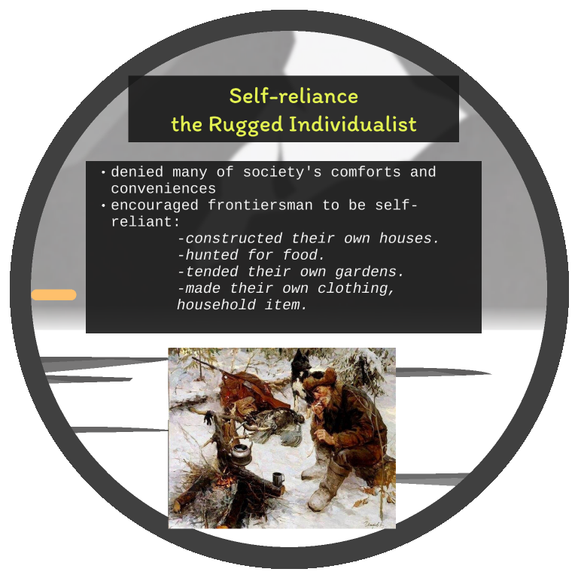

Slide 21
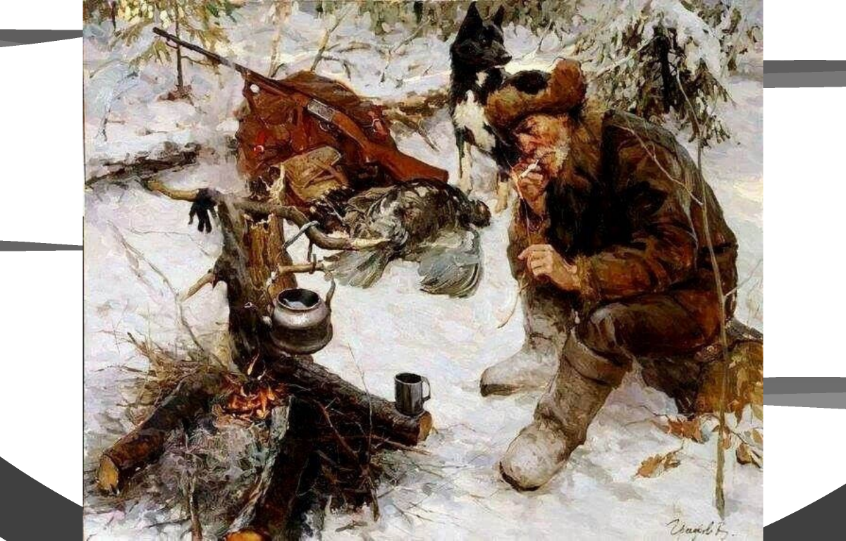
In two or three columns
Yellow
Is the color of gold, butter and ripe lemons. In the spectrum of visible light, yellow is found between green and orange.
Blue
Is the colour of the clear sky and the deep sea. It is located between violet and green on the optical spectrum.
Red
Is the color of blood, and because of this it has historically been associated with sacrifice, danger and courage.

Slide 22
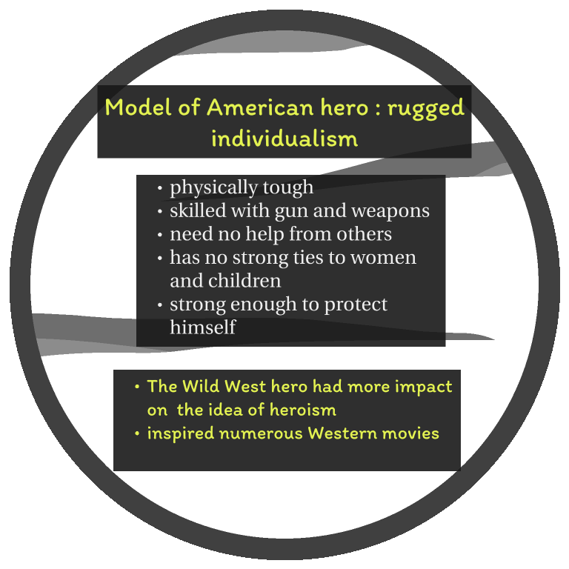
89,526,124$
185,244 users
100%
That’s a lot of money
And a lot of users
Total success!

Slide 24
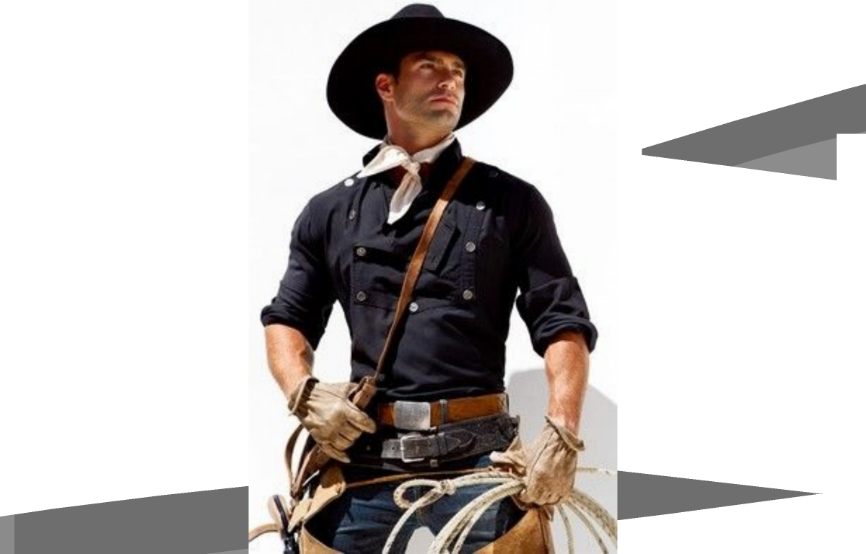

Slide 25
https://www.youtube.com/watch?v=ke6JNVK3AWQ&ab_channel=womel

Slide 26
Want big impact?
Use big image.

Slide 27
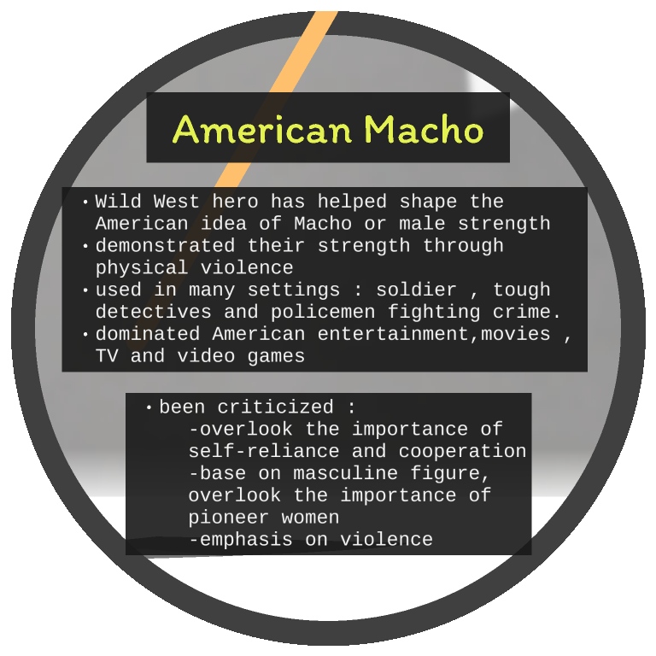
Thanks!
Any questions?
You can find me at:
@username
user@mail.me

Slide 28
And tables to compare data
 | A | B | C
Yellow | 10 | 20 | 7
Blue | 30 | 15 | 10
Orange | 5 | 24 | 16

Slide 29
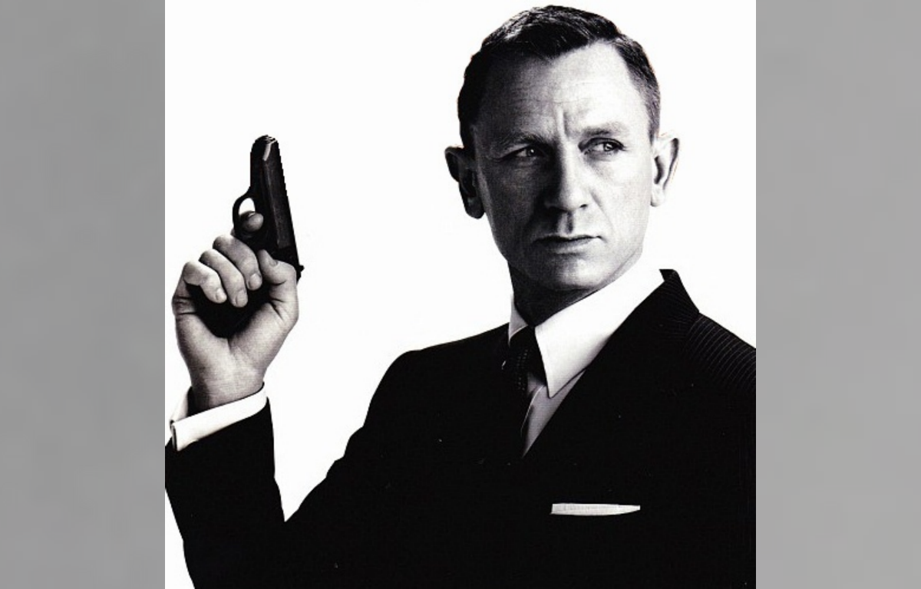

Slide 30
Maps
our office

Slide 31
Breaktime
https://www.youtube.com/watch?v=r7qovpFAGrQ&ab_channel=LilNasXVEVO

Slide 32
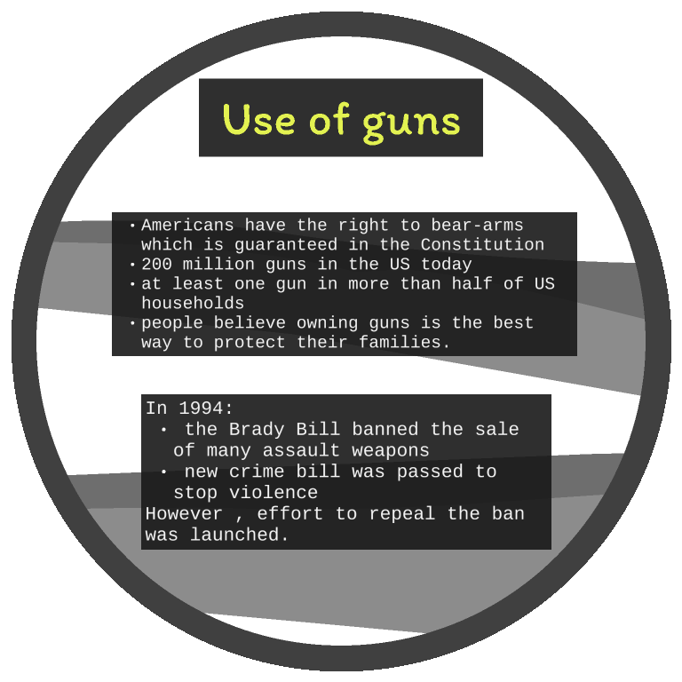
Hello!
I am Jayden Smith
I am here because I love to give presentations.
You can find me at @username

Slide 33
Hello!
I am Jayden Smith
I am here because I love to give presentations.
You can find me at @username

Slide 34
89,526,124
Whoa! That’s a big number, aren’t you proud?

Slide 36
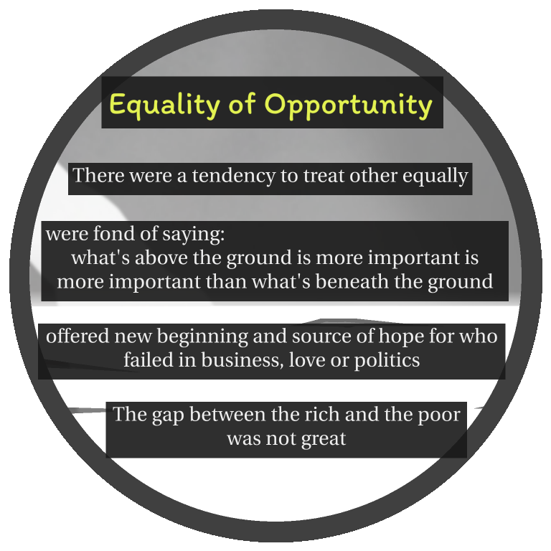

Slide 38
THANKS

