Slide 1
Unit 1: Immigration and diversity

Slide 2
Lecturer: Ms Trịnh Vũ Thanh Tuyền Email: tuyentrinh1803@gmail.com Phone: 0942323117

Slide 3
A nation of immigrants
From Asia (China, Japan, Vietnam, Cambodia), Africa, Hungary, Cuba,…
In 1910: 14.8% of the US population was foreign born
In 1921: limited immigration
In 1965: immigration laws (immigration policy) changed
In 1990s: 90% of all immigrants were coming from Latin America, the Caribbean and Asia
3 states have the largest number of immigrants: California: 27%, New York: 21%, New Jersey: 21%
In 2010 census, there were more Asian immigrants than Hispanic immigrants

Slide 4
History of immigration

Slide 5
Roadmap
1967-Present
Before 1776
1870-1924
1
3
5
2
4
1776-1870
1924-1967

Slide 6
Before 1776
Spanish, French, Dutch and British immigrants came to the place which would become the United States
The Spanish settled in the South and West
The French settled in the Midwest
The Dutch settled in New York
The British settled in New England and the Southeast

Slide 7
1776-1870
Irish immigrants came to the United States in the 1840’s to escape the Potato Famine

Slide 8
1870-1924
Italian, Eastern European and Scandinavian immigrants came to the U. S seeking economic opportunity
Jewish immigrants came to U.S fleeing persecution

Slide 9
1924-1965
Quotas set for immigration to the U.S
Aliens required to have visas to enter the U.S

Slide 10
1965-Present
The Immigration Act of 1965
Allowed increased immigration
Resulted in large increase in immigration from Latin America, Asia and Africa
In the 1970’s, Vietnamese and Cubans immigrated to the U.S

Slide 11
Some Historic reasons for immigration
Germans: many Germans left their country between 1815 and 1914 to escape poverty, religious and political persecution
Italians: the Italians migrated to escape natural disaster, poverty and overpopulation
Chinese people: in California in 1848, the discovery of gold attracted great numbers of Chinese people
Irish people: 25% of Irish people migrated to the US
People from Poland, Finland and Lithuania: these people escaped unfair laws imposed by the Russian government

Slide 12
Immigration today in the usa
Immigration to the USA refers to a phenomenon of international reach that has led people resident in every continent to settle in the nation since the early years of the pioneering era. Immigration was the main source of US demographic and political growth and contributed largely to the cultural enrichment of the US history.
Despite recent moves to close the U.S. borders to new immigrants and refugees, a new immigrant moves to the United States every 33 seconds, according to the Census Bureau

Slide 13
Immigration law

Slide 14
Family-Based Immigrants
1

Slide 15
The Immigration and Nationality Act allows for the immigration of foreigners to the United States based on relationship to a U.S citizen or legal permanent resident. Family-based immigration falls under 2 basic categories: unlimited and limited

Slide 16
Employment-based immigration
2

Slide 17
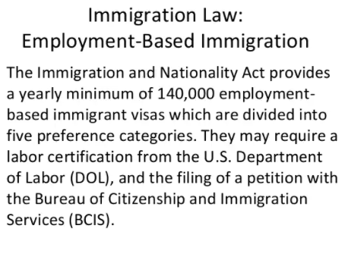
This is a slide title
The Immigration and

Slide 18
3. Marriage-based immigration

Slide 19
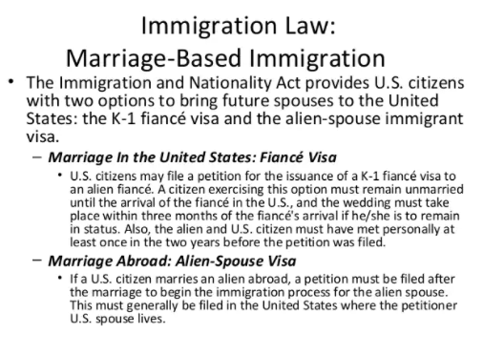
You can also split your content
White
Is the color of milk and fresh snow, the color produced by the combination of all the colors of the visible spectrum.
Black
Is the color of ebony and of outer space. It has been the symbolic color of elegance, solemnity and authority.

Slide 20
4. Diversity lottery

Slide 21
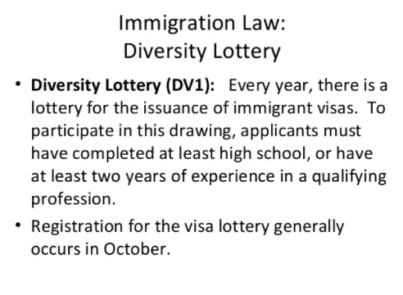
In two or three columns
Yellow
Is the color of gold, butter and ripe lemons. In the spectrum of visible light, yellow is found between green and orange.
Blue
Is the colour of the clear sky and the deep sea. It is located between violet and green on the optical spectrum.
Red
Is the color of blood, and because of this it has historically been associated with sacrifice, danger and courage.

Slide 22
Thanks!

