Slide 2
BRITISH CULTURE 2
Lecturer: Cam Lien, M.A
Email: camlien0104@gmail.com
Phone: 0947320041

Slide 3
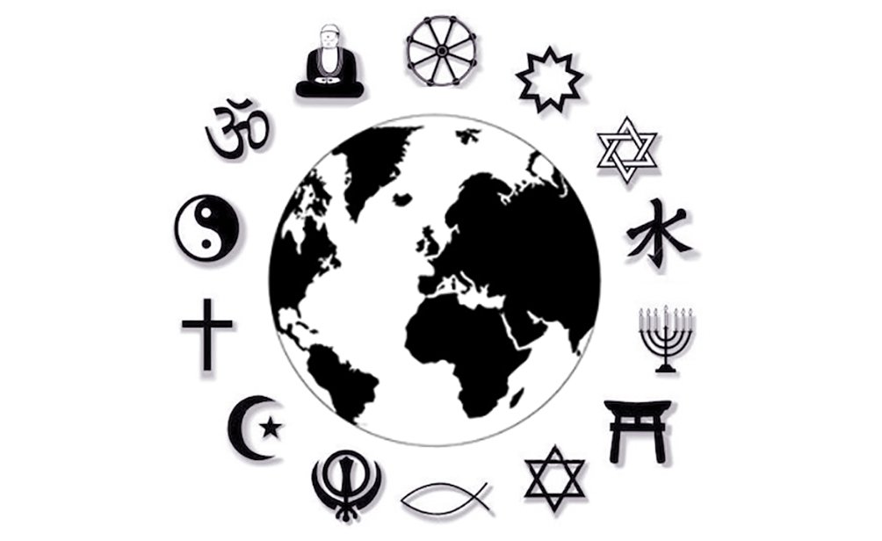
RELIGION IN THE UK

Slide 4
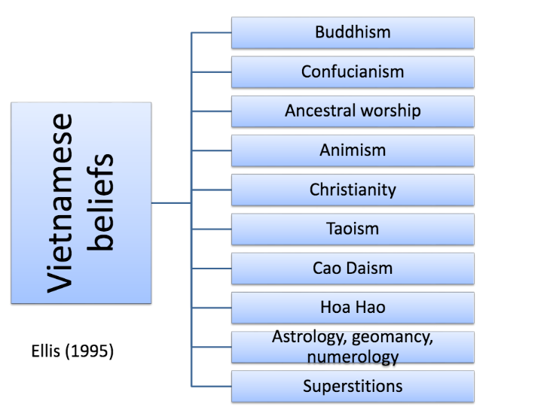
Source 4.
Notes:
Caodaism (Vietnamese: Đạo Cao Đài, Chữ nôm: 道高臺) is a monotheistic religion officially established in the city of Tây Ninh in southern Vietnam in 1926.
Đạo Hòa Hảo is a religious tradition, based on Buddhism, founded in 1939 by Huỳnh Phú Sổ (Popularly called Phật thầy, "Buddha Master" in Vietnamese), a native of the Mekong River Delta region of southern VietnamIn Hòa Hảo homes, a plain brown cloth serves as an altar, at which the family prays morning and night. destined to save mankind from suffering and to protect the Vietnamese nation.
Geomancy: the art of placing or arranging buildings or other sites auspiciously; divination from configurations seen in a handful of earth thrown on the ground, or by interpreting lines or textures on the ground.
Numerology is any belief in the divine, mystical relationship between a number and one or more coinciding events.

Slide 5
Discussion
1. What is the official religion of the United Kingdom?
2. Who is the supreme head of the Church of England?
3. What are major religions in the UK?
4. Which religion has the largest number of followers in the UK?
5. The UK is said to be religiously diverse but what does this mean?
6. How many bishops are there in the House of Lords?

Slide 6
Politics and Religion

Slide 10
Anglicanism

