Slide 2
BRITISH CULTURE 1
Lecturer: Cam Lien, M.A
Email: camlien0104@gmail.com
Phone: 0947320041

Slide 3
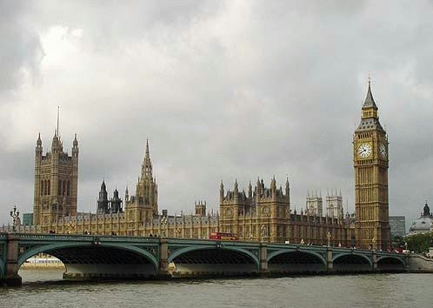
Politics in Britain
The Government and Parliament

Slide 4
British sovereignty consists in 3 elements:
the Crown
Government
Parliament

Slide 5
Group work
1. Who runs the UK?
2. What are the most important ministers called?
3. Who are in the Cabinet of the UK?
4. Who is the Prime Minister?
5. Where does the British Prime Minister live?
6. Where does the British Parliament work?
7. How many row of benches are there inside the meeting room of the House of Commons?
8. How many members are there in the House of Commons?
9.Who chairs and controls discussion in the House of Commons?
10. Who are frontbenchers and backbenchers?

Slide 6
The Government
Prime Minister (PM): leader of the party which has won the majority in the Parliament (largest numbers of MPs)
The Cabinet: Prime Minister appoints a team of main ministers as the Cabinet (about 20 people).
Most heads of the government departments have the title Secretary of State

Slide 7
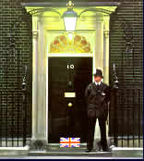
The Cabinet meets at the Prime Minister’s house (official residence) – number 10 Downing street.

Slide 8
The Parliament
British Parliament works in a large building called the Palace of Westminster or The Houses of Parliament

Slide 9
The Houses of Parliament

Slide 10
Contains
Offices
committee rooms
Restaurants
bars
libraries
and even some places of residence

Slide 11
Parliament consists of the House of Commons and the House of Lords.
more important

Slide 12
The House of Commons

Slide 13
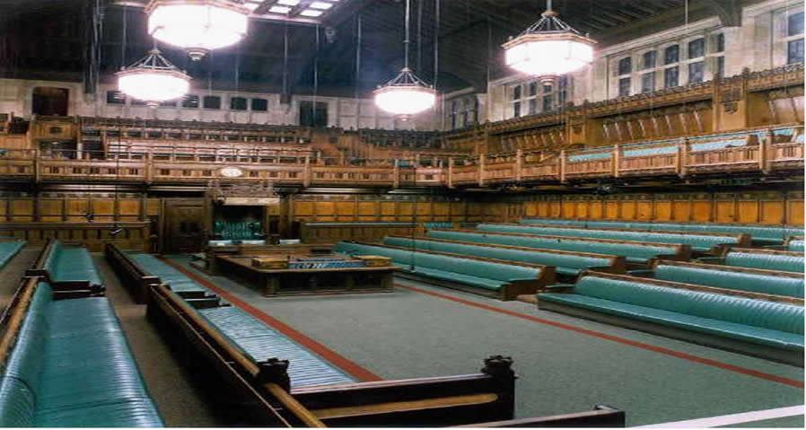
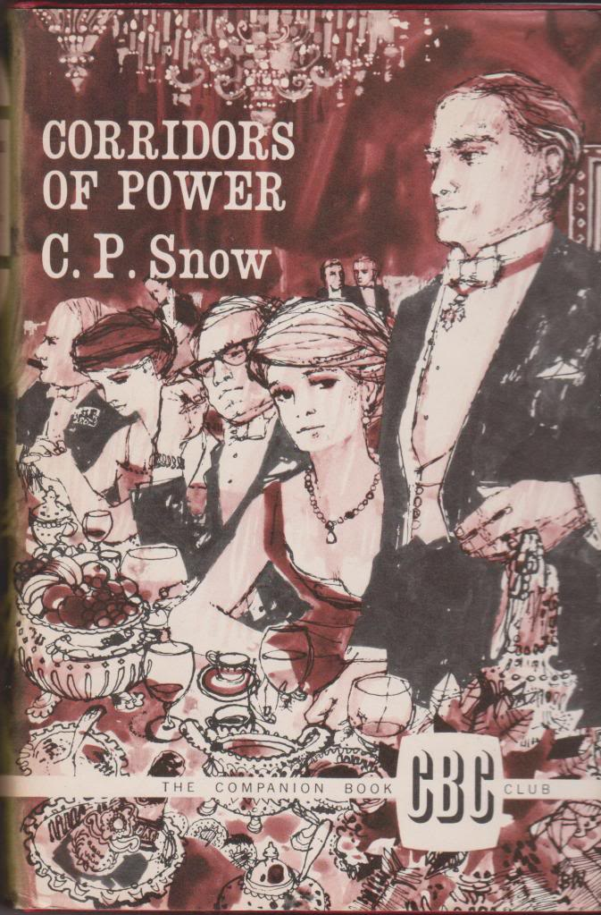
The House of Commons
There are at present 650 members of the House of Commons, who are elected by people every five years.
Members of the House of Commons are known as MPs (Members of Parliament)
speaker
Ruling party
opposition

Slide 14
The Speaker
The Speaker is the person who chairs and controls discussion in the House

Slide 15
House of Lords
Has no real power and only limited influences
Four different types of Lords
1. Life Peer (huân tước suốt đời)
2. Law Lords (luật sư)
3. Bishops and archbishops (Giám mục và tổng giám mục)
4. Hereditary peers (thượng nghĩ sĩ cha truyền con nối)

Slide 16
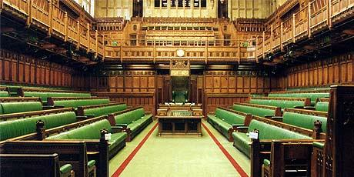
The atmosphere of the Parliament
Seating arrangements: two rows of benches facing each other
No special place for MPs to stand when they are speaking

Slide 17
The atmosphere of the Parliament
No desks for MPs
The room is small (there isn't enough room for all MPs)

Slide 18
Atmosphere?
Formal
Informal
Informal
MPs are forbidden to address one another by NAME
(my honourable member for Winchester or my right honourable friend)
MPs never say “you”

Slide 19
Hansard
This is the name given to the daily verbatim reports of everything that has been said in the Commons.

Slide 20
Frontbenchers and Backbenchers
Front benches are where the leading members of both parties sit
Back benches are where other MPs (do not hold a government post or a post in the shadow cabinet) sit
Frontbenchers
Backbenchers

Slide 21
How a bill become a law
royal assent
Act of Parliament/ Law

Slide 22
Discussion
1. Who runs the UK?
2. What are the most important ministers called? What are the most important Secretaries of State?
3. Who are in the Cabinet of the UK?
4. Who is the Prime Minister and what is his job?
5. Where does the British Prime Minister live?
6. Where does the British Parliament work?
7. How many row of benches are there inside the meeting room of the House of Commons?
8. How many members are there in the House of Commons? Who chairs and controls discussion in the House of Commons?
9. Who are frontbenchers and backbenchers?
10. How does Parliament make new laws?

Slide 23
EXERCISE
1. Who does the monarch normally choose as Prime Minister?
a. the leader of the strongest party
b. the leader of parliament
c. anybody he or she likes

Slide 24
2. Where does the Prime Minister live?
a. 10 Trafalgar Street
b. 10 Downing Street
c. 10 Balmoral Castle

Slide 25
3. By what name is the Palace of Westminster generally known?
a. The Houses of Parliament
b. The House of Commons
c. The House of Lords

Slide 26
4. Which pronoun must a MP never use when speaking in Parliament?
a. She
b. I
c. You

Slide 27
5. Which 'House' will you NOT find in Parliament?
a. House of Lords
b. House of Tudor
c. House of Commons

Slide 28
6. MP stands for member of politics.
a. True
b. False

Slide 29
7. Which of the two bodies is considered the “upper chamber”?
a. The House of Burgesses
b. The House of Lords
c. The House of Commons

Slide 30
8. After both Houses have reached agreement, the bill receives the ______________and thus becomes an Act of Parliament.
a. the royal assent
b. the royal agreement
c. the royal assignment

Slide 31
9. What is the name given to the leader of the UK government?
a. The First Minister
b. The Monarch
c. The Prime Minister

Slide 32
10. How often are members of the UK Parliament elected?
a. Every five years
b. Every year
c. Every four years

