Slide 1
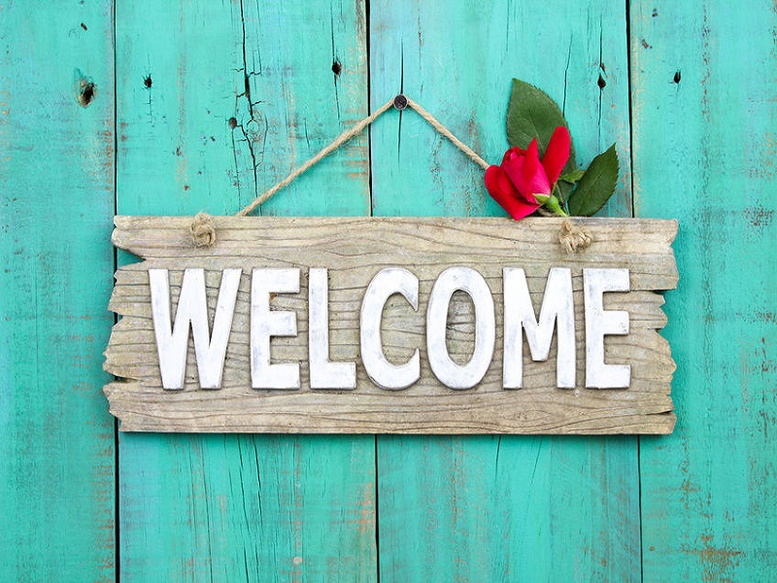

Slide 2
BRITISH CULTURE 2
Lecturer: Cam Lien, M.A
Email: camlien0104@gmail.com
Phone: 0947320041

Slide 3
CHAPTER 2: ATTITUDES

Slide 4
Stereotypes and Change
Public life
The annual ceremony of the state opening of the Parliament ➔ follow the customs carefully
Military ceremony of “trooping the colour”
Changing of the guard outside Buckingham palace
NEVER CHANGE

Slide 5
Stereotypes and Change
Private everyday life
British are probably less inclined to follow tradition
There are few age-old customs
English language has fewer sayings or proverbs in common everyday use than other languages

Slide 6
Stereotypes and Change
Stereotyped image of London “city gent” wearing bowler hat ➔ not typical any more
Traditional British breakfast is large “fry-up” ➔ not typical any more
The tradition of afternoon tea ➔ minority activity (retired people, leisured upper –middle class)

Slide 7
Queuing
Why?
Fairness/ they want everything to be fair

Slide 8
Anti-intellectualism
Teacher and academic staff although respected, do not have as high status in society as they do in most other countries
Traditionally, large sections of both upper and working class were not interested in their children getting to university

Slide 9
It is still unusual for parents to arrange extra private tuition for their children
➔ Small proportion of population holds such attitudes. (England)
British people like to know things especially quizzes

Slide 10
English anti-intellectualism vocabulary
Swot: someone who worked hard and did well academically
Teacher’s pet: students show desire to learn
Clever: a person who cannot quite be trusted/ somebody who “get all ideas from books”
intellectual
Negative meaning

Slide 11
A multicultural society
It’s made up of four different nations - England, Scotland, Wales, and Northern Ireland are all different countries with different dialects, customs, music, and languages.
Different cities in the UK also have different proportions of various ethnic groups.
For example:
London has Indian community
Liverpool has an old Black community. Liverpool is also home to the oldest Chinese community.

Slide 12
Conservatism
British people like symbols of tradition
For example:
Like traditional family values (both parents married and living together, parents as the main source of authority for children, etc)
Enjoy living the the old houses
Like Christmas cards to depict scenes from past centuries
Like pubs to look old
Complain bitterly when system of currency was changed

Slide 13
Being different
Driving on left- hand side
Remaining 1 hour behind Central European Time
Start its financial year at the beginning of April
System of measurement is metric system (feet/mile/stone...)

Slide 14
Love of nature
The first country in the world appoint a government-sponsored conservation body (1949) and the first large green pressure group was founded (1961)
Ideal vision of the countryside: Countryside means peace and quiet, beauty, health, and no crime.
Gardening is one of the most popular hobbies in the country and gardening programmes on radio and TV are very popular.

Slide 15
Love of animals
British tend to have a sentimental attitude to animals
Half of households (50%) in Britain keep at least one domestic pet
“Bird-tables” in the garden: a raised platform on which birds can feed

Slide 16
Formality vs Informality
Formal | Informal
Clothes Public role (On duty) Shake hand Address someone by his or her titles (Mr, Mrs…) Dressing smartly when entertaining guests Saying ‘please’ when making a request Strangers/ Acquaintance | Clothes Private role (being themselves) Not shake hand Not address someone by his or her titles (Mr, Mrs…) Not dressing smartly when entertaining guests Not saying ‘please’ when making a request Friends

Slide 17
Kiss when meeting friends (both women and women, men and women, rarely men and men)

Slide 18
Privacy and sex
Rude to ask personal questions (salary, family, sex life) or keep silent
In passing, casual conversation, British people talk about the weather because they want to fill the gap (They don't like silence)

Slide 19
EXERCISE
1. Why do the British normally form queues when they are waiting for something?
a. they are patient
b. they want things to be fair
c. they like good order

Slide 20
2. What proportion of British households keep an animal as a pet?
a. About 10%
b. About 30%
c. About 50%

Slide 21
3. What is a bird table?
a. a dish made with turkey and chicken
b. a specially designed garden cable with thin legs
c. a raised platform on which birds can feed

Slide 22
4. In Britain, which two people are LEAST likely to kiss when meeting each other?
a. a man and woman
b. two men
c. two women

Slide 23
5. In passing, casual conversation, British people talk about the weather because .........
a. It is correct behaviour
b. They don't like silence
c. They are fascinated by it

Slide 24
6. British people feel comfortable when somebody asks them about personal information.
a. True
b. False

Slide 25
7. To British people, countryside means peace and quiet, beauty, health and no _________.
a. crime
b. job
c. money

Slide 26
8. What system of measurement is used in the UK?
a. International System of Units
b. customary system
c. metric system

Slide 27
9. Which unit is used to talk about distance in Britain?
a. feet
b. stone
c. mile

Slide 28
10. Which of the following descriptions is not negative?
a. s/he's a teacher's pet
b. s/he's a swot
c. s/he's got common sense

