Slide 1
Session 4 Unit 7: Reading 2 Unit 8: Reading 2

Slide 2
Unit 7 What’s Your Medicine ?

Slide 3
Unit 7: Write the words from the box next to their definitions. Not all of the words will be used.
____________________ 1. An area on your body that is larger than usual because of injury
____________________ 2. The liquid in your mouth
____________________ 3. Tubes that bring blood back to the heart from the rest of the body
____________________ 4. When a liquid moves slowly from one place to another
____________________ 5. Someone who is getting medical treatment
____________________6. To feel calm and not be excited
____________________ 7. Medicine that kills bacteria or infections
____________________ 8. A wrap used to protect a swollen body part
antibiotic blood patient relax swelling
bandage flow popular saliva veins

Slide 4
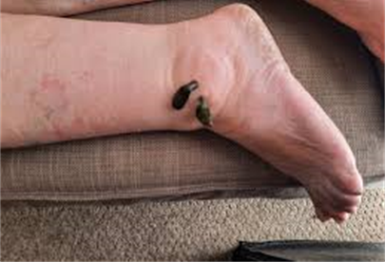
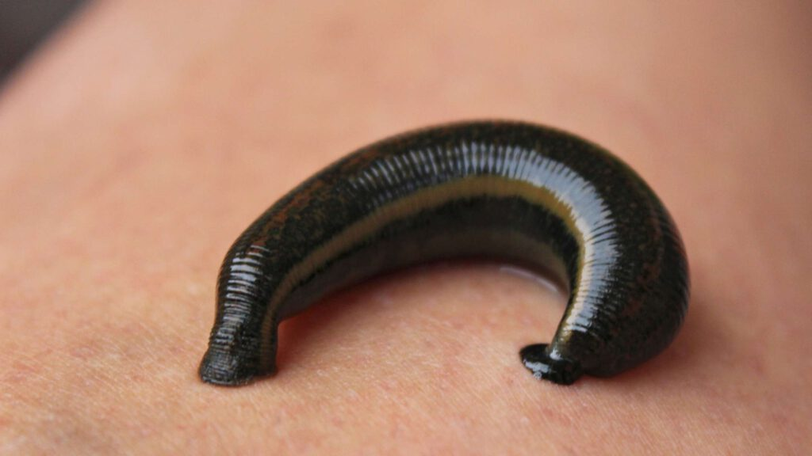
GROSS MEDICINE By Shetal Shah gross: very unpleasant to look at or think about

Slide 5
1. Shah was travelling through _____ when he fell off his bike. A. a village B. Botswana C. the mountains 2. Shah’s ankle was swollen because _____ . A. the leeches bit him B. the rode his bicycle too fast C. he cut his ankle and didn’t wash or bandage it. 3. Shah needed a hospital. He couldn’t get to one soon because _____ . A. he didn’t have a donkey B. it would take too long on his bicycle C. his car was too slow. 4. Ntemisidang tried to make Shah laugh. He ____ . A. was nervous B. wanted Shah think he was funny C. wanted Shah to stop thinking about the leeches 5. The leeches helped Shah because they _____ . A. cured him by healing the infection in his ankle C. made him relax B. took away the swelling so he could bike to the hospital
GROSS MEDICINE By Shetal Shah 1. I was trying to lie still and close my eyes. But I had to look. 2. They looked brown like chocolates. In fact, they were dark-green. But these “chocolates” were leeches. They were sucking the pus from my ankle. They were looking for blood. 3. This happened to me last summer when I rode my bicycle across Botswana, Africa. One day, I fell off my bike and got a small cut on my ankle. I forgot to wash the cut or put a bandage on it. 4. Three days later, I couldn’t put on my shoe because my foot was so swollen. The pain in my ankle was terrible. And it was moving up my leg. I needed to find a doctor fast. But in Botswana, near the Kalahari Desert, a trip to the hospital looked like this: one day by car, three days by bicycle, or six days by donkey. This is when I met Ntemisidang and the leeches. 5. Ntemisidang was a traditional doctor from a village four kilometers away. He look at the cut. He pushed on it carefully. Then he put his hand on my forehead and nodded his head. Yes, I had a fever. He said | he had to take the pus out of the ankle before I could bicycle to the city the next day to get some antibiotics. 6. Ntemisidang smiled to help me relax. He put a wet cloth on my forehead and opened a small metal box. Inside this dirty little box were the leeches. 7. I put my head back and watched the stars. I tried to think of other things. But I felt something cool on my skin. Ntemisidang put the leeches gently around the cut on my ankle. Suddenly, I felt them bite, and then I didn’t feel anything. 8. Ntemisidang tried to make me laugh and forget about what was happening on my ankle. He wasn’t funny, but I laughed. 9. An hour later, my ankle was bandaged and Ntemisidang was smiling, I was smiling too. I thanked him for helping me, and we said goodbye. Two days later, after riding 240 kilimeters to the next city, I found a hospital. As the doctor was giving me a shot of antibiotics, I was thinking, “I sure don’t like shots, but at least they aren’t as gross as leeches!”

Slide 6
GROSS MEDICINE By Shetal Shah 1. I was trying to lie still and close my eyes. But I had to look. 2. They looked brown like chocolates. In fact, they were dark-green. But these “chocolates” were leeches. They were sucking the pus from my ankle. They were looking for blood. 3. This happened to me last summer when I rode my bicycle across Botswana, Africa. One day, I fell off my bike and got a small cut on my ankle. I forgot to wash the cut or put a bandage on it. 4. Three days later, I couldn’t put on my shoe because my foot was so swollen. The pain in my ankle was terrible. And it was moving up my leg. I needed to find a doctor fast. But in Botswana, near the Kalahari Desert, a trip to the hospital looked like this: one day by car, three days by bicycle, or six days by donkey. This is when I met Ntemisidang and the leeches. 5. Ntemisidang was a traditional doctor from a village four kilometers away. He look at the cut. He pushed on it carefully. Then he put his hand on my forehead and nodded his head. Yes, I had a fever. He said Which phrase is the main idea of each paragraph? ____ Introduction. ____ The doctor examined the writer. ____ The doctor started the treatment. ____ The writer got the modern treatment. | he had to take the pus out of the ankle before I could bicycle to the city the next day to get some antibiotics. 6. Ntemisidang smiled to help me relax. He put a wet cloth on my forehead and opened a small metal box. Inside this dirty little box were the leeches. 7. I put my head back and watched the stars. I tried to think of other things. But I felt something cool on my skin. Ntemisidang put the leeches gently around the cut on my ankle. Suddenly, I felt them bite, and then I didn’t feel anything. 8. Ntemisidang tried to make me laugh and forget about what was happening on my ankle. He wasn’t funny, but I laughed. 9. An hour later, my ankle was bandaged and Ntemisidang was smiling, I was smiling too. I thanked him for helping me, and we said goodbye. Two days later, after riding 240 kilometers to the next city, I found a hospital. As the doctor was giving me a shot of antibiotics, I was thinking, “I sure don’t like shots, but at least they aren’t as gross as leeches!” e. ____ The doctor tried to ease the writer f. _____ The writer’s treatment with leeches. g. _____ How the writer got cut. h. _____ Leeches’ description. i. _____ The writer’s pain got worse.

Slide 7
Unit 7: A Doctor’s Journal 1 As a pediatrician,¹ I see a lot of patients with sore throats and swollen ankles that need bandages. Often, parents try to treat their children at home before they bring them to my office. For a sore throat, I may take a sample of their saliva and look at any swelling before giving them a shot or an antibiotic. 2 I am surprised sometimes by parents’ home remedies. The most popular remedies usually don’t work. For example, chicken soup is not a cure for colds and fevers, just a way to treat a sore throat. But there are a few surprising home remedies that work and have a scientific explanation. 3 One home remedy that works is for earaches. Cut an onion in half and put it in the oven. When the onion is comfortably warm to the touch, take it out of the oven and gently put it on the ear with the earache. Relax for a while. You will find that the earache might start to feel better. The reason is the onion releases a gas that treats earaches, and the heat helps the gas move into your ear. 4 My favorite home remedy is the wet sock² cure. It sounds unusual, but unlike chicken soup, this can treat a fever. First, put your feet in hot water. Put socks in cold water. Then put the cold, wet socks on your feet. After that, put warm, dry socks on top of the wet ones, so you are wearing two socks on each foot. Then go to bed. In the morning, you will not have a fever. The cure is complicated, but the wet socks help the flow of blood through your veins, and this is what gets rid of the fever. If this doesn’t work, be sure to call your doctor. ¹ pediatrician: a doctor for children ² sock: clothing you wear on your foot, inside your shoe
A. Choose the best answer. 1. According to Doctor Wailer, chicken soup can treat
a(n) ____. A. cold B. fever C. earache D. sore throat 2. Dr. Wailer works ____. A. in a school B. at her office C. in her home D. on the Internet 3. Dr. Wailer thinks patients with a fever should try ____. A. chicken soup B. the onion cure C. the wet sock cure D. talking to a doctor
4. Dr. Wailer says ____ helps cure an earache. A. hot water B. a dry sock C. blood flow D. half an onion 5. Dr. Wailer probably thinks the onion cure and wet sock
cure ____. A. don’t work at all B. are a little strange C. cause stomachache D. aren’t good for children
6. The home remedies in the article are best described
as ____. A. not effective B. maybe effective C. always effective

Slide 8
Unit 8 Endangered Cultures

Slide 9
Unit 8 A. Read the paragraph about the Qashqai people. Use the words from the box to fill in the blanks. Not all of the words will be used. ancestors endangered powerful settled convince holy roots unique The Qashqai live in southwestern Iran. Many indigenous tribes have disappeared in Asia and the Middle East, but the Qashqai still survive. The Qashqai have their earliest (1). ________________ in Central Asia, and their (2). ________________ arrived in what is now Iran 500 years ago. Today, many Qashqai have moved and (3). ________________ in cities. A (4). ________________ and different Qashqai custom is making rugs. Many Qashqai (5). ________________ tourists to buy their rugs. They are one of the biggest indigenous groups in the world, with more than 400,000 people. The Qashqai are not a(n) (6). ________________ culture.

Slide 10
Unit 8 B. Choose the sentence that does not make sense. Pay attention to the boldfaced words. 7. A. To find enough water, desert people often must be nomadic. B. The San people often travel because of their nomadic lifestyle. C. Nomadic Inuit people have always lived in the same part of Alaska. 8. A. Some Xavante people adapt their hair color to bright red. B. Slowly, many Qashqai adapted to life in the city. C. Many Ariaal children are adapting to Kenyan schools. 9. A. Disease destroyed many Native American tribes, and they disappeared. B. The customer destroyed the rug a little, so the Qashqai woman fixed it. C. The fire destroyed the small village, and there were no buildings left. 10. A. It is difficult for traditional cultures to survive in a modern world. B. The Xavante work together to survive in the Amazon Rain Forest. C. It can be hard to survive during the warm spring months of the year.

Slide 11
THE PENAN: PEOPLE OF THE FOREST

Slide 12
THE PENAN: PEOPLE OF THE FOREST 1. I am going back to visit my Penan friends after 10 years. The big ships are the first thing I see as I turn my boat to go up the river. They are waiting to get filled up with logs from the forests where the Penan live. 2. When I arrive at the Penan village of Long Iman, my old friend, Tu’o, greets me warmly. Tu’o was born a nomad. But 30 years ago, the Malaysian government convinced Tu’o to move to Long Iman. The government said that it was better for the Penan to live in villages and become part of modern Malaysia. But they also wanted to sell the forest to the logging companies. Since that time, thousands more Penan have moved to the villages. The Penan fought to keep their home in the forest, but the logging companies were too powerful. 3. Long Iman is a sad place. The river is dirty, and there is mud everywhere. In the evening, children watch television, but they don’t understand the language. Tu’o says he is sorry about the small amount of food at dinner. “How can you feed your guests in a village? It’s not like the forest where there is a lot of food. The number of nomadic Penan in the forest is _____. increasing b. staying the same c. decreasing One reason the forest is disappearing is _____ . the Penan are burning it the government is building villages c. The logging companies are cutting it down. | In the forest, I can give you as much as you want. Here, you just sit and look at your guests, and you can’t give them anything. My house here is strong, and we have beds and pillows. But you can’t eat a pillow.” 4. I am here to find one of the last groups of Penan nomads. There are only about 300 Penan nomads left. The group I am looking for now lives in the Gunung Mulu National Park, where the forest is safe from logging companies. Tu’o says he will take me to them. We leave the next morning. After three days of travelling, we reach the nomads. 5. Asik, the leader, welcomes us. In the evening, we eat with the nomads. We eat baskets of beautiful fruits, mushroom soup, delicious vegetables, and two pigs – all collected or caught in the forest. Sharing is an important part of the Penan’s way of life. They do not even have a word for “thank you”. 6. I ask Asik about the villages like Long Iman. He says, “There are no more trees, and all the land is no good. The animals are gone; the river is muddy. Here we sleep on hard logs, but we have plenty to eat.” 3. _____ Long Iman. Tu’o was born in b. The government asked Tu’o to move to c. Tu’o decided himself to move to 4. Tu’o is sorry he doesn’t have more _____. boats for the river b. food for his guests c. children to help him 5. The nomadic Penan are happy because they have _____. lots of food b. lots of logs c. muddy river

Slide 13
Unit8 Will the Internet Be Good for the Xavante? 1 There are about 9,600 Xavante people in the world. Their roots are in northern Brazil, but they have settled in the south of the country, in the Amazon Rain Forest. The Xavante are nomadic, moving around the area to hunt animals and gather plants. Life is slowly changing for this endangered culture. The Internet has come to their villages. Some Xavante are happy and others are not, but they all must learn to adapt. 2 Alexandre Tsereptse, the leader of a village of 800 people, was not happy to be connected to the Internet. “I don’t think it’s a good thing, because it’s a threat to our culture,” he protested. Xavante customs are holy to Tsereptse. He is afraid the Internet will destroy these customs and replace them with a Western way of life. 3 Many young people in his village disagreed. They tried to convince others that the Internet would help Xavante culture survive. “It could be a way to record our history,” said Bartolomeu Patira Prenhopa. Prenhopa wants to use the Internet to tell students like him in other countries about his ancestors, language, and unique Xavante traditions. 4 Almir Narayamoga Surui, leader of a village of 1,200 people, wanted the Internet for a different reason—as a powerful tool against logging companies that illegally cut down trees. “When we have any problems with loggers, we can denounce¹ them in a quicker way,” he said. Many environmental groups, technology companies, and the Brazilian government are working to help the Xavante fight illegal logging. 5 The Internet is already providing new opportunities for the Xavante. They have created their own website that brings attention to the damage people are doing to their land and their environment. The website also teaches people about the Xavante culture and way of life. ¹ denounce: publicly express disapproval of someone or something
A. Choose the best answer. 1. The Xavante people live in the ____. A. city B. desert C. forest D. mountains 2. Alexandre Tsereptse was against having the Internet
because he didn’t ____. A. believe that everyone would use it B. know what a computer looked like C. want the Xavante to lose their culture D. think the Xavante would listen to him 3. Some Xavante want to use the Internet to ____. A. fight illegal logging and choose leaders B. choose leaders and study Western culture C. study Western culture and record their history D. tell about their culture and fight illegal logging 4. Bartolomeu Patira Prenhopa is probably ____. A. a holy man B. a young person C. a village leader D. an illegal logger 5. Bringing Internet to the Xavante has ____. A. caused them to be endangered B. made them forget their history C. brought attention to their culture D. allowed them to make more money

Slide 14
Unit8 Will the Internet Be Good for the Xavante? 1 There are about 9,600 Xavante people in the world. Their roots are in northern Brazil, but they have settled in the south of the country, in the Amazon Rain Forest. The Xavante are nomadic, moving around the area to hunt animals and gather plants. Life is slowly changing for this endangered culture. The Internet has come to their villages. Some Xavante are happy and others are not, but they all must learn to adapt. 2 Alexandre Tsereptse, the leader of a village of 800 people, was not happy to be connected to the Internet. “I don’t think it’s a good thing, because it’s a threat to our culture,” he protested. Xavante customs are holy to Tsereptse. He is afraid the Internet will destroy these customs and replace them with a Western way of life. 3 Many young people in his village disagreed. They tried to convince others that the Internet would help Xavante culture survive. “It could be a way to record our history,” said Bartolomeu Patira Prenhopa. Prenhopa wants to use the Internet to tell students like him in other countries about his ancestors, language, and unique Xavante traditions. 4 Almir Narayamoga Surui, leader of a village of 1,200 people, wanted the Internet for a different reason—as a powerful tool against logging companies that illegally cut down trees. “When we have any problems with loggers, we can denounce¹ them in a quicker way,” he said. Many environmental groups, technology companies, and the Brazilian government are working to help the Xavante fight illegal logging. 5 The Internet is already providing new opportunities for the Xavante. They have created their own website that brings attention to the damage people are doing to their land and their environment. The website also teaches people about the Xavante culture and way of life. ¹ denounce: publicly express disapproval of someone or something
B. Read each statement.
Write T if the statement is true or F if it is false.
Use details from the article to help you.
___ 6. The Xavante have always lived
in the south of Brazil.
___ 7. Almir Narayamoga Surui is worried about
others destroying his land.
___ 8. The author believes
that the Internet has helped the Xavante.

Slide 15
Thank You for Your Attention !

