Slide 1
Session 3 Unit 5: Reading 2 Unit 6: Reading 1

Slide 2
Unit 5 We Are What We Eat

Slide 3
Unit 5 Read the letter. Use the words from the box to fill in the blanks. Not all of the words will be used. approve diet grains population complex environment insects weeds Dear Mrs. Greiber, I have a small farm in Philadelphia. Just like City Farm, I grow organic produce. Many of my customers follow a natural (1). ___________________. My farm has many problems. It is a(n) (2). ___________________ situation. Maybe you can help. The first problem is that a lot of (3). ___________________ eat my plants. What can I do? The second problem is the garden is full of (4). ___________________ in the summertime. Can you suggest something to kill them that isn’t bad for the (5). ___________________? Would you (6). ___________________ of something strong but still organic? I need your help! Thank you! Joanna Walton Philadelphia

Slide 4
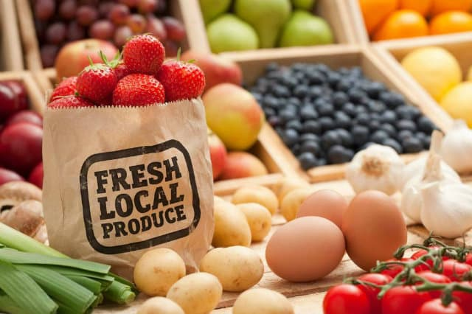
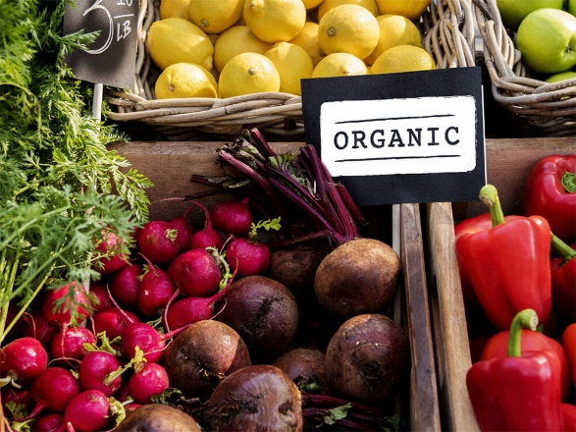
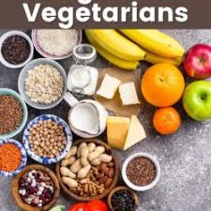
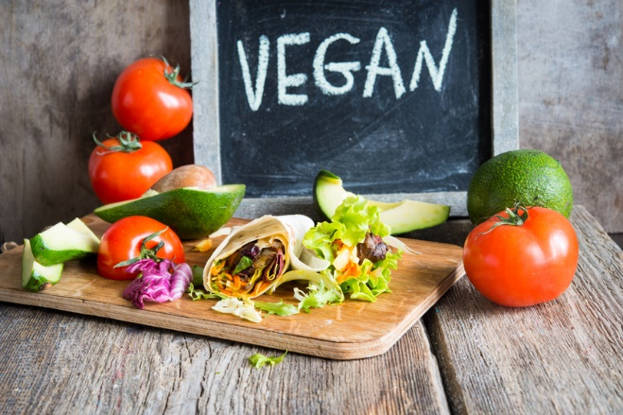
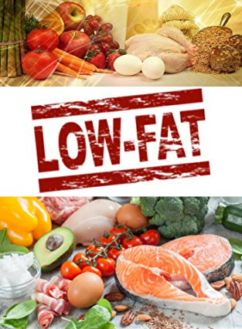
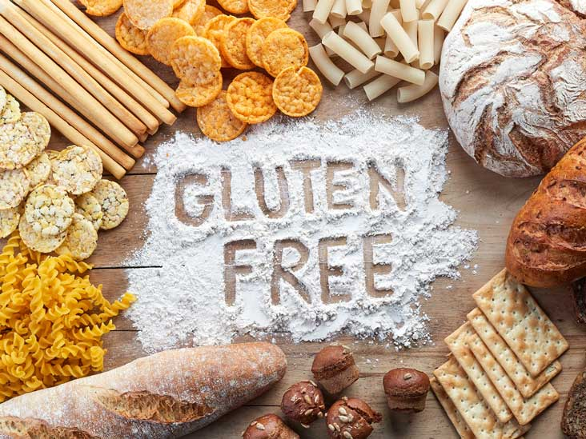
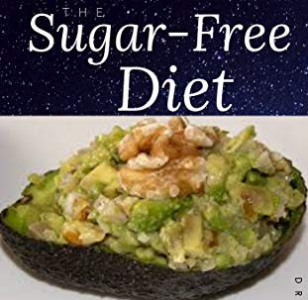
i

Slide 5
TRAVELLING TIPS FOR YOU Making Sense of the American Diet 1. Hamburgers and French fries are known all over the world as “typical American food.” But when you travel in the United States, you will see that Americans choose many different kinds of diets. As a matter of fact, many Americans spend a lot of time thinking very hard about how and what they eat. They think that the traditional American diet is bad for their health and bad for the environment. As a result, you will see many labels and descriptions of food that might seems confusing. Here is a short guide to help you understand some of the choices: 2. ORGANIC food are grown with no pesticides or herbicides. There are also no GMOs in organic food. People who choose organic foods think that they are better for their health and for the environment. 3. VEGETARIAN food contains no meat. People choose a vegetarian diet for a number of reasons. Some believe that eating meat is not good for their health. Others have environmental reasons. They believe eating plants is better for the environment. Cows and other “meat” animals at the top of the food chain need lots of food, water, and energy. Carrots, beans, and potatoes, on the lower end of the food chain, need much less. Still others believe that people should not eat animals for ethical reasons. They believe that humans should not kill animals for any reason. 4. VEGAN food contain nothing at all from animals: no meat, no milk, no eggs, no honey, and no butter, for example. Reasons for eating a vegan diet are very similar to reasons for eating a vegetarian diet. But vegan eaters don’t think that humans should use animals for food at all. 5. LOCAL food is grown less than 100 miles from you. Local food is usually very fresh. And buying it helps nearby farms and other businesses. People who eat local food also care about the environment. They don’t want to eat food that must travel far by trucks, boats, and planes because it uses too much gasoline. This causes more pollution. 6. LOW-FAT foods have very little (for example, butter or oil) in them. People who are trying to lose weight, or people who have heart disease often eat low-fat diets. Many Americans have heart disease or are overweight, so low-fat diets and foods are very common in the U.S. 7. GLUTEN-FREE foods contain no gluten. Gluten is in wheat and many other grains. People with a gluten-free diet are usually allergic to gluten. They might get very bad stomachaches if they eat this. A. someone who doesn’t want to eat animal, but who likes milk, eats _____. B. Someone who doesn’t want to eat animals or anything made by animals eats _____. C. Someone who wants to loose weight eats _____. D. Someone who doesn’t want to eat GMOs and pesticides eats _____. E. Someone who want to supports farmers in nearby areas eats _____. F. Someone who is allergic to wheat eats _____.

Slide 6
Scanning for Information - What? Scanning is looking for specific information within the text. - How? Quickly moving your eyes over the words until you find the information you are looking for. - Example : What are the foods that are not allowed in vegan diet? VEGAN food contain nothing at all from animals: no meat, no milk, no eggs, no honey, and no butter, for example. Reasons for eating a vegan diet are very similar to reasons for eating a vegetarian diet. But vegan eaters don’t think that humans should use animals for food at all.
____________________________________
_____

Slide 7
TRAVELLING TIPS FOR YOU Making Sense of the American Diet 1. Hamburgers and French fries are known all over the world as “typical American food.” But when you travel in the United States, you will see that Americans choose many different kinds of diets. As a matter of fact, many Americans spend a lot of time thinking very hard about how and what they eat. They think that the traditional American diet is bad for their health and bad for the environment. As a result, you will see many labels and descriptions of food that might seems confusing. Here is a short guide to help you understand some of the choices: 2. ORGANIC food are grown with no pesticides or herbicides. There are also no GMOs in organic food. People who choose organic foods think that they are better for their health and for the environment. 3. VEGETARIAN food contains no meat. People choose a vegetarian diet for a number of reasons. Some believe that eating meat is not good for their health. Others have environmental reasons. They believe eating plants is better for the environment. Cows and other “meat” animals at the top of the food chain need lots of food, water, and energy. Carrots, beans, and potatoes, on the lower end of the food chain, need much less. Still others believe that people should not eat animals for ethical reasons. They believe that humans should not kill animals for any reason. 4. VEGAN food contain nothing at all from animals: no meat, no milk, no eggs, no honey, and no butter, for example. Reasons for eating a vegan diet are very similar to reasons for eating a vegetarian diet. But vegan eaters don’t think that humans should use animals for food at all. 5. LOCAL food is grown less than 100 miles from you. Local food is usually very fresh. And buying it helps nearby farms and other businesses. People who eat local food also care about the environment. They don’t want to eat food that must travel far by trucks, boats, and planes because it uses too much gasoline. This causes more pollution. 6. LOW-FAT foods have very little (for example, butter or oil) in them. People who are trying to lose weight, or people who have heart disease often eat low-fat diets. Many Americans have heart disease or are overweight, so low-fat diets and foods are very common in the U.S. 7. GLUTEN-FREE foods contain no gluten. Gluten is in wheat and many other grains. People with a gluten-free diet are usually allergic to gluten. They might get very bad stomachaches if they eat this. Practise 1: A. Scan par. 2 for this information : What are two item that make food non-organic? B. Scan par. 5 for this information: To be local, food must be grown within how many miles? C. Scan par. 6 for this information: Who are the people who eat low-fat foods?

Slide 8
TRAVELLING TIPS FOR YOU Making Sense of the American Diet 1. Hamburgers and French fries are known all over the world as “typical American food.” But when you travel in the United States, you will see that Americans choose many different kinds of diets. As a matter of fact, many Americans spend a lot of time thinking very hard about how and what they eat. They think that the traditional American diet is bad for their health and bad for the environment. As a result, you will see many labels and descriptions of food that might seems confusing. Here is a short guide to help you understand some of the choices: 2. ORGANIC food are grown with no pesticides or herbicides. There are also no GMOs in organic food. People who choose organic foods think that they are better for their health and for the environment. 3. VEGETARIAN food contains no meat. People choose a vegetarian diet for a number of reasons. Some believe that eating meat is not good for their health. Others have environmental reasons. They believe eating plants is better for the environment. Cows and other “meat” animals at the top of the food chain need lots of food, water, and energy. Carrots, beans, and potatoes, on the lower end of the food chain, need much less. Still others believe that people should not eat animals for ethical reasons. They believe that humans should not kill animals for any reason. 4. VEGAN food contain nothing at all from animals: no meat, no milk, no eggs, no honey, and no butter, for example. Reasons for eating a vegan diet are very similar to reasons for eating a vegetarian diet. But vegan eaters don’t think that humans should use animals for food at all. 5. LOCAL food is grown less than 100 miles from you. Local food is usually very fresh. And buying it helps nearby farms and other businesses. People who eat local food also care about the environment. They don’t want to eat food that must travel far by trucks, boats, and planes because it uses too much gasoline. This causes more pollution. 6. LOW-FAT foods have very little (for example, butter or oil) in them. People who are trying to lose weight, or people who have heart disease often eat low-fat diets. Many Americans have heart disease or are overweight, so low-fat diets and foods are very common in the U.S. 7. GLUTEN-FREE foods contain no gluten. Gluten is in wheat and many other grains. People with a gluten-free diet are usually allergic to gluten. They might get very bad stomachaches if they eat this. Practise 2: Scan the reading for this information: How many reasons for each kind of diet are there?

Slide 9
Unit 5 1 Next to a shopping mall, farmers are busy picking ripe tomatoes. This is City Farm, a small farm in the middle of the large, complex city of Chicago. Outside the farm are tall buildings and streets full of cars. “It’s such a surprise in the city,” Kristine Greiber, the director of the farm, says. “It’s unexpected and magical.” 2 City Farm grows only organic produce, and its customers are the city’s population that lives nearby. They certainly approve of the farm and love the fresh lettuce, tomatoes, apples, and cherries it grows. There is a grocery store across the street where people buy grains and dairy products, but many choose to get their vegetables at City Farm. “You can’t get tomatoes over there that taste like these tomatoes,” says Mark Bystrom, a City Farm customer. 3 Many City Farm customers are allergic to certain foods or just want the benefits of a natural diet. “I like that they grow food the old-fashioned way, without any chemicals,” says Linda Evans. Customers like Linda hope that the organic offerings make their way up the food chain within the city limits. 4 Life isn’t always easy at City Farm. The farm cannot stay open year-round because of the cold Chicago winter environment. Additionally, Kristine Greiber constantly works to resist insects and weeds. She thinks the hard work and ethical way of thinking is worth it, though. “People can taste the difference,” she says with a smile. And she’s right! B. Read each statement. Write T if it is true or F if it is false. ___ 5. City Farm is not actually in the city of Chicago. ___ 6. City Farm’s vegetables taste better than other vegetables. ___ 7. Most of City Farm’s customers are from Chicago. ___ 8. A natural diet is not important to City Farm’s customers.
A. Choose the best answer. 1. Kristine Greiber is ____. A. City Farm’s director B. a farmer at City Farm
C. the owner of the grocery store
D. a customer at the grocery store 2. City Farm’s biggest problem is the ____. A. winter weather C. lack of customers B. street full of cars D. taste of the produce 3. The produce in the grocery store across the street
is not ____. A. real food C. always for sale B. safe to eat D. from City Farm
4. Customers like that the vegetables at City Farm
are always ____. A. available C. healthy B. cheap D. frozen

Slide 10
Unit 6 The Heart of a Hero

Slide 11
Unit 6 Read the sentences. Choose the definition for each boldfaced word or phrase. 1. The hero’s mentor was a wise old man who helped him. A. friend B. teacher C. brother 2. Superheroes use their powers to defeat the evil villain. A. overcome B. meet with C. learn about 3. How did the poison affect the hero and his friends? A. look like B. find C. act on 4. Heroes face danger, but they return to safety at the end of the story. A. a starting point B. an old home C. freedom from harm 5. A hero protects others who cannot help themselves. A. keeps safe B. remembers C. follows 6. Heroes often go on journeys far from home. A. dirt roads B. long trips C. new competitions

Slide 12
WHAT IS A HERO? 1. Joseph Campell (1904-1987) spent his life answering this question. Campell was a professor of literature and religion at Sarah Lawrence College in New York. He studied and taught hero stories from around the world. Over the years, he noticed that a lot of myths – a kind of hero story – are very familiar. In old myths or new ones, whether from Asia, Africa, or South America, the world’s hero stories all have the same basic shape. The details of the stories may change, but every hero story has the same three parts. 2. During the first part of any hero story, the hero starts a journey. This can be a trip from one country to another. It can be an adventure into outer space. It can be a journey into a dream world. Often the hero does not, at first, want to go on this journey. But in the end, he agrees. He leaves the safety of his home, friends, and family and goes to this new place. This place is very different from the hero’s home and is often dark and dangerous. Sometimes there is a mentor or a teacher who helps the hero understand this new place. The mentor gives the hero the tools or information he needs. For example, a kind old lady on the road may give our hero a map for his journey. A stranger may give the young hero the key to the door of the enemy king’s castle. 3. The second part in the hero story is the most exciting. This is when the hero must pass some kind of test or challenge. A common example of a test is fighting a monster. In these stories, the monster is much bigger and stronger than the hero. The hero and the readers do not, at first, believe he can kill the monster. Other common challenges include solving a problem or facing a fear such as the fear of snakes. In any challenge, the hero must use his strength, his intelligence, or his heart to pass the test. He must kill the dragon, answer the question, or trust his feelings. Of course, in the end, he always success. 4. Finally, in the third part of the hero story, the hero returns home. He is a different person now and brings what he has acquired or learned on his journey – wealth, knowledge, and wisdom – to share with his family and friends. When he returns home, other are also affected by his journey. Sometimes his enemies are embarrassed. Sometimes his family and his friends become rich. Sometimes the hero’s town becomes free. 5. Campell believes that the adventure of the hero is the adventure of being alive. Campell spent his life studying myths because he loved the stories and believed they were important. He believed that the hero’s journey is similar to a person’s life. All people live through difficult struggles (the test or challenge) and must use their strength, intelligence, and heart to succeed. He says that by going down into the darkness, we find the treasure of life. He explains that the cave we are afraid to enter has the treasure we are looking for and that when we stumble, then we will find gold. In short, Campell believes that opportunities to find deeper powers within ourselves come when life seems most difficult. 1. Main Ideas: Circle the word or phrase that best complete each statement about an idea discussed in the essay. A. Hero stories are the same / different all over the world. B. Hero stories usually have two/ three main parts. C. Hero stories are important because they are similar to / different from life in general.

Slide 13
2. Details : Check (√) the words or phrases that always belong to the three parts of the hero story. Part one: a journey ___ a castle ___ an adventure ___ a dream ___ leaving home ___ a mentor/ teacher ___ coming home ___ 2. During the first part of any hero story, the hero starts a journey. This can be a trip from one country to another. It can be an adventure into outer space. It can be a journey into a dream world. Often the hero does not, at first, want to go on this journey. But in the end, he agrees. He leaves the safety of his home, friends, and family and goes to this new place. This place is very different from the hero’s home and is often dark and dangerous. Sometimes there is a mentor or a teacher who helps the hero understand this new place. The mentor gives the hero the tools or information he needs. For example, a kind old lady on the road may give our hero a map for his journey. A stranger may give the young hero the key to the door of the enemy king’s castle.
.
.

Slide 14
2. Details : Check (√) the words or phrases that always belong to the three parts of the hero story. Part two: a test/ challenge ___ a monster ___ a fight ___ solving a problem ___ facing a fear ___ snakes ___ succeeding at the challenge 3. The second part in the hero story is the most exciting. This is when the hero must pass some kind of test or challenge. A common example of a test is fighting a monster. In these stories, the monster is much bigger and stronger than the hero. The hero and the readers do not, at first, believe he can kill the monster. Other common challenges include solving a problem or facing a fear such as the fear of snakes. In any challenge, the hero must use his strength, his intelligence, or his heart to pass the test. He must kill the dragon, answer the question, or trust his feelings. Of course, in the end, he always success.
.
.

Slide 15
2. Details : Check (√) the words or phrases that always belong to the three parts of the hero story. Part three: returning home ___ bringing what s/he gained ___ wealth ___ knowledge ___ wisdom ___ others are changed, too ___ enemies killed ___ friends become rich ___ 4. Finally, in the third part of the hero story, the hero returns home. He is a different person now and brings what he has acquired or learned on his journey – wealth, knowledge, and wisdom – to share with his family and friends. When he returns home, other are also affected by his journey. Sometimes his enemies are embarrassed. Sometimes his family and his friends become rich. Sometimes the hero’s town becomes free.
.
.

Slide 16
Make Inferences: Inferring meaning from metaphors ● Metaphor ? : word/ phrase creating an image ● Writer uses metaphor to suggest a complex idea ● Why? : to make the complex idea simpler and clearer ● Ex: “… the cave we are afraid to enter has the treasure we are looking for …” (par.5) The image of a cave : metaphor => dark, difficult things in a person’s life (sadness, poverty, anger, poor health or any negative human experience) 5. Campell believes that the adventure of the hero is the adventure of being alive. Campell spent his life studying myths because he loved the stories and believed they were important. He believed that the hero’s journey is similar to a person’s life. All people live through difficult struggles (the test or challenge) and must use their strength, intelligence, and heart to succeed. He says that by going down into the darkness, we find the treasure of life. He explains that the cave we are afraid to enter has the treasure we are looking for and that when we stumble, then we will find gold. In short, Campell believes that opportunities to find deeper powers within ourselves come when life seems most difficult. Practice: What are the meanings of the following metaphors ? 1. treasure 2. stumble 3. gold

Slide 17
Unit 6 The Modern Hero 1 People have told stories about heroes for thousands of years. Beginning with the ancient Greeks, tales have been written about larger-than-life characters that go on great adventures and find treasure or save the day. However, perhaps no type of hero is more widely known today than the superhero. For many readers, the superhero is a shining star. It is a perfect example of what a true hero should be. 2 The superhero can be any of a number of characters. People have read about different superheroes in comic books or seen them on television and in the movies. These heroes never fail to defeat the bad guy. Sometimes they succeed with the help of magic or a superpower. Superman flies over Metropolis and saves Lois Lane from a dangerous situation, carrying her to safety. Other times, superheroes use their intelligence to protect the city and the people they love. Iron Man thinks up new and different ways to improve his metal suit and solve impossible problems. 3 Superheroes may differ in what powers they have, but they all struggle to accept who they are and what their role is. They learn that their actions affect many and that they must take every opportunity to do what is right. Sometimes they have mentors to help them on their journeys of discovery. Other times they travel this path alone. Regardless of their individual stories, superheroes are clearly the greatest heroes of the twenty-first century, and we love to cheer them on.
A. Read each statement.
Write T if it is true or F if it is false. ___ 1. Tales of superheroes have been written
about for thousands of years.
___ 2. The hero of the twenty-first century is
the superhero.
___ 3. Superheroes are all the same
in some ways and different in others.
___ 4. Most people have not heard of superheroes.

Slide 18
Unit 6 The Modern Hero 1 People have told stories about heroes for thousands of years. Beginning with the ancient Greeks, tales have been written about larger-than-life characters that go on great adventures and find treasure or save the day. However, perhaps no type of hero is more widely known today than the superhero. For many readers, the superhero is a shining star. It is a perfect example of what a true hero should be. 2 The superhero can be any of a number of characters. People have read about different superheroes in comic books or seen them on television and in the movies. These heroes never fail to defeat the bad guy. Sometimes they succeed with the help of magic or a superpower. Superman flies over Metropolis and saves Lois Lane from a dangerous situation, carrying her to safety. Other times, superheroes use their intelligence to protect the city and the people they love. Iron Man thinks up new and different ways to improve his metal suit and solve impossible problems. 3 Superheroes may differ in what powers they have, but they all struggle to accept who they are and what their role is. They learn that their actions affect many and that they must take every opportunity to do what is right. Sometimes they have mentors to help them on their journeys of discovery. Other times they travel this path alone. Regardless of their individual stories, superheroes are clearly the greatest heroes of the twenty-first century, and we love to cheer them on.
B. Choose the best answer(s) for each question. 5. Which three words describe a superhero? A. careful D. successful B. smart E. helpful C. young
6. What does the author mean when she describes
the superhero as “a shining star” in paragraph 1? A. Superheroes shine because of their powers. B. Superheroes are the best example of heroes. 7. Which verb tense does the author use to describe
the actions of Superman and Iron Man in paragraph 2? A. present tense B. past tense 8. What does the author mean when she says
that superheroes “travel this path alone” in paragraph 3? A. They travel alone around the world to help people. B. They learn about themselves on their own. .

Slide 19
Thank You for Your Attention !

