Slide 1
Session 2
Unit 3 : Readings 1 & 2
Unit 4: Reading 1

Slide 2
Unit 3 Making Money

Slide 3
Unit 3 A. Complete the email with the words from the list. Not all of the words will be used. arrest counterfeiters illegal scanner bills equipment ink technology Hi Frank, I saw a story that there are a lot of 1. _______________ who are breaking the law in our neighborhood. The 2. _______________ are so good, only an expert can tell they aren’t real. They even have 3. _______________ that changes color from green to yellow, just like real money. The 21st century has new 4. _______________. Maybe we should buy some 5. _______________ to help us, like currency-validator pens. What do you think? Judy B. Match each bold vocabulary word on the left with its antonym on the right. Write the letter of the antonym next to each word. ___ 6. fake A. cause ___ 7. nervous B. partly ___ 8. prevent C. real ___ 9. illegal D. calm ___ 10. completely E. lawful

Slide 4
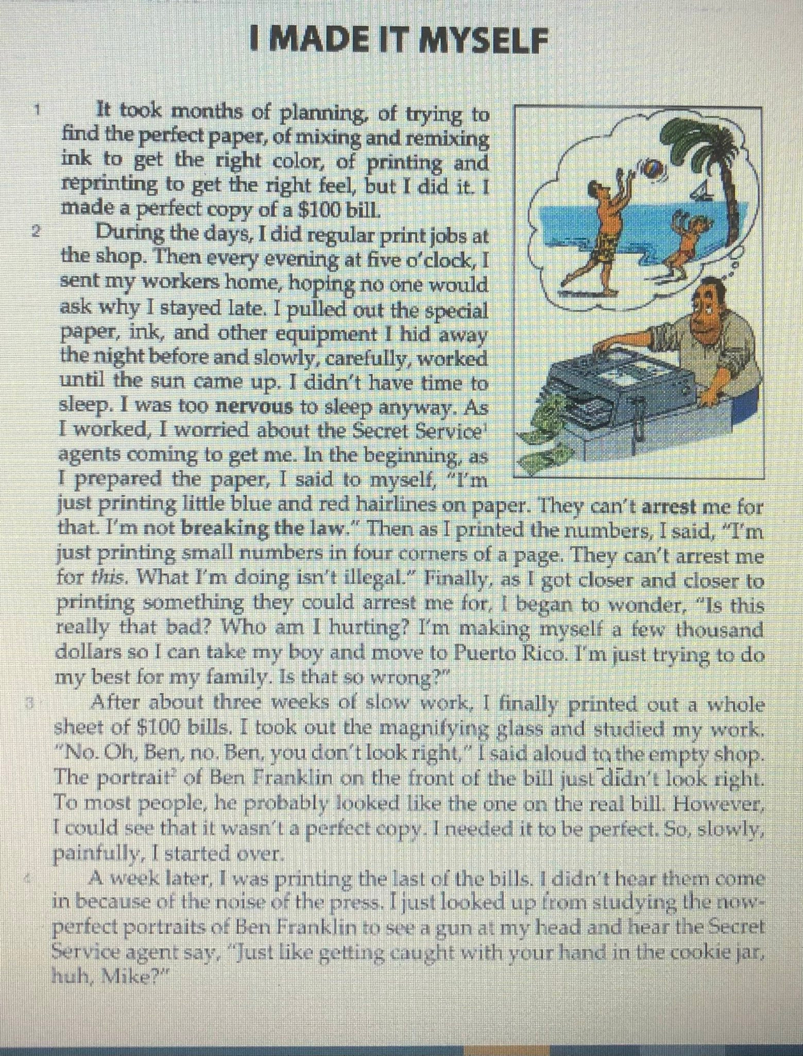
Read the story of Michael Landress, who was once a professional counterfeiter.
COMPREHENSION: Answer the questions: 1. The title of the story is I Made It Myself. What does “It” refer to? ______________________________________________________ 2. In paragraph 3, Landress says, “No. Oh, Ben, no.” Who is Ben? What was wrong? ______________________________________________________ 3. In paragraph 4, Landress says, “I didn’t hear they come in
because of the noise of the press.” Who does “them” refer to? What were they coming to do?
______________________________________________________
4. 4. The story ends with
“Just like getting caught with your hand in the cookie jar, huh, Mike?” What does this mean?
____________________________________________________________
.
.

Slide 5
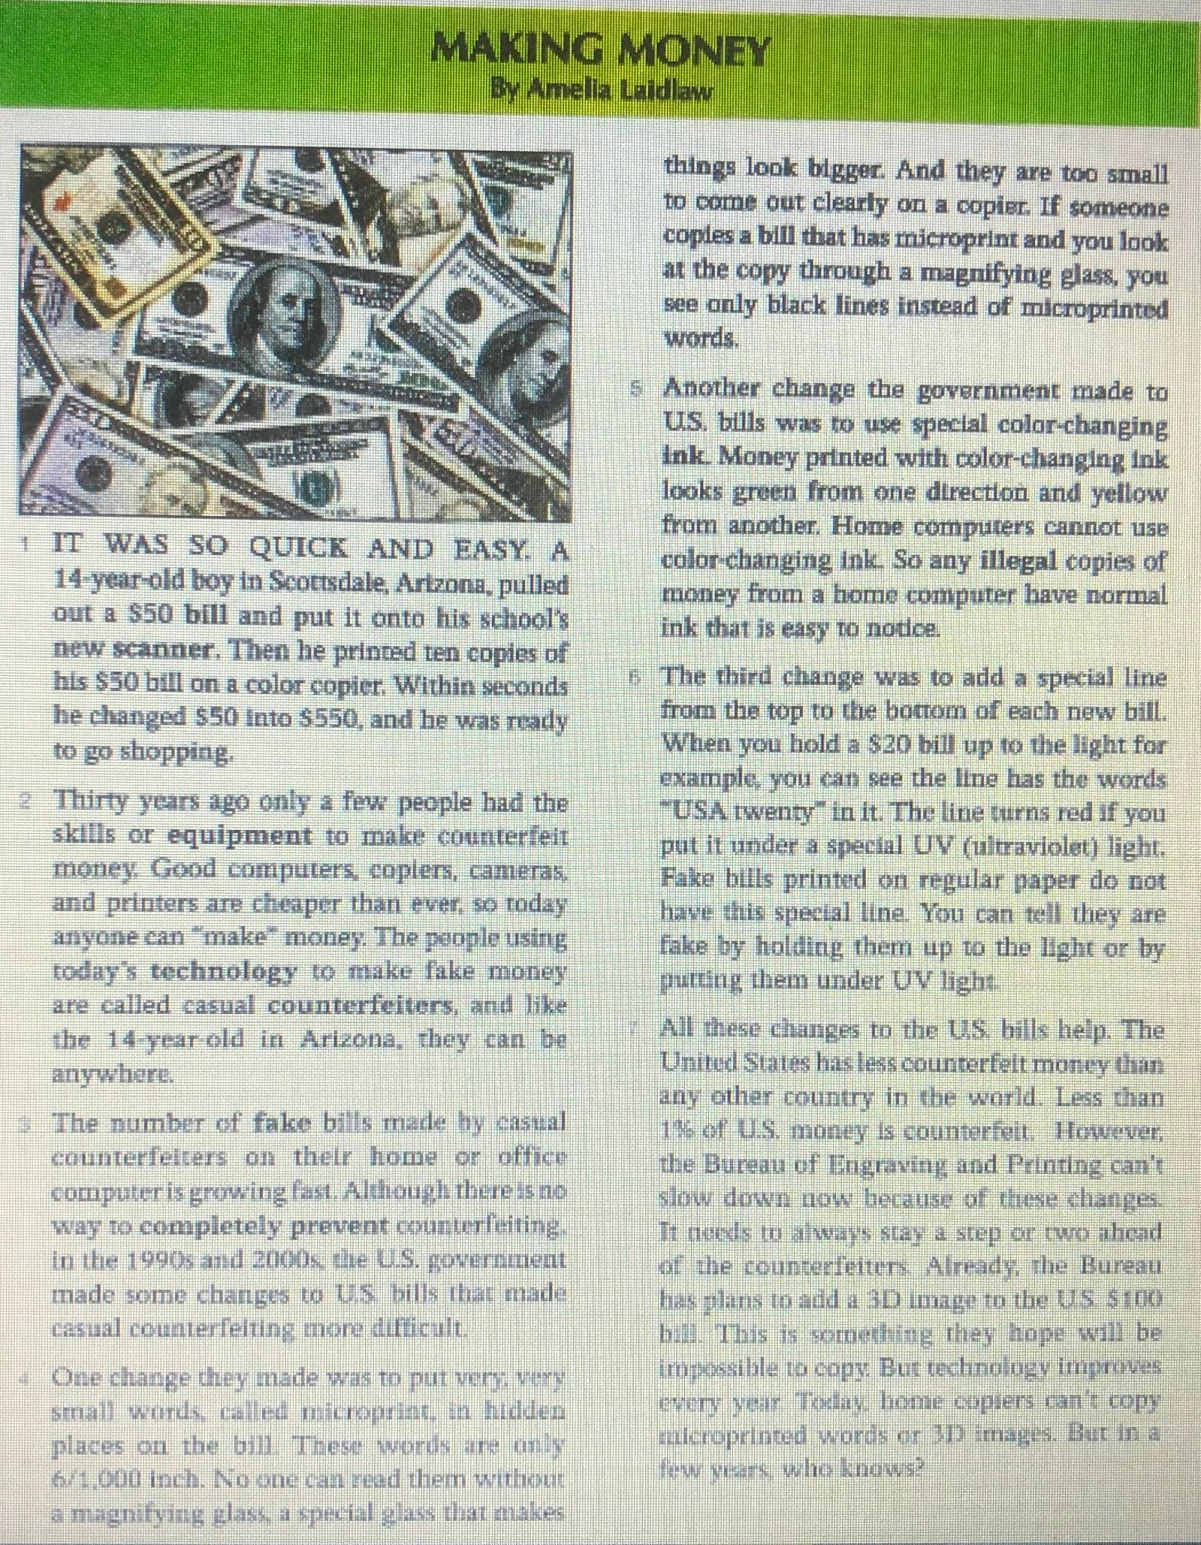
1.Read the statements.
Write the correct par. number in front of each of them. Par. ___ a. Casual counterfeiting is becoming a big problem,
and the government is fighting it. Par. ___ b. Using color-changing ink is a way to prevent counterfeiting. Par. ___ c. A child can easily copy paper money. Par. ___ d. The government must always keep changing the bills
to prevent counterfeiting. Par. ___ e. Putting micro-print on bills helps prevent counterfeiting. Par. ___ f. New technology makes casual counterfeiter possible. Par.___ g. The special lines on U.S. paper money help prevent
counterfeiting.
2. Check the statement that best describes the main idea
of the whole article. A. It’s easier to counterfeit money today than it was 30 years ago,
especially with the right equipment. B. The government has several ways to try to prevent counterfeiting. C. Better home computers and printers made counterfeiting easier,
so the U.S. government changed the bills to make counterfeiting
more difficult.
.
.

Slide 6
Unit 3 Copying Clothes 1 Seema Anand has a $20 million-a-year business. She knows famous people. Her customers are huge clothing stores like Macy’s and Bloomingdale’s. Ms. Anand isn’t a well-known designer; she sells copies of expensive brand-name clothes. 2 Ms. Anand goes to fashion shows, and if she likes a dress, she takes a picture. Then, she uses a scanner or other equipment to send the picture to India by email. In India, advanced technology shows workers how to make the dress. In three weeks, the copied dress arrives in American stores, often before the original dress arrives! The quality of Ms. Anand’s dress is usually lower than the original. So is the amount printed in ink on the price tag! For example, Ms. Anand’s copy of a $760 dress costs $260. 3 Ms. Anand is not nervous about the police arresting her. She does not break the law. Unlike counterfeiters who print fake bills, copying a fashion design is completely legal. It is only illegal to copy a logo or brand name. Some fashion designers are angry. They want the government to prevent Ms. Anand from copying their clothes. 4 Ms. Anand thinks she helps people. “The younger girls do not have so much money,” she said, “but they want to wear fashionable clothes.” Now, fashion designers are becoming nervous. One designer says, “If Ms. Anand doesn’t stop, we can lose our business!” A. Complete the sentences, using the phrases :available in stores faster / better quality / not fashionable / a copy / more expensive / not legal A dress by Ms. Anand is (1) …………………………and (2) ……………………….. A dress by a fashion designer is (3) ………………………….and (4) ………………………
B. Choose the best answer:
5. Right after Ms. Anand takes a picture of a dress
she likes, she ____.
A. has the dress copied
B. sells a copy of the dress
C. sends the picture to India by email
D. shows workers how to make the dress
6. Ms. Anand uses ____ to help her business.
A. a famous logo
B. famous people
C. her own design skill
D. computers and machines
7. Fashion designers ____ what Ms. Anand does.
A. copy
B. dislike
C. follow
D. respect
8. In the future, Ms. Anand will probably ____.
A. stop working in the fashion industry
B. design her own dresses that cost more
C. continue to sell copies of dress designs
D. stop making the copied dresses in India

Slide 7
Unit 4 We Are What We Eat
.
.

Slide 8
Unit 4 A. Use the words and phrases from the list to complete the letter to a newspaper. Not all of the words and phrases will be used. blew his nose enforce expert push elderly etiquette make eye contact with rude I take the 8A bus to Woodson Library some days. I think the other passengers on this bus are 1. ________________. They never wait to get on the bus—they just 2. ________________ past me. I’m 3. ________________; last week was my 85th birthday! There is a rule about letting senior citizens on first, but the drivers never 4. ________________ it. The other problem is all the litter people leave on the buses. The other day, someone 5. ________________ and left the dirty tissue on the seat next to him—unbelievable!

Slide 9
Unit 4 B. Choose the best vocabulary word or phrase to complete each sentence. 6. You can ___ the subway to always be late in this city! A. rely on B. block 7. I was so ___ that I had to stand on the train for the second day in a row. A. annoyed B. confused 8. Some people are in ___ riding the subway because they do it so much. A. manners B. experts 9. ___ people will always try to help you if they can. A. Civilized B. Rude

Slide 10
Editorials are articles in newspapers where writers give their opinions. You are going to read the title and the first paragraph of an editorial from the City section of a New York Newspaper. What do you think the writer’s suggestion might be about? 1. good places to visit on the subway. 2. the restaurants with the best service in New York. 3. how to make the subway nicer to ride. 4. how to get around New York without riding the subway.
A CIVILIZED SUGGESTION By Dan Forman
1 There is a very long list of rules for the New York City subway. Don’t put your feet
on a seat, don’t carry open cups of coffee or soda, don’t take more than one seat, don’t ride while drunk… Those are just a few of the rules. There are hundreds more.

Slide 11
A CIVILIZED SUGGESTION By Dan Forman 1. There is a very long list of rules for the New York City subway. Don’t put your feet on a seat, don’t carry open cups of coffee or soda, don’t take more than one seat, don’t ride while drunk… Those are just a few of the rules. There are hundreds more. 2. With this many rules, why is it still so unpleasant to ride the subway? 3. Some people think that the problem is that no one enforces the rules. There aren’t enough subway police, and the ones we have are too busy catching people who don’t pay. Other passengers sometimes try to enforce the rules. But you can’t rely on them because New Yorkers have unwritten rules of etiquette against talking to strangers and making eye contact with strangers. How can you tell someone to take her shopping bags off the seat and throw away her Coke without talking to her to looking at her? It is difficult. 4. There are other New Yorkers who think that the subway is unpleasant because there are not enough rules. One rider wrote a letter to The New York Times a couple of weeks ago suggesting a few more subway rules. Here are some of the rules that she would like to see: + Don’t lean on the poles. You prevent other people from holding on. They can fall down. | + Talk quietly. The trains are already noisy. + Cover your mouth and nose when you sneeze or cough. Other riders don’t want to catch your cold. + If your MetroCard doesn’t work after three tries, ask a subway employee for help. Don’t block the entrance. + Give your seat to elderly passengers or to parents with small children. 5. Of course, anyone who knows the subway probably agrees that those are great ideas for rules. But polite people already do all of those things. If those unwritten rules of etiquette are written down, will the rude people be more likely to follow them? Will anyone enforce them? It doesn’t make sense to make more rules that no one will enforce. 6. The real problem is that we are forgetting how to be nice to each other. It is embarrassing that we need a rule to tell us to give our seat to elderly passengers. Nobody should need to be reminded to do that. 7. I say we stop talking about the rules and try to remember our manners. Let’s be nice to each other not because a police officer might tell us to get off the train, but because it is right thing to do. Then New York City would be more civilized – both above ground and below.
Main idea: Check (√) the statement that
best describes the main idea of the editorial.
_____ a. The New York subway has plenty of
rules, but police officers need to work harder
to enforce them.
_____ b. People have lots of ideas about how
to make the New York subway more pleasant
to ride, but I think that we all need to just
remember our manners.
_____ c. Elderly passengers often have to stand
up on the New York subway. All passengers need
to work to enforce the etiquette rules about this.
_____ d. New York has many etiquette rules,
such as Don’t make eye contact and
Don’t talk to people you don’t know.
.
.

Slide 12
A CIVILIZED SUGGESTION By Dan Forman 1. There is a very long list of rules for the New York City subway. Don’t put your feet on a seat, don’t carry open cups of coffee or soda, don’t take more than one seat, don’t ride while drunk… Those are just a few of the rules. There are hundreds more. 2. With this many rules, why is it still so unpleasant to ride the subway? 3. Some people think that the problem is that no one enforces the rules. There aren’t enough subway police, and the ones we have are too busy catching people who don’t pay. Other passengers sometimes try to enforce the rules. But you can’t rely on them because New Yorkers have unwritten rules of etiquette against talking to strangers and making eye contact with strangers. How can you tell someone to take her shopping bags off the seat and throw away her Coke without talking to her to looking at her? It is difficult. 4. There are other New Yorkers who think that the subway is unpleasant because there are not enough rules. One rider wrote a letter to The New York Times a couple of weeks ago suggesting a few more subway rules. Here are some of the rules that she would like to see: + Don’t lean on the poles. You prevent other people from holding on. They can fall down. | + Talk quietly. The trains are already noisy. + Cover your mouth and nose when you sneeze or cough. Other riders don’t want to catch your cold. + If your MetroCard doesn’t work after three tries, ask a subway employee for help. Don’t block the entrance. + Give your seat to elderly passengers or to parents with small children. 5. Of course, anyone who knows the subway probably agrees that those are great ideas for rules. But polite people already do all of those things. If those unwritten rules of etiquette are written down, will the rude people be more likely to follow them? Will anyone enforce them? It doesn’t make sense to make more rules that no one will enforce. 6. The real problem is that we are forgetting how to be nice to each other. It is embarrassing that we need a rule to tell us to give our seat to elderly passengers. Nobody should need to be reminded to do that. 7. I say we stop talking about the rules and try to remember our manners. Let’s be nice to each other not because a police officer might tell us to get off the train, but because it is right thing to do. Then New York City would be more civilized – both above ground and below.
2. Details: Choose the best ending for each statement. 1. The New York subway has _____ . a. a long list of rules b. only a few very important rules c. no rules 2. The writer thinks that riding the New York City
subway is _____. a. always a good experience b. very difficult c. not pleasant 3. Some people think that _____ should enforce
the rules more. a. strangers b. police and other passengers c. passengers who take more than one seat 4. Don’t make eye contact and Don’t talk to strangers are examples of _____. a. general etiquette in New York City b. rules that one rider consider would like to have on the subway. c. New York subway rules 5. Don’t lean on the poles and Talk quietly are examples of _____. a. new subway rules that one rider suggested b. New York subway rules c. rules that the author wants to see.
.
.

Slide 13
Unit 4 Taking a Guagua 1 I am now an expert at traveling in the Dominican Republic, an island country in the Caribbean. Taking a “guagua” is a cheap and fun way to travel there. A guagua is a small bus. My first ride was definitely interesting! 2 First, there are no guagua stations. These buses drive on busy streets. I had three pass me before I realized I had to wave my hand for it. The guagua stopped like a taxi would in New York City. 3 It was really crowded when I got on board. I gently pushed by the people blocking the entrance. There were more people than seats, and I saw that many people gave up their seats for elderly riders. This rule wasn’t enforced by the driver. People did it on their own. I stood by the door and held onto the pole there. 4 I learned quickly that people love to talk to each other on guaguas. When you get on, it is good manners to make eye contact with others. I spoke to a few people before I sneezed. When I went to blow my nose, they turned away. I was confused at first, but later I learned that I was being rude. I didn’t realize that there was a certain guagua etiquette! 5 Anyway, I was so busy talking to people that I almost missed my stop! I shouted to the driver just in time and the bus came to a screeching halt. The driver looked annoyed, but at least I made it to where I wanted to go! 6 Because guaguas are privately and not publicly owned, you can’t always rely on them. The good thing is, if you forget your bag on a guagua, sometimes the driver will turn around and bring it back to you. I know this because it happened to me. What a civilized country!
A. Choose the best answer. 1. The information in this article is probably for ____. A. visitors B. taxi drivers C. travel agents D. people who live there
2. It is ____ to go to a guagua station. A. boring B. easy C. important D. impossible
3. Many guaguas are ____. A. crowded B. expensive C. large D. quiet
4. The author’s opinion about guaguas is ____. A. mostly positive B. mostly negative C. completely positive D. completely negative
5. One thing the author likes about guaguas is
that they ____. A. are publicly owned B. sometimes return bags C. stop at a lot of stations D. are free for local people

Slide 14
Thank You for Your Attention !

