Slide 2
American Culture 1
Lecturer: Lam Phan, M.A
Email: lamphan83@gmail.com
Phone: 0983 685 405

Slide 3
UNIT 8: Justice, Freedom and Discrimination

Slide 4
What is justice?
Generally similar to fairness.

Slide 5
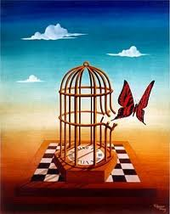
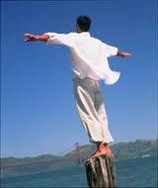
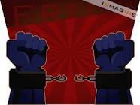
Brainstorming
FREEDOM
What is ‘freedom’?
Is one’s freedom limited by something? (If yes, by what, family, society, government? If no, what’s the consequence?)
FREEDOM
FREEDOM
FREEDOM

Slide 6
Freedom is …
Freedom does mean the right to do as one pleases—to think, believe, speak, worship (or not worship), move about, gather, and generally act as you choose—but only until your choices start to violate another person’s freedom (Mike Treader)
For Americans, freedom is the desire and right of all individuals to control their own destiny without outside interference from the government, a ruling noble class, the church and any other organized authority.

Slide 7
Individual Freedom
Early settlers came to the North American continent (escape from control➔ to be free)
1776 British colonial settlers declared independence and overthrow kings
1787 they separated the church and state
Control their own destiny

Slide 8
Discrimination
The unjust or prejudicial treatment of different categories of people or things, especially on the grounds of race, age, or sex.

Slide 9
1600-1800s: Africans were brought over to American as slaves

Slide 10
1863: 16th president Abraham Lincoln issued “The Emancipation Proclamation,” which declared that all African American be freed from slavery (not recognized by Congress)

Slide 11
AMERICAN CIVIL WAR (1861-1865)

Slide 12
T he U.S. Civil War (1861-1865) between the industrial North and the agricultural, slave-owning South was a watershed in American history

Slide 13
Northern victory in the war preserved the United States as one nation and ended the institution of slavery that had divided the country from its beginning.
But these achievements came at the cost of more than 600,000 lives - nearly as many American soldiers as died in all the other wars in which this country has fought combined.
1865: Slavery was made illegal everywhere in the U.S by the Thirteenth Amendment, after the Civil War was won by the North

Slide 14
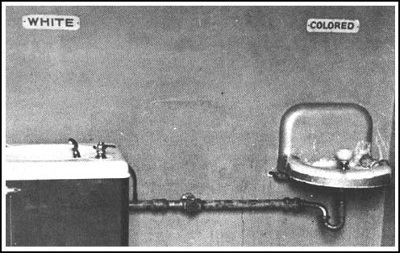
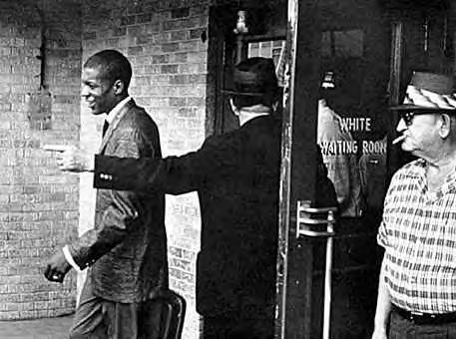
Segregation divides America
1876-1965 Jim Crow laws: State and local laws that mandated racial segregation in all public facilities in the Southern states
Jim Crow laws-enforced strict separation of the races in the South
Schools, hospitals, transportation, & restaurants

Slide 15
The Impact of Segregation
African Americans received low-paying jobs
Higher rates of poverty and illiteracy
Lower rates of homeownership and life expectancy
Couldn’t vote in the South

Slide 16
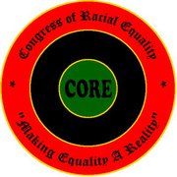
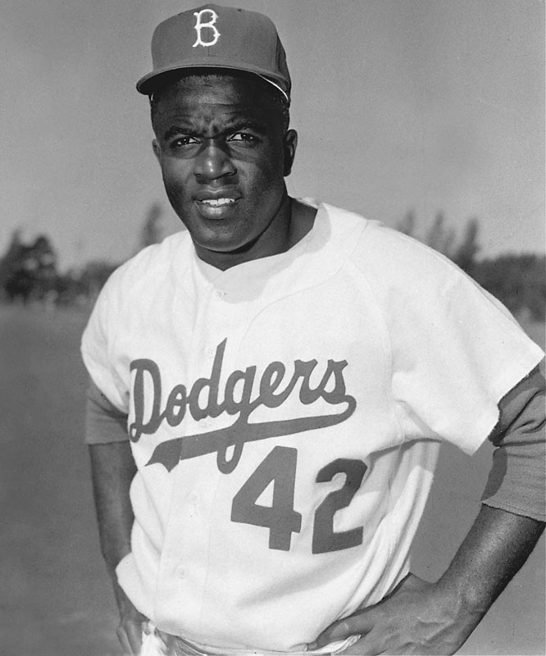
The Civil Rights Movement Grows
Congress of Racial Equality (CORE): became convinced to use non-violent methods to gain civil rights
Organized Protests in northern cities
Jackie Robinson
President Truman used his executive power to order the desegregation of the military

Slide 17
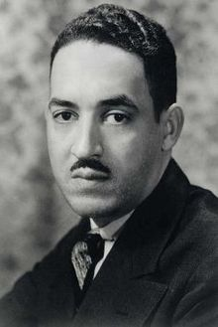
NAACP Challenges Segregation
NAACP became the largest and most powerful civil rights organization
Thurgood Marshal-headed the team that challenged the legality of segregation

Slide 18
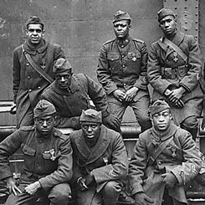
Post-WWII
African Americans grew dissatisfied with their second-class status after WWII
Risked their lives defending freedom abroad
Civil Rights Movement-a broad and diverse effort to attain racial equality

Slide 19
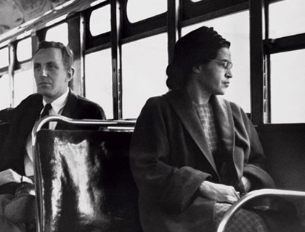
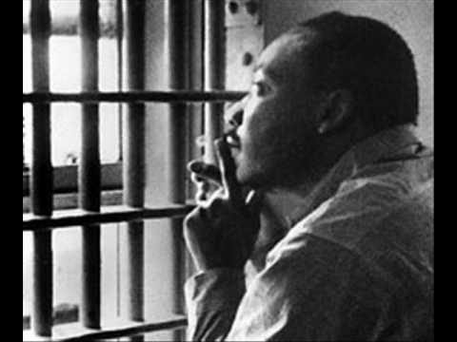
Notable leaders
Thurgood Marshall, lawyer, cases involving school segregation (Brown v Board)
1st African American SC Justice
Rosa Parks—refuses to give up her seat on the bus to a white man and as a result the Montgomery Bus Boycott occurs.
Dr. Martin Luther King, Jr.—he gains national prominence as a leader during the Montgomery Bus Boycott. Arrested in Birmingham
Letter from a Birmingham Jail.

Slide 20
March on Washington August 28, 1963

Slide 21
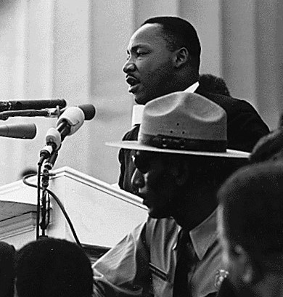
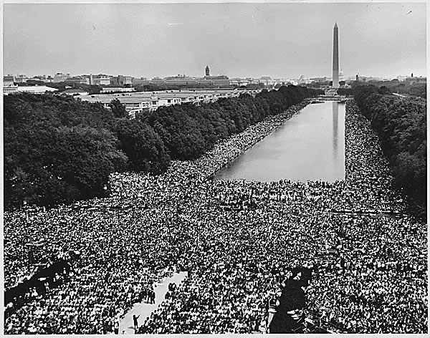
March on Washington
To put pressure on Congress to pass the new civil rights bill
Drew more than 200,000
MLK-”I have a dream”
One of the largest political demonstrations
A model for peaceful protest

Slide 22
The Push for Voting Rights
Literacy tests
Poll taxes
Intimidation
All kept blacks from voting

Slide 23
The Civil Rights Act of 1964
Because of the Civil Rights movement, Congress passed the Civil Rights Act of 1964. This law ended all racial discrimination in public facilities such as restrooms, restaurants, buses, movie theaters, and swimming pools.

Slide 24
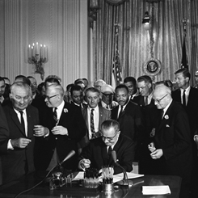
Civil Rights Act of 1964
The act banned segregation in public accommodations
Gave the federal government the ability to desegregate schools
Prosecute individuals who violated people’s civil rights
Outlawed discrimination in employment
Established the Equal Employment Opportunity Commission (EEOC)
1964 Civil Rights Act: Guaranteed equality for
all Americans

Slide 25
What is Martin Luther King, Jr.’s speech “I Have a Dream” about?
Watch the video
https://www.youtube.com/watch?v=vP4iY1TtS3s

