Slide 1
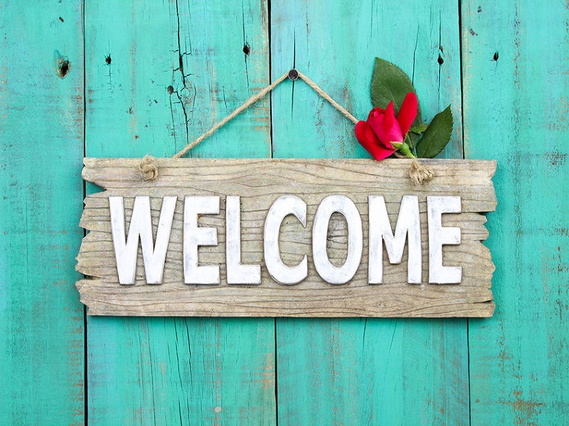

Slide 2
American Culture 1
Lecturer: Lam Phan, M.A
Email: lamphan83@gmail.com
Phone: 0983 685 405

Slide 3
Discussion
1. In what year did Israel Zangwill write a play in which he used the term Melting pot?
2. Who was the first African American president?
3. How many stripes does the American flag have?
4. What is the smallest state by area in the United States?
5. Which was the 50th state to join the United States?

Slide 4
Discussion
6. Which American city was historically known as New Amsterdam?
7. Who was the first president of the USA?
8. How many stars does the American flag have?
9. When did the US become independent ?
10. What are the colors of American flag?

Slide 5
Discussion
1. In what year did Israel Zangwill write a play in which he used the term Melting pot?
2. Who was the first African American president?
3. How many stripes does the American flag have?
4. What is the smallest state by area in the United States?
5. Which was the 50th state to join the United States?

Slide 6
What is Culture?
the way of life, especially the general customs and beliefs, of a particular group of people at a particular time
the customs and beliefs, art, way of life and social organization of a particular country or group
“Culture, or civilization, taken in its broad, ethnographic sense, is that complex whole which includes knowledge, belief, art, morals, law, custom, and any other capabilities and habits acquired by man as a member of society.”
Edward Burnett Tylor

Slide 7
Understanding American Culture
Life in the United States
Two factors influence American life:
1. the immense size of the United States
2. the great ethnic diversity

Slide 8
1. The immense size of the United States
3.8 million square miles (9.8 million square kilometers)
Population: 308,745,538 (2010 census) , 328 million (2019)
For example: travel from New York to Los Angeles by car: 4or 5 days
In a day: Raining in Washington D.C, snowing in New York and Chicago, warm enough to swim in Miami
➔ One factor affecting lifestyle in the US is the variety of climates.

Slide 9
2. The great ethnic diversity
All Americans came from other countries- or their ancestor did ( except Native Americans- American Indians) like Spain, France, England
Some Native Americans/ American Indians have their own language, culture, tradition and even government)
From 1776- most immigrants came from northern Europe (England) ➔ became the dominant traditional culture of the United States

Slide 10
Cultural Pluralism in the Unite States
English is the most commonly spoken language used in the U.S. and is the language used in government
Bilingual, biculturalism continue in some communities
For example: in California, test for driver’s license: more than 30 languages

Slide 11
How do we call people from The United States?
American(s)
No adjective for United States (no term like United Statesians)➔ American

Slide 12
Language

Slide 13
The bureau divides those languages into four categories
all other languages: Hungarian, Arabic, Hebrew, languages of Africa and languages of native people of North, Central and South America.
Other Indo-European languages: German, Swedish, French, Italian, Russian, Polish. Hindi, Greek,…
Asian and Pacific Island languages: Chinese, Korean, Japanese, Thai,..
Spanish

Slide 14
- There is no official language of the United States, according to the U.S. government.
The most frequently spoken non-English languages are Spanish, Chinese, French and German.
90% of the U.S. population speaks and understands at least some English, and most official business is conducted in English.
Some states have official or preferred languages. For example, English and Hawaiian are the official languages in Hawaii.
The Census Bureau estimates that more than 300 languages are spoken in the United States.

Slide 15
Religion

Slide 16
- Religious Freedom

Slide 17
American style

Slide 18
Clothing styles vary by social status, region, occupation and climate. Jeans, sneakers, baseball caps, cowboy hats and boots are some items of clothing that are closely associated with Americans. Ralph Lauren, Calvin Klein, Levi’s and Victoria’s Secret, GAP, Old Navy are some well-known American brands.

Slide 19
American Cuisine

Slide 20
American cuisine was influenced by Europeans and Native Americans in its early history. Today, there are a number of foods that are commonly identified as American, such as hamburgers, hot dogs, potato chips, macaroni and cheese, and meat loaf. "As American as apple pie" has come to mean something that is authentically American.
There are also styles of cooking and types of foods that are specific to a region. Southern-style cooking is often called "American comfort food" and includes dishes such as fried chicken, collard greens, black-eyed peas and corn bread. Tex-Mex, popular in Texas and the Southwest, is a blend of Spanish and Mexican cooking styles and includes items such as chili and burritos, and relies heavily on shredded cheese and beans.
Jerky, dried meats that are served as snacks, is also a food that was created in the United States,

Slide 21
- USA is widely known around the world as a leader in mass media production, including television and movies. According to the U.S. Department of Commerce, USA comprises one-third of the worldwide media and entertainment industry.
- The television broadcasting industry took hold in the USA in the early 1950s, and American television programs are now shown around the world. Movie industry, centered in Hollywood, California, and American movies are popular worldwide.
- The United States' arts culture extends beyond movies and television shows, though. New York is home to Broadway, and Americans have a rich theatrical history. American folk art is an artistic style and is identified with quilts and other hand-crafted items. American music is very diverse with many, many styles, including rhythm and blues, jazz, gospel, country and western, bluegrass, rock 'n' roll and hip hop.
The Art

Slide 22
Sport
The United States is a sports-minded country, with millions of fans who follow football, baseball, basketball and hockey, among other sports. Baseball, which was developed in colonial America and became an organized sport in the mid-1800s, is known as America's favorite pastime, although its popularity has been eclipsed by football for the past three decades, according to the Harris Poll.

Slide 23
Many holidays are celebrated only in the United States.
Americans celebrate their independence from Britain on July 4.
Memorial Day, celebrated on the last Monday in May, honors those who have died in military service.
Labor Day, observed on the first Monday in September, celebrates the country's workforce.
Thanksgiving, another distinctive American holiday, falls on the fourth Thursday in November and dates back to colonial times to celebrate the harvest.
Presidents' Day, marking the birthdays of George Washington and Abraham Lincoln, is a federal holiday that occurs on the third Monday in February.
American holidays

Slide 24
