Slide 1


Slide 2
American Culture 2
Lecturer: Lam Phan, M.A
Email: lamphan83@gmail.com
Phone: 0983 685 405

Slide 3
Chapter 4:
The Frontier Heritage

Slide 4
Get started
What is “frontier”?
What American movies about the Old West have you seen?
What are the characteristics of American movies heroes?
Why do so many Americans own guns?
Frontier (n)
Heritage (n)

Slide 5

Frontier (n) UK/ˈfrʌn.tɪər/ /frʌnˈtɪər/ US /frʌnˈtɪr/
A border between two countries
The Western America

Slide 6
Heritage /ˈher.ɪ.tɪdʒ/
features belonging to the culture of a particular society, such as traditions, languages, or buildings, that were created in the past and still have historical importance

Slide 7

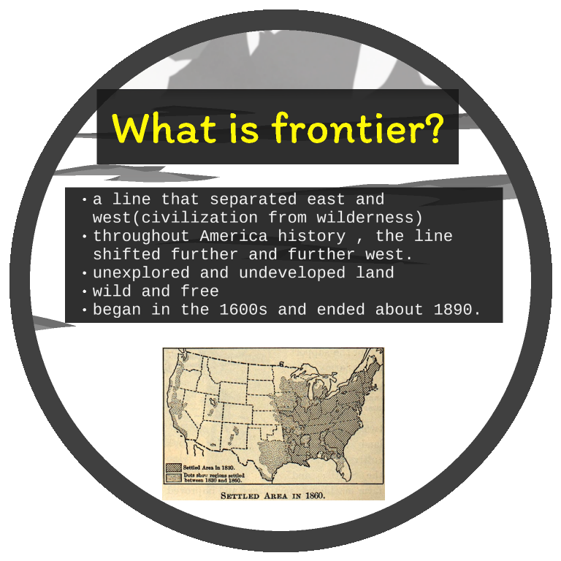
Hello!
I am Jayden Smith
I am here because I love to give presentations.
You can find me at @username

Slide 8
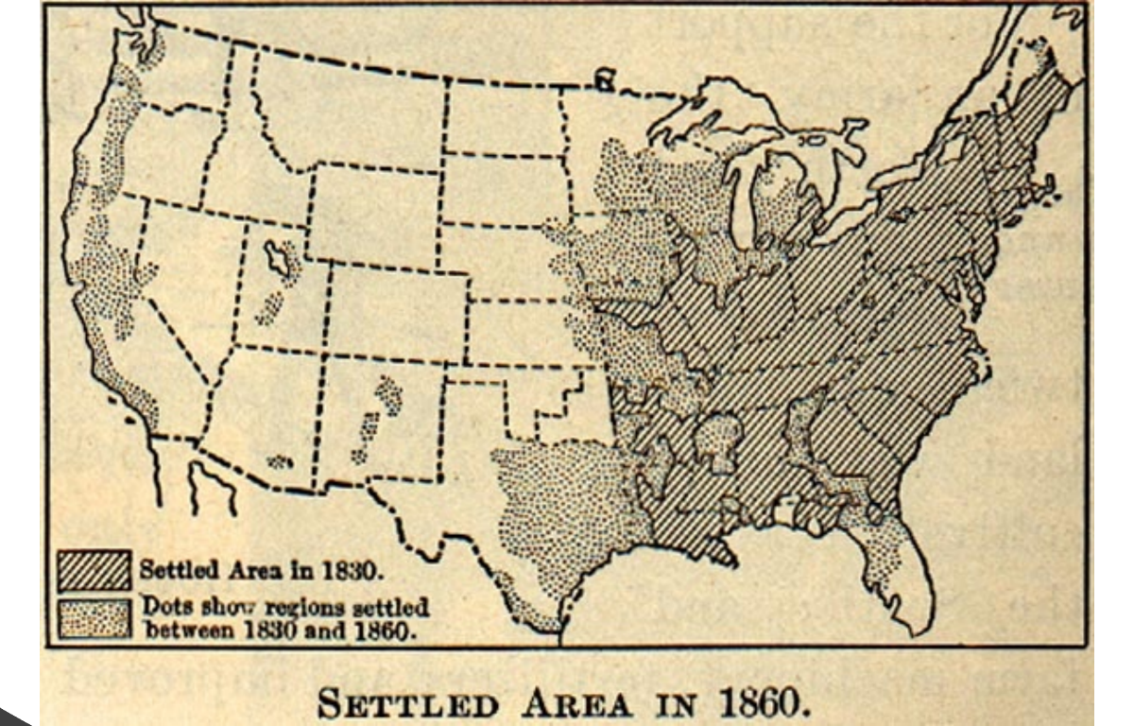
1.
Transition headline
Let’s start with the first set of slides

Slide 9
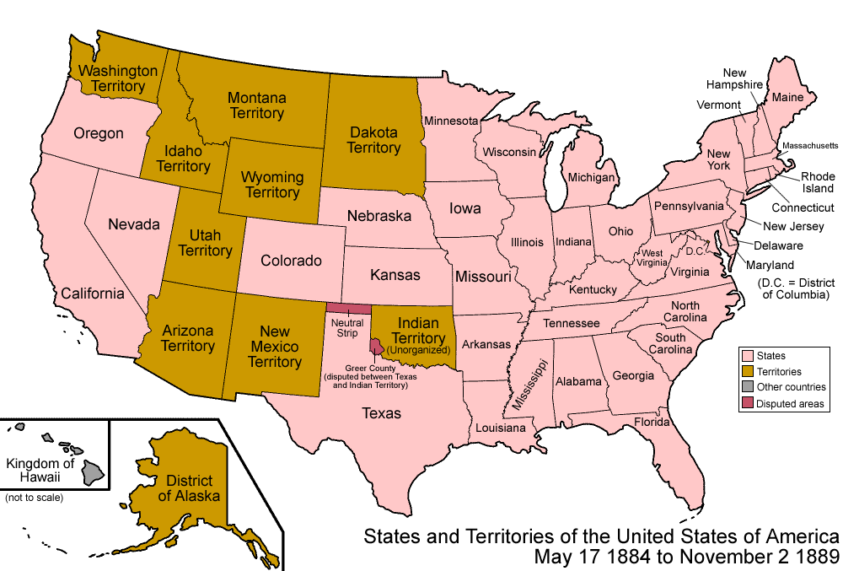

Slide 10
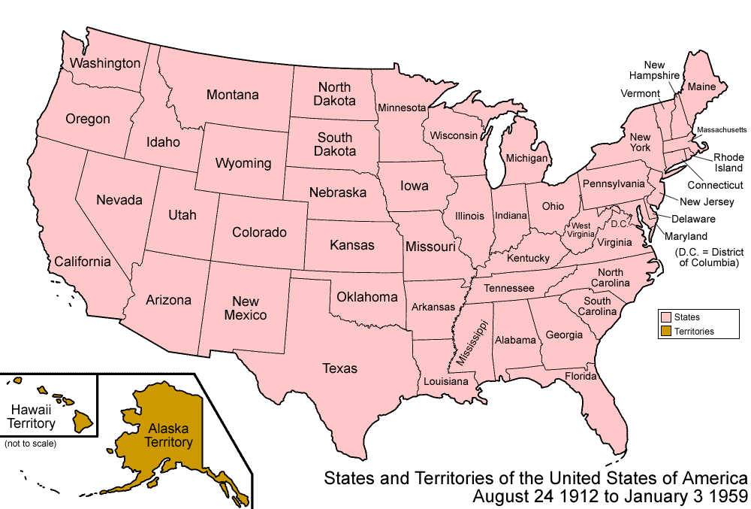

Slide 11
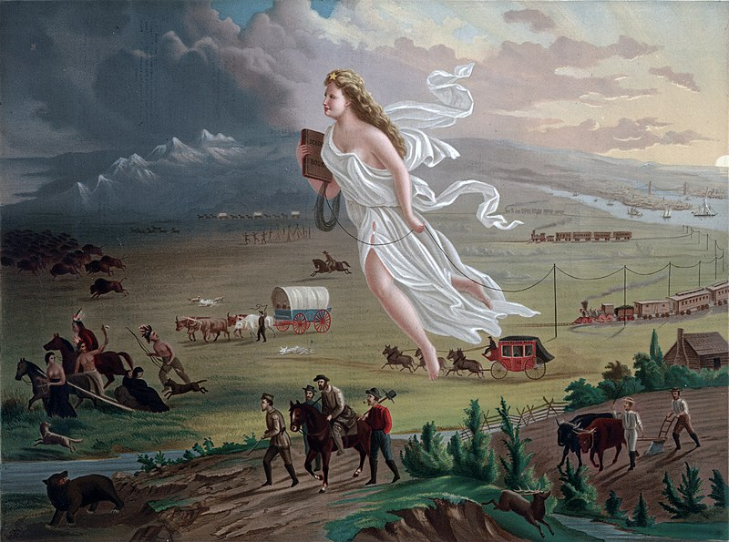
Manifest Destiny
a phrase coined in 1845, is the idea that the United States is destined—by God, expand its dominion and spread democracy and capitalism across the entire North American continent.

Slide 12
The Impact of the American Frontier
The effects of the ‘frontier’ are still present today.
The frontier was very important in shaping American values Many people associate the image of the frontier as a symbol of being a true American (especially used by some Presidents)

Slide 13
The Impact of the American Frontier
The popular image of the frontier was of cowboys (heroes) fighting Indians (villains)
In truth, the Indians (Native Americans) were mistreated (killed, abused, displaced)
Today, there is more awareness of what really happened during the settlement of the frontier

Slide 14
The Impact of the American Frontier
The “frontier” existed from the 1600s until ~1890 as settlers spread from east to west across the American continent
On the frontier life was generally harsh (the wild west)
The settlers believed it was their “manifest destiny” to control all of the land
Displaced native Americans were placed into reservations

Slide 15
The Impact of the American Frontier
Many Americans are still inspired by the frontier culture
This was responsible for many of today’s American values
Hard work – cutting down forests, building towns and cities
Competition – gold rush, land rush Life on the frontier was seen as an example of these values in their purest form

Slide 16
The Impact of the American Frontier
Individualism, Self-Reliance and equality of opportunity were all important attributes for people on the frontier
The value of “Individual freedom” also developed at this time, probably because there was no “establishment” to control what people could do
Many people in western states still value individual freedom very highly.

Slide 17
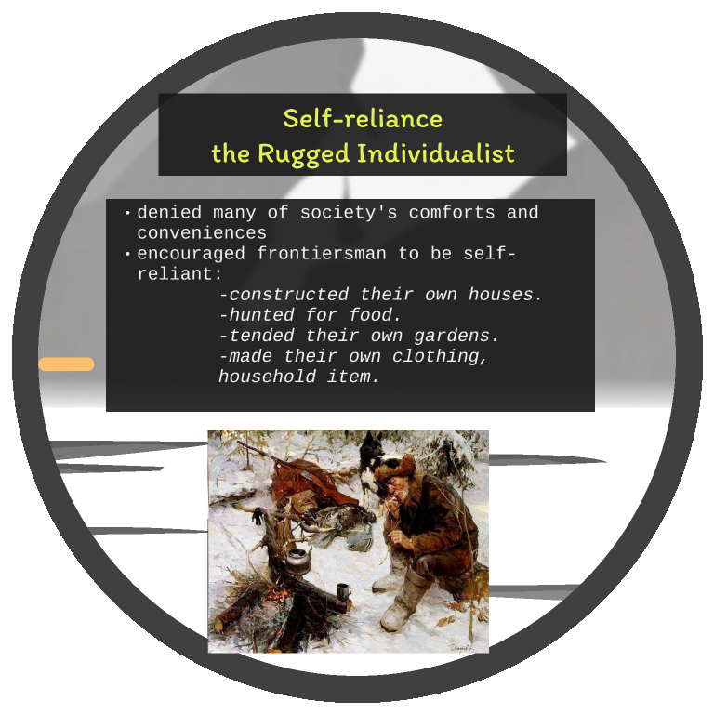

Slide 18
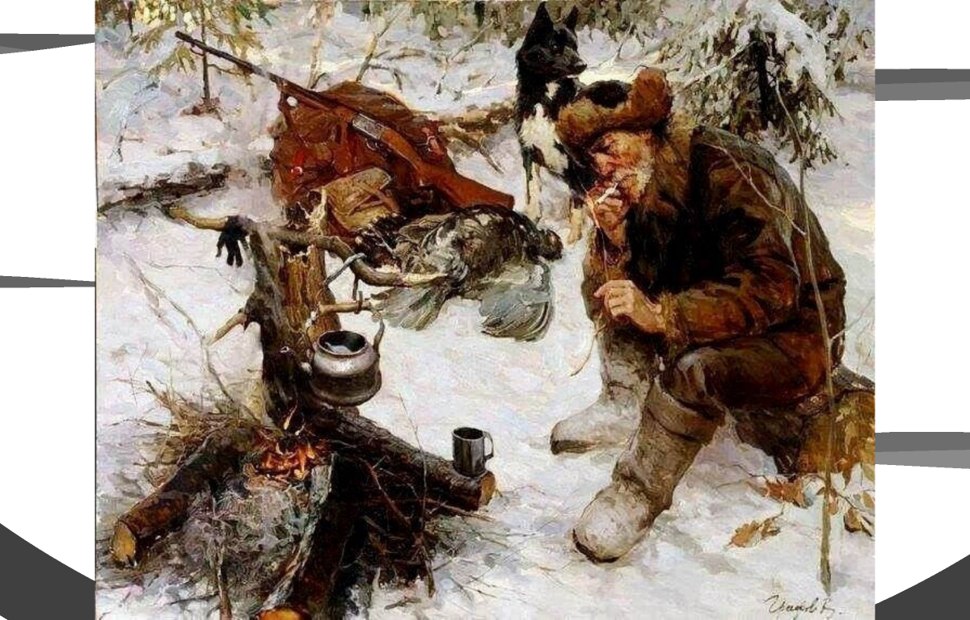

Slide 19
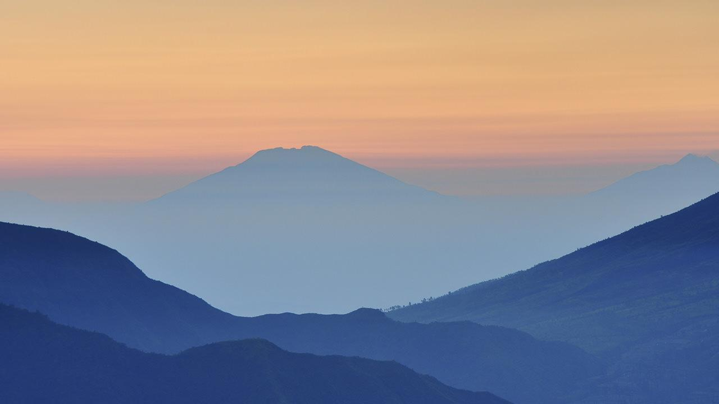
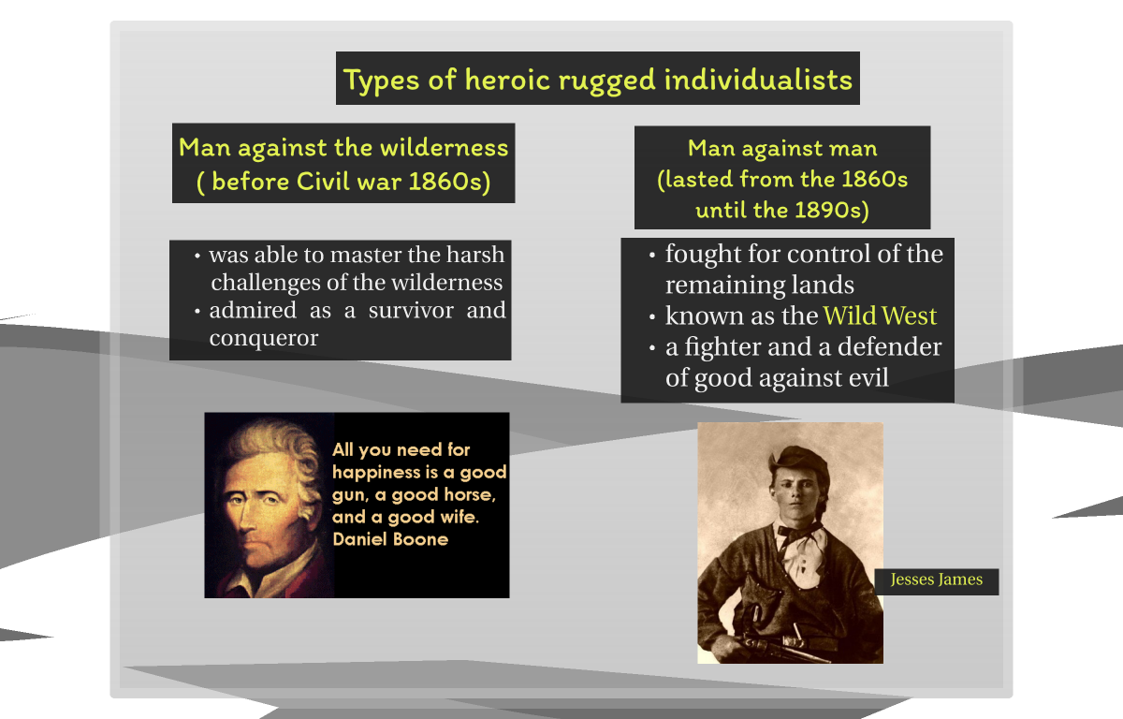
Want big impact?
Use big image.

Slide 20
Self-Reliance and the Rugged Individualist
Wild west heroes are typically lawmen and gunfighters of the time e.g. Jesse James, Wyatt Earp
They had a bigger influence on American ideas of heroism than earlier frontier heroes
Wild west heroes have inspired many movies “Westerns”

Slide 21
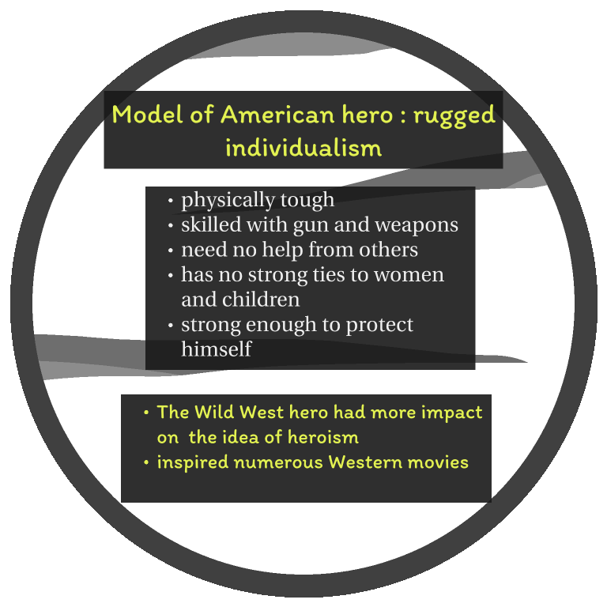
89,526,124$
185,244 users
100%
That’s a lot of money
And a lot of users
Total success!

Slide 22
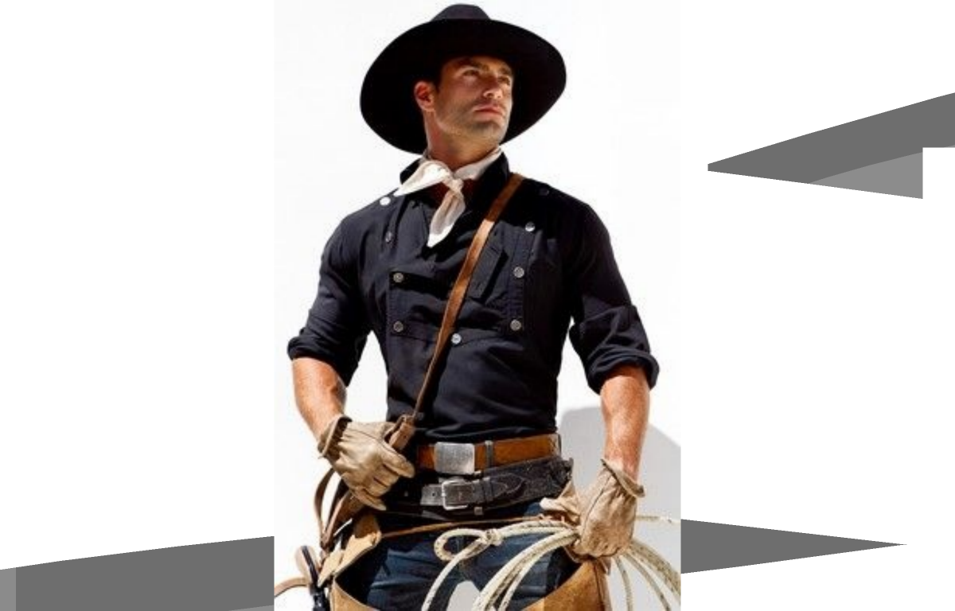

Slide 23

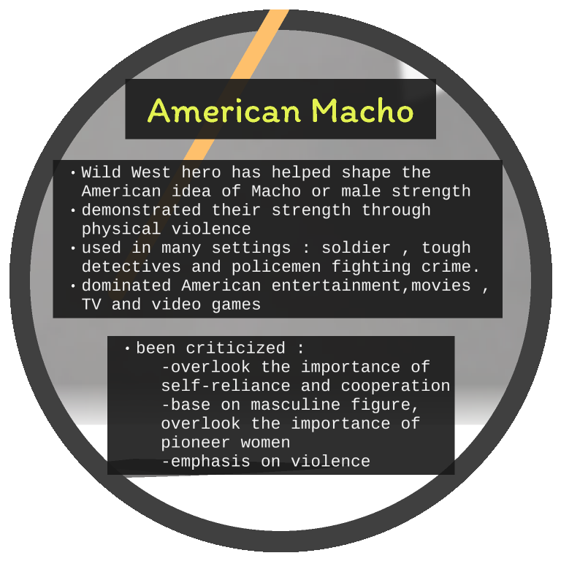
Thanks!
Any questions?
You can find me at:
@username
user@mail.me

Slide 24

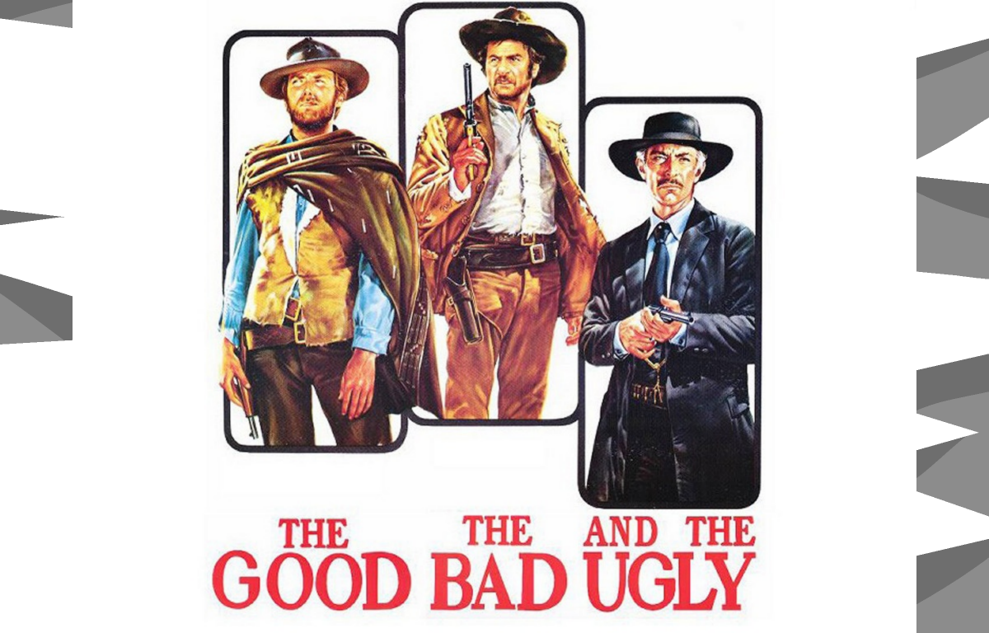
And tables to compare data
 | A | B | C
Yellow | 10 | 20 | 7
Blue | 30 | 15 | 10
Orange | 5 | 24 | 16

Slide 25
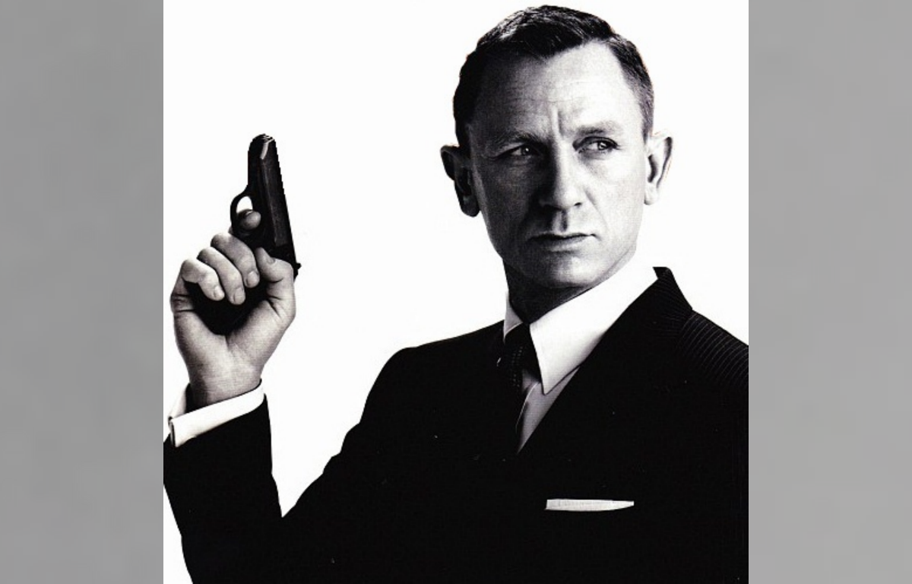

Slide 26

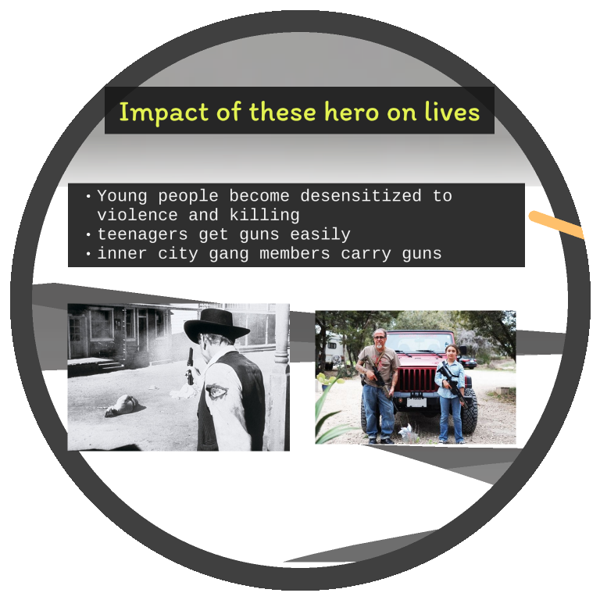
Maps
our office

Slide 27
Breaktime

Slide 28
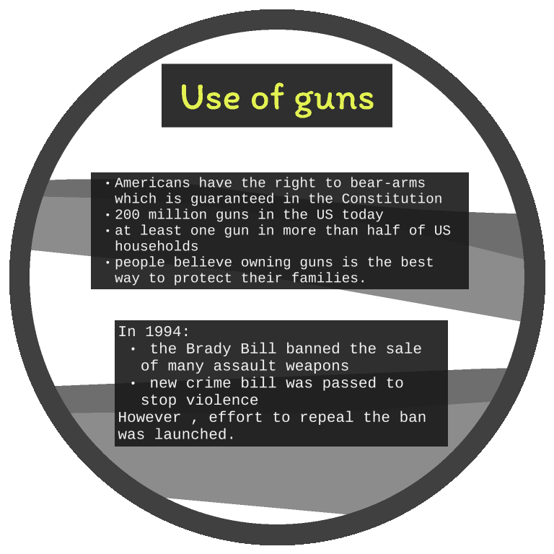
Hello!
I am Jayden Smith
I am here because I love to give presentations.
You can find me at @username

Slide 29
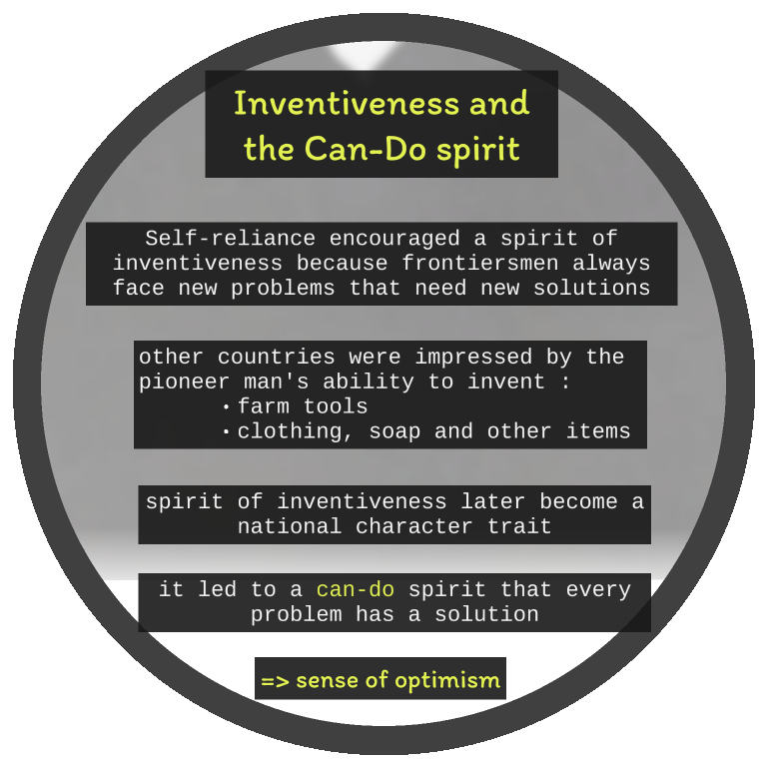
Hello!
I am Jayden Smith
I am here because I love to give presentations.
You can find me at @username

Slide 30
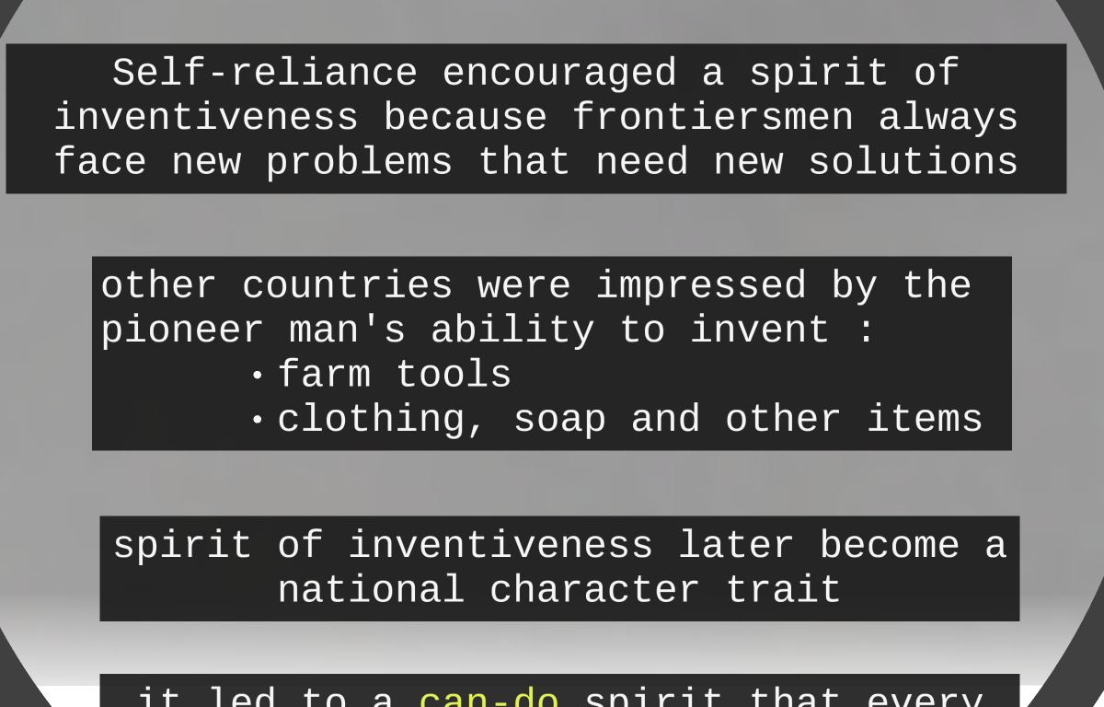
89,526,124
Whoa! That’s a big number, aren’t you proud?

Slide 31
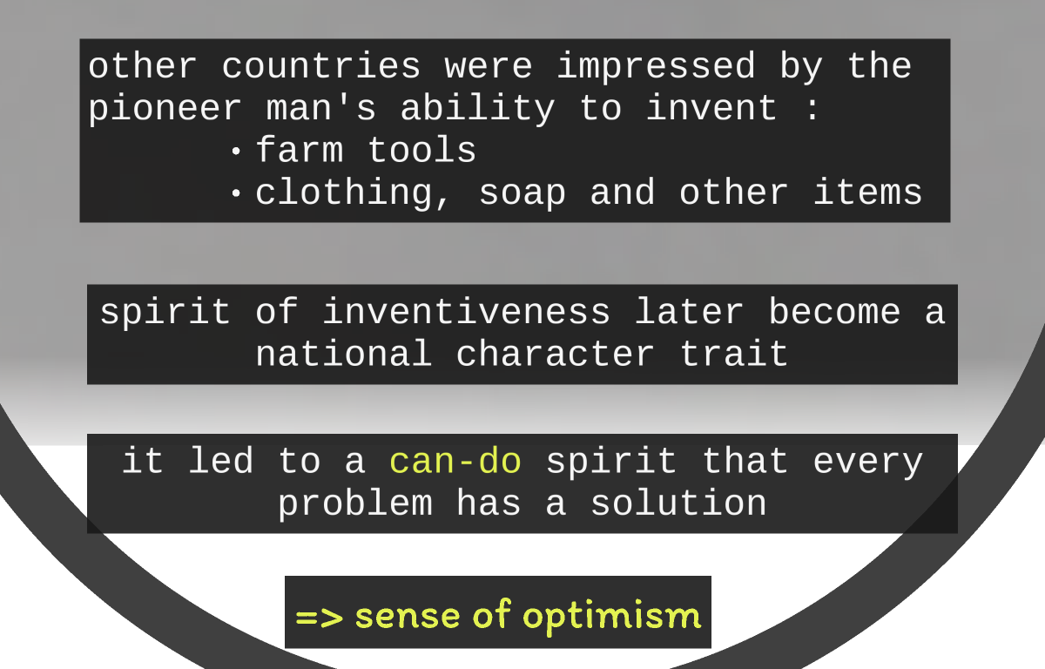

Slide 32
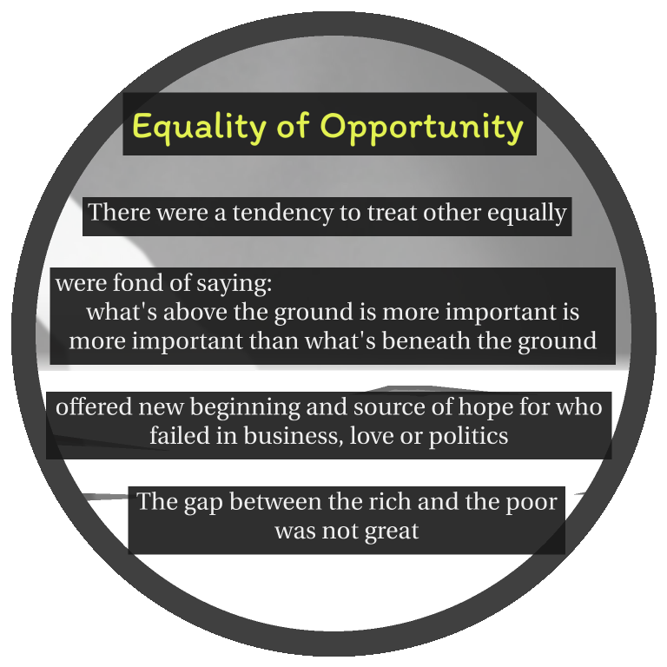

Slide 33
