Slide 2
American Culture 2
Lecturer: Lam Phan, M.A
Email: lamphan83@gmail.com
Phone: 0983 685 405

Slide 3
CHAPTER 3 The American Religious Heritage

Slide 4
DISCUSSION
1. What religions are popular in all over the world?
2. What religions are popular in Vietnam?
3. What religions are popular in America?

Slide 5
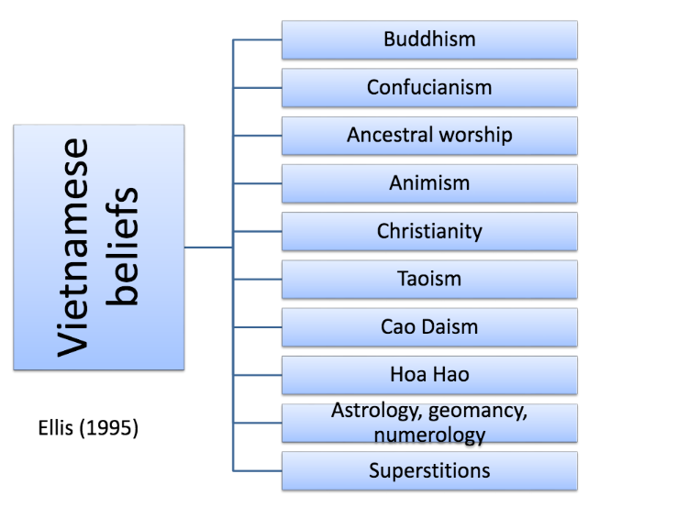
Notes:
Caodaism (Vietnamese: Đạo Cao Đài, Chữ nôm: 道高臺) is a monotheistic religion officially established in the city of Tây Ninh in southern Vietnam in 1926.
Đạo Hòa Hảo is a religious tradition, based on Buddhism, founded in 1939 by Huỳnh Phú Sổ (Popularly called Phật thầy, "Buddha Master" in Vietnamese), a native of the Mekong River Delta region of southern VietnamIn Hòa Hảo homes, a plain brown cloth serves as an altar, at which the family prays morning and night. destined to save mankind from suffering and to protect the Vietnamese nation.
Geomancy: the art of placing or arranging buildings or other sites auspiciously; divination from configurations seen in a handful of earth thrown on the ground, or by interpreting lines or textures on the ground.
Numerology is any belief in the divine, mystical relationship between a number and one or more coinciding events.

Slide 6
Freedom of Religion in the United States
Individual freedom allows Americans to practice any religion
The high level of cultural diversity means there is a lot of religious diversity
90% of Americans believe in “God”

Slide 7
Freedom of Religion in the United States

Slide 9
Freedom of Religion in the United States
Most Americans are Christians
However, other religions also contribute to American culture:
Muslims (Islam)
Jews (Judaism)
Daoism (Taoism)
Confucianism
Shintoism
Buddhism

Slide 10
Freedom of Religion in the United States
Religion has always been important in America
Catholicism was brought to the US by the Spanish in the 1500s, who founded many cities
Most European settlers in the 1600’s were protestants from England
The Protestants had the strongest influence on religious culture in America

Slide 11
The Development of Protestantism
Protestants were Catholics who did not like parts of the Roman Catholic church
In the 1500s the Roman Catholic church dominated religious life in Western Europe
The Pope and his priests controlled everything that happened in Catholicism

Slide 12
The Development of Protestantism
However, Protestants said that individuals could communicate directly with God (i.e. they did not have to use a priest)
In this way, the power and authority of priests was reduced (to ministers)

Slide 13
The Development of Protestantism
The Protestants then began to argue amongst themselves and broke into different denominations:
Baptist
Methodist
Lutheran
Presbyterian
Episcopalian
United Church of Christ

Slide 14
The Development of Protestantism
In the 1600s, there was a lot of anger between denominations in Europe
Many Protestants were persecuted for their beliefs
Many ‘escaped’ to America to have religious freedom

Slide 15
The Development of Protestantism
Because there was no established church in America in the 1600s, many Protestants who were not persecuted also went there
Denominations fought for control, but the colonies were too large for any one to succeed
This lead to the idea of separation of church and state
There is no national religion in America – this is forbidden by the constitution
Religious diversity increased – the various Protestant denominations are now very different from each other

Slide 16
The Protestant Heritage: Self-Improvement
Protestantism has greatly influenced American values
Protestants believe that they are alone before God, and are therefore responsible for their own lives
This has lead to a strong desire for self-improvement (i.e. become less sinful)

Slide 17
The Protestant Heritage: Self-Improvement
The desire for self-improvement is not limited to religion, but has expanded into all aspects of life:
Weight loss / fitness
Education
Relationships
Career
“God helps those who help themselves”

Slide 18
Material Success, Hard Work, and Self-Discipline
Early Protestants believed that material possessions were a blessing from God
“Godliness is in league with riches….Material prosperity is helping to make the national character sweeter, more joyous, more unselfish, more Christlike.”
- Bishop William Lawrence, 1900

Slide 19
Material Success, Hard Work, and Self-Discipline
Wealth was seen a reward for hard work and self-discipline. Inherited/easy wealth was frowned upon
These values contributed to the industrial success of America
Self-discipline was a ‘holy’ characteristic
E.g to save and invest money

Slide 20
Material Success, Hard Work, and Self-Discipline
“The Protestant/Puritan work ethic”
Hard work
Self-discipline
Pursuit of wealth
This ethic is shared by many Americans, not just protestants
E.g. Americans take less vacation than many other countries

Slide 21
Volunteerism and Humanitarianism
Self-improvement can also be achieved through helping others:
Charity work / donation
Educational causes
Religious causes

Slide 22
Volunteerism and Humanitarianism
Many wealthy Americans give a lot of money to charities
Andrew Carnegie
John D. Rockefeller
Many Americans believe they should give to religious/ humanitarian causes to be accepted by God and other Americans

Slide 23
Born-Again Christians and the Religious Right
People who (re)discover Christ at a late age are often called “born again” Christians
They are usually very conservative in their religious beliefs
Between 1/3 and 1/2 of Americans are religiously conservative
Religious conservatism = political conservatism

Slide 24
September 11, 2001, and the National Religion
The attack on the World Trade Center in New York had a profound effect on Americans
Most New Yorkers were not angry, but were very saddened by the event

Slide 25
September 11, 2001, and the National Religion
Americans became very patriotic following the attack
This was illustrated by:
Donations and fundraising for victims
Displaying the American flag
Singing patriotic songs e.g. “God Bless America”

Slide 26
September 11, 2001, and the National Religion
Even though there is no official national religion in America, one has developed
Religion mixed with patriotism has been called the “national religion” of America
This provides support for the dominant values, and comfort in a crisis.

Slide 27
September 11, 2001, and the National Religion
The national religion can sometimes be harmful, especially to those who don’t conform with national practices
EX: people who disagree with war may be called “unpatriotic”

Slide 28
Religious Diversity in the United States: A Spiritual Kaleidoscope
Freedom of religion has encouraged a tolerance and acceptance of many different religions
There are ~2000 distinct religious groups in the U.S.

Slide 29
Religious Diversity in the United States: A Spiritual Kaleidoscope
There are 4 trends in American Religion
Protestant, Catholic, Jewish, multiple religions
Expressive individualism (pick’n’mix)
Emergence of new religious organizational structures for a specific purpose e.g. help the homeless
Spiritual rather than religious

Slide 30
Religious Diversity in the United States: A Spiritual Kaleidoscope
Religious freedom is a basic American right
Majority religions do not wish to impose their beliefs on other groups
The basic values of America are acceptable to many diverse faiths i.e. people can still practice their own religion and still be 100% “American”

