Slide 1
FUNCTIONAL GRAMMAR– chapter FIVE CONCEPTUALISING PATTERNS OF EXPERIENCE
lecturer: Phạm hồng anh

Slide 2
CHAPTER Five OUTLINE
Conceptualising experiences expressed as situation types
Material processes of doing and happening
Causative processes
Processes of transfer
Conceptualising what we think, perceive and feel
Relational processes of being and becoming
Processes of saying, behaving and existing

Slide 3
CONCEPTUALISING EXPERIENCES EXPRESSED AS SITUATION TYPES
Processes, participants, and circumstances
Types of processes:
Material processes are processes of ‘doing’
Mental processes, or processes of ‘experiencing’ or ‘sensing’
Relational processes, or processes of ‘being or ‘becoming’
Inherent participants and actualised participants
E.g. Do you drive? (a car); Have you eaten yet? (lunch, dinner)

Slide 4
MATERIAL PROCESSES OF DOING AND HAPPENING
Agent and Affected in voluntary processes of “doing”
E.g.: The Prime Minister (Agent) resigned (Process). (What did X do?)
Ted (Agent) hit (Process) Bill (Affected).
Force
E.g.: The earthquake (Force) destroyed (Process) most of the city (Affected)
Affected subject of involuntary processes of “happening”
E.g.: Jordan (Affected subject) slipped (Involuntary Process) on the ice (Circumstance)

Slide 5
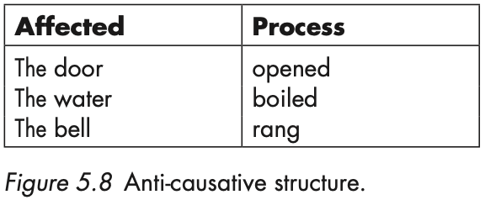
CAUSATIVE PROCESSES
Causative material processes and ergative pairs

Slide 6
PROCESSES OF TRANSFER
PROCESSES THAT ENCODE TRANSFER: GIVE, LEND, CHARGE, PAY, OFFER OWE
Examples:
Ed gave the cat a bit of tuna.
Bill’s father has lent us his car.
Have you paid the taxi-driver the right amount?

Slide 7
CONCEPTUALISING WHAT WE THINK, PERCEIVE, AND FEEL
MENTAL PROCESSES: COGNITION (know, understand), PERCEPTION (see, notice, hear, feel), AFFECTIVITY
(like, love, admire, miss), and DESIDERATION (hope, want, desire)

Slide 8
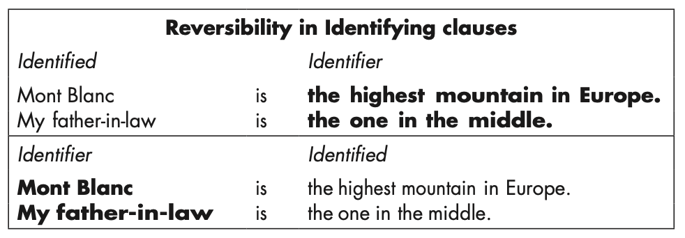
RELATIONAL PROCESSES OF BEING AND BECOMING
The attributive pattern
The identifying pattern

Slide 9
PROCESSES OF SAYING, BEHAVING, AND EXISTING
Verbal processes:
Silvia (Sayer) had to say (Verbal process) her name twice (Said)
Jill (Sayer) told (Verbal process) him (Recipient) what she knew (Said)
Behavioural processes:
He yawned rudely.
Existential processes:
There is a good film on at the Scala.

