Slide 1
FUNCTIONAL GRAMMAR– chapter FOUR INTERACTION BETWEEN SPEAKER AND HEARER
lecturer: Phạm hồng anh

Slide 2
CHAPTER FOUR OUTLINE
Speech acts and clause types
The declarative and interrogative clause types
The exclamative and imperative clause types
Indirect speech acts, clause types, and discourse functions
Questions, clause types and discourse functions
Directives

Slide 3
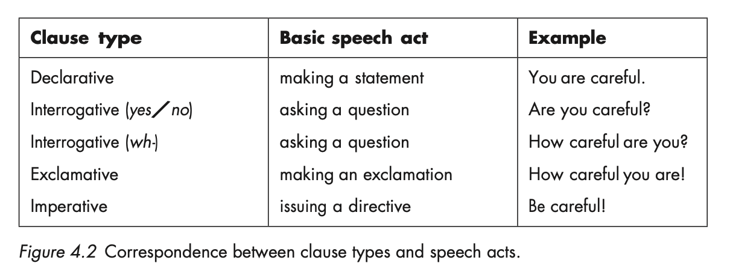
SPEECH ACTS AND CLAUSE TYPES
Speech acts are the acts we perform through words. Certain general types of speech acts
are basic to everyday interaction: statements, questions, exclamations, and directives.

Slide 4
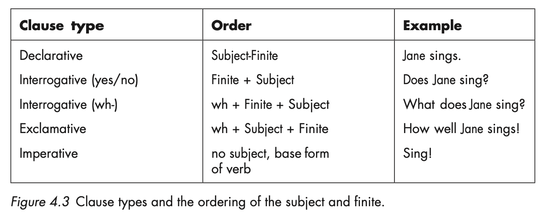
THE DECLARATIVE AND INTERROGATIVE CLAUSE TYPES
SUBJECT-FINITE VARIATION

Slide 5
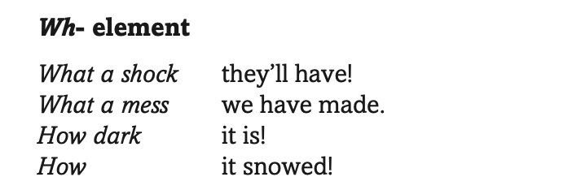
THE EXCLAMATIVE AND IMPERATIVE CLAUSE TYPES
The exclamative
The imperative

Slide 6
INDIRECT SPEECH ACTS, CLAUSE TYPES AND DISCOURSE FUNCTIONS
Performatives
Explicit performatives
I promise I’ll be careful.
We advise you to book early to avoid disappointment.
Less explicit performatives with modalisation
I can offer you beer, whisky, gin, cola…
Let me thank you once more for your collaboration.
I am afraid I have to request you to move to another seat.
Negative declaratives
I don’t need any more calendars, thank you.
I don’t promise you that I’ll convince him.
Smoking is not allowed here.

Slide 7
QUESTIONS, CLAUSE TYPES AND DISCOURSE FUNCTIONS
Rhetorical questions:
Do you expect me to wait here all day?
What could I say?
Questions as preliminaries:
Are you going to the hospital this morning?
No.
Well if you do it’ll give us a chance to find out whether he’s coming home.
SOME, ANY, and NEGATIVES forms in biased questions:
Do you know anyone in Westminster? Vs Do you know someone in Westminster?
Is there no butter? (There should be some butter, but it seems there isn’t.)
Isn’t there some butter somewhere? (It seems there isn’t, but I expect there is.)
Would you like some more coffee?
Do you want something, a soft drink before you go?

Slide 8
DIRECTIVES

Slide 9
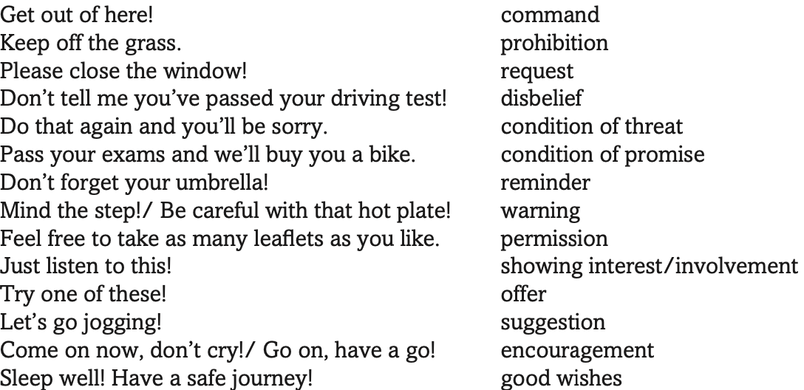
DIRECTIVES

