Slide 1
FUNCTIONAL GRAMMAR– chapter THREE THE DEVELOPMENT OF THE MESSAGE
lecturer: Phạm hồng anh

Slide 2
CHAPTER tHREE OUTLINE
Complementation of the verb and Valency
Intransitive and copular patterns
Transitive patterns
Complementation by finite clauses
Complementation by non-finite clauses

Slide 3
COMPLEMENTATION OF THE VERB AND VALENCY
Complementation of the verb refers to the syntactic patterns made up by configurations of
the clause elements. Each pattern contains a Subject and a Verb. The number and type of other
elements in each pattern is determined by the verb.
The potential number of participants, including the Subject – that is, the number of places in
the clause that the verb controls is referred to as its semantic valency.

Slide 4
Intransitive and copular patterns
When there is no complementation, the verb is said to be intransitive. The structure is S-V
Examples:
They laughed.
We walked home.
He retired last year.
The S-V-Cs pattern contains a copular verb that links the Subject to a Complement encoding
what the Subject is or becomes. The most typical copula is be.
Example: A couch potato is someone who lies watching television all day.

Slide 5
TRANSITIVE PATTERNS
Monotransitive
S-V-Od
E.g.: I (S) ate (V) a toasted cheese sandwich (Od)
Verbs used transitively and intransitively
E.g.: Drinking and driving don’t match.
Causatives with an intransitive counterpart (ergative pairs)
E.g. He opened the door; The door opened.
Verbs with a reflexive meaning
E.g. He shaved (himself). She dressed (herself).
Verbs with a reciprocal meaning
E.g. Tom and Jo met (each other) at a concert.

Slide 6
TRANSITIVE PATTERNS
Ditransitive
S-V-Oi-Od
E.g.: I (S) gave (V) her (Oi) a present (Od)
S-V-Od-Cprep
E.g.: This sunblock (S) will protect (V) your skin (Od) from the sun’s rays (Cprep).
Complex-transitive
S-V-Od-Co
E.g.:
He (S) got (V) his shoes (Od) wet (Co)

Slide 7
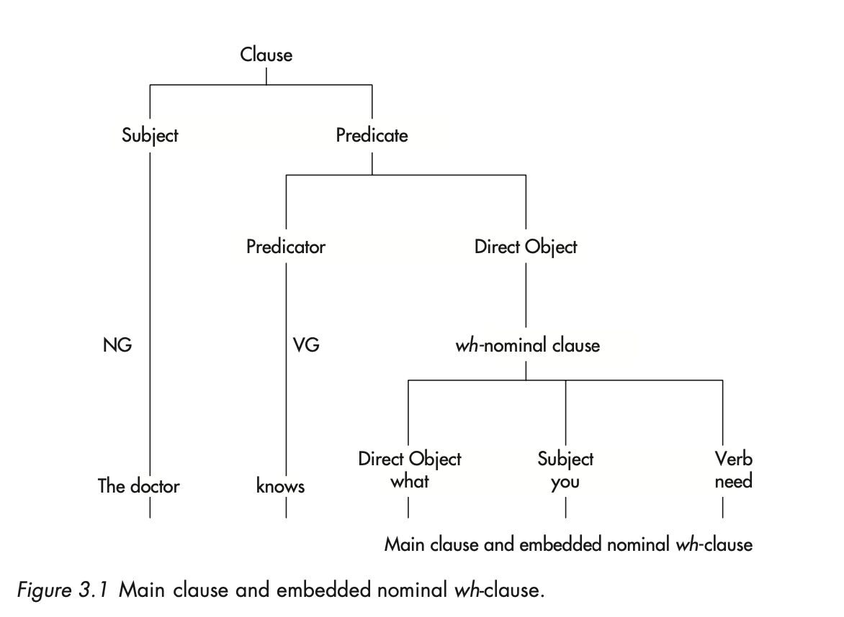
COMPLEMENTATION BY FINITE CLAUSES

Slide 8
COMPLEMENTATION BY non-FINITE CLAUSES
A catenative verb is a verb that controls a non-finite complement.
Want, wish, intend, arrange
Like, love, prefer, can’t bear, hate
Promise, agree, learn, forget, decide
Examples:
He wants to stay.
They believe him to be a genius.
He made them stand up.
She saw two men enter the shop.
I heard two shots fired.

