Slide 1
FUNCTIONAL GRAMMAR– chapter two THE SKELETON OF THE MESSAGE
lecturer: Phạm hồng anh

Slide 2
CHAPTER two OUTLINE
Syntactic elements and structures of the clause
Subject and Predicator
Direct, Indirect, and Prepositional Objects
Subject and Object Complements
Adjuncts

Slide 3
SYNTACTIC ELEMENTS AND STRUCTURES OF THE CLAUSE
Example:
A crash involving four vehicles caused delays on the A14 yesterday.
(Cambridge News, 20 April, 2016)
A clause describes an event/situation/state.

Slide 4
SYNTACTIC ELEMENTS AND STRUCTURES OF THE CLAUSE
Subject and Predicator
Object and Complement

Slide 5
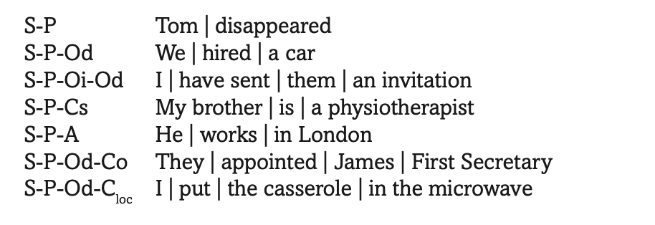
BASIC SYNTACTIC STRUCTURES OF THE CLAUSE

Slide 6
SUBJECT AND PREDICATOR
The Subject (S)
Semantic and cognitive features

Slide 7
SUBJECT AND PREDICATOR
The Subject (S)
Realisations of the Subject:
Nominal groups, e.g. That man is crazy; The handicapped are given special facilities in public areas.
Finite and Non-finite clauses, e.g. That we’ve gotten to this point is astonishing to me; To take such a risk is rather foolish.
Anticipatory It + end-placed subject, e.g. It was impossible for everyone to escape.
Dummy It, e.g. It’s nearly three o’clock; It’s raining.
Unstressed There, e.g. There was only one letter delivered today.

Slide 8
SUBJECT AND PREDICATOR
The Predicator (P)
Semantically, the predicator encodes the following main types of ‘processes’:
Material processes of ‘doing’ with verbs like make, catch, go;
Mental processes of ‘experiencing’ with cognitive verbs of perception (see), cognition (know), affectivity, (like) and desideration (hope)
Relational processes of ‘being’ with verbs such as be and belong.

Slide 9
DIRECT, INDIRECT, AND PREPOSITIONAL OBJECTS
The Direct Object (Od): Realisations
Nominal group, e.g We hired a caravan.
Anticipatory it, e.g. I find it strange that she left
Finite clause, e.g. You know (that) I am right.
Non-finite clause, e.g, They enjoy travelling by train.

Slide 10
DIRECT, INDIRECT, AND PREPOSITIONAL OBJECTS
The Indirect Object (Oi): Syntactic and semantic features
Examples:
0. I am writing him a letter.
I am writing a letter to him.
I am writing a letter for him.

Slide 11
DIRECT, INDIRECT, AND PREPOSITIONAL OBJECTS
The Prepositional Object (PO): Syntactic and semantic features
Examples:
I looked after their cat.
You can rely on Jane in an emergency.
Stranding the preposition:

Slide 12
SUBJECT AND OBJECT COMPLEMENTS
The Complement of the Subject (Cs):
Attributive Complements (S-P-Cs); E.g She was ambitious.
Identifying Complements (S-P-Cs); E.g. Her name was Betina.
The Complement of the Object (Co):
You (S) are making (P) me (Od) angry (Co)
Dye your hair blue (AdjG)/whatever colour you like (finite nominal clause)

Slide 13
ADJUNCTS
Circumstantial Adjuncts: information concerning time, place, manner, means, etc.
Stance Adjuncts: information concerning the speaker’s attitude on the content of the clause
Connective Adjuncts: are not elements but connectors of the clause structure

