Slide 1
FUNCTIONAL GRAMMAR– chapter one: INTRODUCTION
lecturer: Phạm hồng anh

Slide 2
CHAPTER ONE OUTLINE
Language and meaning
Three ways of interpreting clause structure
Grammatical units and ranks of units
Classes of units

Slide 3
LANGUAGE AND MEANING
Context
Form
Function
Meaning

Slide 4
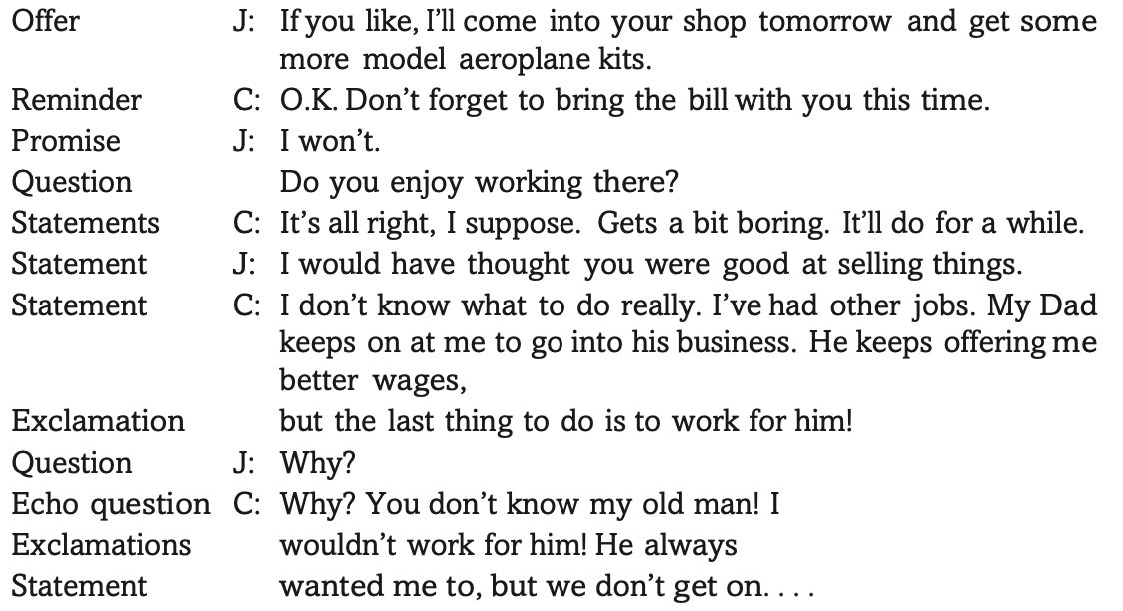
COMMUNICATIVE ACTS (SPEECH ACT)

Slide 5
COMMUNICATIVE ACTS (SPEECH ACT)
The kind of meaning encoded as questions, statements, offers, reminders, and thanks is interpersonal meaning.

Slide 6
THE CONTENT OF COMMUNICATION
Language and context (language operates in context)
Context has to do with one’s experience of life (the doings and happenings) in the real world or imaginary world (called situation).
The conceptualisation of the situation has such components as processes, participants, attributes, and circumstances.
Representational meaning is the meaning that has to do with the content of the message.

Slide 7
THREE WAYS OF INTERPRETING CLAuse structure
A clause as
The linguistic representation of our experience of the world;
A communicative exchange between persons;
An organised message or text.

Slide 8
THE CLAUSE AS REPRESENTING SITUATIONS: TRANSITIVITY STRUCTURES

Slide 9
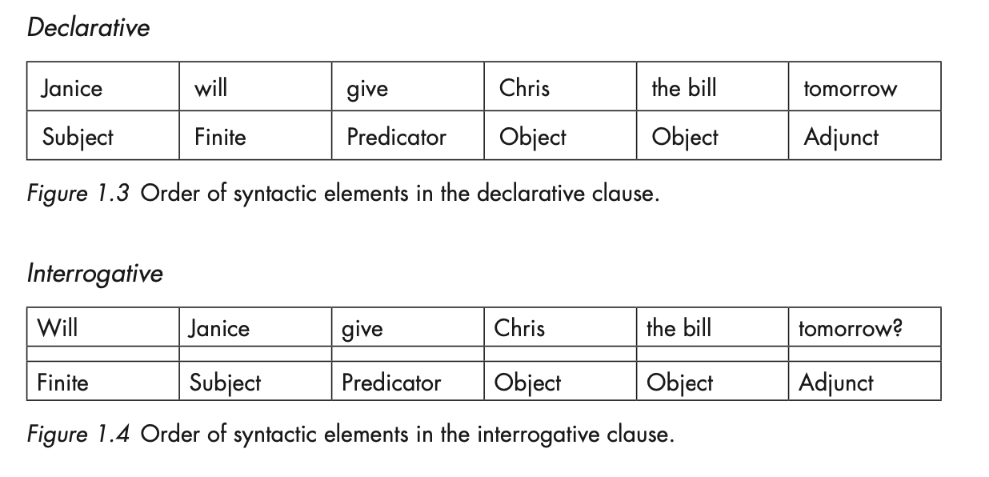
THE CLAUSE AS INTERACTION: MOOD STRUCTURES

Slide 10
THE CLAUSE AS MESSAGE: THEMATIC STRUCTURES

Slide 11
SUBJECT, ACTOR (AGENT), THEME
The Theme functions in the structure of the clause as a message;
The Subject functions in the structure of the clause as an exchange;
The Actor/Agent functions in the structure of the clause as representation.

Slide 12
Linguistic forms and syntactic functions
Syntactic concepts:
Structural units
Ranks
Classes
Elements

Slide 13
Linguistic forms and syntactic functions

