Slide 1
SESSION 4
PREPOSITIONS FOLLOWING ADJECTIVES

Slide 2
ADJECTIVES + PREPOSITIONS
1. Adj + of… nice/kind/good/polite/silly/stupid… of somebody (to do something)
- It is stupid of her to go out without a coat in such cold weather.
2. Adj + about/with… angry/annoyed/furious/excited/worried/ upset/ nervous/happy about something
- It’s stupid to get angry about things that don’t matter. angry/annoyed/furious with somebody for doing something
- Are you annoyed with me for being late? delighted/pleased/ satisfied/ disappointed with something
- I was delighted with the present you gave me.
3. surprised/shocked/ amazed/astonished at/by something
- I hope you weren’t shocked by/at what I said.
4. Adj + of… afraid/ frightened/ terrified/scared of..: fond/proud/ashamed/jealous/envious/suspicious/critical/aware of/ conscious/capable/ incapable/tired of…:
5. good/bad/excellent/brilliant at…:

Slide 3
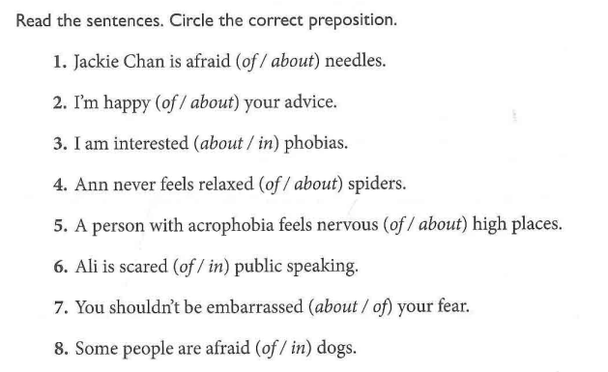

Slide 4
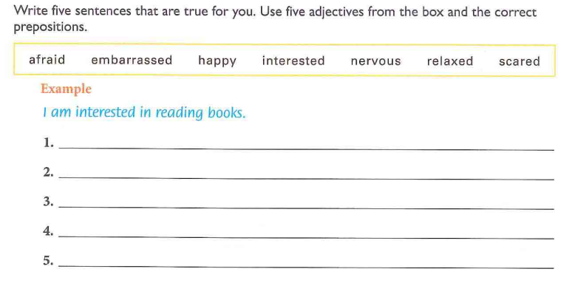

Slide 5
Chọn giới từ đúng
1) Cheques are useful (with/to/for/on) travellers.
2) Are you successful (on/in/at/to) your experiment?
3) She got back safe (for/from/with/to) her adventure.
4) It was very lucky (to/for/of/with) me that my bag was found.
5) He seems friendly (on/to/for/about) everyone in the village.
6) She was sad (about/for/with/to) my refusal.
7) Quang Linh is popular (with/for/to/in) folk songs.
8) The student is quick (with/at/on/to) understanding what the teacher explains.
9) The story is very pleasant (to/with/for/in) us.
10) He is very kind (to/of/with/for) me.

Slide 6
11) I'm capable (of/with/for/to) speaking two languages.
12) She is never late (to/for/with/from) work.
13) It was very nice (to/of/in/for) him to give me a lift.
14) Yesterday Nga was absent (with/from/to/for) class because she was ill.
15) Contrary (to/with/for/about) his doctor's orders, he has gone back to work.
16) Don't worry (about/with/to/for) the money! I'll lend you.
17) They have been waiting (for/with/to/at) the bus for half an hour.
18) Why don't you ask (with/to/for/on) a pay increase?
19) He took advantage (of/in/about/for) this opportunity to explain why he had done that.
20) The weeks went slowly (by/with/of/for).

Slide 7
KEY
1. for 2. in 3. from 4. for 5. to 6. about 7. with 8. at 9. to 10. to | 1. of 12. for 13. of 14. from 15. to 16. about 17. for 18. for 19. of 20. By

Slide 8
KIỂM TRA CUỐI MÔN VIẾT 1

