Slide 1
SESSION 2

Slide 2
UNIT 2
POSITION OF ADJECTIVES IN A SENTENCE

Slide 3
POSITION OF ADJECTIVES IN A SENTENCE
- Before a noun to describe it.
a large picture/ a famous person
After linking verbs: be/ become/get/turn/keep/make/find
The horse became tired after the race.
After verbs of senses: feel/smell/taste/look/sound/seem/appear
After the indefinite pronouns: someone/everyone/no one/anyone/
something/everything/no thing/anything

Slide 4
RECOGNIZING NOUNS/ADJECTIVES/VERBS
Động từ | Tính từ | Danh từ | Danh từ chỉ người
en (deepen) | ic (economic: kinh tế), le (able: có thể) ly (lovely: đáng yêu/lively: sống động) | ity (le - ability: khả năng), ism (tourism: du lịch) | er/or (survivor)
ate (generate : sinh ra) | ical (economical: tiết kiệm) | ment (government: chính phủ/ development: sự phát triển) | ist (tourist)
ize (organize: tổ chức) | ive (imaginative: giàu trí tưởng tượng) | al (arrive – arrival: đến) survive- survival: sự sống sót | ee/eer (engineer)
ve | ous, ful(beautiful: đẹp), ing (exciting: hấp dẫn), ed, less (careless: bất cẩn), ent (convenient: thuận tiện/patient: kiên nhẫn), ant (pleasant: thú vị) | ce (importance: sự quan trọng/convenience), tion (invent – invention: phát minh), ness (carelessness: sự bất cẩn) | ese/ian/ant

Slide 5
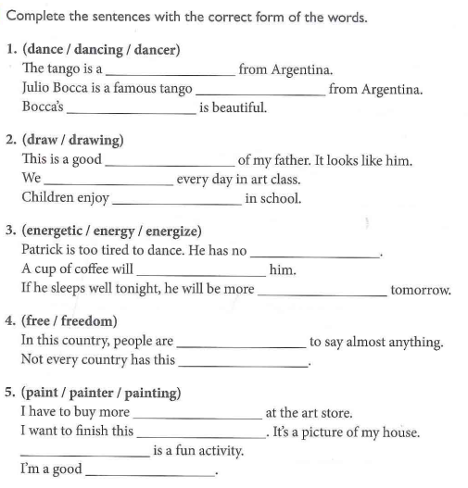

Slide 6
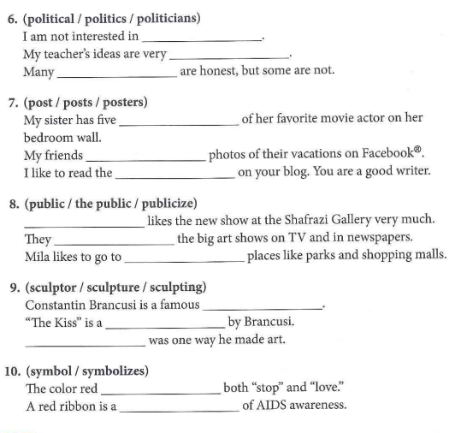

Slide 7
Give the right form of word for each blank.
1. Mary was absent from class because of her …………… . < SICK >.
2. What’s she like ? She’s ……………… . < LOVE >.
3. After their summer holidays, the children looked ………. . < HEALTH >.
4. Miss Lan ……………… us English. < TEACH >.
5. She came with a …….. smile on her face. < CHEER >.
6. I was full of ………… about their plans. < CURIOUS >.
7. She teaches her naughty boy ……………… < STRICT >.
8. You can see a great ………….. in his eyes. < CHEER >.
9. Mr. Nam is my French ……………. . < TEACH >.
10. Pupils shouldn’t make …………. in class. < NOISY >.

Slide 8
11. Time passes ……….. when you are alone . < SLOW >.
12. Be ……….. in your work ! < CARE >.
13. He ……….. got up and left the room. < QUIET >.
14. My heart was filled with the ……. of the first school day. < EXCITE >.
15. Don’t do things …………… from others. < DIFFER >.
16. Nam has broken these glasses. He is a ………… boy. < CARE >.
17. The boy has painted the picture …………. . < CLEVER >.
18. We are tired now. We have worked ………….. all day. < BUSY >.
19. We have a class ………. every month. < DISCUSS >.
20. They felt ………… in living on a farm. < INTEREST >.

Slide 9
Choose the best option to complete each sentence.
1. I wasn't_____ with my exam result.
A. please B. pleased C. pleasing D. pleasant
2. The water is _____. You can't drink it.
A. polluted B. pollution C. polluting D. pollutant
3. We avoid_______ our environment.
A. polluted B. polluting C. pollute D. to pollute
4. Many spacemen could never get back to the Earth because of ____ accidents.
A. tragedy B. tragic C. tragically D. tragedies
5. We've decided to interview only ten _____ for the job.
A. applicants B. applicable C. appliances D. applications
6. They have no _____ for help.
A. expectation B. expect C. expectative D. expectancy
7. Boys and girls may behave _____ in this situation.
A. difference B. differing C. different D. differently
8. One recent ________ in medicine is the development of laser in treating cancer.
A. Achievements B. achievement C. achiever D. achieved
9. You have to be aware of the damage humans are doing to quicken the ________ of wildlife.
A. extinct B. extinctive C. extinctions D. extinction
10. He was finally _________ in his final attempt.
A. Successful B. successive C. unsuccessful D. success
11. They did everything possible to _______ the police force.
A. Strengthen B. strengthening C. strength D. stronger
12. It was a(n) ________ mistake that he made.
A. shamed B. shameful C. ashamed D. shameless
13. I spent a(n)________ night because of my toothache. I’m very tired now.
A. sleepy B. sleeping C. sleepless D. asleep
14. His low scores in the mock tests ______ him quite a lot.
A. Courageous B. encouraging C. discouraged D. encouragement
15. Recently pop-rock music has decreased in ________.
A. popular B. popularizing C. popularity D. popularly
16. The waste from the chemical factory is extremely ________.
A. harmed B. unharmed C. harmful D. harmless
17. The restaurant is now under new ________.
A. manager B. manageable C. management D. manager
18. Your money will be refunded if the goods prove to be ________.
A. Satisfying B. dissatisfied C. satisfactory D. unsatisfactory
19. The problem of ________ among young people is hard to solve.
A. Employment B. employers C. employees D. unemployment
20. The _________ of old buildings should be taken into consideration.
A. preserve B. preservation C. preservative D. preserves

