Slide 1
WRITING 1

Slide 2
UNIT 1
NOUNS AND VERBS HAVING THE SAME SPELLING

Slide 3
POSITION OF NOUNS IN A SENTENCE
Subject | Verb | (Object) | to Verb/V-ing | Object/Complement
Noun |  | Noun |  | Noun
Ms. Joan | wants | her daughter | to become | a singer

Slide 4
POSITION OF VERBS IN A SENTENCE
Subject | Verb | (Object) | to Verb/V-ing | Object/Complement
Ms. Joan | wants | her daughter | to become | a singer

Slide 5
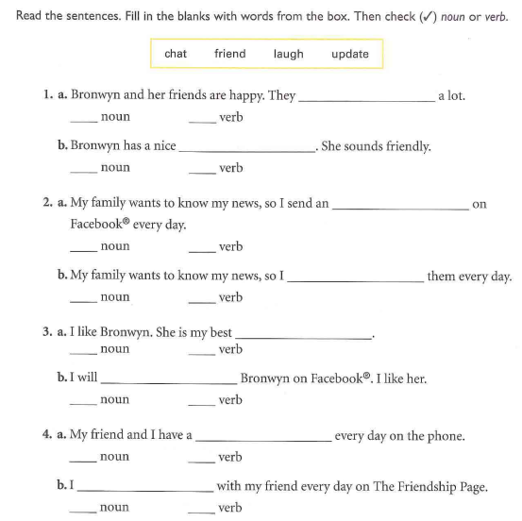

Slide 6
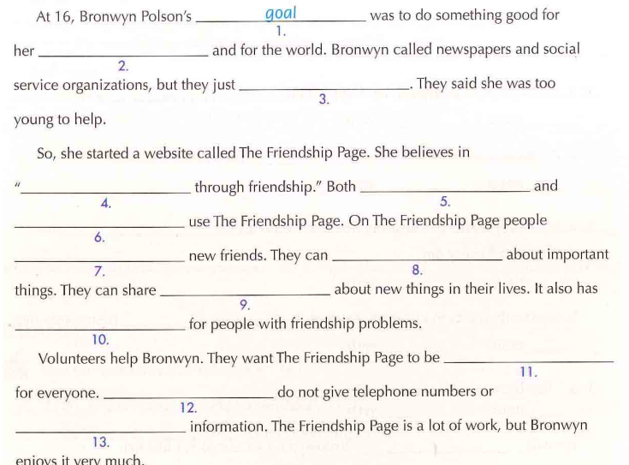

Slide 7
EXAMPLES OF NOUNS AND VERBS HAVING THE SAME SPELLING
NOUN | VERB
REcord | reCORD
PERmit | perMIT
PREsent | preSENT
CONduct | conDUCT
PROgress | proGRESS
OBject | obJECT

Slide 8
Practice 1 Read each pair of sentences to yourself. First, decide if the underlined word is a noun or a verb.
1. Read the entire contract before signing it.
2. People contract malaria when they are bitten by a mosquito that is carrying it.
3. I need to conduct a research study for my thesis.
4. She got a bad grade for poor conduct.
5. Does anyone object to the rules of this game?
6. What is that object over there? I can’t see it from here.
7. We attribute her success more to luck than to hard work.
8. Patience is an essential attribute for a teacher.
9. The abstract of the article was well written.
10. Quantum physics is just too abstract for me to really understand.

Slide 9
11. The store has a wide variety of produce.
12. We need to produce a lot of evidence at the trial in order to make our case.
13. She cried endlessly and there was nothing we could do to console her.
14. Remember to turn off the console when you’re done using the computer.
15. The dentist wants to extract my tooth.
16. The recipe calls for vanilla extract.
17. The new tax law will have a negative impact on our company.
18. How will the new tax law impact our company?
19. It’s important to combat poverty.
20. He was awarded for his excellence in combat.

Slide 10
Practice 2 Decide which word fits into each blank in the sentences below. The first one is done for you.
I went to the pharmacy for a REfill, but they wouldn’t reFILL my prescription.
I SUSpect/susPECT that the SUSpect/susPECT we have is innocent.
I PERmit/perMIT you to give him the PERmit/perMIT.
They want to CONvict/conVICT the CONvict/conVICT of a second crime.
We shouldn’t Desert/deSERT our troops in the Desert/deSERT.
It’s important to keep an accurate Record/reCORD of all of our transactions, so please be careful when you Record/reCORD the date, time, and cost of all of our sales.
I felt like such a Reject/reJECT when you Rejected/reJECTed me.
If you are going to call yourself a Rebel/reBEL, then you need to Rebel/reBEL against something.
Your Insults/inSULTS are Insulting/inSULting.

