Slide 1
https://docs.google.com/presentation/d/1PI-RSRysxuq-DiZbdIH60NWb66SxWWRB/edit?usp=sharing&ouid=115971414926050025680&rtpof=true&sd=true
Reading 2
Lecturer: Phạm Xuân Đạt, M.A.

Slide 2
Session 1
Brief Introduction to Reading
Unit 1 : Reading 2

Slide 3
Brief Introduction to Reading Skills ● Be flexible: read quickly to find relevant sections, then read carefully when you have found what you want. Efficient reading strategies : - Scanning to find certain information - Skimming to get the main idea - Predicting to understand a text well ● Be an active reader, not a passive one - Reading - an interactive process - Construct the meaning using your knowledge of the language and the world - Continually predict and assess

Slide 4
. ● Reading Strategies A. Predicting: B. Skimming for Main Ideas C. Scanning for specific Information D. Making inferences
Illustrations: photos, graphs, tables, diagrams & captions
- The title and author details
- Run your eyes over the text very quickly. - Look at headings to gain an overview of a text - Do not pay attention to details. - Read a few words of every paragraph, perhaps the first and last sentences. ( A fast process that takes only a few minutes)
Sweeping your eyes (like radar ) over parts of a text
Identify the section(s) of the text that you probably need to read.
Slow down to read the relevant section more thoroughly when you catch an important word or phrase
- being a reading detective / reading between the lines - understanding information that is not explicitly stated. - What I already know + What I learned from the text = What I infer

Slide 5
● Basic steps to complete a reading task Step 1 : Read the title, headings, examine the pictures, etc. to predict the information in the text Step 2 : Read the questions, underline key words Step 3: - Paraphrase key words - Read the information carefully (make inferences if any), - Choose the correct answer

Slide 6
Unit 1 Finding the Ideal Job

Slide 7
Vocabulary Review A. Match each incomplete sentence on the left with the vocabulary word on the right that completes it. Not all words will be used. ___ 1. Will my ___ be high enough to pay my bills? A. hire ___ 2. It was a(n) ___ to get all of the work done in time. B. manager ___ 3. This job is ___ for me because I am great at it! C. income __ 4. Did they ___ more waiters or just you? D. résumé E. ideal F. challenge

Slide 8
B. Read the restaurant manager’s interview with Alex. Use the words from the box to fill in the blanks. Not all of the words will be used. advice hire posting setting career ideal résumé skills Manager: Did you see our newspaper 1. _____________________ for a waiter? Alex: No, my friend works here. He told me that you needed more waiters. Manager: OK. I see from your résumé that you have 15 years of experience. Is this a job for you or more of a(n) 2.________________? Alex: It’s definitely more than a job for me. I want to do this forever. Manager: Do you have experience in another type of work 3. _____________________ or only in restaurants? Alex: Yes, I worked in an office for a few months, but I didn’t like it. Manager: What are some of your 4. _____________________ as a waiter? Alex: Well, I have a good memory, and I work very fast. Also, I know how to keep customers happy so that they will come back again. Manager: Can you tell me what 5. _____________________ you would give someone who just started his first job as a waiter? Alex: Yes. I would tell him to listen to customers. It is important to pay attention to what they want. Manager: That sounds great! When can you start?

Slide 9
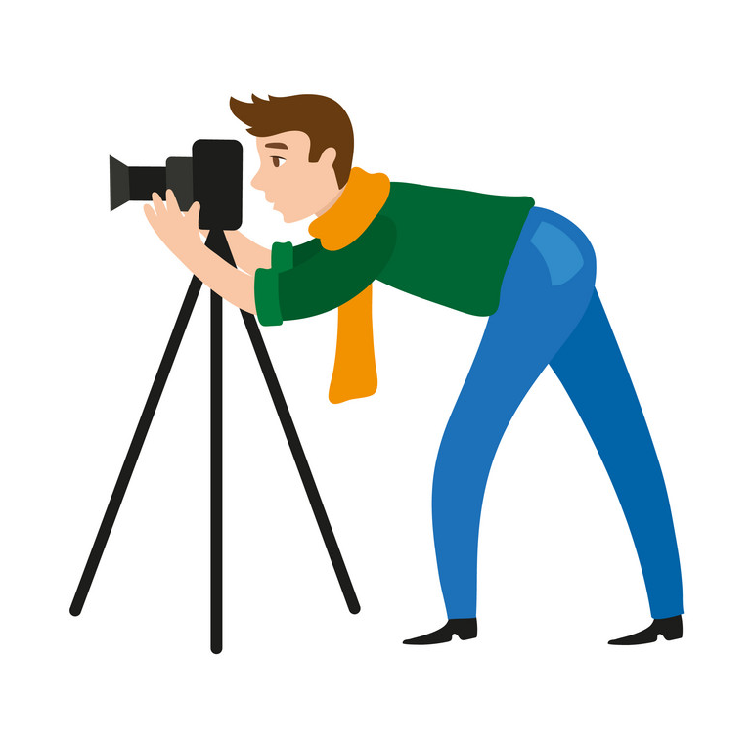
PREDICTING CONTENT FROM VISUALS Before reading any text, strong readers look at all the visuals (pictures, photos, graphs, etc.) on the page. This gets them to think what they already know about the topic and allows them to predict the content of the text. Jobmob is a blog that post about interesting and unusual jobs. Read about some people who have found their ideal job in some very unexpected way. Ex: In the photo for paragraph 2, I see a man behind a video camera. => The paragraph must be about a man whose ideal job is to make video.

Slide 10
The Ideal Job by Alex Frost 1. Believe it or not, some people get paid for doing the things that make them really happy. Read about a few people who have the jobs of their dreams. “I get paid to make videos!” 2. When I was 14, my uncle gave me his old video camera, and I started making videos. I didn’t do well in school, but I loved getting to know people and making videos about them. I taught myself to edit the videos on a simple computer program of my dad’s. One day a friend of my mom’s asked me to make a video of their family. She wanted to send it to her mother who lived in China. It was a lot of fun, and she paid me $150. Soon her friends asked me to make videos for them, and suddenly I had a business. That was 10 years ago. Things changed a lot in this work, so I’m always taking classes. But I have to say I love running my own business. – Ryan “I have the greatest job in the world.” 3. These days almost everyone turns to the Internet when they are single and want to meet someone. There are many Internet dating sites. But most people don’t know how important it is to have a personal touch. What do I do? I am a matchmaker with 41 years of experience. Because of me, 60 couples are now happily married or engaged. I have a very good eye for people. And I don’t mean I match people on how they look. I mean, I can meet a person just once for 15 minutes, and I know for sure what kind of person he or she is. I get a feeling. And this feeling tells me, “Oh, he might be a great husband for Stephanie,” or “Ah, now here is the woman for Timothy.” I can’t imagine a job that’s more fun. I meet wonderful people. I work for myself. Nobody tells me what to do. I don’t spend much time with a computer in an office – the whole city is my office! I make enough money to live a simple life. And I get so much joy from seeing what happens to my matches. A month ago, a couple stopped by on their way home from the hospital with their new baby girl. I’m so happy to think that I helped make that family! - Amanda “I have a job with an incredible view.” 4. Teaching skydiving is exciting. It get to be outside, and I love seeing students on their first jump. They are nervous and excited. For them, that first step out of the plane is the biggest challenge. After they take that step, it’s all good. When they get to the ground, they can’t wait to call everyone they know to tell them they just jumped out of an airplane. Later, when they learn to turn and fly forward, they realize that they’re not just flying stones. They realize that they’re like birds – they can fly! 5. It wasn’t easy to get this job. I had to have about 1,000 jumps and about two years of training. And the salary was only $15,000 for the first year. But I don’t do it for the money. In fact, I don’t need to get paid at all. I love it that much. – Don 1. ____Don________ made $15,000 her/his first year. 5. ______________is studying to get better skills. 2. ______________ helped 60 couples find each other. 6. _____________ loves teaching. 3. ______________ didn’t do well in school as a child. 7. _____________studied and practiced for her/his job for two years. 4. _____________as the same job s/he had over 40 years ago. 8. ______________ is in charge of a video business.

Slide 11
Unit 1 1 Alex Mansfield drives a red sports car and wears a suit and tie to work every day. He isn’t a businessman; Alex is a waiter at one of New York City’s most popular restaurants. The food is very expensive at the restaurant, and Alex doesn’t make a large salary, but he makes a huge amount of money from customers’ tips.¹ “For me, being a waiter is more than a job; it is a career,” he says. The restaurant hired Alex right after his interview. The manager liked his long résumé: Alex has 15 years of experience and training as a waiter. 2 Alex enjoys the money, and a busy restaurant is an ideal work setting for him. “I have a good time, and I like talking to people,” he says. Alex never feels bored or tired at work. 3 Alex likes restaurants, but he thinks it is too much of a challenge to open a restaurant of his own. “I realized I don’t have the skills to run a business,” he explains. “I studied business in college, but I didn’t do well.” Alex thinks his job as a waiter has more rewards. He says, “As a waiter, I don’t have to worry about money. Take my advice—in New York City there are 50,000 restaurants. There are postings for jobs every day, so you will never be out of work!” He sounds like he knows what he’s talking about. ¹ tip: extra money you give someone for good service A. Read each statement. Write T if it is true or F if it is false. ___ 1. Alex wants to open his own restaurant one day. ___ 2. There are many jobs for waiters in New York. ___ 3. Alex makes a lot of money because of his skills. ___ 4. The author believes that others could learn from Alex.
B. Choose the best answer.
5. Alex thinks being a waiter is ___. A. boring B. difficult C. fun D. popular 6. Alex was hired because he ___. A. wears a suit B. is experienced C. goes to college D. likes restaurants 7. The best title for this article is ___. A. “Great City Careers” B. “Alex in New York” C. “A Day as a Waiter” D. “More Than a Job” 8. The author thinks that Alex ___. A. is very good at what he does B. should try to start his own business C. cares too much about what others think D. thinks that he is more important than he is

Slide 12
FURTHER READING 1 I. Read the passage and answer these following questions. One identifying characteristic of minerals is their relative hardness, which can be determined by scratching one mineral with another. In this type of test, a harder mineral can scratch a softer one, but a softer mineral is unable to scratch the harder one. The Mohs’ hardness scale is used to rank minerals according to hardness. Ten minerals are listed in this scale, ranging from talc with a hardness of 1 to diamond with a hardness of 10. On this scale, quartz (number 7) is harder than feldspar (number 6) and is therefore able to scratch it; however, feldspar is unable to make a mark on quartz. 1. Which of the following best states the subject of this passage? A. The hardness of diamonds. B. Identifying minerals by means of a scratch test. C. Feldspar on the Mohs’ scale. D. Recognizing minerals in their natural state. 2. The main idea of this passage is that _____________________. A. the hardness of a mineral can be determined by its ability to make a mark on other minerals B. diamonds, with a hardness of 10 on the Mohs’ scale, can scratch all other minerals C. a softer mineral cannot be scratched by a harder mineral D. talc is the first mineral listed on the Mohs’ scale

Slide 13
Thank you for your attention !

