Slide 1
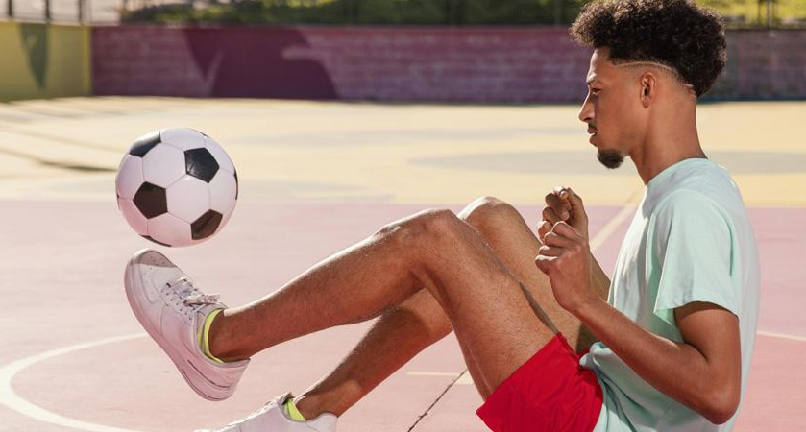
Speaking One
UNIT 8
SOCCER: THE BEAUTIFUL GAME
SPORTS
SPORTS

Slide 2
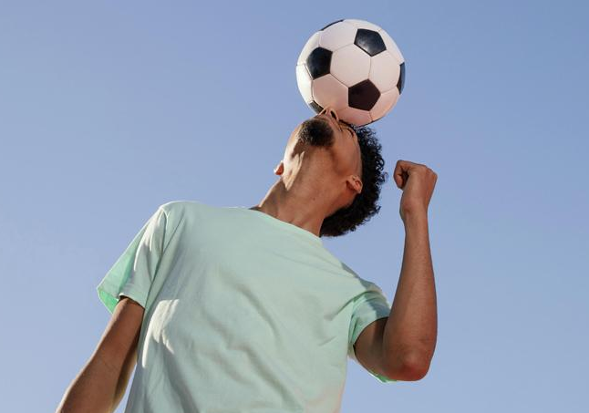
01.
Guessing Game
SPEAKING ONE
Guess the words based on their definitions and given letters. Students who get the most accurate answers in the fastest time will get good marks.

Slide 3
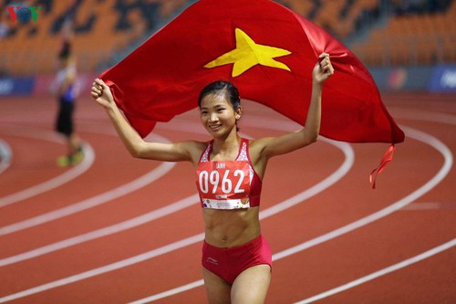
VOCABULARY
SPORTS
a______ (n)
a person who competes in sports
→ athlete (n)
/ˈæθliːt/
SPORTS

Slide 4
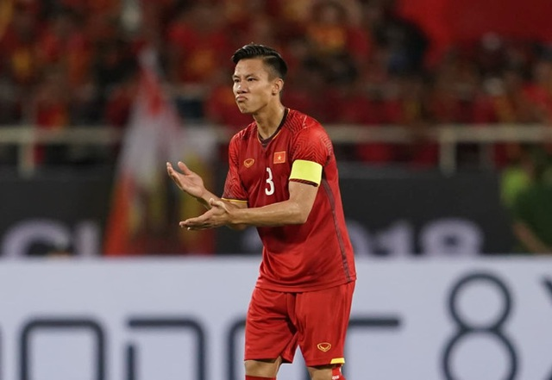
VOCABULARY
SPORTS
c______ (n)
the leader of a group of people, especially a sports team
captain (n)
/ˈkæptɪn/
SPORTS

Slide 5
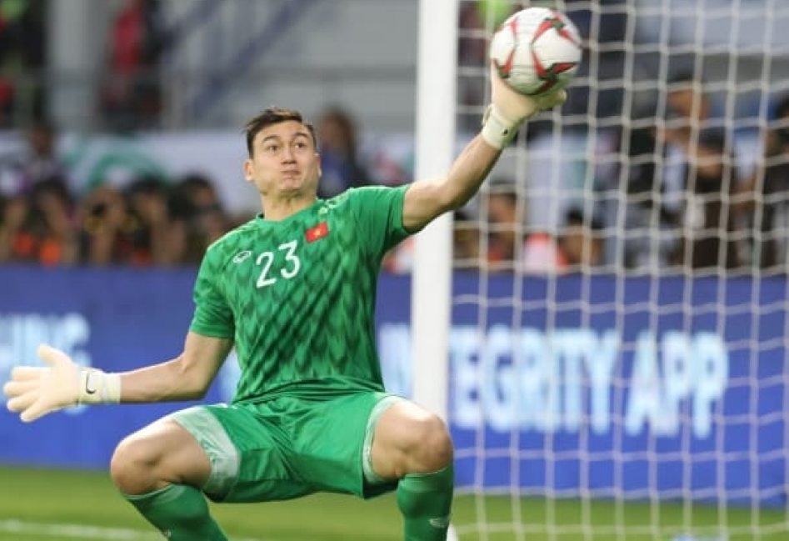
VOCABULARY
SPORTS
g_________ (n)
a player whose job is to stop the ball from going into his or her own team’s goal
→ goalkeeper (n)
/ɡəʊlˌkiːpər/
SPORTS

Slide 6
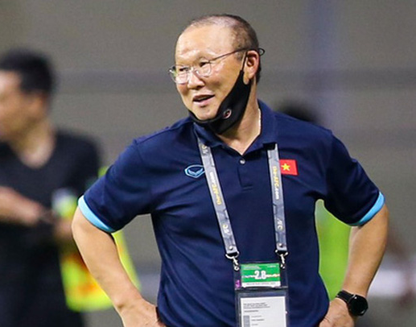
VOCABULARY
SPORTS
c____ (n)
a person who trains a person or team in sport
coach (n)
/kəʊtʃ/
SPORTS

Slide 7
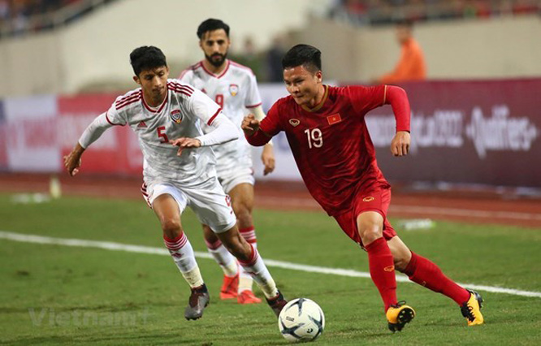
VOCABULARY
SPORTS
o_______ (n)
a person that you are playing or fighting against in a game, competition, argument, etc.
opponent (n)
/əˈpəʊnənt/
SPORTS

Slide 8
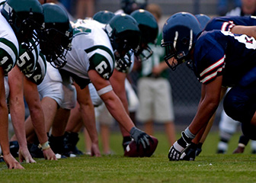
VOCABULARY
SPORTS
c______ (v)
to take part in a contest or game
compete (v)
/kəmˈpiːt/
e.g. The Vietnamese team will be competing against Cambodia on December 19th.
SPORTS

Slide 9
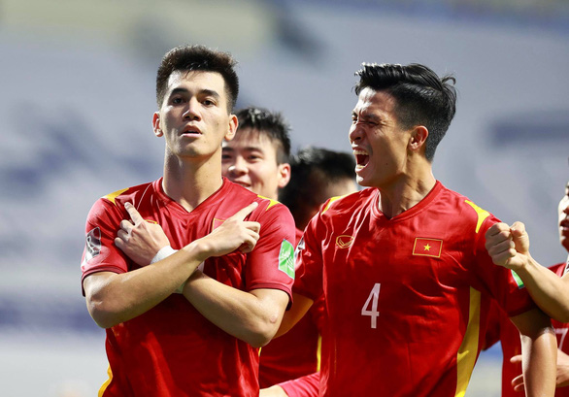
VOCABULARY
SPORTS
s____ a g___
to earn a point by scoring a goal on the opposing team’s net
score a goal
SPORTS

Slide 10
VOCABULARY
SPORTS
t__ (n)
a situation in a game or competition when two or more players have the same score
tie (n)
/taɪ/
SPORTS

Slide 11
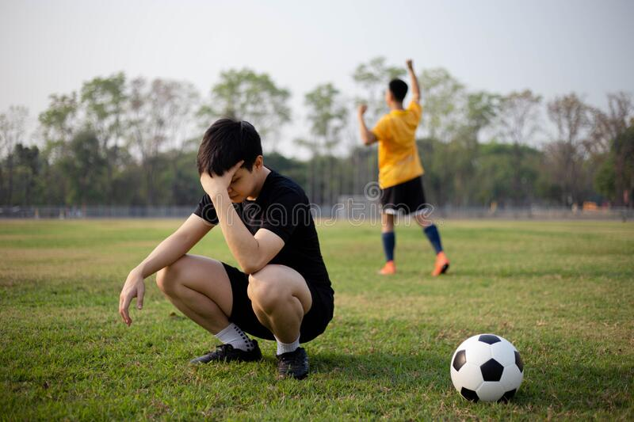
VOCABULARY
SPORTS
d_____ (n)
failure to win or to be successful
defeat (n)
/dɪˈfiːt/
SPORTS

Slide 12
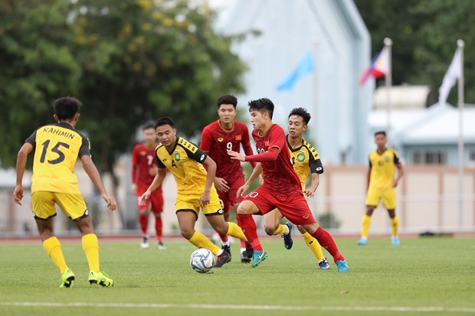
VOCABULARY
SPORTS
m____ (n)
a sports event where people or teams compete against each other
match (n)
/mætʃ/
SPORTS

