Slide 1


Slide 2


Reading 2
Lecturer: Le Thi Hanh, M.A

Slide 3
Tài liệu chính:
[1] Haugnes, N. & Maher, B. (2009). Northstar 2- Reading and Writing: Students’book. Longman: Pearson.
- Tài liệu tham khảo:
[2] Falla, T. & Davies, P. A. (2008). Intermediate Solutions: Students’ book. Oxford: OUP.
[3] Burgmeier, A. (2009). Inside Reading 1. Oxford, UK: Oxford University Press.
[4] Wilson, J. J., & Clare, A. (2006). Intermediate Total English: Student's book.
[5] Zwier, L J. (2009). Inside Reading 2. Oxford, UK: Oxford University Press.Harlow: Pearson.

Slide 4
Tài liệu tham khảo:
[6] Website for PET practice tests: a. http://www.flo-joe.co.uk/pet/students/tests/ b. http://www.examenglish.com/PET/pet_listening.html\. c.http://www.englishclub.com d. http://www.bbc.co.uk e. http://www.voanews

Slide 5

Self – study(the first 04 sessions)
Google meeting(the last 04 sessions)

Slide 6
Đánh giá kết quả học tập
Final Test |  | TỰ LUẬN (Ngày 11/03)

Slide 7


DAY 1
DAY 2
DAY 3
DAY 4
DAY 5
DAY 6
DAY 7
DAY 8

Slide 8


Slide 9
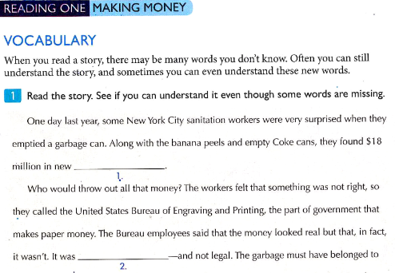
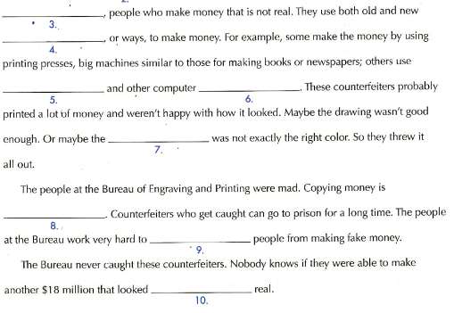

Slide 10
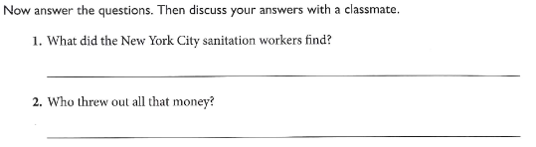

Slide 11
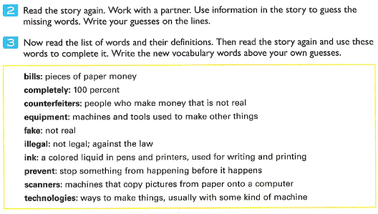

Slide 12
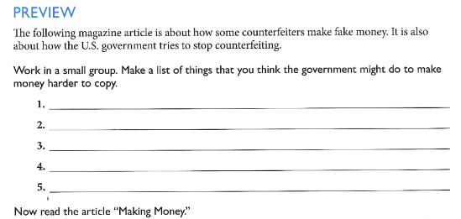

Slide 13
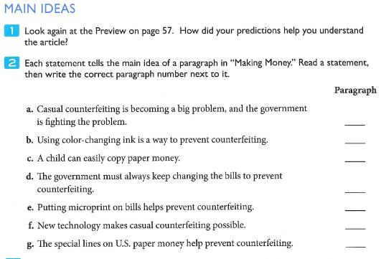

Slide 14
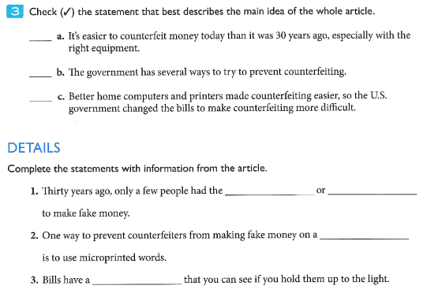
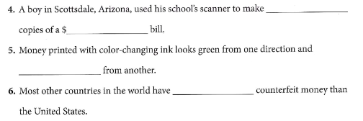

Slide 15

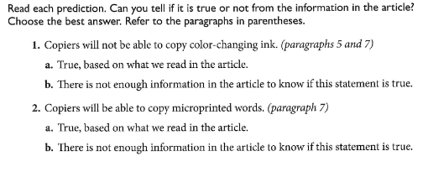
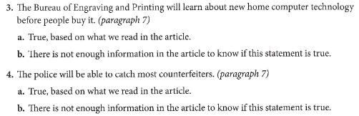

Slide 16
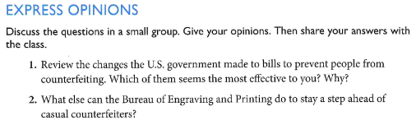

Slide 17
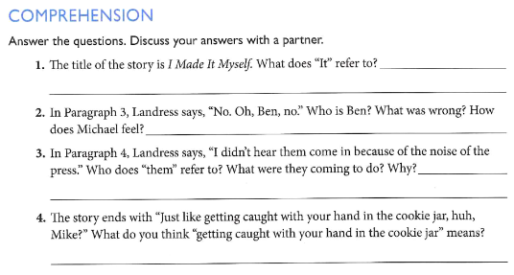

Slide 18
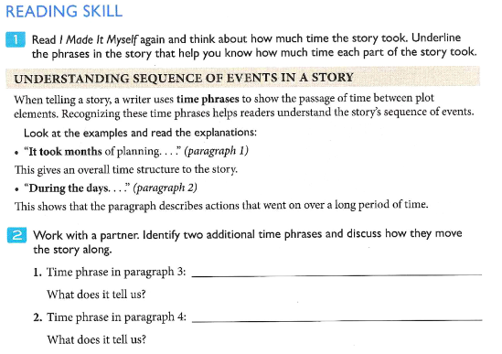

Slide 19
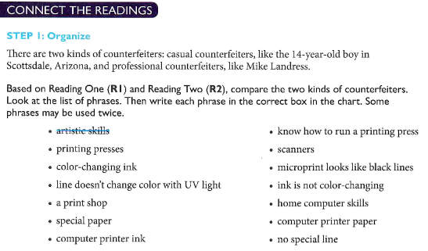

Slide 20
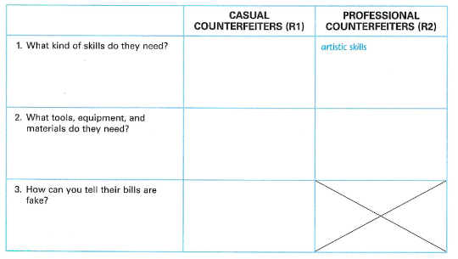

Slide 22
HOMEWORK

Slide 23


