Slide 1
WRITING AN OPINION PARAGRAPH
WRITING 1

Slide 2
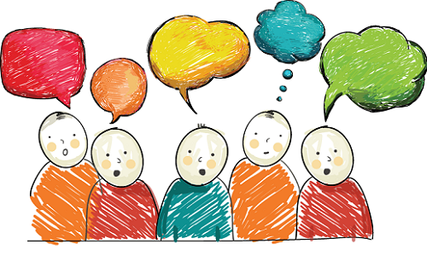
Expressing Opinions
An opinion is a thought or belief about something or someone.
You have to understand the given topic and have an opinion (choose either agree or disagree)

Slide 3
1. A topic sentence: - Topic - Controlling idea: showing whether you agree or disagree with a topic. 2. Supporting sentences: - Reason 1 + supporting detail (explanations, examples, etc.) - Reason 2 + supporting detail (explanations, examples, etc.) etc. 3. Concluding sentence: - Summarizing the main reasons/ restating the topic sentence.
Organization

Slide 4
USEFUL LANGUAGES
Introduction/ Topic sentence
Giving opinions
Reasons
Conclusion
I agree/ disagree that ...
I agree/ disagree with ... for ... reasons.
I am for/ against the idea that S + V
There are reasons why ...
I (strongly/ firmly) believe/ feel/ think that …
I am convinced/ certain/ sure that …
It seems to me that …
In my opinion, /In my point of view/ In my view, ..
The first reason is ...
Another reason is ...
First (Firstly),/ Second (Secondly), / …
Moreover, / Furthermore,/ …
In conclusion,/ To conclude,
In summary, / To sum up,
In short, / In brief,

Slide 5
Example
Write a paragraph to show your opinion about this statement
“Lotteries should be banned.”

Slide 6
Waste of money
Not a good chance to earn money
Lottery addiction

Slide 7
Outline
I completely agree that lotteries should be banned. Firstly, in my opinion, lotteries are a waste of money. Everytime we buy a lottery ticket, we have less money to buy things we need such as food or medicine. In addition, I think playing the lottery is very addictive. When you buy a lottery ticket, but do not win, we may want to buy more and more tickets. Finally, in my point of view, lotteries are not really a good chance to make money. We can not use our skills or abilities to win the lottery. The only thing we can depend on is luck. To sum up, for these reasons, I believe that banning lotteries is a good idea.
1. Topic sentence:
“Lotteries should be banned” → Agree
2. Supporting sentences:
a. Reason 1: Waste of money
+ Supporting detail:
less money to buy things we need
b. Reason 2: Lottery addiction
+ Supporting detail:
not win → buy more and more
c. Reason 3:
Not a good chance to make money
+ Supporting detail: not use skills or abilities to win lotteries, just depend on luck.
3. Concluding sentence:
banning lotteries is a good idea.

Slide 8
Final Writing Task
Write an opinion paragraph (100-120 words) about this topic
“Does travelling benefit young people?”

Slide 9
Suggested Ideas
Steps of Writing
Travelling benefits young people. → AGREE
Gain more knowledge about culture, history and people of the areas. → Broaden your horizon.
Be good for your health.
Become more independent (plan your journey, solve problems by yourself)
Reduce stress after work.
Experience the nature → raise awareness to protect the environment., etc.
Pick up 2-3 ideas and then clear your ideas with supporting details (example, explanation, etc.)
Brainstorm ideas
Make an outline
Write the 1st paragraph
Revise your paragraph

