Slide 1
How to write Comparison paragraph

Slide 2
A comparative paragraph
is the type of paragraph that provides points of comparison of two subjects

Slide 3
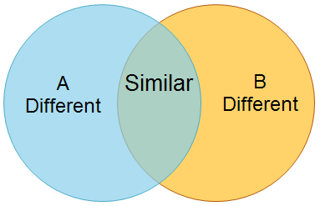
Steps of Writing a Comparison Paragraph
01
Brainstorming
Brainstorming the similarities and differences between the 2 subjects based on a Venn Diagram

Slide 4
02
Outlining
1. Topic sentence:
Introduce the 2 subjects (E.g.: A and B)
State the relationship between the 2 subjects
2. Supporting details:
Option 1 ( Block method)
Describe A in details
Describe B in details
Option 2 ( Point-by-point method)
(Nên chọn cách này để viết vì thấy được sự so sánh)
- Similarities in A and B
+ supporting detail
- Differences between A and B
+ difference 1 + supporting detail
+ difference 2 + supporting detail.
3. Concluding sentence:
Summarise the similarities and differences.
Or paraphrase the topic sentence.

Slide 5
Useful language
To show Comparison
Similarly,
Likewise,
Same as
In the same way,
… have in common is …
To Show Contrast
However,
Nevertheless,
In contrast,/ On the contrary,
Whereas
While
Although

Slide 6
Sample
Write a comparison paragraph about your two favorite teachers
(~100-120 words)

Slide 7
Sample
My favourite teachers are Ms Marie and Ms Kate. I deeply into their personalities and love for the job, however, each of them has outstanding differences. As for their appearance, Ms Marie has short blond hair, but Ms. Kate has long black hair. When I entered Ms. Marie’s class, I felt full of energy because she looked like a very positive person. On the contrary, when I attended Ms. Kate’s class, I felt the elegance and comfort. In terms of personalities, I think Ms Kate is more serious than Ms. Kate. To sum up, I like them both because each has different characteristics and teaching styles.

